Slide 1
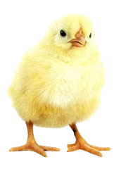
Adult Bible Study Guide
Jul • Aug • Sep 2014
powerpoint presentation designed by claro ruiz vicente
http://clarovicente.weebly.com

Slide 2
Adult Sabbath School Bible Study Guide
An Appeal
Dear User….
This PowerPoint Show is freely shared to all who may find it beneficial. While intended primarily for personal use, some find it useful for teaching the lesson in church.
There are those, however, who add illustrations, change background, change fonts, etc. While their intention may be good, this is not right. Slide #2 says “designed by claro ruiz vicente.” For honest Christians, it is not necessary for another’s creation to be copyrighted in order to be respected.
PLEASE USE AS IS.

Slide 3
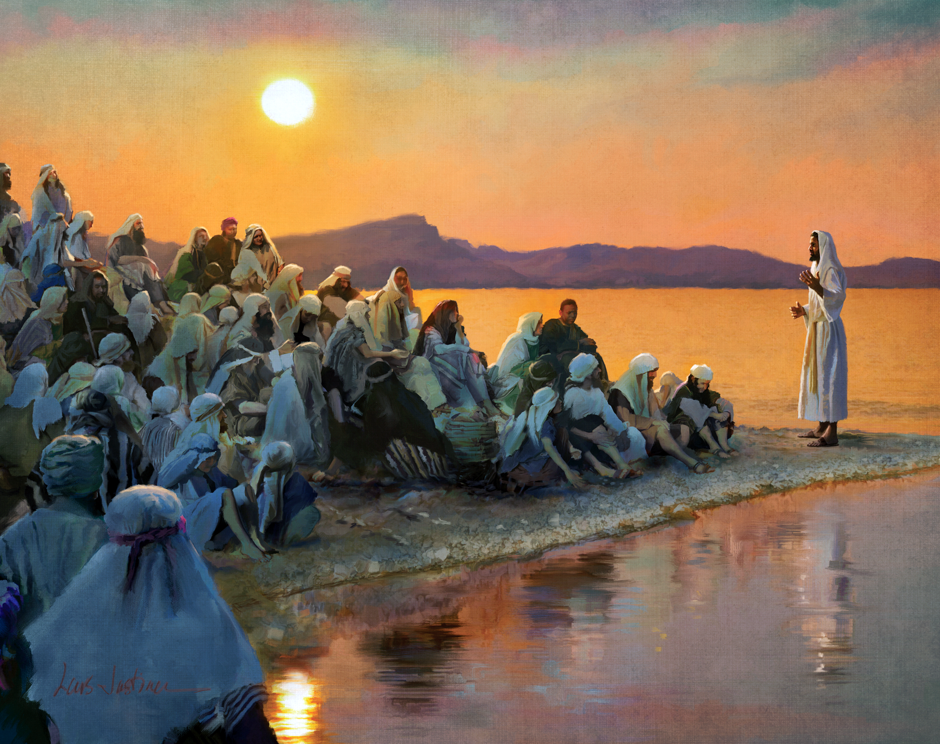
THE TEACHINGS OF
JESUS
Carlos Steger, Principal Contributor
Notes:
Ang mga Katuruan ni Jesus

Slide 4
The Teachings of Jesus
Contents
1 Our Loving Heavenly Father
2 The Son
3 The Holy Spirit
4 Salvation
5 How to Be Saved
6 Growing in Christ
7 Living Like Christ
8 The Church
9 Our Mission
10 The Law of God
11 The Sabbath
12 Death and Resurrection
13 The Second Coming of Jesus
Notes:
Ikalawang liksyon

Slide 5
The Teachings of Jesus
Our Goal
Let us pray for spiritual discernment to understand His message and to grasp His unfathomable love manifested on the cross.
And as we hear His tender voice calling us to follow Him, let us renew our commitment to walk daily with Him by faith and in obedience.
Notes:
Ang Ating Mithiin. Ating pag-aaralan ang kautusan, lalo na ang katanungan kung bakit napakaraming Kristiyano—na hindi nauunawaan ang relasyon sa pagitan ng kautusan at biyaya—ay nahulog sa bitag ng pagtanggi sa patuloy na bisa ng Sampung Utos, ¶ kaya walang-malay na tinutulungan ang tangkang “ibagsak” ang kautusan ng Diyos.

Slide 6
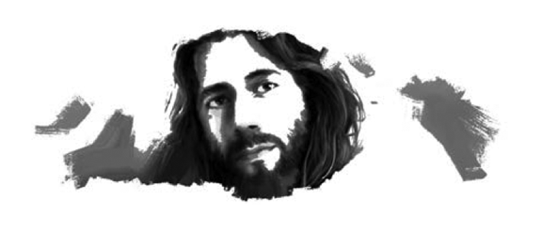
The Teachings of Jesus
Lesson 2, July 12
The Son
Notes:
Ang Anak

Slide 7
The Son
Key Text
Mark 10:45 NKJV
“ ‘For even the Son of Man did not come to be served, but to serve, and to give His life a ransom for many.’ ”
Notes:
Susing Talata. “ ‘Sapagkat maging ang Anak ng Tao ay hindi naparito upang paglingkuran, kundi upang maglingkod at ibigay ang kanyang buhay na pantubos sa marami.’ ”

Slide 8
The Son
Initial Words
Each has to decide who Jesus is.
It doesn’t help to repeat what other people say or believe; the answer must be genuinely our own personal belief.
On that answer the destiny of every human being hangs.
We will seek the answer on the basis of what Jesus Himself said and did.
Notes:
Panimulang Salita. Bawat isa’y kailangang magpasya kung sino si Jesus. Hindi makakatulong na ulitin ang sinasabi o pinaniniwalaan ng iba; ang sagot ay dapat na maging tunay na ating personal na paniniwala. ¶ Sa sagot na ‘yon nakabitin ang kapalaran ng bawat tao. ¶ Ating hahanapin ang sagot base sa sinabi at ginawa mismo ni Jesus.

Slide 9
The Son
Quick Look
1. Christ’s Dual Title (Daniel 7:13, 14)
2. Christ’s Divine Nature (John 5:18)
3. Christ’s Mission (Matthew 20:27, 28)
Notes:
1. Ang Dalawang Titulo ni Cristo
2. Ang Paka-Diyos na Likas ni Cristo
3. Ang Misyon ni Cristo

Slide 10
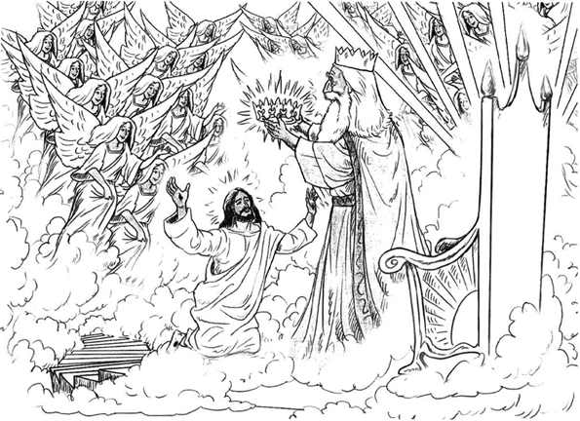
The Son
1. Christ’s Dual Title
Daniel 7:13, 14 NKJV
“And behold, One like the Son of Man coming with the clouds of heaven! He came to the Ancient of Day...and to Him was given dominion...which shall not pass away,
and His kingdom the one which shall not be destroyed.
Notes:
1. Ang Dalawang Titulo ni Cristo. “At narito, ang isang gaya ng Anak ng Tao na dumarating kasama ng mga ulap. At Siya’y lumapit sa Matanda ng Araw at iniharap sa kanya. Binigyan siya ng kapangyarihan...na hindi lilipas, ¶ at ang kanyang kaharian ay hindi mawawasak.

Slide 11
1. Christ’s Dual Title
The Son of Man
“The Son of man,” was Jesus’ favorite designation for Himself. He referred to Himself as Son of man more than eighty times. Other people never addressed Him that way.
With just one exception, it always referred to human in the Old Testament; thus, Jesus used it in order to emphasize His humanity.
Notes:
Ang Anak ng Tao “Ang Anak ng Tao,” ay paboritong katawagan ni Jesus para sa sarili. Tinukoy Niya ang sarili bilang Anak ng Tao nang higit na 80 beses. Hindi kailanman Siya tinawag nang ganoon ng ibang tao. ¶ Maliban sa isang bukod na gamit, parating tumutukoy ito sa tao sa Lumang Tipan; kaya, ginamit ito ni Jesus upang idiin ang Kanyang pagkatao.

Slide 12
1. Christ’s Dual Title
The Son of Man
In Daniel 7:13 and 14, “ ‘One like the Son of Man’ ” came “ ‘to the Ancient of days,’ ” and received eternal dominion and a kingdom. The Jews identified
this Son of Man with the Messiah.
So, when Jesus used this title,
He was revealing that He was also
the promised Messiah, the
incarnate Christ.
Notes:
Sa Daniel 7:13 at 14, “ ‘Isang gaya ng Anak ng Tao’” ay dumating “ ‘ sa Matanda sa mga Araw,’” at tumanggap ng kapangyarihan at isang kaharian. Kinilala ng mga Judio itong Anak ng Tao na ang Mesiyas. ¶ Kaya, nang gamitin ni Jesus ang titulong ito ay inihayag Niya na Siya rin ang ipinangakong Mesiyas, ang nagkatawang-taong Cristo.

Slide 13
1. Christ’s Dual Title
The Son of God
The title “Son of God” was used not only by Gabriel (Luke 1:35) but also by several people when addressing Jesus (Matt. 14:33, Mark 15:39,
John 1:49, 11:27).
He accepted that title but was very careful not to apply it directly to Himself, lest He be stoned to death.
Notes:
Ang Anak ng Diyos. Ang titulong “Anak ng Diyos” ay di lang si Gabriel ang gumamit (Lucas 1:35) kundi ng ilang tao rin kapag tinatawag si Jesus (Mateo 14:33, Marcos 15:39, Juan 1:49, 11:27). ¶ Tinanggap Niya ang titulo subalit naging napakaingat sa deretsahang paggamit sa sarili, baka Siya’y batuhin hanggang mamatay.

Slide 14
1. Christ’s Dual Title
The Son of God
Because He came to live as a man, Christ voluntarily subordinated Himself to the Father (Phil. 2:6–8).
This limitation was functional but not part of His essence. Jesus subordi-nated Himself for a specific purpose, a specific goal. From this point of view, He could say: “ ‘My Father is greater than I’ ” (John 14:28, NKJV).
Notes:
Dahil Siya’y naparito para mamuhay bilang isang tao, habang narito’y kusang ipinasakop ni Cristo ang sarili sa Ama (Filipos 2:6-8). ¶ Ang limitasyong ito’y ayon sa tungkulin ngunit hindi bahagi ng Kanya mismong pinakadiwa. Ipinailalim ni Jesus ang sarili para sa isang tiyak na layunin, isang tiyak na mithiin. Mula sa pananaw na ito’y masasabi Niya: ‘ ‘Ang Ama ay higit na dakila kaysa akin’ ” (Juan 14:28, NKJV).

Slide 15
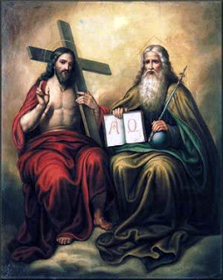
The Son
2. Christ’s Divine Nature
John 5:18 NKJV
“Therefore the Jews sought all the more to kill Him, because He not only broke the Sabbath, but also said that God was His Father,
making Himself equal with God.”
Notes:
2. Pagka-Diyos na Likas ni Cristo. “Dahil dito ay lalong pinagsikapan ng mga Judio na siya’y patayin sapagkat hindi lamang nilabag niya ang araw ng Sabbath, kundi tinatawag din na kanyang Ama ang Diyos, ¶ at ginagawa ang sarili niya na kapantay ng Diyos.”

Slide 16
2. Christ’s Divine Nature
Foundational of Our Faith
The deity of Christ is the foundation of our faith. A human being could never be our Savior, no matter how extraordinary his life may have been.
His mission required Him to make known that He was the Messiah, God in the flesh; however, there is no record of His saying publicly, I am God or I am the Messiah.
Notes:
Pinakapundasyon ng Ating Pananampalataya. Ang pagka-Diyos ni Cristo ang pundasyon ng ating pananampalataya. Ang isang tao kailanman ay hindi magiging tagapagligtas natin, gaano man pambihira ang naging buhay niya. ¶ Ang Kanyang misyon ay hinihingan Siyang ipaalam na Siya ang Mesiyas, ang Diyos sa laman; gayunman, walang tala na sinasabi Niya ito sa publiko, Ako ang Diyos o Ako ang Mesiyas.

Slide 17
2. Christ’s Divine Nature
Foundational of Our Faith
Had He done so, His life could have immediately been taken. Therefore, He chose to hint at His divine nature:
1. His creative power to restore health.
2. His divine prerogative to forgive sins.
3. His power to overcome death.
4. His assertion to preexistence.
5. His acceptance of worship.
Notes:
Kung ginawa Niya ito ay maaaring pinatay Siya agad. Kaya, pinili Niyang magpahiwatig sa Kanyang pagka-Diyos na likas: ¶ 1. Ang Kanyang malikhaing kapangyarihan na magsauli ng kalusugan. ¶ 2. Ang Kanyang banal na natatanging karapatan na magpatawad ng kasalanan. ¶ 3. Ang Kanyang kapangyarihan na mapagtagumpayan ang kamatayan. ¶ 4. Ang Kayang paggigiit sa naunang pag-iral. ¶ 5. Ang Kanyang pagtanggap ng pagsamba.

Slide 18
The Son
3. Christ’s Mission
Matthew 20:27, 28 NKJV
“And whoever desires to be first among you, let him be your slave—just as the Son of Man did not come to be served, but to serve,
and to give His life a ransom for many.”
Notes:
3. Ang Misyon ni Cristo. “At sinuman sa inyo na nagnanais na maging una ay kailangan maging alipin ninyo—kung paanong ang Anak ng Tao ay naparito hindi upang paglingkuran , kundi upang maglingkod, ¶ at upang ibigay ang kanyang buhay na pantubos sa marami.”

Slide 19
3. Christ’s Mission
“To Seek and Save”
After considering who Jesus was, we are in a better position to under- stand what He came to do for us.
Jesus came to represent the Father’s character and to correct the false concept about the Godhead. He wanted us to know God, because to know Him is indispensable in order to have eternal life (John 17:3).
Notes:
“Upang Hanapin at Iligtas ang Nawala” Matapos isaalang-alang kung sino si Jesus, tayo’y nasa mas mabuting katayuan na maunawaan ang ipinarito Niya na gagawin para sa atin. ¶ Naparito si Jesus upang katawanin ang karakter ng Ama, at upang ituwid ang maling konsepto na nabuo ng marami tungkol sa Kadiyosan. Gusto Niyang makilala natin ang Diyos dahil ang pagkakilala sa Kanya ay mahalaga para magkaron ng buhay na walang-hanggan (Juan 17:3).

Slide 20
3. Christ’s Mission
“To Seek and Save”
“ ‘The Son of Man has come to seek and to save that which was lost’ ”
(Luke 19:10, NKJV).
He reestablishes our relationship with the Father (John 1:51);
He forgives us our sins (Matt. 26:28); He gives us an example of how to live (1 Pet. 2:21); and, of course
He gives us eternal life (John 3:16).
Notes:
“ ‘Ang Anak ng Tao ay dumating upang hanapin at iligtas ang nawala’” (Lukas 19:10, NKJV). ¶ Muling itinatatag Niya ang ating relasyon sa Ama (Juan 1:51); pinapatawad Niya ang ating mga kasalanan (Mateo 26:28); binibigyan Niya tayo ng halimbawa kung paano mamuhay (1 Pedro 2:21); at siyempre, binibigyan Niya tayo ng walang-hanggang buhay (Juan 3:16).

Slide 21
3. Christ’s Mission
Patriarchs and Prophets 63
“The broken law of God demanded the life of the sinner. In all the universe there was but one who could, in behalf of man, satisfy its claims. Since the divine law is as sacred as God Himself, only one equal with God could make atonement for its transgression.
None but Christ could redeem fallen man from the curse of the law....”
Notes:
“Ang nalabag na kautusan ng Diyos ay inangkin ang buhay ng nagkasala. Sa buong sansinukob ay may iisa lang ang maaari, sa kapakanan ng tao, na masapatan ang pag-aangkin nito. Sapagkat ang banal na kautusan ay kasimbanal ng Diyos mismo, isa lang na kapantay ng Diyos ang makakatubos para sa pagkakasalang ito. ¶ Wala kundi si Cristo ang makakatubos sa nagkasalang tao mula sa sumpa ng kautusan....”

Slide 22
The Son
Final Words
“In Christ is life, original, unborrowed, underived. ‘He that hath the Son hath life.’ 1 John 5:12. The divinity of Christ is the believer’s assurance of eternal life.”—The Desire of Ages 530.
Notes:
Huling Pananalita. “Kay Cristo ay buhay, orihinal, di-hiniram, di-nakamit. ‘Ang kinaroroonan ng anak ay kinaroroonan ng buhay.’ 1 Juan 5:12. Ang pagka-Diyos ni Cristo ang katiyakan ng buhay na walang-hanggan ng mananampalataya.”—The Desire of Ages 530.

Slide 23
The Son
Presentation Record
1. SSL 12 Jul 14

