Slide 1
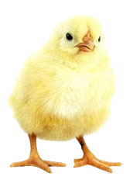
Adult Bible Study Guide
Jul • Aug • Sep 2014
powerpoint presentation designed by claro ruiz vicente
http://clarovicente.weebly.com

Slide 2
Adult Sabbath School Bible Study Guide
An Appeal
Dear User….
This PowerPoint Show is freely shared to all who may find it beneficial. While intended primarily for personal use, some find it useful for teaching the lesson in church.
There are those, however, who add illustrations, change background, change fonts, etc. While their intention may be good, this is not right. Slide #2 says “designed by claro ruiz vicente.” For honest Christians, it is not necessary for another’s creation to be copyrighted in order to be respected.
PLEASE USE AS IS.

Slide 3
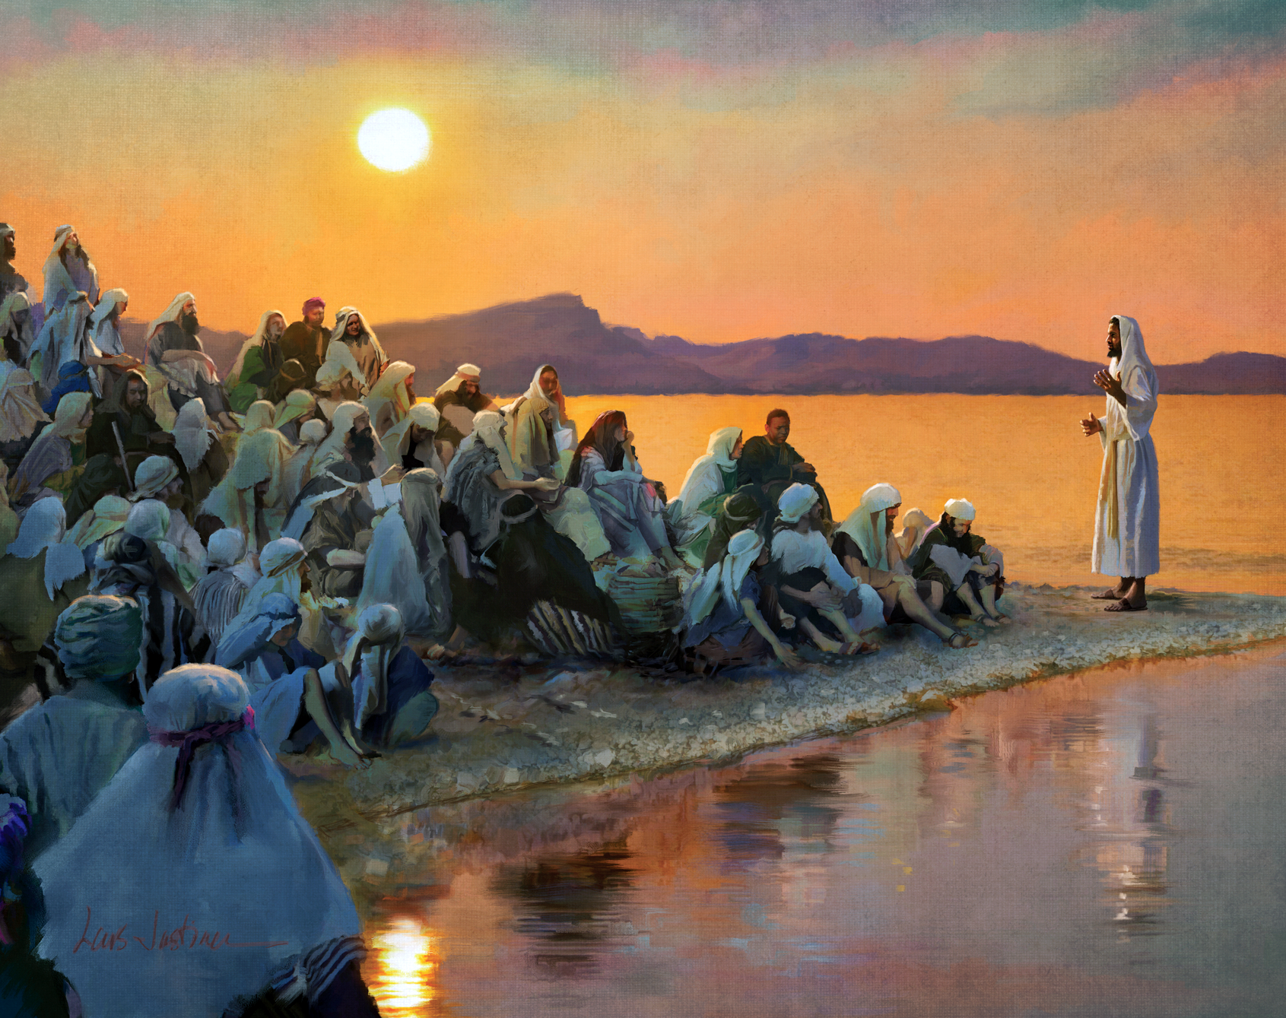
THE TEACHINGS OF
JESUS
Carlos Steger, Principal Contributor
Notes:
Ang mga Katuruan ni Jesus

Slide 4
The Teachings of Jesus
Contents
1 Our Loving Heavenly Father
2 The Son
3 The Holy Spirit
4 Salvation
5 How to Be Saved
6 Growing in Christ
7 Living Like Christ
8 The Church
9 Our Mission
10 The Law of God
11 The Sabbath
12 Death and Resurrection
13 The Second Coming of Jesus
Notes:
Ika-6 liksyon

Slide 5
The Teachings of Jesus
Our Goal
Let us pray for spiritual discernment to understand His message and to grasp His unfathomable love manifested on the cross.
And as we hear His tender voice calling us to follow Him, let us renew our commitment to walk daily with Him by faith and in obedience.
Notes:
Ang Ating Mithiin. Manalangin tayo para sa espirtuwal na pagkaunawa para maunawaan ang Kanyang di maarok na pag-ibig na nahayag sa krus. ¶ At habang naririnig natin ang Kanyang magiliw na tinig na tumatawag sa atin na sundan Siya, ay pag-ibayuhin natin ang ating pagtatalagang araw-araw na lumakad kasama Niya sa pamamagitan ng pananampalataya’t pagsunod.

Slide 6
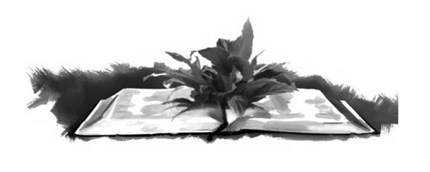
The Teachings of Jesus
Lesson 6, August 9
Growing in Christ
Notes:
Lumalago kay Cristo

Slide 7
Growing in Christ
Key Text
John 3:3 NKJV
“Jesus answered and said to him, ‘Most assuredly, I say to you, unless one is born again, he cannot see the kingdom of God.’ ”
Notes:
Susing Talata. “Sumagot sa kanya si Jesus, ‘Katotohanang sinasabi ko sa iyo, malibang ang isang tao’y ipanganak na muli ay hindi niya makikita ang kaharian ng Diyos.’ ”

Slide 8
Growing in Christ
Initial Words
Spiritual transformation is a super- natural work produced by the Holy Spirit. Though we cannot see or understand how it happens, we can perceive the results. We call it conversion, a new life in Christ.
Our challenge is to steadfastly abide in Him daily so that He can transform us more and more into His image.
Notes:
Panimulang Salita. Ang espirituwal na pagbabago ay isang kahima-himalang gawa na likha ng Banal na Espiritu. Bagaman hindi natin nakikita o mauunawaan kung paano ito nangyayari ay mahihiwatigan natin ang bunga. Tinatawag natin itong pagbabagong-loob, isang bagong buhay kay Cristo. ¶ And hamon sa atin ay ang buong tapat na manatili sa Kanya araw-araw upang mabago Niya tayo nang higit at higit pa sa Kanyang larawan.

Slide 9
Growing in Christ
Quick Look
1. Born Again (John 3:3-5 )
2. Abide in Christ (John 15:4, 5)
3. Die to Self (Luke 9:23, 24)
Notes:
1. Ipanganak na Muli
2. Manatili kay Cristo
3. Mamatay sa Sarili

Slide 10
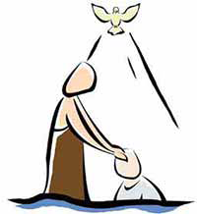
Growing in Christ
1. Born Again
John 3:3, 5 NKJV
“ ‘Most assuredly, I say to you, unless one is born again, he cannot see the kingdom of heaven. ...
[U]nless one is born of water and the Spirit, he cannot enter the kingdom of God.’ ”
Notes:
1. Ipanganak na Muli. “ ‘Katotohanang sinsabi ko sa iyo, malibang ang isang tao’y ipanganak na muli ay hindi niya makikita ang kaharian ng langit. ... ¶ [M]alibang ang isang tao’y ipanganak ng tubig at ng Espiritu , hindi siya makakapasok sa kaharian ng Diyos.’ ”

Slide 11
1. Born Again
Of Water and of the Spirit
The fact that it is necessary to be born again shows without a doubt that our previous birth is insufficient from a spiritual standpoint.
The new birth must be of water and of the Spirit. To be born of water referred to baptism with water. To be born of the Spirit is the renewing of the heart by the Holy Spirit.
Notes:
Ng Tubig at ng Espirirtu. Ang katotohanang mahalagang ipanganak na muli ay walang dudang nagpapakita na ang ating naunang pagkapanganak ay hindi sapat mula sa espirituwal na paninindigan. ¶ Ang bagong pagkapanganak ay dapat maging doble: ng tubig at ng Espiritu. Ang ipanganak ng tubig ay tumutukoy sa bautismo ng tubig. Ang ipanganak ng Espirirtu ay ang pagbabago ng puso sa pamamagitan ng Banal na Espiritu.

Slide 12
1. Born Again
Of Water and of the Spirit
There are similarities between physical and spiritual births. Both mark the beginning of a new life. We produce neither birth ourselves; it’s done for us.
But there is also an important difference between them: we were unable to choose if we wanted to be born physically; we can, however, choose to be born spiritually.
Notes:
May pagkakatulad sa pagitan ng pisikal at espirituwal na kapanganakan. Parehong nagpapakita ng pasimula ng isang bagong buhay. Hindi natin ginagawa mismo ang alinmang kapanganakan; ginawa ito para sa atin. ¶ Subalit meron ding isang mahalagang pagkakaiba sa pagitan nila: hindi natin mapipili kung gusto nating maipanganak sa pisikal; gayunman, maaari nating mapiling maipanganak sa espiritu.

Slide 13
1. Born Again
Of Water and of the Spirit
Only those who freely decide to allow the Holy Spirit to generate a new spiritual self within them are born again.
God respects our freedom and, although eager to transform us, He does not change us by force.
Notes:
‘Yun lang malayang nagpapasyang pahintulutan ang Banal na Espirirtu na lumikha ng isang bagong espirituwal na sarili sa kanila ang ipinanganganak na muli. ¶ Iginagalang ng Diyos ang ating kalayaan at, bagaman nananabik na baguhin tayo, hindi Niya tayo babaguhin ng sapilitan.

Slide 14
1. Born Again
New Life in Christ
Is there any way to know if we
have experienced the new birth?
Yes. The Spirit works invisibly, but the results of His activity are visible.
The Spirit always produces an outward demonstration of the inward transformation He makes in us. As Jesus said, “ ‘by their fruits you will know them’ ” (Matt. 7:20, NKJV).
Notes:
Bagong Buhay kay Cristo. Meron bang paraan na malaman kung naranasan na natin ang bagong pagkapanganak? ¶ Oo. Gumagawang hindi nakikita ang Espiritu, subalit ang bunga ng Kanyang paggawa ay nakikita. ¶ Laging lumilikha ang Espiritu ng panlabas na pagpapakita ng panloob na pagbabagong ginagawa Niya sa atin. Gaya ng sinabi ni Jesus, “ ‘sa pamamagitan ng kanilang mga bunga ay makikilala ninyo sila’ ” (Mateo 7:20 NKJV).

Slide 15
1. Born Again
New Life in Christ
Through the Holy Spirit, Christ implants in us new thoughts, feel- ings, and motives. He awakens our conscience, changes our mind, sub- dues every unholy desire, and fills us with the sweet peace of heaven.
Though the change doesn’t happen instantly, over time we do become a new creature in Christ.
Notes:
Sa pamamgitan ng Banal na Espiritu, itinatanim ni Cristo ang mga bagong pag-iisip, damdamin, at motibo. Ginigising Niya ang ating konsiyensya, binabago ang ating isip, sinusupil ang bawat masamang nasa, at pinupuno tayo ng kalugud-lugod na kapayapaan ng langit. ¶ Bagaman ang pagbabago ay hindi nangyayari kaagad, paglipas ng panahon tayo’y talagang magiging isang bagong nilalang kay Cristo.

Slide 16
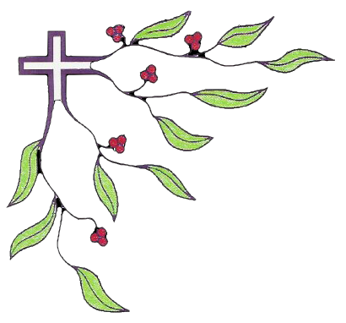
Growing in Christ
2. Abide in Christ
John 15:4, 5 NKJV
“ ‘Abide in Me.... As the branch cannot bear fruit of itself, unless it abides in the vine, neither can you, unless you abide in Me.
I am the vine you are the branches... without Me you can do nothing.’ ”
Notes:
2. Nananatili kay Cristo. “ ‘Kayo’y nananatili sa akin.... Gaya ng sanga na hindi magbubunga sa kanyang sarili malibang nakakabit sa puno, gayundin naman kayo, malibang kayo’y manatili sa akin. ¶ Ako ang puno ng ubas, kayo ang mga sanga...kung kayo’y hiwalay sa akin ay wala kayong magagawa.’ ”

Slide 17
2. Abide in Christ
Continually
A branch recently separated from the vine may appear alive for a while, but it will surely die because it has been cut off from the source of life.
We can receive life only through our connection with Christ. But in order to be effective, this union must be maintained.
Notes:
Nagpapatuloy. Ang isang sangang kahihiwalay lang mula sa puno ng ubas ay maaaring magmukhang buhay sumandali, pero ito’y tiyak na malalanta’t mamamatay dahil naputol ito mula sa pinanggagalingan ng buhay. ¶ Makakatanggap lang tayo ng buhay sa pamamagitan ng ating koneksyon kay Cristo. Ngunit para maging epektibo, ang pagsasamang ito’y dapat mapanatili.

Slide 18
2. Abide in Christ
Continually
Devotional time in the morning is essential, but our communion with the Lord has to continue throughout the day.
Abiding in Christ means seeking
Him constantly, asking for His guidance, praying for His strength to obey His will, and begging for His love to fill us.
Notes:
Mahalaga ang oras ng debosyon sa umaga, subalit ang ating pakikipag-isa sa Panginoon ay kailangang magpatuloy buong araw. ¶ Ang pananatili kay Cristo ay nangangahulugang hinahanap Siya na nagpapatuloy, hinihingi ang Kanyang gabay, nananalangin para sa Kanyang kalakasang sundin ang Kanyang kalooban, at nakikiusap para punuin tayo ng Kanyang pag-ibig.

Slide 19
2. Abide in Christ
Through Prayer
Along with studying the Bible, prayer is indispensable in order for us to abide in Christ and grow spiritually.
Through prayer, we learn to
empty ourselves of ourselves and become more dependent upon Him. We need to persevere in prayer, clinging to His promises (John 15:7, 16:24) no matter what.
Notes:
Sa Pamamagitan ng Panalangin. Kasama ang pag-aaral ng Biblia, ang panalangin ay di-maaaring wala para tayo ay makapanatili kay Cristo at lumago sa espiritu. ¶ Sa pamamagitan ng panalangin ay natututo tayong alisin ang sarili sa sarili at maging mas nakadepende sa Kanya. Kailangan nating magtiyaga sa pananalangin, nanghahawakan sa Kanyang mga pangako (Juan 15:7, 16:24) anuman ang mangyari.

Slide 20
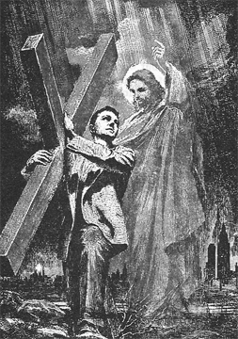
Growing in Christ
3. Die to Self
Luke 9:23, 24 NKJV
“ ‘If anyone desires to come after Me, let him deny himself, and take up his cross daily, and follow Me.
For whoever desires to save his life will lose it, but whoever loses his life got My sake will save it.’ ”
Notes:
3. Mamatay sa Sarili. “ ‘Kung ang sinuman ay nagnanais sumunod sa akin, tanggihan niya ang kanyang sarili at magpasan ng kanyang krus araw-araw at sumunod sa akin. ¶ Sapagkat sinumang nagnanais na iligtas ang kanyang buhay ay mawawalan nito, subalit sinumang mawalan ng kanyang buhay dahil sa akin ay maililigtas niya ito.’ ”

Slide 21
3. Die to Self
A Daily Matter
Paradoxically, it is only by dying that we may truly live. When bap- tized, we (ideally) died to our old nature and rose again to a new life.
It would have been wonderful if the old man of sin had permanently died when we were buried under baptismal waters.
Notes:
Isang Araw-araw na Bagay. Buong kabalintunaan, sa pagkamatay lang tayo tunay na mabubuhay. Nang mabautismuhan, tayo (ayon sa prinsipyo) ay namatay sa ating lumang likas at bumangong muli sa isang bagong buhay. ¶ Napakaganda sana kung ang lumang taong kasalanan ay permanenteng namatay nang tayo’y nailibing sa ilalim ng tubig ng bautismo.

Slide 22
3. Die to Self
A Daily Matter
Sooner or later, however, all of us have discovered that our past habits and tendencies are still alive and do strive to regain control of our lives.
After our baptism, our old nature has to be put to death again and again. That is why Jesus associated the Christian life with a cross.
Notes:
Sa malao’t madali, gayunman, lahat tayo’y makakatuklas na ang ating nakaraang pag-uugali at hilig ay buhay pa at nagsisikap na makabalik sa kontrol sa ating mga buhay. ¶ Ito ang dahilan na iniuugnay ni Jesus ang buhay Kristiyano sa isang krus.

Slide 23
3. Die to Self
A Daily Matter
Many think the cross they have to bear is a serious sickness, unfavor- able circumstances in life, or a permanent disability. The meaning of Jesus’ words goes further.
To take up our cross means to deny ourselves daily. Not just once in a while but every day; not just a part of us but our entire being.
Notes:
Maraming nag-iisip na ang krus na kanilang papasanin ay isang matinding karamdaman, masamang katayuan sa buhay, o isang permanenteng kapansanan. Ang kahulugan ng mga salita ni Jesus ay humihigit pa. ¶ Ang ating pagpasan ng krus ay nangangahulugang pagtanggi sa sarili araw-araw. Hindi lang paminsan-minsan kundi araw-araw, hindi lang isang bahagi kundi ang ating buong pagkatao.

Slide 24
3. Die to Self
A Daily Matter
“ ‘I have been crucified with Christ;
it is no longer I who live, but Christ lives in me’ ” (Gal. 2:20, NKJV).
Our old nature, although crucified, fights to survive and get down from the cross.
It is not easy to deny ourselves.
We can only consent for Christ to accomplish the work.
Notes:
“ ‘Ako’y ipinakong kasama ni Cristo at hindi na ako ang nabubuhay, kundi si Cristo ang nabubuhay sa akin’ ” (Galacia 2:20 NKJV). ¶ Ang luma nating likas, bagaman nakapako, ay lumalaban para mabuhay at bumaba mula sa krus. ¶ Hindi madaling tanggihan ang sarili. Makakapayag lang tayo na gawin ito ni Cristo para sa atin.

Slide 25
Growing in Christ
Final Words
“The warfare against self is the greatest battle that was ever fought.
The yielding of self, surrendering all to the will of God, requires a struggle; but the soul must submit to God before it can be renewed in holiness.”—Steps to Christ 173.
Notes:
“Ang pakikibaka laban sa sarili ang pinakamalaking labanan na kailanma’y nilabanan. ¶ Ang pagsuko ng sarili, isinusuko ang lahat sa kalooban ng Diyos ay humihingi ng pakikibaka; subalit ang kaluluwa ay kailangang pasakop sa Diyos bago ito mapapanibago sa kabanalan.”—Steps to Christ 173.

Slide 26
Growing in Christ
Presentation Record
1. SSL 009 Aug 14

