Slide 1
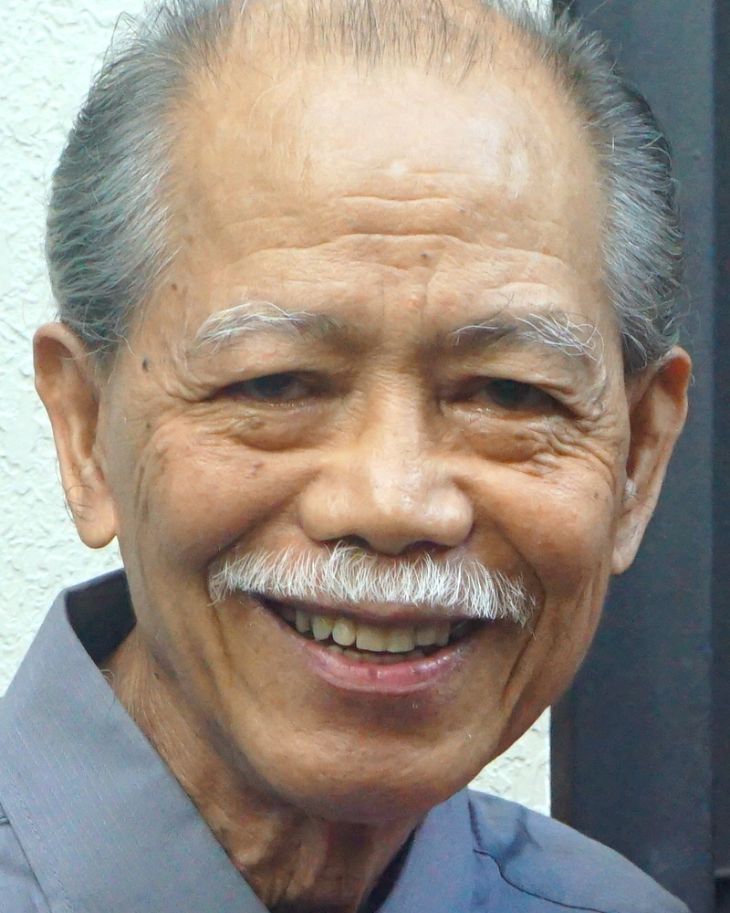
Adult Bible Study Guide
Jul • Aug • Sep 2021
powerpoint presentation designed by claro ruiz vicente
http://clarovicente.weebly.com

Slide 2
Adult Sabbath School Bible Study Guide
An Appeal
DEAR USER
This PowerPoint Show is freely shared to all who may find it beneficial. While intended primarily for personal use, some find it useful for teaching the lesson
in church.
There are those, however, who add illustrations, change background, replace fonts, etc. While their intention may be good, this is not right. Slide #1 says “designed by claro ruiz vicente.” For honest Christians, it is not necessary for another’s creation to be copyrighted in order to be respected.
PLEASE USE AS IS.

Slide 3
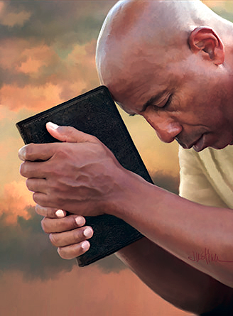
Gerald & Chantal Klingbeil
Principal Contributors
Notes:
Kapahingahan Kay Cristo.

Slide 4
Rest in Christ
Contents
1 Living in a 24-7 Society
2 Restless and Rebellious
3 The Roots of Restlessness
4 The Cost of Rest
5 “ ‘Come to Me . . .’ ”
6 Finding Rest in Family Ties
7 Rest, Relationships, and Healing
8 Free to Rest
9 The Rhythms of Rest
10 Sabbath Rest
11 Longing for More
12 The Restless Prophet
13 The Ultimate Rest
Notes:
Panglabindalawang Liksyon.

Slide 5
Rest in Christ
Our Goal
“Resting in Christ is the key to the type of life that Jesus promises to His followers: ‘The thief does not come except to steal, and to kill, and to destroy. I have come that they may have life, and that they may have it more abundantly’ ” (John 10:10 NKJV).
As we study the weekly lessons, let us remember to come and rest in Him.
Notes:
Ang Ating Mithiin. “Kapahingahan kay Cristo ay ang susi sa uri ng buhay na ipinapangako ni Jesus sa Kanyang mga tagasunod: ‘Ang magnanakaw ay dumarating lamang upang magnakaw, pumatay, at pumuksa. Ako’y pumarito upang sila’y magkaroon ng buhay, at magkaroon nito nang may kasaganaan’ ” (Juan 10:10). ¶ Samantalang pinag-aaralan natin ang lingguhang liksyon, ating tandaang lumapit at magpahinga sa Kanya.

Slide 6
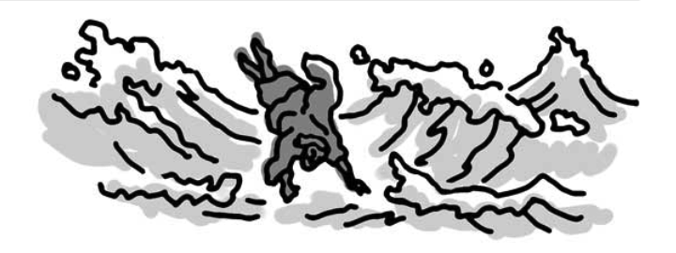
Rest in Christ
Lesson 14, August 21, 2021
The Restless Prophet
Notes:
Ang Balisang Propeta

Slide 7
The Restless Prophet
Key Text
Jonah 4:11 NKJV
“ ‘And should I not pity Nineveh, that great city, in which are more than one hundred and twenty thousand persons who cannot discern between their right hand and their left—and much livestock?’ ”
Notes:
Susing Talata. “ ‘Hindi ba ako manghihinayang sa Ninive, sa malaking lunsod na iyon na may mahigit sa isandaan at dalawampung libong katao na hindi nalalaman kung alin sa kanilang mga kamay ang kanan o ang kaliwa, at mayroon ding maraming hayop?’ ” (Jonas 4:11).

Slide 8
The Restless Prophet
Initial Words
What an example of someone not at rest, not at peace—even to the point where he cried out, “ ‘Therefore now, O Lord, please take my life from me, for it is better for me to die than to live!’ ” (Jon. 4:3). Jesus said:
“ ‘[N]ineveh...repented at the preaching of Jonah; and indeed a greater than Jonah is here’ ” (Matt. 12:41).
Notes:
Panimulang Salita. Ano ngang isang halimbawa ng isang wala sa kapahingahan, wala sa kapayapaan—kahit sa puntong humihiyaw siya, “ ‘Kaya ngayon, O Panginoon, ipinapakiusap ko sa iyo na kunin mo ang aking buhay, sapagkat mabuti pa sa akin ang mamatay kaysa mabuhay’ ” (Jonas 4:3). Sinabi ni Jesus: ¶ “ ‘Ang mga tao ng Ninive ay tatayo sa paghuhukom na kasama ng lahing ito at hahatulan nila ito, sapagkat nagsisi sila sa pangangaral ni Jonas; at masdan ninyo, may isang higit na dakila kaysa kay Jonas ang narito’ ” (Mateo 12:41).

Slide 9
The Restless Prophet
Quick Look
1. Restless in the First Call (Jonah 1:1-3)
2. Restless in the Second Call (Jonah 3:1, 2, 5, 10; 4:1)
3. Relationships in the Call (Jude 20-23)
Notes:
1. Balisa sa Unang Tawag (Jonas 1:1-3) 2. Balisa sa Pangalawang Tawag (Jonas 3:1, 2, 5, 10; 4:1)
3. Mga Relasyon sa Tawag (Judas 20-23)

Slide 10
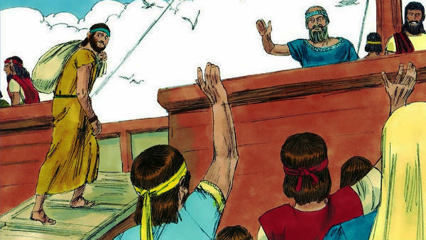
The Restless Prophet
1. Restless in the First Call
Jonah 1:1-3 NKJV
“Now the word of the Lord came to Jonah the son of Amittai, saying, “Arise, go to Nineveh, that great city, and cry out against it; for their wickedness has come up before Me.”
But Jonah arose to flee to Tarshish from the presence of the Lord.”
Notes:
1. Balisa sa Unang Tawag. “Ang salita ng Panginoon ay dumating kay Jonas na anak ni Amitai, na nagsasabi, “Bumangon ka, pumaroon ka sa Ninive, sa malaking lunsod na iyon, at sumigaw ka laban doon; sapagkat ang kanilang kasamaan ay umabot sa harapan ko.” ¶ Ngunit si Jonas ay bumangon upang tumakas patungo sa Tarsis mula sa harapan ng Panginoon” (Jonas 1:1-3).

Slide 11
Restless in the First Call
Running Away
Jonah was a successful missionary. He also was a very reluctant one, at least at first. Instead of taking God’s yoke upon his shoulders and disco-vering for himself that His yoke is easy and His burden light, Jonah decided to find his own “rest,” and that was by running in the opposite direction from where God was calling him to go.
Notes:
Pagtakas. Si Jonas ay isang matagumpay na misyonero. Isa rin siyang urung-sulong, kahiman sa pasimula. Sa halip na pasanin niya ang pamatok ng Diyos at matuklasan para sa sarili na ang Kanyang pamatok ay madaling dalhin at ang Kanyang pasan ay magaan, nagpasya si Jonas na hanapin ang sarili niyang “kapahingahan,” at iyo’y sa pamamagitan ng pagtakbo sa kabilang direksiyon mula kung saan siya’y tinatawag ng Diyos na kanyang pupuntahan.

Slide 12
Restless in the First Call
Running Away
Historical and archaeological records document the cruelty of the Neo-Assyrian overlords who dominated the ancient Near East at the time that Jonah ministered in Israel.
And God was sending Jonah into the very heart of that empire? Is it any wonder that Jonah didn’t want to go?
Fleeing from God? Have you done that?
Notes:
Ang mga tala sa kasaysayan at arkeolohiya ay nagdokumento ng kalupitan ng mga Bagong-Asirianong nakatataas na panginoon na nangibabaw sa matandang Malapit na Silangan sa panahon na naglingkod si Jonas sa Israel. ¶ At pinapapunta ng Diyos si Jonas sa pinakapuso ng imperyo? Nakapagtataka ba na ayaw pumunta ni Jonas? Tinatakbuhan ang Diyos? Nagawa mo na ba ito?

Slide 13
Restless in the First Call
A Three-Day Rest
Jonah’s flight from God was not without problems. His short-lived “rest” was disturbed when God miraculously intervened with the storm.
Jonah was saved from a watery grave by God, who ordered a fish to save Jonah.
Notes:
Tatlong-araw na Kapahingahan. Hindi walang mga problema ang pagtakas ni Jonas mula sa Diyos. Ang kanyang maiksing “pahinga” ay nagambala nang may himalang namagitan ang Diyos sa pamamagitan ng unos. ¶ Mula sa matubig na libingan, si Jonas ay nailigtas ng Diyos, na nag-utos sa isang isda upang iligtas si Jonas.

Slide 14
Restless in the First Call
A Three-Day Rest
It was only when Jonah found himself in a forced three-day rest in the stomach of the big fish that he realized how very dependent he was on God.
Sometimes we have to be brought to the place where we don’t have anything that this world offers to lean on in order to realize that Jesus is who we really need.
Notes:
Kaya lamang nang masumpungan ni Jonas ang sarili sa isang puwersadong tatlong-araw na pahinga sa tiyan ng malaking isda na natanto niya kung gaano napakadepende niya sa Diyos. ¶ Kung minsan ay kailangan nating madala sa lugar na wala tayong masasandigan sa anumang maiaalok ng daigdig sa natin upang matanto na si Jesus ang talagang kailangan natin.

Slide 15
A Three-Day Rest
“Your Holy Temple”
Jonah, in his prayer, would look toward “Your holy temple.” The temple should be the central point of prayer in general. There is only one place in the Old Testament where God can be found.
Yet, he was talking about the heavenly sanctuary (Jon. 2:7). That’s where his hope existed; where God and the salvation He offers truly come from.
Notes:
"Iyong Banal na Templo.” Si Jonas, sa kanyang panalangin, ay titingin sa “Iyong banal na templo.” Ang templo ay dapat ang sentrong punto ng panalangin sa pangkalahatan. Iisa lamang ang lugar sa Lumang Tipan kung saan masusumpungan ang Diyos. ¶ Gayunma’y nagsasalita siya tungkol sa makalangit na santuwaryo (Jonas 2:7). Doon umiiral ang kanyang pag-asa; doon naroroon ang Diyos at ang kaligtasang Kanyang iniaalok.

Slide 16
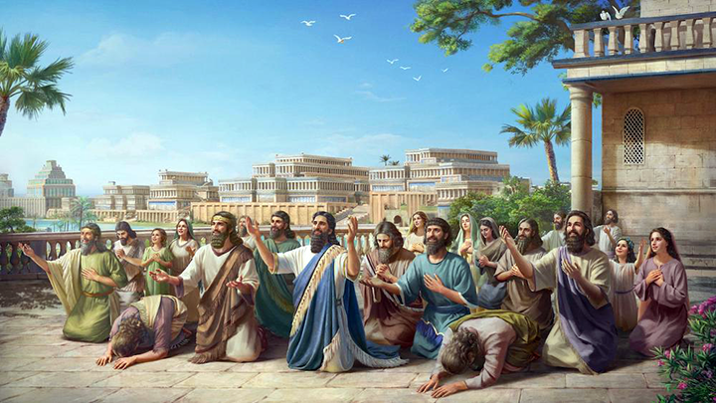
The Restless Prophet
2. Restless in the Second Call
Jonah 3:1, 2, 4, 5, 10; 4:1 NKJV
“Now the word of the Lord came to Jonah the second time...‘Arise, go to Nineveh....’ Then he cried out...“Yet forty days, and Nineveh shall be overthrown!” So the people of Nineveh believed God, proclaimed a fast.... Then God saw their works...and God relented....
But it displeased Jonah exceedingly, and he became angry.
Notes:
2. Balisa sa Pangalawang Tawag. “Ang salita ng Panginoon ay dumating kay Jonas sa ikalawang pagkakataon...‘Bumangon ka, pumaroon ka sa Ninive....’ At siya’y sumigaw, ‘Apatnapung araw pa at ang Ninive ay mawawasak!’ At ang mga mamamayan ng Ninive ay sumampalataya sa Diyos. Sila’y nagpahayag ng ayuno.... Nang makita ng Diyos ang kanilang ginawa,...nagbago ng isip ang Diyos.... ¶ Ngunit iyon ay ipinagdamdam nang labis ni Jonas at siya’y nagalit.” (Jonas 3:1, 2, 4, 5; 4:1).

Slide 17
2. Restless in the Second Call
Mission Accomplished
Jonah proclaimed God’s message: “ ‘Yet forty days, and Nineveh shall be over- thrown!’ ” The message fell on receptive ears; the people of Nineveh believed.
A decree was declared by the king.
Everyone had to fast and mourn.
The king stepped down from his throne and sat in the dust of the ground, a very important symbolic act.
Notes:
Naisagawa na ang Misyon. Iprinoklama ni Jonas ang mensahe ng Diyos: “ ‘Apatnapung araw pa at ang Ninive ay mawawasak!’ ” Ang mensahe ay tumama sa mga handang tumanggap, at naniwala ang mga tao ng Nineve. ¶ Isang utos ang idineklara ng hari. Lahat ay kailangang mag-ayuno at magdalamhati. ¶ Bumaba ang hari mula sa kanyang trono at naupo sa alikabok ng lupa, isang napakahalagang simbolikong pagkilos.

Slide 18
2. Restless in the Second Call
Mission Accomplished
While Jonah had been preaching, the Holy Spirit must have been hard at work in the hearts of the Ninevites.
Strangely, Jonah, who had experienced God’s grace for himself personally, firsthand, seemed to think that God’s grace was something so exclusive that only some might have opportunity to rest in it.
Notes:
Samantalang nangangaral si Jonas, ang Banal na Espiritu ay maaaring gumagawang mabuti sa mga puso ng taga-Nineve. ¶ Buong kataka-taka, si Jonas, na mismong naranasan para sa sarli ang biyaya ng Diyos ay tila nag-aakalang ang biyaya ng Diyos ay napaka-eksklusibo na iilan lamang ang may oportunidad na makahimlay rito.

Slide 19
2. Restless in the Second Call
An Angry, Restless Missionary
Jonah 4 begins with Jonah’s anger toward God because his mission out-reach was so successful. Jonah was worried about looking foolish. “He allowed his mind to dwell upon the possibility of his being regarded as a false prophet.”
Here is evidence that true followers of God—even prophets—may have some growing and overcoming yet to do.
Notes:
Isang Galit at Balisang Misyonero. Nagpapasimula ang Jonas 4 sa galit ni Jonas sa Diyos dahil ang kanyang misyon ng pag-abot ay napaka-tagumpay. Nag-aalala si Jonas tungkol sa pagiging katawa-tawa. Pinayagan ang kanyang pag-iisip na manahan sa posibilidad na maituring na isang bulaang propeta. ¶ Narito ang katunayan na ang mga tunay na tagasunod ng Diyos—kahit mga propeta—ay may paglago’t pananagumpay pang gagawain.

Slide 20
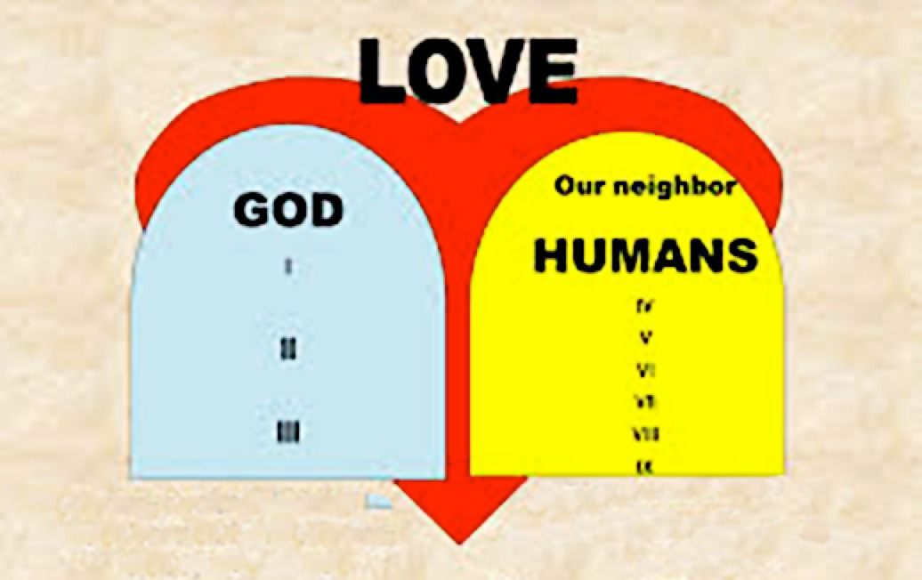
The Restless Prophet
3. Relationships in the Call
Jude 20-23 niv
“But...by building yourselves up in your most holy faith and praying in the Holy Spirit, keep yourselves in God’s love as you wait for the mercy of our Lord Jesus Christ to bring you to eternal life.
Be merciful to those who doubt; save others by snatching them from the fire; to others show mercy....”
Notes:
3. Mga Relasyon sa Tawag. “Ngunit...patatagin ninyo ang inyong sarili sa inyong kabanal-banalang pananampalataya; manalangin sa Espiritu Santo; ingatan ninyo ang inyong sarili sa pag-ibig ng Diyos, na inyong hintayin ang habag ng ating Panginoong Jesu-Cristo tungo sa buhay na walang hanggan. ¶ At ang ibang nag-aalinlangan ay inyong kahabagan; ang iba’y inyong iligtas, na agawin ninyo mula sa apoy; at ang iba’y inyong kahabagan...” (Judas 20-23).

Slide 21
3. Relationships in the Call
A Two-Way Street
In this account, God pursued a reluctant prophet because He knew that Jonah needed the missionary trip to Nineveh as much as the Ninevites needed to hear the missionary’s message.
Notes:
Isang Salubungang Daan. Sa salaysay na ito, tinugis ng Diyos ang isang atubiling propeta dahil alam Niya na kailangan ni Jonas ang paglalakbay misyonero patungong Nineve gaya na kailangan ng mga taga-Nineve na marinig ang mensahe ng misyonero.

Slide 22
3. Relationships in the Call
A Two-Way Street
Jude tells us in verse 21 to “keep yourselves in God’s love as you wait for the mercy of our Lord Jesus Christ to bring you to eternal life” (NIV).
Experiencing God’s love and grace personally is not a one-time event.
One sure way to “keep yourselves in God’s love” is to reach out to others.
Notes:
Sinasabi ni Judas sa atin sa talatang 21 na “ingatan ninyo ang inyong sarili sa pag-ibig ng Diyos, na inyong hintayin ang habag ng ating Panginoong Jesu-Cristo tungo sa buhay na walang hanggan.” ¶ Ang personal na maranasan ang pag-ibig at biyaya ng Diyos ay hindi isang minsanang pangyayari. ¶ Ang isang tiyak na paraan upang “ingatan ninyo ang inyong sarili sa pag-ibig ng Diyos" ay ang pag-abot sa ibang tao.

Slide 23
3. Relationships in the Call
A Two-Way Street
God called Jonah to go to Nineveh because Jonah probably hadn’t spent much time thinking about his relationship to the Assyrians before this particular call.
He probably knew that he didn’t like them, but he had no idea of how much he hated them or the extremes to which he would go in order to avoid them.
Notes:
Tinawag ng Diyos si Jonas upang pumunta sa Nineve dahil marahil hindi gumugol si Jonas nang maraming panahon sa pag-iisip tungkol sa kanyang relasyon sa mga Asiriano bago itong partikular na tawag. ¶ Marahil ay alam Niya na ayaw ni Jonas sa kanila, ngunit marahil ay wala siyang ideya kung gaanong kinamumuhan niya sila o ang mga sukdulang gagawin niya upang maiwasan sila.

Slide 24
3. Relationships in the Call
A Two-Way Street
Jonah hadn’t learned to love as God loves.
God called Jonah to go to Nineveh because God loved the Ninevites and wanted them in His kingdom.
But God also called Jonah because God loved Jonah.
Notes:
Hindi pa natutunan ni Jonas na umibig gaya nang paano umiibig ang Diyos. ¶ Tinawag ng Diyos si Jonas upang pumunta sa Nineveh dahil iniibig ng Diyos ang mga taga-Nineve at nais Niya sila sa Kanyang kaharian. ¶ Subalit tinatawag din ng Diyos si Jonas dahil iniibig ng Diyos si Jonas.

Slide 25
3. Relationships in the Call
A Two-Way Street
He wanted Jonah to grow and become more like Him as they worked together.
God wanted Jonah to find the true rest that comes only by being in a saving relationship with Him and by doing God’s will, which includes reaching out to others and pointing them to the faith and hope that we have.
Notes:
Gusto Niyang lumago si Jonas samantalang magkasama silang gumagawa. ¶ Gusto ng Diyos na masumpungan ni Jonas ang tunay na kapahingahan na dumarating lamang sa pamamagitan ng pagiging nasa isang nagliligtas na relasyon sa Kanya at sa pamamagitan ng paggawa ng kalooban ng Diyos, na kabilang ang pag-abot sa iba at nagtuturo sa kanila sa pananampalataya’t pag-asang mayroon tayo.

Slide 26
The Restless Prophet
Final Words: Prophets and Kings 266
“In the charge given him, Jonah had been entrusted with a heavy respon-sibility; yet He who had bidden him go was able to sustain His servant and grant him success. ... Yet in the hour of Jonah’s despair the Lord did not desert him. Through a series of trials and strange providences, the prophet’s confidence in God...was to be revived.”
Notes:
Huling Pananalita. “Sa naibigay na sagutin sa kanya, pinagkatiwalaan si Jonas ng isang mabigat na responsibilidad; gayunman, Siya na nag-atas sa kanya na humayo ay nabigyang-lakas ang Kanyang lingkod at napagkalooban siya ng tagumpay. ... Gayunman sa oras ng kawalang-pag-asa ni Jonas hindi siya iniwan ng Panginoon. Sa pamamagitan ng mga serye ng pagsubok at di-karaniwang mga kalinga, ang kompiyansa ng propeta sa Diyos...ay muling binuhay.”—Prophets and Kings 266.

