Slide 1
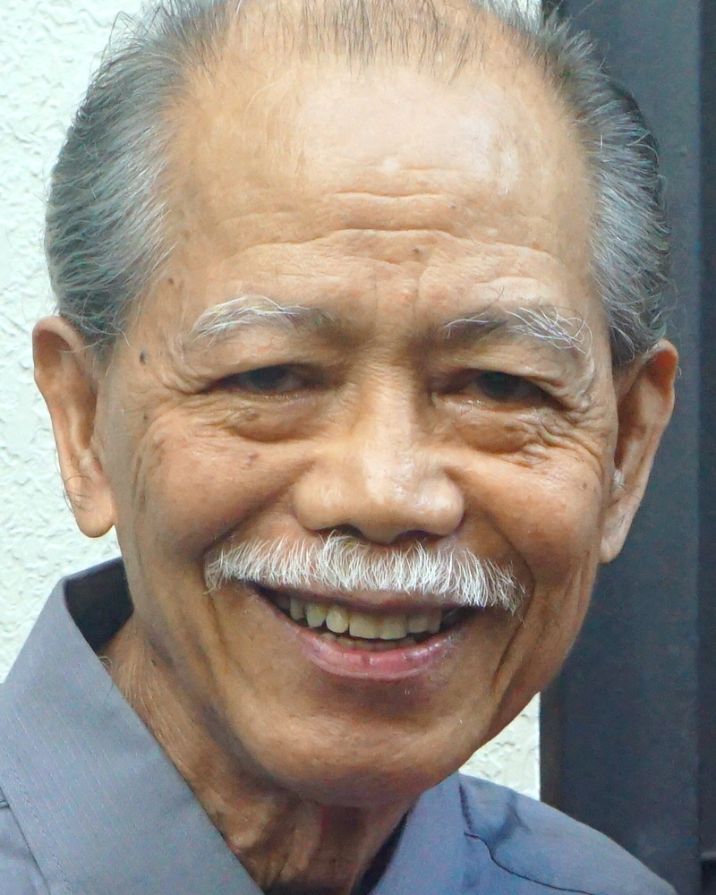
Adult Bible Study Guide
Apr • May • Jun 2022
powerpoint presentation designed by claro ruiz vicente
http://clarovicente.weebly.com
Notes:
“At malalaman ninyo ang katotohanan, at ang katotohanan ang magpapalaya sa inyo” (Juan 8:32 FSV).

Slide 2
Adult Sabbath School Bible Study Guide
An Appeal
DEAR USER
This PowerPoint Show is freely shared to all who may find it beneficial. While intended primarily for personal use, some find it useful for teaching the lesson
in church.
There are those, however, who add illustrations, change background, replace fonts, etc. While their intention may be good, this is not right. Slide #1 says “designed by claro ruiz vicente.” For honest Christians, it is not necessary for another’s creation to be copyrighted in order to be respected.
PLEASE USE AS IS.

Slide 3
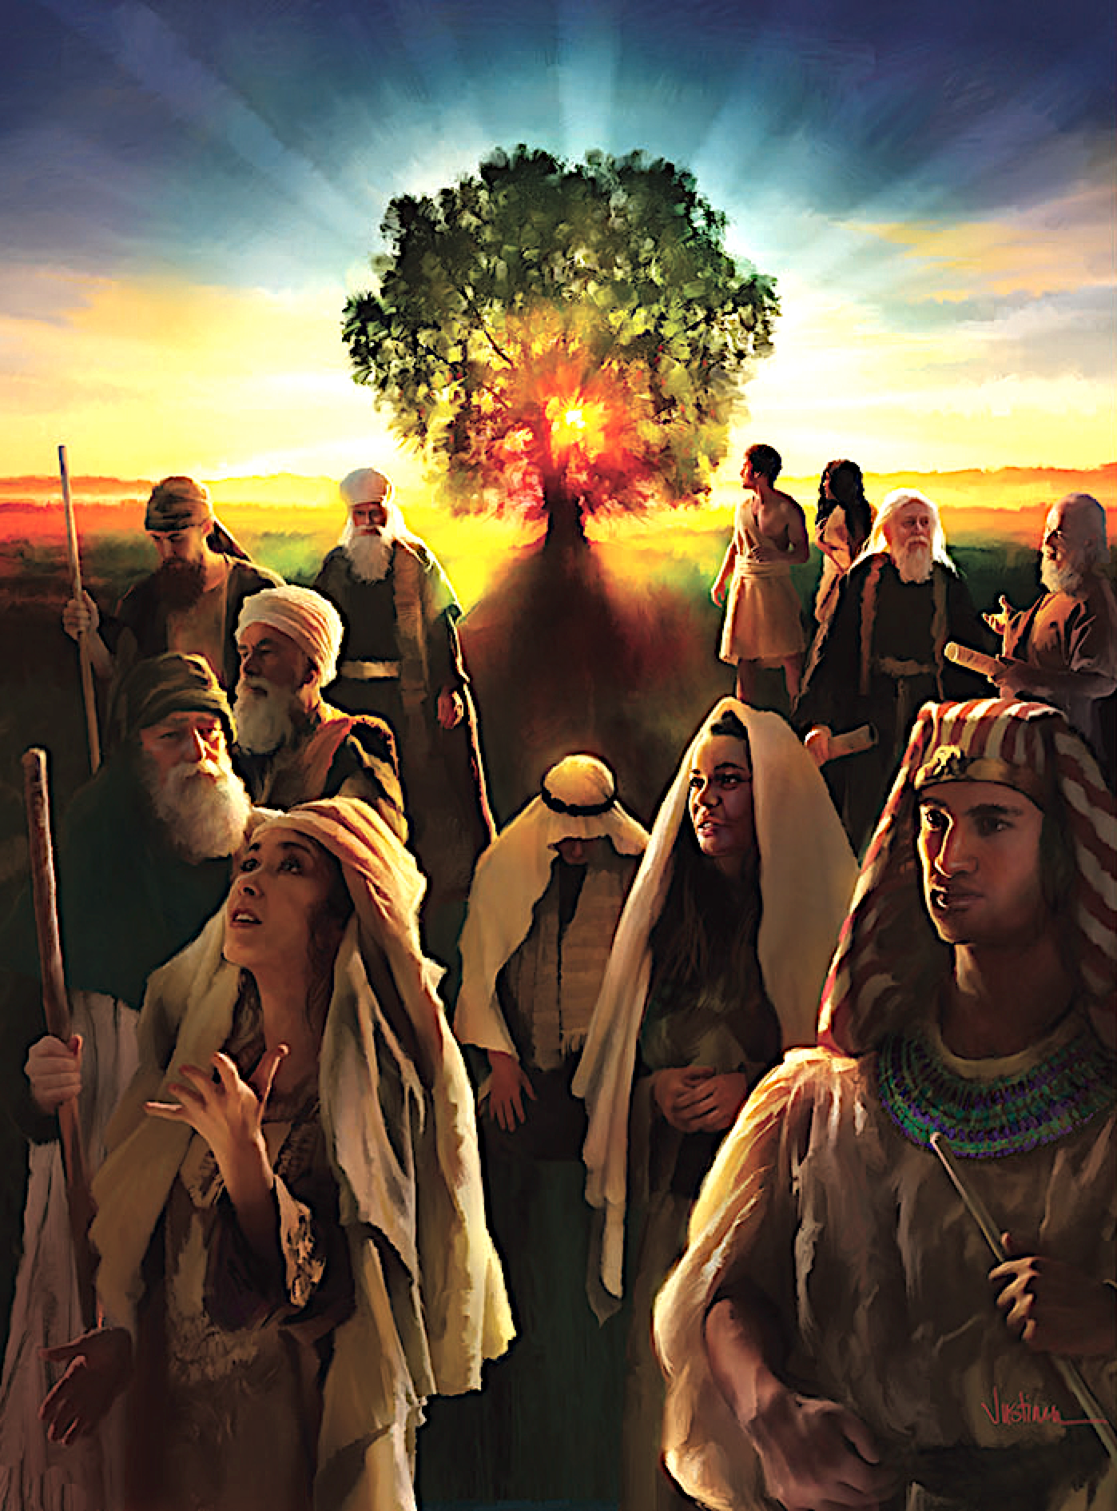
Jacques B. Doukhan
Principal Contributor
Notes:
Genesis

Slide 4
Genesis
The Book of the Beginning
Genesis is about Jesus:
Jesus our Creator,
Jesus our Sustainer,
Jesus our Redeemer.
“In Him was life, and the life was the light of men” (John 1:4).
Notes:
Ang Aklat ng Pasimula. Ang Genesis ay tungkol kay Jesus: // si Jesus and ating Manlalalang, // si Jesus ang ating Tagasustena, si Jesus ating Manunubos. ¶ “ Nasa sa kanya ang buhay at ang buhay ay siyang ilaw ng mga tao” (Juan 1:4).

Slide 5
Genesis
Our Goal
During this quarter, not only will we read and study the book of Genesis— but we also will enjoy its beautiful stories and learn to walk better with the Lord of Creation, the God of Abraham, Isaac, and Jacob.
Notes:
Ang Ating Mithiin. Sa tatlong buwan na ito, hindi lamang natin babasahin at pag-aaralan ang aklat ng Genesis—kundi atin ding tatamasahin ang magagandang kuwento at matutunan na mas mabuting lumakad kasama ang Panginoon ng Paglalang, ang Diyos ni Abraham, Isaac, at Jacob.

Slide 6
Genesis
Contents
1 The Creation
2 The Fall
3 Cain and His Legacy
4 The Flood
5 All Nations and Babel
6 The Roots of Abraham
7 The Covenant With Abraham
8 The Promise
9 Jacob the Supplanter
10 Jacob-Israel
11 Joseph, Master of Dreams
12 Joseph, Prince of Egypt
13 Israel in Egypt
Notes:
Pangwalong Liksyon

Slide 7
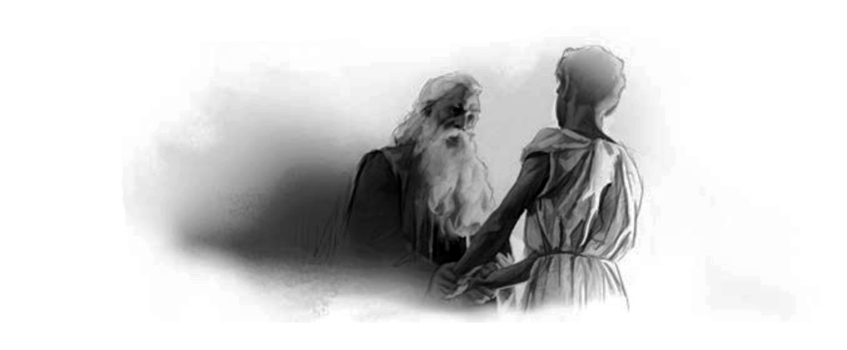
Genesis
Lesson 8, May 20, 2022
The Promise
Notes:
Ang Pangako

Slide 8
The Promise
Key Text
Genesis 24:1 NKJV
“Now Abraham was old, well advanced in age; and the Lord had blessed Abraham in all things.”
Notes:
Susing Talata. “Si Abraham ay matanda na at lipas na sa panahon; at pinagpala ng Panginoon si Abraham sa lahat ng mga bagay” (Genesis 24:1).

Slide 9
The Promise
Initial Words
As God had promised, Sarah bore Abraham a son, “in his old age.”
But the story of Abraham is far from over, reaching a climactic moment when he took his son to Mount Moriah to be sacrificed. Isaac is replaced by a ram, which signified God’s commitment to bless the nations through his “seed.”
That Seed was Jesus. Hence, in this story, more of the plan of salvation is revealed.
Notes:
Panimulang Salita. Gaya nang pagkakapangako ng Diyos, ipinanganak ni Sarah kay Abraham ang isang anak na lalaki, “sa kanyang katandaan.” ¶ Subalit ang kuwento ni Abraham ay malayong tapos na, nirarating ang isang kulminasyong sandali nang dinala niya ang kanyang anak sa Bundok ng Moria upang ihain. Si Isaac ay pinalitan ng isang tupang lalaki, na nagpapabatid ng pangako ng Diyos na pagpalain ang mga bansa sa pamamagitan ng kanyang “binhi.” ¶ Ang binhing iyon ay si Jesus. Kaya, sa kuwentong ito, higit pang naihayag ang panukala ng kaligtasan.

Slide 10
The Promise
Quick Look
1. The Promise Under Test (Genesis 22:2)
2. Events Important to the Promise (Genesis 23:1; 24:67)
3. More Promises Filfilled (Genesis 25:1, 8)
Notes:
1. Ang Pangako’y Sumailalim sa Pagsubok (Genesis 22:2).
2. Mga Pangyayaring Mahalaga sa Pangako (Genesis 23:1; 24:67).
3. Mga Karagragang Pangako’y Natupad (Genesis 25:1, 8).

Slide 11
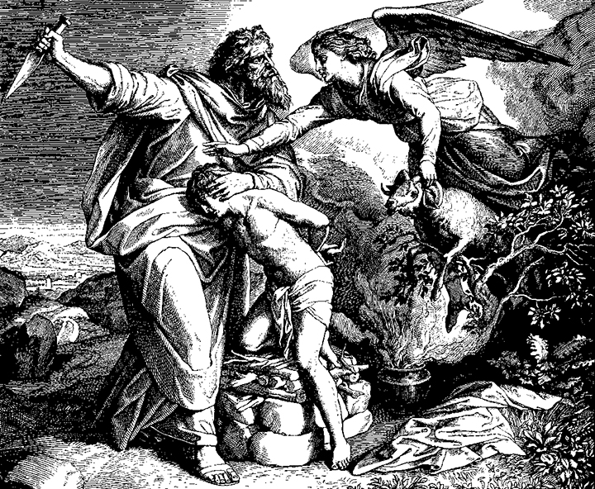
The Promise
1. The Promise Under Test
Genesis 22:2 NKJV
“Then He said, ‘Take now your son, your only son Isaac, whom you love, and go to the land of Moriah, and offer him there as a burnt offering
on one of the mountains of which I shall tell you.’ ”
Notes:
1. Ang Pangako’y Sumailalim sa Pagsubok. “At kanyang sinabi,’Kunin mo ngayon ang iyong anak, ang iyong kaisa-isang anak na si Isaac, na iyong minamahal at pumunta ka sa lupain ng Moria. Ialay mo siya bilang handog na susunugin ¶ sa itaas ng isa sa mga bundok na aking sasabihin sa iyo’ ” (Genesis 22:2).

Slide 12
1. The Promise Under Test
a. Mount Moriah
The meaning of God’s test is difficult to comprehend. This divine command contradicted the later biblical prohibition against human sacrifices (Lev. 18:21), and it work against God’s promise of an covenant through Isaac (Gen. 15:5).
What, then, was the purpose of God’s calling him to do this? Why test him in such a powerful way?
Notes:
a. Bundok ng Moria. Ang kahulugan ng pagsubok ng Diys ay mahirap unawain. Itong makalangit na utos ay kumontra sa darating na biblikal na pagbabawal sa paghahain ng tao (Levitico 18:21), at sumasalungat ito sa pangako ng Diyos ng isang tipan sa pamamagitan ni Isaac (Genesis 15:5). ¶ Ano, kung gayon ang layon ng panawagan ng Diyos sa kanya upang gawin ito? Bakit susubukan siya sa gayong napakalakas na paraan?

Slide 13
1. The Promise Under Test
a. Mount Moriah
The biblical notion of “test” (nissah) embraces two opposite ideas. It refers to the idea of judgment; that is, a judgment in order to know what is in the heart of the tested one (Deut. 8:2; compare with Gen. 22:12).
But it also brings the assurance of God’s grace on behalf of the tested (Exod. 20:18–20).
Notes:
Ang biblikal na pananaw ng "pagsubok" (nissah) ay pagyakap sa dalawang magkasalungat na pananaw. Tumutukoy ito sa isipan ng paghuhukom; ibig sabihin, isang paghuhukom upang alamin ang nasa puso ng sinusubukan (Deuteronomio 8:2; ihambing sa Genesis 22:12). ¶ Subalit nagdadala rin ito ng katiyakan ng biyaya ng Diyos sa kapakanan ng nasubukan (Exodo 20:18–20).

Slide 14
1. The Promise Under Test
a. Mount Moriah
In this case, Abraham’s faith in God takes him to the point that he runs the risk of losing his “future”
(his posterity).
And yet, because he trusts God, he will do what God asks, no matter how difficult it all is to understand.
After all, what is faith if not trust in what we don’t see or fully understand?
Notes:
Sa kasong ito, ang pananampalataya ni Abrahan sa Diyos ay nagdadala sa kanya sa puntong isinasapanganib niya ang pagkawala ng kanyang “kinabukasan” (ang mga susunod na henerasyon). ¶ At gayunman, dahil nagtitiwala siya sa Diyos, gagawin niya ang hinihingi ng Diyos, gaanuman kahirap itong maunawaan. Matapos ang lahat, ano ang pananampalataya kundi pagtitiwala sa hindi natin nakikita o lubos na nauunawaan?

Slide 15
1. The Promise Under Test
a. Mount Moriah
Also, biblical faith is not so much about our capacity to give to God and to sacrifice for Him—though that has a role, no doubt (Rom. 12:1)
—but about our capacity to trust Him and to receive His grace while understanding just how unde- serving we are.
Notes:
At saka, ang biblikal na pananampalataya ay hindi gaanong tungkol sa ating kapasidad na magbigay sa Diyos at magsakripisyo para sa Kanya—bagaman iyan ay walang dudang isang papel na ginagampanan (Roma 12:1)— ¶ kundi tungkol sa ating kapasidad na magtiwala sa Kanya at tumanggap sa Kanyang biyaya samantalang nauunawaan kung gaano tayo hindi karapat-dapat.

Slide 16
1. The Promise Under Test
b. God Will Provide
When Isaac asked about the sacrificial animal, Abraham answered, God will “ ‘provide for Himself the lamb for a burnt offering’ ” (Gen. 22:8). Yet, the Hebrew verbal form can actually mean “God will provide Himself as the lamb.”
Here is the essence of the plan of salva-tion, with the Lord Himself suffering and paying in Himself the penalty for our sins!
Notes:
b. Maglalaan ang Diyos. Nang nagtanong si Isaac tungkol sa haing hayop, tumugon si Abraham na ang Diyos ay “ ‘magbibigay [para sa sarili Niya] ng tupa para sa handog na susunugin’ ” (Genesis 22:8). Gayunman, ang Hebreong porma ng pandiwa ay maaaring mangahulugang “ibibigay ng Diyos ang sarili bilang tupa.” ¶ Narito ang diwa ng panukala ng kaligtasan, ang Panginoon mismo ang nagdurusa at nagbabayad ng Kanyang sarili sa parusa para sa ating mga kasalanan!

Slide 17
b. God Will Provide
Patriarchs and Prophets 154
“It was to impress Abraham’s mind with the reality of the gospel, as well as to test his faith, that God commanded him to slay his son.
The agony which he endured during the dark days of that fearful trial was permitted that he might understand from his own experience something of the greatness of the sacrifice made by the infinite God for man’s redemption.”
Notes:
Patriarchs and Prophets 154. “Ito’y upang idiin sa isipan ni Abraham ang reyalidad ng ebanghelyo, gayundin upang subukan ang kanyang pananampalataya, na nag-utos ang Diyos sa kanya na patayin ang kanyang anak. ¶ Ang pagdurusa na kanyang tiniis sa panahon nang madidilim na araw ng nakakatakot na pagsubok ay pinahintulutan upang maunawaan niya mula sa sariling karanasan ang tungkol sa kadakilaan ng sakripisyong nagawa sa pamamagitan nang walang hanggang Diyos para sa katubusan ng tao.”

Slide 18
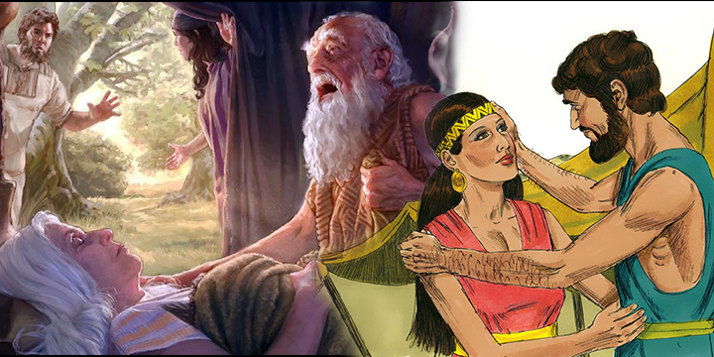
The Covenant with Abraham
2. Events Important to the Promise
Genesis 23:1; 24:67 NKJV
“Sarah lived one hundred and twenty-seven years; these were the years of the life of Sarah.”
“Then Isaac brought her into his mother Sarah’s tent; and he took Rebekah and she became his wife, and he loved her.
So Isaac was comforted after his mother’s death.”
Notes:
2. Mga Pangyayaring Mahalaga sa Pangako. “Ang buhay ni Sara ay tumagal ng isandaan at dalawampu’t pitong taon. Ito ang naging mga taon ng buhay ni Sara. ¶ “Dinala siya ni Isaac sa tolda ni Sara na kanyang ina. Kinuha niya si Rebecca at siya'y naging asawa niya, at siya’y kanyang minahal. ¶ Kaya’t naaliw si Isaac pagkamatay ng kanyang ina” (Genesis 24:67).

Slide 19
2. Events Important to the Promise
a. The Death of Sarah
Sarah is the only woman in the Old Testament of whom the number of her years is mentioned, which could show her involvement in the story even after the fact.
The focus on the purchase of Sarah’s burial place, rather than on her death, emphasizes the connection with the Promised Land.
Notes:
a. Ang Kamatayan ni Sara. Si Sara ang kaisa-isang babae sa Lumang Tipan na nabanggit ang bilang ng kanyang mga taon, na maaaring magpakita sa kanyang pagkakasangkot sa kuwento kahit pa matapos ang pangyayari. ¶ Ang pagtutuon sa magbili ng libingan ni Sara, sa halip sa kanyang kamatayan, ang nagdiriin sa kaugnayan sa Lupang Pangako.

Slide 20
2. Creation Was Very Good
a. The Death of Sarah
The specification that she died “in the land of Canaan” (Gen. 23:2) underlines the rooting of Sarah’s death in God’s promise of the land. Sarah is the first of Abraham’s clan to have died and been buried in the Promised Land.
His concern of being “ ‘a foreigner’ ”
(Gen. 23:4), show that he is concerned with settling in the land permanently.
Notes:
Ang pagtutukoy na siya’y namatay “sa lupa ng Canaan” (Genesis 23:2) ay binibigyang diin ang nagkakabit sa kamatayan ni Sara sa pangakong lupa ng Diyos. Si Sara ang una sa mga angkan ni Abraham na namatay at nailibing sa Lupang Pangako. ¶ Ang kanyang pag-alala sa pagiging” ‘isang dayuhan’ ” (Genesis 24:4), ay nagpapakita na siya’y nag-aalala sa permanenteng paninirahan sa lupain.

Slide 21
2. Events Important to the Promise
b. A Wife for Isaac
Just as Abraham wanted to acquire the land in order to bury his wife, because of God’s promise to his descendants that they would have this land, he now insists that Isaac not settle outside of the Promised Land either (Gen. 24:7).
The Angel of the Lord who intervened to save Isaac, will lead in this question of marriage.
Notes:
b. Isang Misis Para kay Isaac. Gaya nang si Abraham ay nais na makabili ng lupa upang mailibing ang kanyang misis, dahil sa pangako ng Diyos sa kanyang mga inapo na sasakanila itong lupain, nagpumilit siya ngayon sa si Isaac ay hindi rin maninirahan sa labas ng Lupang Pangako (Genesis 24:7). ¶ Ang Anghel ng Panginoon na namagitan upang iligtas si Isaac, ay mangunguna dito sa usapin ng pag-aasawa.

Slide 22
2. Events Important to the Promise
b. A Wife for Isaac
Although God’s plan for Rebekah is to follow Eliezer, she retains her freedom of choice. If she would not want to come, she would not be forced to.
God has given us a freedom that He will not trample on. And despite of the the terrible choices humans make with that free will, we can trust that in the end God’s love and goodness will prevail.
Notes:
Bagaman ang panukala ng Diyos para kay Rebekah ay ang sumunod kay Eliezer, pinananatili niya ang kanyang kalayaang pumili. Kung ayaw niyang sumama, hindi siya pipilitin. ¶ Nagbigay ang Diyos sa atin ng isang kalayaan hindi Niya yuyurakan. At sa kabila nang matitinding pagpiling nagawa ng tao sa malayang kaloobang ‘yon, makapagtitiwala tayo na sa katapusan ay mangingibabaw ang pag-ibig at kabutihan ng Diyos.

Slide 23
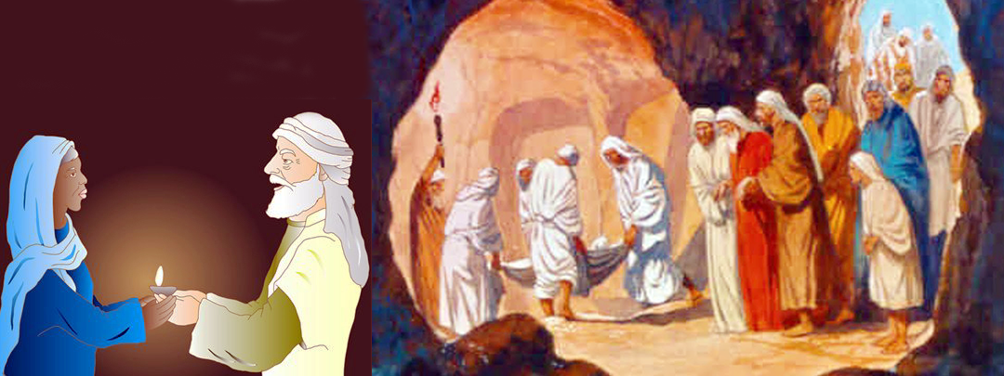
The Promise
3. More Promises Filfilled
Genesis 25:1, 8 NKJV
“Abraham again took a wife, and her name was Keturah. And she bore him Zimran, Jokshan, Medan, Midian, Ishbak, and Shuah. ...
Then Abraham breathed his last and died in a good old age, an old man and full of years, and was gathered to his people.”
Notes:
3. AnMga Karagragang Pangako’y Natupad. “Si Abraham ay nag-asawa ng iba at ang kanyang pangalan ay Ketura. Naging mga anak nito sina Zimram, Jokshan, Medan, Midian, Isbak, at Shua. ¶ ... Nalagot ang hininga ni Abraham at namatay sa mabuting katandaan, matanda at puspos ng mga taon; at naging kasama ng kanyang bayan” (Genesis 25:1, 8).

Slide 24
3. More Promises Fulfilled
a. Father of Many Nations
After Sarah died, Abraham married again. The purpose of the genealogy (Genesis 25:1–4, 12–18) after Abraham’s marriage with Keturah, who gave him six sons, versus his two other sons (Isaac and Ishmael), is perhaps to provide immediate evidence of God’s promise that Abraham would father many nations.
Notes:
Anga. Ama ng Maraming Bansa. Pagkatapos mamatay si Sara, muling nag-asawa si Abraham. Ang layon ng pinaglahian (Genesis 25:1–4, 12–18) pagkatapos ng pag-aasawa ni Abraham kay Ketura, na nagbigay sa kanya ng anim na mga anak na lalaki, kung ihahambing sa kanyang dalawang iba pang anak (sina Isaac at Ismael), ay marahil upang magbigay nang kagyat na patunay sa pangako ng Diyos na si Abrahan ang mag-aanak ng maraming mga bansa.

Slide 25
3. More Promises Fulfilled
b. “Good Old Age; Full of Years”
The report of Abraham’s death sandwiched between the two gene- alogies (Gen. 25:7–11) also testifies to God’s blessing.
It reveals the fulfillment of His promise to Abraham, made many years earlier, that he would die “ ‘at a good old age’ ” (Gen. 15:15) and “ ‘full of years’ ” (compare with Eccles. 6:3).
Notes:
b. “Mabuting Katandaan; Puspos ng mga Taon.” Ang ulat ng kamatayan ni Abraham na napagitna sa dalawang pinaglahian (Genesis 25:7–11) ay nagpapatotoo rin sa pagpapala ng Diyos. ¶ Nagpahayag ito sa katuparan ng pangako kay Abraham na nagawa maraming taong nakalipas, na siya’y mamamatay “ ‘ sa isang mabuting katanaan’ ” (Genesis 15:15) at “ ‘puspos ng mga taon’ ” (ihambing sa Eclesiastes 6:3).

Slide 26
The Promise
Last Word: Testimonies for the Church 3:369
“Isaac was a figure of the Son of God, who was offered a sacrifice for the sins of the world. God would impress upon Abraham the gospel of salvation to man.
In order to do this...He required him to slay his darling Isaac. ... He was made to understand in his own experience how unutterable was the self-denial of the in-finite God in giving His own Son to die....”
Notes:
Huling Pananalita. “Si Isaac ay isang larawan ng Anak ng Diyos, na naihandog bilang hain para sa mga kasalanan ng sanlibutan. Ikikintal ng Diyos kay Abraham ang ebanghelyo ng kaligtasa sa tao. ¶ Upang magawa ito...iniutus Niya sa kanya na patayin ang kayang mahal na Isaac. ... Naipaunawa sa kanya sa sarili niyang karanasan kung paano hindi mabigkas ang pagtanggi sa sarili ng walang hanggang Diyos sa pagbibigay ng Kanyang sariling Anak upang mamatay....”—Testimonies for the Church 3:369.

Slide 27
The Promise
Presentation Record
1. Ala SDA Ch SSL 20 Apr 22 via ZOOM

