Slide 1
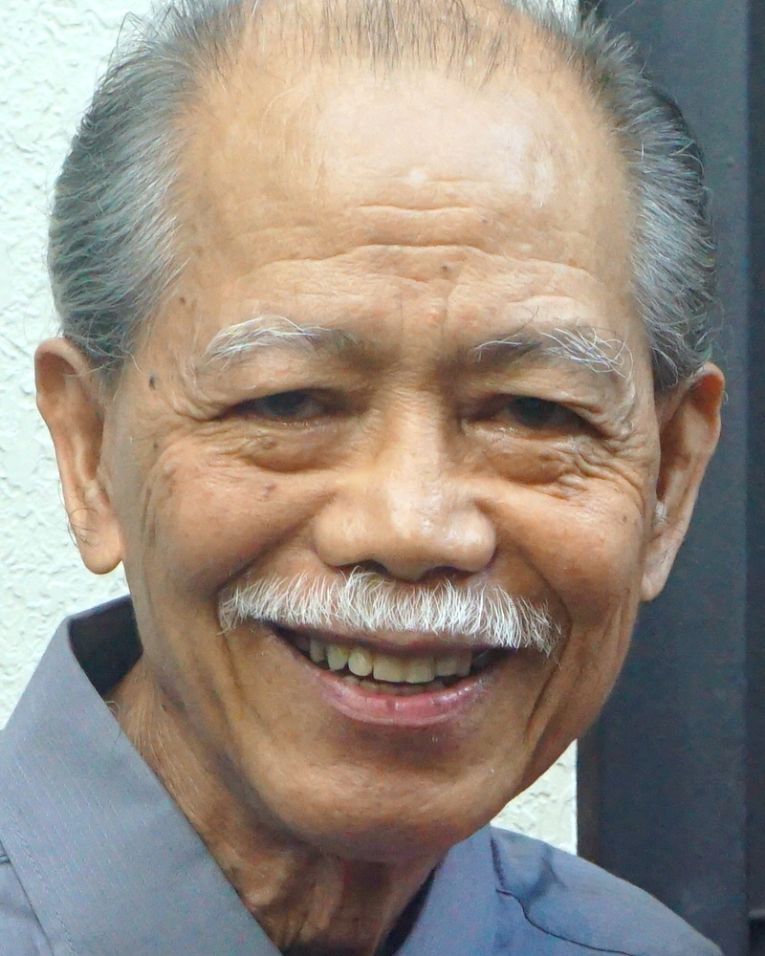
Adult Bible Study Guide
Jul • Aug • Sep 2022
Teacher’s Preview
powerpoint presentation designed by claro ruiz vicente
Notes:
“At malalaman ninyo ang katotohanan, at ang katotohanan ang magpapalaya sa inyo” (Juan 8:32 FSV).

Slide 2
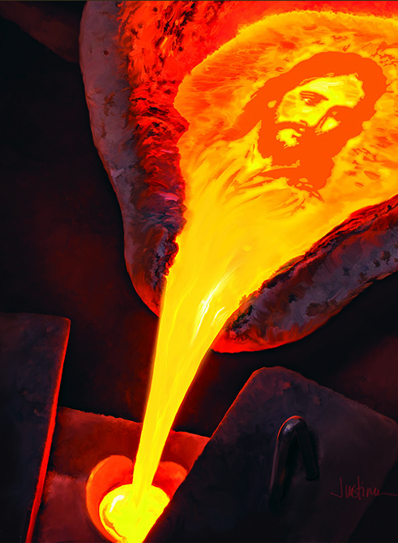
Gavin Anthony
Principal Contributor
Notes:
Nasa Pahirap Kasama si Cristo

Slide 3
In the Crucible With Christ
Our Goal
We will see
how other flesh and blood, though radiated in faith, nevertheless faced despair, betrayal, disappointment, loss, injustice, and abuse.
As we look at these people we must always see them contrasted against the background of the Cross.
Notes:
Ang Ating Mithiin. Makikita natin kung paano ang ibang tao, bagaman nagpapahiwatig ng pananampalataya, ay gayunma’y napapaharap sa kawalan ng pag-asa, pagtataksil, pagkabigo, pagkapahamak, kawalan ng katarungan, at pagmamalabis. ¶ Samantalang tumitingin tayo sa mga taong ito’y dapat laging nakikita ang mga ito (yung hinaharap ng tao) na naihahambing sa likuran ng Krus (ang paghihirap ni Cristo).

Slide 4
In the Crucible With Christ
Contents
1 The Shepherd’s Crucible Identified in Psalm 23
2 The Crucibles That Come The reasons why
3 The Birdcage Israel in exodus
4 Seeing the Goldsmith’s Face Christlike character
5 Extreme Heat God’s risk
6 Struggling With All Energy Willpower
7 Indestructible Hope Hope
8 Seeing the Invisible Faith
9 A Life of Praise Praise
10 Meekness in the Crucible Meekness
11 Waiting in the Crucible Patience
12 Dying Like a Seed Submission
13 Christ in the Crucible Christ’s suffering
Notes:
Huling Liksyon

Slide 5
In the Crucible With Christ
Lesson 13, September 24, 2022
Christ in the Crucible
Notes:
Si Cristo sa Pahirap

Slide 6
Christ in the Crucible
Key Text
Matthew 27:46 NKJV
“And about the ninth hour Jesus cried out with aloud voice, saying, ‘Eli, Eli, lama sabachthani?’ that is, ‘My God, My God, why have You forsaken Me?’ ”
Notes:
Susing Talata. “At nang malapit na ang oras na ikasiyam ay sumigaw si Jesus ng may malakas na tinig, na sinasabi, ‘Eli, Eli, lama sabacthani?’ na ang kahulugan ay ‘Diyos ko, Diyos ko, bakit mo ako pinabayaan?’ ” (Mateo 27:46).

Slide 7
Christ in the Crucible
Sabbath Afternoon, September 17
The freedom of all His intelligent crea-tures was so sacred that, rather than deny us freedom, God chose to bear in Himself the brunt of the suffering caused by our abuse of that freedom. And we see this suffering in the life and death of Jesus, who, through suffering in our flesh, has created bonds between heaven and earth that will last throughout eternity.
The freedom of all His intelligent crea-tures was so sacred that, rather than deny us freedom, God chose to bear in Himself the brunt of the suffering caused by our abuse of that freedom.
Notes:
Sabbath ng Hapon, Setyembre 17. Ang kalayaan ng lahat ng Kanyang matatalinong mga nilalang ay talagang sakdal na, sa halip na pagkaitan tayo ng kalayaan ay pinili ng Diyos na pasanin sa Kanyang sarili ang bagsik ng pagdurusa na dahilan ng ating pagmamalabis ng kalayaang ‘yon. ¶ At nakikita natin itong pagdurusa sa buhay at kamatayan ni Jesus, na, sa pamamagitan ng pagdurusa sa ating laman, ay lumikha na pagkakaisa sa pagitan ng langit at lupa na magtatagal sa buong walang hanggan.

Slide 8
Sunday, September 18
The Early Days
“And she brought forth her firstborn Son, and wrapped Him in swaddling cloths, and laid Him in a manger, because there was no room for them in the inn” (Luke 2:7).
“[T]hey brought Him to Jerusalem to present Him to the Lord...and to offer...“ ‘a pair of turtledoves or two young pigeons’ ” (vs. 22-24).
Notes:
Ang mga Unang Araw. “At kanyang isinilang ang kanyang panganay na anak na lalaki, binalot niya ito ng mga lampin, at inihiga sa isang sabsaban sapagkat walang lugar para sa kanila sa bahay-panuluyan” (Lucas 2:7) ¶ “[K]anilang dinala siya sa Jerusalem upang iharap siya sa Panginoon.... Sila'y naghandog ng alay ‘dalawang batu-bato, o dalawang batang kalapati’ ” (tal. 22-24).

Slide 9
Sunday, September 18
The Early Days
With the exceptions of Adam and Eve before the Fall, Jesus was the only sinless Person who ever lived on the earth. In His purity, in His sinlessness, He was immersed in a world of sin.
What torture it must have been, even as a child, for His pure soul constantly to be in contact with sin. It must have been exceedingly painful for Him.
Notes:
Maliban kina Adan at Eva bago ang Pagkakasala, si Jesus ang nag-iisang Katauhan na nabuhay na sa lupa. Sa Kanyang kadalisayan, sa Kanyang pagiging walang-kasalanan, Siya’y nababad sa isang sanlibutan ng kasalanan. ¶ Ano ngang naging pagpapahirap ito, kahit bilang isang bata, para ang kanyang dalisay na kaluluwang patuloy sa pakikiharap sa kasalanan. Malamang ito’y naging lubhang masakit para sa Kanya.

Slide 10
Monday, September 19
Despised and Rejected of Men
• The multitudes: “Could this be the Son of David?” (Matt. 22:23).
• In the synagogue: “Is this not Joseph’s son?” (Luke 4:22). “Filled with wrath,... thrust Him out of the city;...to throw Him down over the cliff” (28, 29).
• The Jews: “They took up stones to throw at Him” (John 8:59).
Notes:
Lunes, Setyembre 19. Kinamuhian at Tinanggihan ng Tao. • Lahat ng tao: “Ito na kaya ang Anak ni David?” (Mateo 22:23). ¶ • Sa sinagoga: “Hindi ba ito ay anak ni Jose?” (Lucas 4:22). “Napuno ng galit... ipinagtabuyan siya sa labas ng bayan...hanggang sa taluktok ng burol...upang siya'y ihulog“ (28, 29). ¶ • Mga Judio: “Dumampot ng mga bato upang ibato sa kanya” (Juan 8:59).

Slide 11
Monday, September 19
Despised and Rejected of Men
“ ‘O Jerusalem, Jerusalem, the one who kills the prophets and stones those who are sent to her! How often I wanted to gather your children together, as a hen gathers her chicks under her wings, but you were not willing!’ ” (Matt. 23:37).
Notes:
“ ‘O Jerusalem, Jerusalem, na pumapatay ng mga propeta at bumabato sa mga isinusugo sa kanya! Makailang ulit kong ninais na tipunin ang iyong mga anak, na gaya ng pagtitipon ng inahing manok sa kanyang mga sisiw sa ilalim ng kanyang mga pakpak, at ayaw ninyo!’ ” (Mateo 23:37).

Slide 12
Monday, September 19
Despised and Rejected of Men
We’ve all felt the sting of rejection, and maybe our pain was similar to Christ’s in that it was unselfish:
we were pained, not because we were rejected, but because of what the rejection would mean for the one who was rejecting us (perhaps someone we care about who refuses to accept salvation in Christ).
Notes:
Lahat tayo’y nakadama ng kamandag ng pagtanggi, at marahil ang ating kirot ay katulad sa kay Cristo dahil ito’y hindi makasarili: ¶ tayo’y nasaktan, hindi dahil tayo’y tinanggihan, kundi dahil sa magiging kahulugan ng pagtanggi para sa isa na tinatanggihan tayo (marahil ang isa na ating minamahal na tumatangging tanggapin ang kaligtasan kay Cristo). Ano ang kahulugan para doon sa tumatanggi sa atin? Ang kamatayang walang hanggan.

Slide 13
Monday, September 19
Despised and Rejected of Men
Imagine, though, how it must have felt to Jesus, who was fully aware of what He was to face in order to save them, and at the same time fully aware of what the consequences of their rejection would be.
“It was because of His innocence that He [Christ] felt so keenly the assaults of Satan.”—Selected Messages 3:129.
Notes:
Isipin, gayunman, kung paano ito nadama ni Jesus, na lubos na nababatid ang Kanyang haharapin upang mailigtas sila, at kasabay nito’y lubos na nababatid ang magiging bunga ng kanilang pagtanggi. ¶ “ Ito’y dahil sa Kanyang kawalang-sala na Siya [si Cristo] ay talagang matinding naramdaman ang mga atake ni Satanas.” —Selected Messages 3:129.

Slide 14
Tuesday, September 20
Jesus in Gethsemane
“And saith unto them, ‘My soul is exceeding sorrowful unto death: tarry ye here, and watch’ ” (Mark 14:34).
Whatever Jesus suffered throughout His 33 years here on earth, nothing com-pared to what He began to face in the last hours before the Cross. From the eternal ages, the sacrifice of Jesus was planned, and now it was all coming to pass.
Notes:
Martes, Setyembre 20. Si Jesus sa Getsemani. “At sinabi niya sa kanila, ‘Namamanglaw na lubha ang aking kaluluwa, hanggang sa kamatayan: mangatira kayo rito, at mangagpuyat’ ” (Marcos 14:34). ¶ Anuman ang pinagdusahan ni Jesus sa buong 33 taon Niya dito sa lupa, walang maihahambing sa pinasimulan Niyang harapin sa mga huling oras bago ang Krus. Mula sa walang-hanggang kapanahunan, pinanukala ang sakripisyo ni Jesus, at ngayon lahat ito’y mangyayari na.

Slide 15
Tuesday, September 20
Jesus in Gethsemane
“Father, if it is Your will, take this cup away from Me; nevertheless not My will, but Yours, be done” (Luke 22:42).
As the substitute and surety for sinful man, Christ was suffering under divine justice. He saw what justice meant. Hitherto He had been as an intercessor for others; now He longed to have an intercessor for Himself.”—The Desire of Ages 686.
Notes:
“Ama, kung ibig mo, ilayo mo sa akin ang kopang ito; gayunma'y huwag ang kalooban ko ang mangyari kundi ang sa iyo” (Lucas 22:42). ¶ Bilang panghalili at panagot para sa makasalanang tao, si Cristo ay nagdurusa sa ilalim ng banal na katarungan. Nakita Niya ang kahulugan ng katarungan. ¶ Hanggang ngayon Siya’y naging bilang isang tagapamagitan para sa iba; ngayo’y umaasam Siya na magkaroon ng isang mamamagitan para sa Kanya.” —The Desire of Ages 686. Yung namamagitan ay ngayon nangangailangan ng tagapamagitan.

Slide 16
Tuesday, September 20
Jesus in Gethsemane
No human being has ever been
called to go through anything
like this before or since.
What does this tell us
about God’s love for us?
What hope can you draw
from this for yourself?
Notes:
Walang tao ang kailanman ay natawagan upang danasin ang anumang gaya nito bago o mula noon. ¶ Anong sinasabi nito sa atin tungkol sa Pag-big ng Diyos para sa atin? ¶ Anong pag-asa na maaari mong makuha mula rito para sa iyong sarili?

Slide 17
Wednesday, September 21
The Crucified God
Death by crucifixion was one of the harshest punishments the Romans meted out to anyone. It was considered the worst way to die. Between the scourgings, the nails hammered into His hands and feet, the physical pain must have been unbearable. Yet, as we know, Christ’s physical sufferings were mild in contrast to what really was happening.
Death by crucifixion was one of the harshest punishments the Romans meted out to anyone. It was considered the worst way to die. Between the scourgings, the nails hammered into His hands and feet, the physical pain must have been unbearable.
Notes:
Miyerkules, Setyembre 21. Ang Ipinakong Diyos. Ang kamatayan sa pamamagitan ng pagpapako sa krus ay isa sa pinakamalupit na parusang iginagawad ng mga Romano sa sinuman. Itinuring itong pinakamasamang paraan upang mamatay. Sa pagitan ng mga hagupit, mga pakong iminartilyo sa Kanyang mga kamay at paa, ang kirot ng katawan ay talagang naging hindi mapagtitiisan. ¶ Gayunman, gaya ng alam natin, ang mga pisikal na pagdurusa ni Cristo ay babahagya kung ihahambing sa kung ano talaga ang nangyayari.

Slide 18
Wednesday, September 21
The Crucified God
• Matt. 27:45. “Now from the sixth hour until the ninth hour there was darkness over all the land.”
• Matt. 27:51, 52. “The veil of the temple was torn in two from top to bottom; and the earth quaked, and the rocks were split, and the graves were opened; and many bodies of the saints who had fallen asleep were raised.”
Notes:
• Mateo 27:45. “Mula nang oras na ikaanim noon time; unang oras, pagsikat ng araw ay nagdilim sa buong lupain hanggang sa oras na ikasiyam alas tres ng hapon.” ¶ • Mateo 27:51, 52. “At nang sandaling iyon, ang tabing ng templo ay napunit sa dalawa, mula sa itaas hanggang sa ibaba; nayanig ang lupa; at nabiyak ang mga bato. Nabuksan ang mga libingan at maraming katawan ng mga banal na natulog[a] ay bumangon.”

Slide 19
Wednesday, September 21
The Crucified God
Clearly, something much more was happening here than just the death. Jesus on the cross suffered a righteous God’s righteous indignation against the sins of the whole world.
As such, Jesus suffered something deeper, darker, and more painful than any human being could ever know or experience.
Notes:
Buong linaw na may higit pang nangyayari rito kaysa kamatayan lamang. Si Jesus sa krus ay nagdusa ng isang makatwirang galit ng isang makatarungang Diyos laban sa mga kasalanan ng buong sanlibutan. ¶ Sa gayon, nagdusa si Jesus nang isang bagay na mas malalim, mas madilim, at higit na masakit kaysa anumang malalaman o mararanasan ng sinumang tao.

Slide 20
Thursday, September 22
The Suffering God
• Acts 14:22. “ ‘We must through many tribulations enter the kingdom of God.’ ”
• Phil. 1:29. “For to you it has been granted on behalf of Christ, not only to believe in Him, but also to suffer for His sake.”
• 2 Tim. 3:12. “All who desire to live godly in Christ Jesus will suffer persecution.”
Notes:
Huwebes, Setyembre 22. Ang Nagdurusang Diyos. Mga Gawa 14:22 “ ‘Pamamagitan ng maraming mga kapighatian ay kailangang pumasok tayo sa kaharian ng Diyos.’ ” ¶ Filipos 1:29 “ ‘Sapagkat sa inyo'y ipinagkaloob alang-alang kay Cristo, hindi lamang ang manampalataya sa kanya, kundi ang magtiis din naman alang-alang sa kanya.’ ” ¶ 2 Tim. 3:12. “Tunay na ang lahat ng ibig mabuhay na may kabanalan kay Cristo Jesus ay daranas ng pag-uusig.”

Slide 21
The Suffering God
Reminders as We Suffer
First, Christ, our Lord, has suffered more than any of us ever could. At the cross, He “has borne our griefs and carried our sorrows” (Isa. 53:4).
Second, as we suffer, we should remember the results of Christ’s suffering; that is, what we have been promised through what Christ has done for us.
Notes:
Mga Paalaala Samantalang Nagdurusa Tayo. Una, si Cristo, ang ating Panginoon ay nagdusa nang higit sa sinuman sa atin ay mararanasan. Sa krus, kanyang “pinasan ang ating mga karamdaman, at dinala ang ating mga kalungkutan” (Isaias 53:4). ¶ Ikalawa, Samantalang tayo’y nagdurusa, dapat nating tandaan ang mga bunga ng pagdurusa ni Cristo; ibig sabihin, ang naipangako sa atin sa pamamagitan ng nagawa ni Cristo para sa atin.

Slide 22
The Suffering God
What We Are Promised
• John 10:28. “And I give them eternal life, and they shall never perish; neither shall anyone snatch them out of My hand.”
• Rom. 6:23. “For the wages of sin is death, but the gift of God is eternal life in Christ Jesus our Lord.”
• 1 John 2:25. “And this is the promise that He has promised us—eternal life.”
Notes:
Ang Naipangako sa Atin. • Juan 10:28. “ ‘Sila'y binibigyan ko ng buhay na walang hanggan, at kailanma'y hindi sila mapapahamak, at hindi sila aagawin ng sinuman sa aking kamay.’ ” ¶ • Roma 6:23 “Sapagkat ang kabayaran ng kasalanan ay kamatayan; ngunit ang kaloob ng Diyos na walang bayad ay buhay na walang hanggan kay Cristo Jesus na Panginoon natin.” ¶ • 1 Juan 2:25. “At ito ang pangako na kanyang ipinangako sa atin, ang buhay na walang hanggan.”

Slide 23
The Suffering God
What We Are Promised
• Titus 1:2. “In hope of eternal life which God, who cannot lie, promised before time began.”
And all this is promised to us and made certain for us only because of Christ and the crucible He went into so that one day, coming soon, He will see “the travail of his soul, and shall be satisfied” (Isa. 53:11).
Notes:
• Tito 1:2. “Sa pag-asa sa buhay na walang hanggan. Bago pa nagsimula ang mga panahon, ito ay ipinangako ng Diyos na hindi nagsisinungaling.” ¶ At lahat ito’y ipinangako sa atin at tiniyak para sa atin dahil lamang kay Cristo at ang mga pahirap na dinanas Niya upang balang araw, malapait nang darating, Kanyang makikita ang “paghihirap ng kanyang kaluluwa, at masisiyahan” (Isaias 53:11).

Slide 24
Friday, September 24
Further Thought: The Desire of Ages 693.
“He has left the courts of heaven, where all is purity, happiness, and glory, to save...the one world that has fallen by transgression. And He will not turn from His mission. He will become the propitia- tion of a race that has willed to sin.
His prayer now breathes only submis-sion: ‘If this cup may not pass away from Me, except I drink it, Thy will be done.’ ”
Notes:
Huwebes, Setyembre 24. Karagdagang Isipan. “Nilisan Niya ang mga bulwagan ng langit, kung saan lahat ay kadalisayan, kagalakan, at kaluwalhatian, upang iligtas...ang isang daigdig na nagkasala sa pamamagitan ng paglabag. At hindi Siya tatalikod mula sa Kanyang misyon. Siya’y magiging ang kabayaran ng isang lahi na piniling magkasala. ¶ Ang panalangin Niya ngayo’y tahimik na nagsasabi lamang ng pagpapasakop: “ ‘Ama ko, kung hindi maaaring lumampas ito, malibang inumin ko ito, ang iyong kalooban ang siyang mangyari.’ ”—The Desire of Ages 693.

Slide 25
Christ in the Crucible
Outline for Teaching
The Early Days
a. Sun. “Come and See.” Jn. 1:46 b. Mon. Despised, Rejected. Isa. 53:3
2. Jesus in Gethsemane
Tue. Sorrowful to Death. Mk. 14:34
3. Crucified, Suffering God
a. Wed. “Crucify Him.” Mk. 15:13 b. Thu. “Sin For Us.” 2 Cor. 5:21
Notes:
Balangkas para sa Pagtuturo.
(1) Mga Unang Araw
(2) Si Jesus sa Getsemani.
(3) Ipinako, Nagdurusang Diyos.
¶ a. Linggo, “Halika at Tingnan Mo.” Juan 1:46.
b. Lunes, Hinamak, Itinakuwil. Isaias 53:3
¶ Martes, Kalungkutang Halos Ikamatay . Marcos 14:34.
¶ a. Miyerkules, “Ipako Siya sa Krus.” Marcos 15:13.
b. Huwebes, “Kasalanan para sa Atin.” 2 Cor. 5:21

Slide 26
Christ in the Crucible
Presentation Record
1. PAA ‘77 Dev. 24 Sep 22 via Messenger chat room

