Slide 1
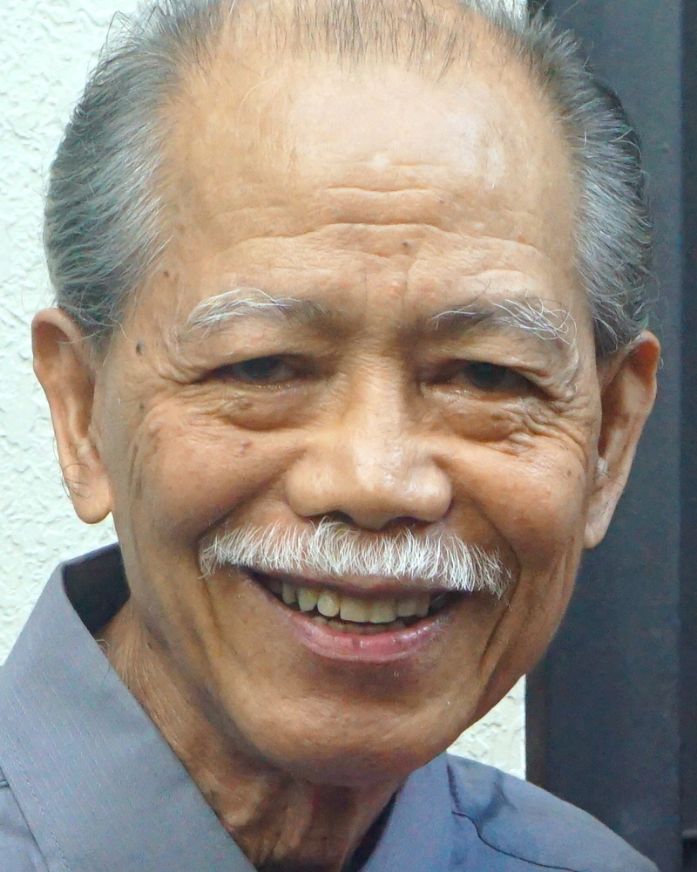
Adult Bible Study Guide
Oct • Nov • Dec 2022
Teacher’s Preview
powerpoint presentation designed by claro ruiz vicente
Notes:
“At malalaman ninyo ang katotohanan, at ang katotohanan ang magpapalaya sa inyo” (Juan 8:32 FSV).

Slide 2
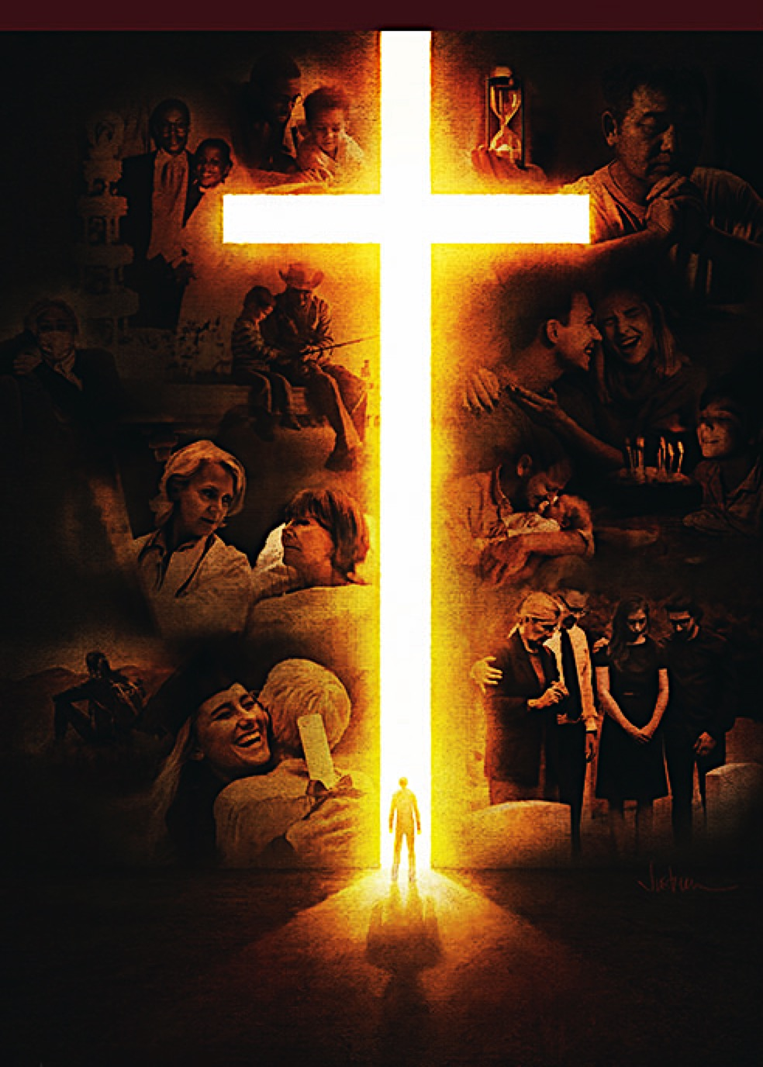
Alberto R. Timm
Principal Contributor
Notes:
Sa Kamatayan, Pag-aagaw-buhay, at ang Kinabukasang Pag-asa.

Slide 3
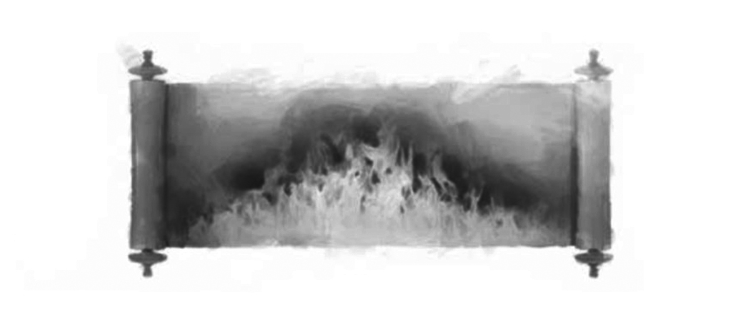
On Death, Dying, and the Future Hope
Lesson 10, December 3, 2022
The Fires of Hell
Notes:
Ang mga Apoy ng Impiyerno

Slide 4
The Fires of Hell
This Week
We will deal with some of these unbiblical theories, as well as with the biblical view of what happens after death.
Notes:
Sa Linggong Ito. Ating patutungkulan ang ilan dito sa mga di-biblikal na teorya, gayundin ang biblikal na pananaw sa kung ano ang nangyayari pagkatapos ang kamatayan.

Slide 5
The Fires of Hell
Key Text
1 Thessalonians 5:21 NKJV
“Test all things; hold fast what is good.”
Notes:
Susing Talata. “Kundi subukin ninyo ang lahat ng mga bagay; panghawakan ninyo ang mabuti” (1 Tesalonica 5:21).

Slide 6
The Fires of Hell
Sabbath Afternoon, November 26
Italian poet Dante Alighieri (1265–1321) wrote his famous work, The Divine Comedy, about a fictional journey of the soul after death. The soul went either to the inferno (hell) within the earth; or to purgatory, where the human spirit can purge itself and become worthy of ascending to heaven; or to Paradise, to the presence of God Himself.
Italian poet Dante Alighieri (1265–1321) wrote his famous work, The Divine Comedy, about a fictional journey of the soul after death.
Notes:
Sabbath ng Hapon, Nobyembre 26. Isinulat ng Italyanong makata na si Dante Alighieri (1265–1321) ang kanyang tanyag ng likahin, The Divine Comedy, tungkol sa isang kathang paglalakbay ng kaluluwa pagkatapos ang kamatayan. ¶ Ang kaluluwa ay nagpunta alinman sa impiyerno sa ilalim ng lupa; o sa purgatoryo, kung saan ang espiritu ng tao ay malilinis ang sarili at magiging marapat sa pag-akyat sa langit; o sa Paraiso, sa harapan ng Diyos mismo.

Slide 7
The Fires of Hell
Sabbath Afternoon, November 26
Though only a poem, fiction, Dante’s words ended up having a great deal of influence on Christian theology, espe-cially Roman Catholic theology. The basic notion of an immortal soul’s going either to hell, or to purgatory, or to Paradise is foundational to that church. Many con-servative Protestant denominations also believe in an immortal soul that after
Though only a poem, fiction, Dante’s words ended up having a great deal of influence on Christian theology, espe-cially Roman Catholic theology. The basic notion of an immortal soul’s going either to hell, or to purgatory, or to Paradise is foundational to that church.
Though only a poem, fiction, Dante’s words ended up having a great deal of influence on Christian theology, espe-cially Roman Catholic theology.
Notes:
Bagaman isangtula lamang at kathang-isip, ang mga salita ni Dante ay nauwing sa pagkakaroon ng napakalaking impluwensya sa Kristiyanong teolohiya, lalo na sa Romano Katolikong teiolohiya. ¶ Ang mahalang pagpapalagay ng pagpunta ng walang kamatayang kaluluwa sa alinmang sa impiyerno o sa purgatoryo, o sa Paraiso ay batayan sa iglesyang ‘yon. ¶ Maraming makalumang mga Protestanteng denominsyon ang naniniwala rin sa isang imortal na kaluluwa na pagkatapos

Slide 8
The Fires of Hell
Sabbath Afternoon, November 26
death ascends either to Paradise or descends to hell. Indeed, if the human soul never dies, then it has to go some- where after the body dies. In short, a false understanding of human nature has led to terrible theological errors.
death ascends either to Paradise or descends to hell. Indeed, if the human soul never dies, then it has to go some- where after the body dies.
death ascends either to Paradise or descends to hell.
Notes:
Mamatay ay umaakyat alinman sa Paraiso o bumababa sa impiyerno. ¶ Tunay nga, kung ang kaluluwa ng tao ay hinding-hindi namamatay, kung gayon kailangang pumunta ito sa isang lugar pagkatapos mamatay ang katawan. ¶ Sa maising salita, isang maling pagkaunawa ng likas ng tao ay umakay sa mga nakatatakot na kamaliang teolohikal.

Slide 9
Sunday, November 27
Immortal Worms?
“If your hand causes you to sin, cut it off. It is better for you to enter into life maimed, rather than having two hands, to go to hell, into the fire that shall never be quenched—where
‘Their worm does not die
And the fire is not quenched’ ”
(Mark 9:43, 44).
Notes:
Linggo, Nobyembre 27. Mga Walang Kamatayang Uod? “Kung ang kamay mo ay nakapagpapatisod sa iyo, putulin mo ito. Mas mabuti pa sa iyo ang pumasok sa buhay na baldado, kaysa may dalawang kamay at mapunta sa impiyerno, sa apoy na hindi mapapatay, na kung saan ang kanilang mga uod ay hindi namamatay, at ang apoy ay hindi napapatay” (Marcos 9:43, 44).

Slide 10
Sunday, November 27
Immortal Worms?
Some interpret the singular noun “worm”(Mark 9:48) as an allusion to the supposed disembodied soul or spirit of the wicked that, after death, flies into hell, where it never dies and suffers eternal torment.
1. Does not reflect the biblical notion of unconscious death. 2. Ignores the Old Testament background of this passage.
Some interpret the singular noun “worm”(Mark 9:48) as an allusion to the supposed disembodied soul or spirit of the wicked that, after death, flies into hell, where it never dies and suffers eternal torment.
1. Does not reflect the biblical notion of unconscious death.
Notes:
May nagpapaliwanag sa pang-isang pandiwang “uod” (Marcos 9:48) na isang pahiwatig sa ipinapalagay na hiwalay sa katawang kaluluwa o espiritu ng masama na, pagkatapos mamatay ay lumilipad sa impiyerno, kung saan hinding-hindi ito mamamatay at nagdurusa ng walang-hanggang pagpapahirap. ¶ 1. Hindi ito sumasalamin sa palagay na walang-malay na kamatayan. ¶ Winawalang-bahala ang Konteksto ng siping ito sa Lumang Tipan.

Slide 11
Sunday, November 27
Immortal Worms?
“ ‘And they will go out and look on the dead bodies of those who rebelled against me; the worms that eat them will not die, the fire that burns them will not be quenched, and they will be loathsome to all mankind’ ” (Isaiah 66:24 NIV). This metaphorical scene portrays a battlefield with God’s enemies dead and being destroyed.
“ ‘And they will go out and look on the dead bodies of those who rebelled against me; the worms that eat them will not die, the fire that burns them will not be quenched, and they will be loathsome to all mankind’ ” (Isaiah 66:24 NIV).
Notes:
“Kung ang kamay mo ay nakapagpapatisod sa iyo, putulin mo ito. Mas mabuti pa sa iyo ang pumasok sa buhay na baldado, kaysa may dalawang kamay at mapunta sa impiyerno, sa apoy na hindi mapapatay, na kung saan ang kanilang mga uod ay hindi namamatay, at ang apoy ay hindi napapatay” (Marcos 9:43, 44). ¶ Ang metaporang tanawing ito’y naglalarawan ng isang larangan ng digmaan na ang mgakaaway ng Diyos ay patay at pinupuksa.

Slide 12
Sunday, November 27
Immortal Worms?
The bodies not consumed by fire are decomposed by worms, or perhaps first by worms and then by fire.
Either way, there is no reference whatsoever to any alleged soul escaping the destruction of the body and flying into hell.
Notes:
Ang mga katawang hindi natupok ng apoy ay binubulok ng mga uod, o marahil una sa pamamagitan ng mgauod at pagkatapos ay ng apoy. ¶ Alinmang paraan, walang anumang pagtukoy sa alinmang sinasabing kaluluwang tinatakasan ang pagwasak ng katawan at lumilipat patungong impiyerno.

Slide 13
Sunday, November 27
Immortal Worms?
The metaphoric language of Isaiah 66:24 does not imply that those worms are im-mortal. The worms do not leave their destructive task incomplete. They conti-nue to devour the bodies of the wicked until these bodies are destroyed. By con-trast, God’s faithful children will joyfully abide in “ ‘the new heavens and the new earth’ ” and worship God in His very
The metaphoric language of Isaiah 66:24 does not imply that those worms are im-mortal. The worms do not leave their destructive task incomplete. They conti-nue to devour the bodies of the wicked until these bodies are destroyed.
The metaphoric language of Isaiah 66:24 does not imply that those worms are im-mortal.
Notes:
Ang metaporikang lengguwahe ng Isaias 66:24 ay hindi nagpapahiwatig na yung mga uod at imortal. ¶ Hindi iniiwan ng mga uod na hindi lubod ang kanilang mapanirang tungkulin. Nagpapatuloy ang mga ito na lamunin ang mga katawan ng masasama hanggang ang mga katawang ito’y malipol.¶ Kataliwas, ang matatapat na anak ng Diyos ay maykagalakang tumatahansa “ ‘ang mga bagong langit at ang bagong lupa’” at sinasamba ang Diyos sa Kanyang pinaka

Slide 14
Sunday, November 27
Immortal Worms?
presence (Isa. 66:22, 23, NIV). With such contrasting destinies in mind, no wonder Jesus stated that it would be far better for someone to enter the kingdom of God without a crucial part of his or her body—without a hand, or foot, or even an eye—than to have a perfect body that will be destroyed by worms and fire (Mark 9:42–48).
presence (Isa. 66:22, 23, NIV).
Notes:
harapan (Isaias 66:22, 23). ¶ Isinasaisip ang gayong magkaibang kapalaran sa isip, hindi kataka-takang sinabi ni Jesus na malayong mas mabutin para sa isa na pumsok sa kaharian ng Diyosna wala ang isang mahalagang bahagi ng kanyang katawan—walang kamay, o paa, at kahit isang mata—kaysa mayroong isang kompletong katawan na lilipulin ng mga uod at apoy.

Slide 15
Monday, November 28
The Fires of Hell
“The day is coming, burning like an oven, and...all who do wickedly will be stubble. And the day which is coming shall burn them up,...That will leave them neither root nor branch” (Mal. 4:1).
“Vengeance of eternal fire” (Jude 7).
“Into the everlasting fire” (Matt. 18:8).
“Fire that shall never be quenched”
(Mark 9:43).
Notes:
Lunes, Nobyembre 28. Ang mga Apoy ng Impiyerno. “Ang araw ay dumarating na gaya ng nagniningas na pugon, na ang lahat ng palalo at lahat ng gumagawa ng masama ay magiging parang ipa, at ang araw na dumarating ang susunog sa kanila, sabi ng Panginoon ng mga hukbo, anupa't hindi mag-iiwan sa kanila ng ugat ni sanga man” (Malakias 4:1). ¶ “Kaparusahan sa apoy na walang hanggan (Judas 7). ¶ “Maitapon sa apoy na walang katapusan” (Mateo 18:8). ¶ “Apoy na hindi mapapatay” (Marcos 9:43).

Slide 16
Monday, November 28
The Fires of Hell
The word “eternal” (Hebrew ‘olam; Greek aion, aionios) carries different meanings, depending on the imme-diate context. For example, when associated with God (Deut. 33:27, “everlasting”), the word expresses His eternity. When related to human beings (Exod. 21:6, “forever”), the word is limited by their life span.
The word “eternal” (Hebrew ‘olam; Greek aion, aionios) carries different meanings, depending on the imme-diate context. For example, when associated with God (Deut. 33:27, “everlasting”), the word expresses His eternity.
The word “eternal” (Hebrew ‘olam; Greek aion, aionios) carries different meanings, depending on the imme-diate context.
Notes:
Ang salitang "walang hanggan” ” (Hebreo ‘olam; Griyego aion, aionios) ay may magkakaibang kahulugan, depende sa pinakamalapit na konteksto. ¶ Halimbawa, kapag nauugnay sa Diyos (Deuteronomio 33:27, “walang hanggan”), ang salita’y naghahayag ng Kanyang kawalang-katapusan. ¶ Kapag nakaugnay sa tao (Exodo 21:6, “fhabambuhay”), ang salita ay limitado nang Kanila haba ng buhay.

Slide 17
Monday, November 28
The Fires of Hell
When qualifying fire (Matt. 18:8, 25:41, “everlasting”), it implies that the fire will not go out until it fully consumes what is being burned. This means that the “eternal fire” will be eternal in the sense that it will consume the wicked com-pletely and irreversibly, leaving them “ ‘neither root nor branch’ ” (Mal. 4:1).
When qualifying fire (Matt. 18:8, 25:41, “everlasting”), it implies that the fire will not go out until it fully consumes what is being burned.
Notes:
Kapag nilalarawan ang apoy (Mateo 18:8, 25:41, “walang katapusan”) nagpapahiwatig ito na ang apoy ay hindi mamamatay hanggang lubos nitong natutupok ang sinusunog. ¶ Nangangahulugan itong ang “walang-hanggang apoyay maging walang katapusan sa isipang tutupukin nito ang masasama nang lubos at permanente, “ ‘hindi mag-iiwan sa kanila ng ugat ni sanga man’ ” (Malakias 4:1).

Slide 18
The Fires of Hell
Serious implications
1. If the wicked are punished forever, then evil will never be eradicated.
2. All human life derives from God (Deut. 32:39, Ps. 36:9), who has “ ‘ “no pleasure in the death of the wicked” ’ ” (Ezek. 33:11).
Notes:
Mga Seryosong Implikasyon. 1. Kung ang masasama ay parurusahang magpakailanman, kung gayon ang kasamaan ayhinding-hindi malilipol. ¶ 2. Lahat ng buhay ng tao’y nagmumulasa Diyos (Deuteronomio 32:39, Awit 36:9), na “ ‘ “walang kasiyahan sa kamatayan ng masama” ’ ” (Ezekiel 33:11).

Slide 19
The Fires of Hell
Serious implications
Why then would He continue to grant life to the wicked to suffer in endless torment? Would it not be much more reasonable for Him just to end their existence? If the wicked will be punished “according to their works” (Rev. 20:12), why then should a short human life be punished endlessly?
Why then would He continue to grant life to the wicked to suffer in endless torment? Would it not be much more reasonable for Him just to end their existence?
Why then would He continue to grant life to the wicked to suffer in endless torment?
Notes:
Bakit kung gayon Siya’y patuloy na magkakaloob ng buhay sa masasama upang magdusa sa walang-katapusang pagpapahirap? ¶ Hindi ba magiging mas higit na makatwiran para sa Kanya na tapusin na lamang angkanilang pag-iral? ¶ Kung ang masasama ay parurusahan “ayon sa kanilang mga gawa” (Apocalipsis 20:12), bakit kung gayon ang isangmaigsing buhay ng tao’y parurusahan nang walang katapusan?

Slide 20
The Fires of Hell
Serious implications
All Bible references to the “eternal fire” should be seen as allusions to the postmillennium “lake of fire” of Revelation 20.
Thus, it is unbiblical to speak of an already-present, ever-burning hell.
Notes:
Lahat ng reperensya sa “wlang-hanggang apoy” ay dapat na tingnan bilang pagtukoy sa matapos ang milenyong “dagat-dagatang apoy” ng Apocalipsis 20. ¶ Sa gayon, hindi bibilikal ang magsalita ng isang naririto-na at nagpapatuloy na nag-aapoy na impiyerno.

Slide 21
Tuesday, November 29
The Saints in Purgatory
“All who die in God’s grace and friend-ship, but still imperfectly purified, are indeed assured of their eternal salva-tion; but after death they undergo purification, so as to achieve the holiness necessary to enter the joy of heaven.”—Catechism of the Catholic Church 291.
Notes:
Martes, Nobyembre 29. Mga mga Banal sa Purgatoyo. “Lahat nang mamamatay sa biyaya at pagkakaibigan ng Diyos, subalit hindi pa lubusang nadadalisay, ay tunay na nakakatiyak ng kanilang walang-hanggang kaligtasan; subalit magkatapos mamatay ay sumasailalim sila sa pagdadalisay, upang sa gayon ay matamo ang kabanalang kinakailangan upang pumasok sa kagalakan ng langit.” —Catechism of the Catholic Church 291.

Slide 22
Tuesday, November 29
The Saints in Purgatory
“The Church also commends alms-giving, indulgences, and works of penance undertaken on behalf of the dead.”—Ibid.
The dogma of purgatory combines the pagan notion of a burning hell with the pagan practice of praying for the dead.
Notes:
“
Ang Simbahan ay pinapupurihan din ang paglilimos, mga indulhensya, at mga gawa ng penitensiya na ginagawa para sa kapakanan ng patay.”—Ibid. ¶ Ang aral ng purgatoryo ay pinagsasama ang pagpapalagay ng isang nag-aapoy ng impiyerno sa paganong gawi ng pananalangin para sa patay.

Slide 23
The Saints in Purgatory
Boblical Teachings
(1) The dead remain resting unconsciously in their graves.
“There is no work or device or knowledge or wisdom in the grave where you are going” (Eccl. 9:10).
(2) Our only Mediator is Jesus Christ.
“For there is one God and one Mediator between God and men, the Man Christ Jesus” (1 Tim. 2:5).
Notes:
Mga Katuruang Bibilikal. (1) Ang patay ay nananatiling walang malay sa kanilang libingan. ¶ “Walang gawa, kaisipan, kaalaman, ni karunungan man sa Sheol, na iyong patutunguhan” (Eklesiastes 9:10). ¶ (2) Si Jesu Cristo lamang ang ating Tagapamagitan. ¶ “Sapagkat may isang Diyos at may isang tagapamagitan sa Diyos at sa mga tao, ang taong si Cristo Jesus” (1 Timoteo 2:5).

Slide 24
The Saints in Purgatory
Boblical Teachings
(3) The righteousness of one fallen human being cannot be transferred to another fallen human being.
“The righteousness of the righteous shall be upon himself, and the wickedness of the wicked shall be upon himself” (Eze. 18:20).
Notes:
(3) Ang katuwiran ng isang nagkasalang tao ay hindi maililipat sa isa pang nagkasalang tao. ¶ “Ang katuwiran ng matuwid ay sasakanya, at ang kasamaan ng masama ay sasakanya” (Ezekiel18:20).

Slide 25
The Saints in Purgatory
Boblical Teachings
(4) Death is followed by the final judgment, without any second chance to repent from the pitfalls of this life.
“And as it is appointed for men to die once, but after this the judgment”
(Heb. 9:27).
Notes:
(4) Ang kamatayan ay sinusundan ng pangwakas na paghuhukom, na walang ikalawang pagkakatao upang magsisi mula sa mga patibong ng buhay na ito. ¶ “At yamang itinakda sa mga tao ang mamatay na minsan, at pagkatapos nito ay ang paghuhukom” (Hebreo 9:27).

Slide 26
The Saints in Purgatory
Distorts God’s Character
“The idea of an eternally burning hell was the production of Satan; purga-tory is his invention. These teachings falsify the character of God, that He shall be regarded as severe, revenge-ful, arbitrary, and not exercising forgiveness.”—Manuscript 51, 1890.
Notes:
Binabaluktot ang Karakter ng Diyos. “Ang isipann ng isang walang-hanggang apoy na nagliliyab ay ang likha ni Satanasl ang purgatoyo ay kanyang imbensiyon. Ang mga katuruangito’y nagpapasinungaling sa karakter ng Diyos, na Siya’y ituturing na mabagsik, mapaghiganti, at hindi nagpapatawad.”—Manuscript 51, 1890.

Slide 27
Wednesday, November 30
A Paradise With Disembodied Souls
Though Protestants don’t accept purgatory, many nevertheless believe that the souls of the righteous dead are already enjoying Paradise in the very presence of God. Some argue that those “souls” are just disem-bodied spirits; others believe they are disembodied spirits but covered by a spiritual body of glory.
Though Protestants don’t accept purgatory, many nevertheless believe that the souls of the righteous dead are already enjoying Paradise in the very presence of God. Some argue that those “souls” are just disem-bodied spirits;
Though Protestants don’t accept purgatory, many nevertheless believe that the souls of the righteous dead are already enjoying Paradise in the very presence of God.
Notes:
Miyerkules, Nobyembre 30. Isang Paraisong May mga Kaluluwang Walang Katawan. Bagaman ang mga Protestante ay hindi tinatanggap ang purgatoryo, marami ang gayunama’y naniniwala ang ang mga kaluluwa ng matuwid na patay ay tinatamasa na ang Paraiso sa pinakapresensya ng Diyos. ¶ May nangangatwiran na yung “mga kaluluwa” ay mga espiritung walang katawan lamang; ¶ ang iba’y naniniwalang ang mga ito’y mga espiritung walang katawan kundi nababatultan sa pamamagitan sa espirituwal na katawan ng kaluwalhatian.

Slide 28
A Paradise With Disembodied Souls
Revelation 20:12
“And I saw the dead, small and great, standing before God, and books were opened. And another book was opened, which is the Book of Life. And the dead were judged according to their works....”
Why is there a resurrection and a judgment if the souls of the righteous are already enjoying Paradise?
Notes:
Apocalispis 20:12. “At nakita ko ang mga patay, mga dakila at mga hamak, na nakatayo sa harapan ng trono, at binuksan ang mga aklat. Binuksan din ang isa pang aklat, ang aklat ng buhay. At ang mga patay ay hinatulan ayon sa kanilang mga gawa....” ¶ Bakit may biling pagkabuhay at paghuhukom kung ang mga kaluluwa ng matutuwid ay tinatamasa na ang Paraiso?

Slide 29
A Paradise With Disembodied Souls
Acts 2:29, 34, 35
²⁹ “Let me speak freely to you of the patriarch David, that he is both dead and buried, and his tomb is with us to this day. ... ³⁴ “For David did not ascend into the heavens, but he says himself:
‘The Lord said to my Lord, “Sit at My right hand, ³⁵ Till I make Your enemies Your footstool.” ’ ”
Notes:
Mga Gawa 2:29, 34, 35. ²⁹ “Mga kapatid, may tiwalang masasabi ko sa inyo ang tungkol sa patriyarkang si David. Siya rin ay namatay at inilibing, at nasa atin ang kanyang libingan hanggang sa araw na ito. ... ³⁴ Sapagkat hindi umakyat si David sa mga langit, ngunit siya rin ang nagsabi, ¶ ‘Sinabi ng Panginoon sa aking Panginoon; “Maupo ka sa kanan ko, ³⁵ hanggang sa gawin ko ang mga kaaway mo na tuntungan ng iyong mga paa.” ’ ”

Slide 30
Wednesday, November 30
A Paradise With Disembodied Souls
The Bible teaches that all human beings who are already in heaven were either translated alive, as in the case of Enoch (Gen. 5:24) and Elijah (2 Kings 2:9–11),
or resurrected from the dead, as Moses (Jude 9) and those raised with Christ (Matt. 27:51–53).
Notes:
Miyerkules, Nobyembre 30. Isang Paraisong May mga kaluluwang Walang Katawan. Nagtuturo ang Biblia na lahat ng taong nasa langit na au alinamang nailipat nang buhay, gaya ng kaso ni Enoc (Genesis 5:24) at Elias (2 Mga Hari 2:9–11), ¶ o muling binuhay mula sa pataym gaya ni Moises (Judas 9) at yung mga binangon kasamasi Cristo (Mateo 27:51–53).

Slide 31
A Paradise With Disembodied Souls
1 Corinthians 15:16-18
¹⁶ “For if the dead do not rise, then Christ is not risen. ¹⁷ And if Christ is not risen, your faith is futile; you are still in your sins! ¹⁸ Then also those who have fallen asleep in Christ have perished.” How could they have perished if they are already in the bliss of heaven and have been there for however long since they died?
¹⁶ “For if the dead do not rise, then Christ is not risen. ¹⁷ And if Christ is not risen, your faith is futile; you are still in your sins! ¹⁸ Then also those who have fallen asleep in Christ have perished.”
Notes:
1 Corinto 15:16-18. ¹⁶ “Sapagkat kung ang mga patay ay hindi muling binubuhay, si Cristo man ay hindi muling binuhay. ¹⁷ Kung si Cristo ay hindi muling binuhay, ang inyong pananampalataya ay walang kabuluhan, kayo'y nananatili pa rin sa inyong mga kasalanan. ¹⁸ Kung gayon, ang mga namatay[a] kay Cristo ay napahamak.” Paanong sila’y namatay kung sila na ay nasa kagalakan ng langit at naroroon na gaanuman katagal mula nang sila’y namatay?

Slide 32
A Paradise With Disembodied Souls
1 Corinthians 15:16-18
A central and key doctrine of the New Testament, the resurrection of the dead when Christ returns, is made null and void by the false teaching that the righteous dead soar off to their eternal reward right after they die.
Notes:
1 Corinto 15:16-18. Isang sentro at susing doktrina ng Bagong Tipan, ang muling pagkabuhay ng mga patay kapag bumalik si Cristo, ay ginagawang walang bisa sa pamamgitan ng maling katuruan na ang matuwid na patay ay papailanglang sa kanialng walang-hanggang gantimpala pagkatapos-na-pagkatapos na sila’y mamatay.

Slide 33
Thursday, December 1
The Biblical View
“And this is the testimony: that God has given us eternal life, and this life is in His Son. He who has the Son has life; he who does not have the Son of God does not have life” (1 John 5:11, 12).
The biblical doctrine of conditional im-mortality of humans—in contrast to the nonbiblical theory of the natural im-mortality of the soul—is explicit here.
Notes:
Huwebes, Disyembre 1. ang Biblikal na Pananaw. “ ‘At ito ang patotoo, na tayo'y binigyan ng Diyos ng buhay na walang hanggan at ang buhay na ito ay nasa kanyang Anak. Ang kinaroroonan ng Anak ay kinaroroonan ng buhay; ang hindi kinaroroonan ng Anak ng Diyos ay hindi kinaroroonan ng buhay” (1 Juan 5:11, 12). ¶ Ang biblikal na doktrina ng may kondisyong imortalidad ng tao—kataliwas sa di-bibikal na teorya ng natural na imortalidad ng kaluluwa—ay malinaw rito.

Slide 34
Thursday, December 1
The Biblical View
To grasp the meaning of this significant passage, we have to remember that only the
Godhead “has immortality”
(1 Tim. 6:15, 16)
and is the only
Source of life
(Ps. 36:9, Col. 1:15–17, Heb. 1:2).
Notes:
Upang maunawaan ang kahulugan nitong mahalagang sipi, kailangan nating tandaan na ang ¶ Kadiyosan lamang ang “may imortalidad (11 Tim. 6:15, 16) ¶ at Pinagmumulan lamang ng buhay (Awit 36:9, Colosas 1:15–17, Hebreo 1:2).

Slide 35
Thursday, December 1
The Biblical View
When sin entered the world through the fall of Adam and Eve, they and all their descendants (including us) came under the curse of physical death and lost the gift of eternal life. But our loving God implemented the plan of salvation for human beings to regain eternal life, the life that was to have been theirs from the start.
When sin entered the world through the fall of Adam and Eve, they and all their descendants (including us) came under the curse of physical death and lost the gift of eternal life.
Notes:
Nang pumasok ang kasalanan sa sanlibutan sa pamamagitan ng pagkakasala nina Adan at Eva, sila at lahat ng kanilang mga inapo (kabilang tayo) ay napailalim sa sumpa ng pisikal na kamatayan at pagkawala ng regalo ng buhay na walang hanggan. ¶ Subalit ang ating maibiging Diyos ay nagpatupad ng panukala ng kaligtasan para sa tao upang mabawi ang buhay na walanghanggan, ang buhay na kanila sana mula sa pasimula.

Slide 36
Thursday, December 1
The Biblical View
“Just as through one man [Adam] sin entered the world, and death through sin,” so through “the one Man, Jesus Christ,” the gift of eternal life became available to all (Rom. 5:12–21). This means that eternal life is a gift of God through Christ, which is secured in the present but fully enjoyed only after the final resurrection of the righteous.
“Just as through one man [Adam] sin entered the world, and death through sin,” so through “the one Man, Jesus Christ,” the gift of eternal life became available to all (Rom. 5:12–21).
Notes:
“Kaya't kung paanong sa pamamagitan ng isang tao [Adan] ay pumasok ang kasalanan sa sanlibutan, at sa pamamagitan ng kasalanan ay ang kamatayan,” gayundin sa pamamagitan “ng isa, si Jesu-Cristo,” ang regalo ng buhay na walang hanggan ay naging makukuha ng lahat (Roma 5:12–21). ¶ Nangangahulugan ito na ang buhay na walanghanggan ay isang regalo ng Diyos sa pamamagitan ni Cristo, na natiyak sa kasalukuyan subalit lubos na matatamasa lamang pagkatapos ng pangwakas na muling pagkabuhay ng mga matuwid.

Slide 37
The Biblical View
The Simple Conclusion
If everlasting life is granted only to those who are in Christ, then those who are not in Him do not have ever-lasting life. By contrast, the theory of the natural immortality of the soul grants everlasting life—whether in Paradise or in hell—to all, even to those who are not in Christ. However popular this teaching, it is not biblical.
If everlasting life is granted only to those who are in Christ, then those who are not in Him do not have ever-lasting life. By contrast, the theory of the natural immortality of the soul grants everlasting life—whether in Paradise or in hell—to all, even to those who are not in Christ.
If everlasting life is granted only to those who are in Christ, then those who are not in Him do not have ever-lasting life.
Notes:
Ang Simpleng Konklusyon. Kung walanghanggang buhay ay ipagkakaloob lamang sa mga nakay Cristo, kung gayon yung wala sa Kanya ay walang buhay na walang hanggan. ¶ Kataliwas, ang teorya ng natural na imortalidad ng kaluluwa ang nagbibigay ng buhay na walang hanggan—kahiman sa Paraiso o impiyerno—sa lahat, kahit yung wala kay Cristo. ¶ Gaanuman ka popular ang katuruang ito,hindi ito biblikal.

Slide 38
Friday, December 2
Further Thought: The Great Controversy 545.
“Upon the fundamental error of natural immortality rests the doctrine of cons-ciousness in death—a doctrine, like eter-nal torment, opposed to the teachings of the Scriptures, to the dictates of reason, and to our feelings of humanity. Accor-ding to the popular belief, the redeemed in heaven are acquainted with all that takes place on the earth and especially
“Upon the fundamental error of natural immortality rests the doctrine of cons-ciousness in death—a doctrine, like eter-nal torment, opposed to the teachings of the Scriptures, to the dictates of reason, and to our feelings of humanity.
Notes:
Biyernes, Disyembre 1. Karagdagang Isipan. The Great Controversy 545.
“Nakasalalay sa pangunahing kamalian ng natural na imortalidad ang doktrina ng pagiging may malay sa kamataya—isang doktrina, gaya ng walang katapusang pagpapahirap, salungat sa mga katuruan ng Kasulatan, sa atas ng katwiran, at ang ating mga damdamin ng sangkatauhan. ¶ Ayon sa popula na paniniwala, ang natubos sa langit ay nalalaman ang lahat nang nagyayari sa lupa lao na

Slide 39
Friday, December 2
Further Thought: The Great Controversy 545.
with the lives of the friends whom they have left behind. But how could it be a source of happiness to the dead to know the troubles of the living, to witness the sins committed by their own loved ones, and to see them enduring all the sor-rows, disappointments, and anguish of life? How much of heaven’s bliss would be enjoyed by those who were hovering
with the lives of the friends whom they have left behind. But how could it be a source of happiness to the dead to know the troubles of the living, to witness the sins committed by their own loved ones, and to see them enduring all the sor-rows, disappointments, and anguish of life?
with the lives of the friends whom they have left behind.
Notes:
sa buhay ng kanilang mga kaibigan na iniwan nila. Subalit paano ito na magiging panggagalingan ng kaligayahan sa patay na nalalaman ang mga kabagabagan ng nabubuhay, upa masaksihan ang mga kasalanang nagawa ng sarili nilang mahal sa buhay, at upang makita sila na pinagtitiisan ang mga kalungkutan, pagkabigo, at dalamhati ng buahy? ¶ Gaano karami ng kagalakan ng langi ang matatamasa nang mga umaali-aligid

Slide 40
Friday, December 2
Further Thought: The Great Controversy 545.
over their friends on earth? And how utterly revolting is the belief that as soon as the breath leaves the body the soul of the impenitent is consigned to the flames of hell! To what depths of anguish must those be plunged who see their friends passing to the grave unprepared, to enter upon an eternity of woe and sin!”
Notes:
Sa kanilang mga kaibigan sa lupa? At paanong lubos na kasuklam-suklam ang paniniwala na karakarakang iiwan ng hininga ang katawan ang kaluluwa ng di-nagsisisi ay ipadadala sa mga apoy ng impiyerno! ¶ Sa anung lalim ng dalamhati ilalaglag sila na nakikita nag kanilang mga kaibigan lilipat sa libingan na hindi handa, upang pumasok sa isang walang katapusang kaswian at kasalan!”

Slide 41
The Fires of Hell
Outline for Teaching
1. In Hell and Purgatory
a. Sun. Immortal Worms? Mark 9:48. b. Mon. Eternal Fire. Mal. 4:1.
c. Tue. Saints in Purgatory. Heb. 9:27.
2. In Paradise
Wed. Enjoying Paradise? Rev. 20:12.
3. The Biblical View
Thu. Eternal Life. 1 John 5:12.
Notes:
Balangkas para sa Pagtuturo.
Sa Impiyerno at Purgatoryo
a. Linggo. “Walang Kamatayang mga Uod? Marcos 9:48.
b. Lunes. Walang–hanggang Apoy. Malakias 4:1.
c. Martes. Mga Banal sa Purgatoryo. Hebreo 9:7.
(2) Sa Paraiso
Miyerkules. Nagtatamasa sa Paraiso? Apocalipsis 20:12.
(3) Ang Pananaw ng Biblia
Huwebes. Walang-Hanggang Buhay. 1 Juan 5:12.

Slide 42
The Fires of Hell
Presentation Record
1. PAA ‘77 Dev. 27 Nov 22 via Messenger chat room

