Slide 1
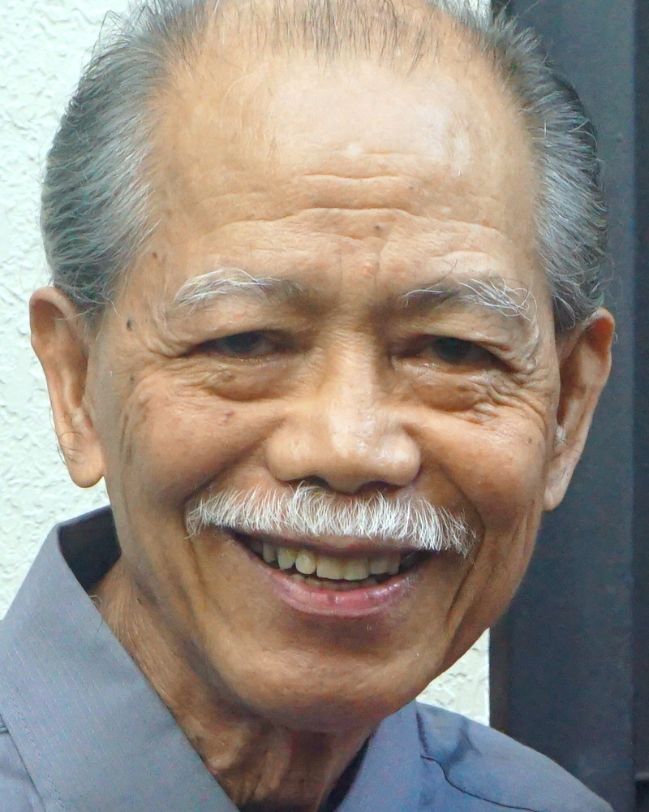
Adult Bible Study Guide
Oct • Nov • Dec 2022
Teacher’s Preview
powerpoint presentation designed by claro ruiz vicente
Notes:
“At malalaman ninyo ang katotohanan, at ang katotohanan ang magpapalaya sa inyo” (Juan 8:32 FSV).

Slide 2
Alberto R. Timm
Principal Contributor
Notes:
Sa Kamatayan, Pag-aagaw-buhay, at ang Kinabukasang Pag-asa.

Slide 3
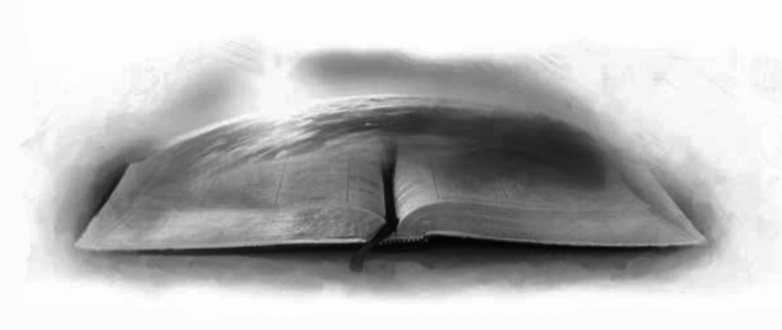
On Death, Dying, and the Future Hope
Lesson 12, December 17, 2022
Biblical Worldview
Notes:
Ang Biblikal na Pananaw sa Mundo

Slide 4
Biblical Worldview
Key Text
1 Thessalonians 5:23 NKJV
“Now may the God of peace Himself sanctify you completely; and may your whole spirit, soul, and body be preserved blameless at the coming of our Lord Jesus Christ.”
Notes:
Susing Talata. “Pakabanalin nawa kayong lubos mismo ng Diyos ng kapayapaan; at ang inyong espiritu at kaluluwa at katawan ay ingatang buo, na walang kapintasan sa pagdating ng ating Panginoong Jesu-Cristo” (1 Tesalonica 5:23).

Slide 5
Biblical Worldview
Sabbath Afternoon, December 10
The book of Revelation speaks of two major “globalizations” prior to the second coming of Christ. Revelation 13 describes the globalization of error, when “all the world” will marvel and follow the beast from the sea (Rev. 13:3, 7, 8, 12, 16). Revelation 14 highlights the globalization of truth, when the “ever-lasting gospel” will be preached “to
The book of Revelation speaks of two major “globalizations” prior to the second coming of Christ. Revelation 13 describes the globalization of error, when “all the world” will marvel and follow the beast from the sea (Rev. 13:3, 7, 8, 12, 16).
The book of Revelation speaks of two major “globalizations” prior to the second coming of Christ.
Notes:
Sabbath ng Hapon, Disyembre 10. Ang Aklat ng Apocalipsis ay nagsasalita ng dalawang pangunahing “globalisasyon” bago sa ikalawang pagdating ni Cristo. ¶ Inilalarawan ng Apocalipsis ang globalisasyon ng kamalian, nang ang “lahat ng sanlibutan” ay mamamangha at susunod sa halimaw mula sa dagat (Apocalipsis 7, 8, 12, 16). ¶ Itinatampok ng Apocalipsis 14 ang globalisasyon ng katotohanan, nang ang ‘walang-hanggang ebanghelyo” ay ipangangaral “sa

Slide 6
Biblical Worldview
Sabbath Afternoon, December 10
every nation, tribe, tongue, and people”
(Rev. 14:6, 7). During those “distressing times” (2 Tim. 3:1, NRSV), “every wind of doctrine” will be blowing (Eph. 4:14), and people will “turn away from listen-ing to the truth and wander away to myths” (2 Tim. 4:4, NRSV). “Through the two great errors, the immortality of the soul and Sunday sacredness, Satan will
every nation, tribe, tongue, and people”
(Rev. 14:6, 7). During those “distressing times” (2 Tim. 3:1, NRSV), “every wind of doctrine” will be blowing (Eph. 4:14), and people will “turn away from listen-ing to the truth and wander away to myths” (2 Tim. 4:4, NRSV).
every nation, tribe, tongue, and people”
(Rev. 14:6, 7).
Notes:
lahat ng bansa, lipi, wika, at bayan” (Apocalipsis 14:6, 7). ¶ Habang yung “mga panahon ng kapighatian” (2 Timoteo 3:1),” bawat hangin ng aral” ay iihip (Efeso 4:14), at ang tao ay “tatalikod sa pakikinig sa katotohanan ang kanilang mga tainga, at babaling sa mga kathang-isip” (2 Timoteo 4:4). ¶ “Sa pamamagitan ng dalawang malalaking mga kamalian, ang imortalidad ng kaluluwa at kabanalan ng Linggo, si Satanas ay

Slide 7
Biblical Worldview
Sabbath Afternoon, December 10
bring the people under his deceptions.
While the former lays the foundation of spiritualism, the latter creates a bond of sympathy with Rome.”—The Great Controversy 588.
Notes:
dadalhin ang tao sa ilalim ng kanyang mga panlilinlang. Samantalang ang una ay naglalagay ng pundasyon ng espirituwalismo, ang huli ay lumilikha ng isang tali ng simpatiya sa Roma.”—The Great Controversy 588.

Slide 8
Sunday, December 11
The Model of Jesus: The Desire of Ages 68, 69
Jesus was the perfect Human Being, and His growth comprised all basic dimen-sions of human existence. Luke 2:52 says “Jesus grew in wisdom [mentally] and stature [physically], and in favor with God [spiritually] and man [socially]” (NIV).
“His mind was active and penetrating, with a thoughtfulness and wisdom be-yond His years. Yet, His character was
Jesus was the perfect Human Being, and His growth comprised all basic dimen-sions of human existence.
Notes:
Linggo, Disyembre 11. Ang Huwaran ni Jesus: The Desire of Ages 68, 69. Si Jesus ang sakdal na Tao, at ang Kanyang paglago ay binubuo ang lahat ng mahahalagang askpeto ng pag-iral ng tao. ¶ Sinasabi ng Lucas 2:52 “Lumago si Jesus sa karunungan, [mental] sa pangangatawan, [pisikal], at naging kalugud-lugod sa Diyos [espirituwal] at sa mga tao [sosyal].” ¶ “Ang Kanyang pag-iisip ay aktibo at matindi, may isang pagkamaalalahanin at dunong na higit sa Kanyang edad. Gayunman, ang Kanyang karakter ay

Slide 9
Sunday, December 11
The Model of Jesus: The Desire of Ages 68, 69
beautiful in its symmetry. The powers of mind and body developed gradually, in keeping with the laws of childhood. ...
His willing hands were ever ready to serve others. He manifested a patience that nothing could disturb, and a truth-fulness that would never sacrifice integ-rity. In principle firm as a rock, His life revealed the grace of unselfish courtesy.”
beautiful in its symmetry. The powers of mind and body developed gradually, in keeping with the laws of childhood. ...
His willing hands were ever ready to serve others.
beautiful in its symmetry.
Notes:
napakaganda sa kanyang pagkakabalase. ¶ Ang mga kapangyarihan ng isip at katawan ay unti-unting lumago, sa pagsunod sa mga batas ng pagkabata. ... ¶ Ang mga nahahanda Niyang mga kamay ay laging handa upang paglingkuran ang iba. ¶ Nagpakita Siya ng isang pagtiyagang walang makagagambala, at ang isang pagkamatapat na hinding-hindi isasakrepisyo ang integridad. Sa prinsipyo ay matatag gaya ng isang bato, ang Kanyang buhay ay naghayag ng biyaya ng di-makasariling paggalang.”

Slide 10
Sunday, December 11
The Model of Jesus
“And Jesus went about all Galilee, teaching in their synagogues, preaching the gospel of the kingdom, and healing all kinds of sickness and all kinds of disease among the people” (Matt. 4:23).
If we recognize that a human being is an integrated and indivisible person, then we cannot restrict our religion to spiritual matters only. The truth actually embra-
“And Jesus went about all Galilee, teaching in their synagogues, preaching the gospel of the kingdom, and healing all kinds of sickness and all kinds of disease among the people” (Matt. 4:23).
If we recognize that a human being is an integrated and indivisible person, then we cannot restrict our religion to spiritual matters only.
Notes:
“At nilibot ni Jesus ang buong Galilea, na nagtuturo sa mga sinagoga nila, at ipinangangaral ang ebanghelyo ng kaharian, at nagpapagaling ng lahat ng sakit at ng lahat ng karamdaman na nasa mga tao” (Mateo 4:23). ¶ Kung ating kikilalanin na ang isang tao ay isang pinagsamasama at di-mahahating persona, kung gayon hindi natin matatakdaan ang ating relihiyon sa espirituwal na bagay lamang. ¶ Ang latotohanan ay talagang nayayakap

Slide 11
Sunday, December 11
The Model of Jesus
ces our whole being, covers our entire life span, and comprises all dimensions of our life. Our physical and spiritual elements are so powerfully integrated that they really cannot be separated.
And though, as fallen beings, we will never be equal to the depiction of Jesus as presented above, we are by God’s grace to emulate it because “to restore
ces our whole being, covers our entire life span, and comprises all dimensions of our life.
Notes:
ang buong pagkatao natin, sinasaklaw ang ating buong buhay. ¶ Ang ating pisikal at espirituwal na mga elemento ay napakamakapangyarihang pinagsamasama na ang mga ito’y hindi mapaghihiwalay. ¶ At bagama’t, bilang mga nagkasalang nilalang, hinding-hindi tayo magiging kapantay sa pagkakalarawan ni Jesus gaya nang pagkakahayag sa itaas, tayo sa pamamagitan ng biyaya ng Diyos ay tutularan ito dahil “upang isauli

Slide 12
Sunday, December 11
The Model of Jesus
in man the image of his Maker, to bring him back to the perfection in which he was created, to promote the develop-ment of body, mind, and soul” (Education 15, 16) is the work of redemption. This is what God seeks to do in His people as part of the process to prepare them for His return.
in man the image of his Maker, to bring him back to the perfection in which he was created, to promote the develop-ment of body, mind, and soul” (Education 15, 16) is the work of redemption.
Notes:
sa tao ang larawan ng kanyang Lumalang, upang ibalik siya sa kasakdalan ng pagkakalikha sa kanya, upang isulong ang pag-unlad ng kayang katawan, isip, at kaluluwa” (Education 15, 16) ay ang gawain ng katubusan. ¶ Ito ang hinahangad ng Diyos na gagawin sa Kanyang bayan bilang bahagi ng proseso upang ihanda sila para sa Kanyang pagbabalik.

Slide 13
Monday, December 12
The Body as a Temple
1. The dualistic theory of a mortal body with an immortal soul has generated various theories about the human body.
Ancient Greek Philosophers: the prison of the soul liberated by death.
Echoed by Christians—the temporal housing of the immortal soul, which will be reintegrated with the body at the resurrection.
Notes:
Lunes, Disyembre 12. Ang Katawan bilang isang Templo. Ang pandalawahang teorya ng isang mortal na katawan na may imortal na kaluluwa ay lumikha ng iba’t-ibang mga teorya tungkol sa katawan ng tao. ¶ 1. Mga Matatandang Griyegong Pilosopo: ang pagkabilanggo ng kaluluwa ay napalaya sa pamamagitan ng kamatayan. ¶ Inulit ng mga Kristiyano—ang pansamantalang pagpapabahay ng imortal na kaluluwa, na maisasama sa katawan sa muling pagkabuhay.

Slide 14
The Body as a Temple
Dualistic Theory
2. Pantheists: the human body is divine; they believe that God and the universe are one and the same.
All things are God and the human body is part of the one single, integrated, and universal divine substance.
Notes:
2. Mga Panteista: ang katawan ng tao ay banal; naniniwala sila na ang Diyos at ang sansinukob at iisa at magkatulad. ¶ Lahat ng mga bagay ay Diyos at ang katawan ng tao ay bahagi nung isang nag-iisa, pinagsamasama, at panlahat na banal na sangkap.

Slide 15
The Body as a Temple
1 Corinthians 6:19, 20; 10:31
“Or do you not know that your body is the temple of the Holy Spirit who is in you, whom you have from God, and you are not your own? For you were bought at a price; therefore glorify God in your body and in your spirit, which are God’s.”
“Therefore, whether you eat or drink, or whatever you do, do all to the glory of God.”
Notes:
1 Corinto 6:19, 20; 10:31. “O hindi ba ninyo nalalaman na ang inyong katawan ay templo ng Espiritu Santo na nasa inyo, na tinanggap ninyo mula sa Diyos, at kayo ay hindi sa inyong sarili? Sapagkat kayo'y binili sa isang halaga, kaya't luwalhatiin ninyo ng inyong katawan ang Diyos” (1 Corinto 6:19, 20). ¶ “Kaya kung kayo man ay kumakain, umiinom, o anuman ang inyong ginagawa, gawin ninyo ang lahat sa ikaluluwalhati ng Diyos” (1 Corinto 10:31).

Slide 16
The Body as a Temple
Marred and Restored
Adam and Eve were created in God’s own image and likeness (Gen. 1:26, 27), which was reflected in their character and phy-sical aspect. Because that image was marred by sin, the work of redemption is to restore them, including their physical health, to their original condition. This restoration is a lifetime process com-pleted only at Christ’s second coming.
Adam and Eve were created in God’s own image and likeness (Gen. 1:26, 27), which was reflected in their character and phy-sical aspect. Because that image was marred by sin, the work of redemption is to restore them, including their physical health, to their original condition.
Adam and Eve were created in God’s own image and likeness (Gen. 1:26, 27), which was reflected in their character and phy-sical aspect.
Notes:
Nasira at Naisauli. Sina Adan at Eva ay nilikha sa sariling larawan at wangis ng Diyos (Genesis 1:26, 27), na naipakita sa kanilang karakter at askpetong pisikal. ¶ Dahil ang larawang ‘yon ay nasira ng kasalanan, ang gawain ng katubusan ay upang isauli ang mga ito, kabilang ang pisikal na kalusugan, sa kanilang orihinal na katayuan. ¶ Ang pagsasauling ito’y isang panghabambuhay na proseso na malulubos lamang sa ikalawang pagparito ni Cristo.

Slide 17
The Body as a Temple
Marred and Restored
“I pray that all may go well with you and that you may be in good health, just as it is well with your soul” (3 John 1:2 NRSV).
If we recognize that a human being is an indivisible entity, and that religion embraces all aspects of human life, then we should consider the protection of our physical health also to be a religious duty.
“I pray that all may go well with you and that you may be in good health, just as it is well with your soul” (3 John 1:2 NRSV).
If we recognize that a human being is an indivisible entity, and that religion embraces all aspects of human life, then we should consider the protection of our physical health also to be a religious duty. “Do all to the glory of God.”
Notes:
“Aking idinadalangin na sa lahat ng mga bagay ay mapabuti ka at magkaroon ng kalusugan, kung paanong nasa mabuti ring kalagayan ang iyong kaluluwa.” (3 Juan 1:2). ¶ Kung ating kinikilala na ang tao ay isang di-mahahating katauhan, at na ang relihiyon ay sinasakop ang lahat ng askpeto sa buhay ng tao, kung gayon ating dapat na isaalang-alang din ang pag-iingat ng ating pisikal na kalusugan upang maging isang relihiyosong tungkulin. ¶ “Gawin lahat sa ikaluluwalhati ng Diyos.”

Slide 18
Tuesday, December 13
The Mind of Christ
Some people believe that by changing the environment the individual will be transformed. Definitely, we should avoid places and circumstances that can make us more vulnerable to temptation (Ps. 1:1). But our problem with temptation and sin can be solved only by the trans-formation of our own hearts (or minds).
Christ touched the core of the issue
Some people believe that by changing the environment the individual will be transformed. Definitely, we should avoid places and circumstances that can make us more vulnerable to temptation (Ps. 1:1).
Notes:
Martes, Disyembre 13. Ang Pag-iisip ni Cristo. May mga taong naniniwalang sa pamamagitan ng pagbabago sa kapaligiran ang indibiduwal ay mababago. Tiyak, dapat nating iwasan ang mga lugar at pangyayari na makagagawa sa atin na higit na mahina sa tukso (Awit 1:1). ¶ Nunit ang ating problema sa tukso at kasalanan ay maaaring mas malulutas lamang sa pamamagitan ng pagbabago ng ating mga puso (o pag-iisip). ¶ Tinalakay ni Cristo ang buod ng isyu

Slide 19
Tuesday, December 13
The Mind of Christ
when He stated, “ ‘For it is from within, out of a person’s heart, that evil thoughts come—sexual immorality, theft, murder, adultery, greed, malice, deceit, lewdness, envy, slander, arro-gance and folly’ ” (Mark 7:21, 22 NIV).
This means that our minds need to be transformed in order for our behavior to be changed.
Notes:
nang sinabi Niya, “ ‘Sapagkat mula sa loob, mula sa puso ng tao, lumalabas ang masasamang pag-iisip, pakikiapid, pagnanakaw, pagpaslang, ang pangangalunya, kasakiman, kasamaan, pandaraya, kahalayan, pagkainggit, paninirang-puri, kapalaluan, at kahangalan’ ” (Mark 7:21, 22). ¶ Nangangahulugan ito na ang ating mga isipan ay kailangang mabago upang ang ating kilos ay mabago.

Slide 20
Tuesday, December 13
The Mind of Christ
“For ‘who has known the mind of the Lord that he may instruct Him?’ But we have the mind of Christ”
(1 Cor. 2:16).
The Lord had promised that under the “ ‘new covenant’ ” He would put His law in the minds of His people and write it on their hearts (Jer. 31:31–33).
Notes:
“Sapagkat ‘sino ang nakakaalam ng pag-iisip ng Panginoon, upang siya’y turuan niya?’ Subalit nasa amin ang pag-iisip ni Cristo” (1Corinto 2:16). ¶ Nangako ang Panginoon na sa ilalim ng “ ‘bagong tipan’ ” ay ilalagay Niya ang Kanyang kautusan sa mga isip ng Kanyang bayan at isusulat ang mga ito sa kanilang mga puso (Jeremias 31:31–33).

Slide 21
Tuesday, December 13
The Mind of Christ
Christ broadened and deepened the meaning of God’s commandments to the level of thoughts and intentions (see Matt. 5:17–48). So, we can gain victory over temptation only by God’s transforming grace and, at the level of thoughts and intentions, we should claim that promise to stop sinful thoughts.
Christ broadened and deepened the meaning of God’s commandments to the level of thoughts and intentions (see Matt. 5:17–48).
Notes:
Pinalawak at pinalalim ni Cristo ang kahulugan ng mga utos ng Diyos sa antas ng mga pag-iisip at pagtatangka (tingnan ang Mateo 5:17–48). ¶ Upang, mapapanagumpayan lamang natin ang tukso sa pamamagitan ng nagpapabagong biyaya ng Diyos at, sa antas ng mga pag-iisaip at balakin, dapat nating angkinin ang pangakong ‘yon upang patigilin ang masasamang isipan.

Slide 22
The Mind of Christ
Selected Messages 1:337
“When we are united to Christ, we have the mind of Christ. Purity and love shine forth in the character, meekness and truth control the life. The very expression of the countenance is changed. Christ abiding in the soul exerts a transforming power, and the outward aspect bears witness to the peace and joy that reign within.”
“When we are united to Christ, we have the mind of Christ. Purity and love shine forth in the character, meekness and truth control the life. The very expression of the countenance is changed.
“When we are united to Christ, we have the mind of Christ. Purity and love shine forth in the character, meekness and truth control the life.
Notes:
Selected Messages 1:337. Kapag tayo’y nagkaisa kay Cristo, mayroon tayo ng pag-iisip ni Cristo. Ang kadalisayan at pag-ibig ang magniningning sa pag-uugali, kaamuan at katotohanan ay kokontrolin ang buhay. ¶ Ang pinaka-anyo ng mukha ay mababago. ¶ Ang pananatili ni Cristo sa kaluluwa ay magtutuon ng isang nagpapabagong kapangyarihan, at ang panlabas na askpeto ay sasaksi sa kapayapaan at kagalakang maghahari sa loob.

Slide 23
Wednesday, December 7
The Guidance of the Spirit
The Holy Spirit is God’s powerful Agent
•pours out the love of God (Rom. 5:5)
•leads to saving experience (John 16:7)
•guides into all truth (John 16:13)
•empowers for gospel mission (Acts 1:8)
•counteracts Satan’s work to distort the nature and work of the Holy Spirit
(a) deny His personality (b) emphasize His gifts over His transforming power.
Notes:
Miyerkules, Disyembre 7. Ang Pamamatnubay ng Espiritu. Ang Banal na Espiritu ay ang makapangyarihang Ahente ng Diyos ¶ ¶ •nagbubuhos ng pag-ibig ng Diyos (Roma 5:5) ¶ •umaakay sa nagliligtas na karanasan ¶ •gumagabay sa lahat ng katotohanan (Juan 16:13) ¶ •nagbibigay kapangyarihan para sa misyon ng ebanghelyo (Mga Gawa 1:8) ¶ •sinasalungat ang gawain ni Satanas na pasamain ang likas at gawain ng Banal na Espiritu ¶ (a) tanggihan ang Kanyang personalidad (b) pahalagahan ang Kanyang mga kaloob higit sa Kanyang nagpapabagong kapangyarihan.

Slide 24
Wednesday, December 7
The Guidance of the Spirit
“ ‘Not everyone who says to me, “Lord, Lord,” will enter the kingdom of heaven, but only the one who does the will of my Father.... Many will say..., “Lord, Lord, did we not prophesy in your name and
...drive out demons and...perform many miracles?” Then I will tell them plainly, “I never knew you. Away from me, you evildoers!” ’ ” (Matt. 7:21–23 NIV).
Notes:
“ ‘Hindi lahat ng nagsasabi sa akin “Panginoon, Panginoon,” ay papasok sa kaharian ng langit, kundi ang gumaganap ng kalooban ng aking Ama.... Marami ang magsasabi..., “Panginoon, Panginoon, hindi ba nagpropesiya kami sa iyong pangalan, at nagpalayas ng mga demonyo at...gumawa kami ng maraming gawang makapangyarihan?’ At kung magkagayon ay ipahahayag ko sa kanila, “Hindi ko kayo kilala kailanman; lumayo kayo sa akin, kayong mga gumagawa ng kasamaan!” ’ ” (Mateo 7:21–23).

Slide 25
Wednesday, December 7
The Guidance of the Spirit
This means that the Holy Spirit never guides anyone away from God’s Word—which He Himself inspired—but rather always leads us into conformity to that Word. So, morning by morning, we must kneel before the Lord and renew our vows of consecration to Him. Then, He will grant us the presence of His Spirit, with His reviving, sanctifying power.
This means that the Holy Spirit never guides anyone away from God’s Word—which He Himself inspired—but rather always leads us into conformity to that Word.
Notes:
Nangangahulugan ito na ang Banal na Espiritu ay hinding-hindi gagabayan ang sinuman papalayo mula sa Salita ng Diyos—na Siya mismo ang nagkasi—kundi sa halip ay laging aakayin tayo sa pakikiayon sa Salitang ‘yon. ¶ Kaya, tuwing umaga, dapat tayong lumuhod sa harap ng Panginoon at magpanibago ng ating panata ng pagtatalaga sa Kanya. Kung gayon, ipagkakaloob Niya ang presensya ng Kanyang Espiritu, kasama ang Kanyang nagpapanauli at nagpapabanal na kapangyarihan.

Slide 26
Wednesday, December 7
The Guidance of the Spirit
We must, however, be open to His leading by making conscious choices, every day, to do what we know is right and avoid what we know is wrong.
That is, only by seeking, in our God-given strength, to live as we should will we be open to receiving that power of the Holy Spirit in our lives, which God promises us.
Notes:
Kailangan natin, gayunman, na maging bukas sa Kanyang pangunguna sa pamamagitan ng may-malay na pagpili, araw-araw, na gawin ang nalalaman nating tama at iwasan ang nalalaman nating mali. ¶ Ibig sabihin, sa pamamagitan lamang ng paghahangad, sa ating kalakasang bigay ng Diyos, na mamuhay ayon sa nararapat ay tayo’y magiging bukas sa pagtanggap nung kapangyarihan ng Banal na Espiritu sa ating mga buhay, na ipinapangako sa atin ng Diyos.

Slide 27
Thursday, December 18
Ready for His Appearing
Christians in every age, to one degree or another, have to be on guard against Satan’s attempts to distract them from what really matters in life. Who, if not careful, is not in danger of looking away from the Lord and dwelling on worldly, carnal things, things that, in the end, cannot ultimately satisfy us, and that, in the end, can lead to our spiritual ruin?
Christians in every age, to one degree or another, have to be on guard against Satan’s attempts to distract them from what really matters in life.
Notes:
Huwebes, Disyembre 18. Handa para sa Kanyang Pagpapakita. Ang mga Kristiyano sa bawat kapanahunan, sa isang antas o iba pa, ay kailangang maging mapagbantay laban sa mga pagtatangka ni Satanas upang abalahin sila mula sa talagang mahahalaga sa buhay. ¶ Sino, kung hindi maingat, ay hindi nasa panganib nang tuminging papalayo mula sa Panginoon at magtuon sa makamundo at makalaman na mga bagay, mga bagay na, sa katapusan ay hindi magpapalugod sa atin, at na, sa dakong huli, ay makakaakay sa ating espirituwal na pagkapahamak?

Slide 28
Thursday, December 18
Ready for His Appearing
Christians in every age, to one degree or another, have to be on guard against Satan’s attempts to distract them from what really matters in life. Who, if not careful, is not in danger of looking away from the Lord and dwelling on worldly, carnal things, things that, in the end, cannot ultimately satisfy us, and that, in the end, can lead to our spiritual ruin?
Christians in every age, to one degree or another, have to be on guard against Satan’s attempts to distract them from what really matters in life.
Notes:
Huwebes, Disyembre 8. Hnda para sa Kanyang Pagpapakita. Ang mga Kristiyano sa bawat kapanahunan, sa isang antas o iba pa, ay kailangang magbantay laban sa mga pagtatangka ni Satanas upang abalahin sila mula sa talagang mahahalaga sa buhay. Sino, kung hindi maingat, ay wala sa panganib nang pagtalikod sa Panginoon at nakatuon sa mga bagay na makamundo at makalaman, mga bagay na, sa katapusan ay hindi makapagpapalugod sa atin, at na, sa wakas ay makakaakay sa ating espirituwal na pagkapahamak?

Slide 29
Thursday, December 18
Ready for His Appearing
What’s the difference between preparing ourselves for the Second Coming and being ready for that glorious event
Often the notion of an ongoing prepara-tion for the Second Coming becomes an excuse for procrastination. This notion can easily lead one to relax under the evil servant’s assumption, “ ‘ “My mas-ter is delaying his coming” ’ ” (Matt. 24:48).
What’s the difference between preparing ourselves for the Second Coming and being ready for that glorious event?
Often the notion of an ongoing prepara-tion for the Second Coming becomes an excuse for procrastination.
Notes:
Ano ang pagkakaiba sa pagitan ng paghahanda sa ating sarili para sa Ikalawang Pagparito at ang pagiging handa para sa maluwalhating pangyayaring ‘yon? ¶ Madalas na ang palagay ng isang nagpapatuloy na paghahanda para sa Ikalawang Pagparito ay nagiging isang dahilan para sa pagpapabukas-bukas. ¶ Itong pagpapalagay ay maaaring madaling akayin ang isa na magrelaks sa ilalim ng masamang palagay ng lingkod, “ ‘ “Magtatagal ang aking panginoon,” ’ “ (Mateo 24:48).

Slide 30
Thursday, December 18
Ready for His Appearing
From the biblical perspective, the time of salvation is always “today” and never tomorrow (Ps. 95:7, 8).
And unless one is continually growing in grace, and pressing on ahead in faith, the tendency would be to fall away, to become hardened, skeptical, cynical, even disbelieving.
Notes:
Mula sa biblikalna pananaw, ang panahon ng kaligtasan ay laging “ngayon” ang hinding-hindi bukas (Ps. 95:7, 8). ¶ At malibang ang isa ay nagpapatuloy na lumago sa biyaya, at magpatuloy sa pananampalataya, ang hilig ay tumalikod, maging matigas, mapagduda, mapangutya, kahit pa hindi naniniwala.

Slide 31
Thursday, December 18
Ready for His Appearing
From this perspective we can say that every single day of our life is our life in miniature.
So, by God’s grace, we should plan for the future but should live each day ready for the return of Jesus—especially because, given the contingencies of this life, today could be our last day.
Notes:
Mula sa pananaw na ito’y masasabi natin na bawat isang araw ng ating buhay ay isang maliit na larawan ng ating buhay. ¶ Kaya, sa pamamagitan ng biyaya ng Diyos ay dapat tayong magpanukala para sa kinabukasan subalit dapat na mamuhay araw-araw na handa para sa pagbabalik ni Jesus—lalo na dahil, sa walang katiyakan nitong buhay, ngayon ay maaaring ang ating huling araw.

Slide 32
Friday, December 19
Further Thought
“Live the life of faith day by day. Do not become anxious and distressed about the time of trouble, and thus have a time of trouble beforehand. Do not keep thinking, ‘I am afraid I shall not stand in the great testing day.’ You are to live for the present, for this day only. Tomorrow is not yours. Today you are to maintain the victory over self. Today you are to
“Live the life of faith day by day. Do not become anxious and distressed about the time of trouble, and thus have a time of trouble beforehand. Do not keep thinking, ‘I am afraid I shall not stand in the great testing day.’ You are to live for the present, for this day only. Tomorrow is not yours.
“Live the life of faith day by day.
“Live the life of faith day by day. Do not become anxious and distressed about the time of trouble, and thus have a time of trouble beforehand. Do not keep thinking, ‘I am afraid I shall not stand in the great testing day.’
Notes:
Biyernes, Disyembre 19. Karagdagang Isipan: “”Isakabuhayan ang buhay ng pananampalataya araw-araw. ¶ Huwag maging balisa at mamighati tungkol sa panahon ng kabagabagan. Huwag patuloy na nag-iisip, ‘natatakot akong hindi makatindig sa dakilang araw ng pagsubok.’ ¶ Ikaw ay mamuhay para sa kasalukuyan, para lamang sa araw na ito. Hindi sa iyo ang bukas. ¶ Ngayon ikaw ay panatilihin ang tagumpay laban sa sarili. Ngayon ikaw ay

Slide 33
Friday, December 19
Further Thought
live a life of prayer. Today you are to fight the good fight of faith. Today you are to believe that God blesses you. And as you gain the victory over darkness and unbelief, you will meet the re-quirements of the Master, and will become a blessing to those around you.”—“The Light of the World,” Signs of the Times, October 20, 1887.
live a life of prayer. Today you are to fight the good fight of faith. Today you are to believe that God blesses you.
live a life of prayer.
Notes:
mamumuhay ng isang mapanalangining buhay. Ngayon ikaw ay makikipaglaban sa mabuting laban ng pananampalataya. Ngayon ikaw ay maniniwalang pagpapalain ka ng Diyos. ¶ At samantalang nagtatagumpay ka sa kadiliman at kawalan ng paniniwala, matutupad mo ang mga kahilingan ng Panginoon, at magiging isang pagpapala sa nakapalibot sa ‘yo.”—“The Light of the World,” Signs of the Times, October 20, 1887.

Slide 34
Biblical Worldview
Outline for Teaching
1. Perfect Human Being
Sun. Jesus’ Example. Luke 2:52.
2. Three Dimentions
a. Mon. Physical. 1 Cor. 6:19, 20 b. Tue. Mental. 1 Cor. 2:16 a. Wed. Spiritual. Rom. 8:14–16
3. Ready for His Coming
Thu. Life Today. Heb. 3:14, 15.
Notes:
Balangkas para sa Pagtuturo.
Sakdal na Tao
Linggo. Halimbawa ni Jesus. Lucas 2:52.
(2) Tatlong Panig
a. Lunes. Pisikal. 1 Corinto 6:19, 20
b. Martes. Mental. 1 Corinto 2:16
c. Miyerkules. Espirituwal. Roma 8:14–16
(3) Handa para sa Kanyang Pagdating
Huwebes. Ang Buhay Ngayon. Hebreo 3:14, 15

