Slide 1
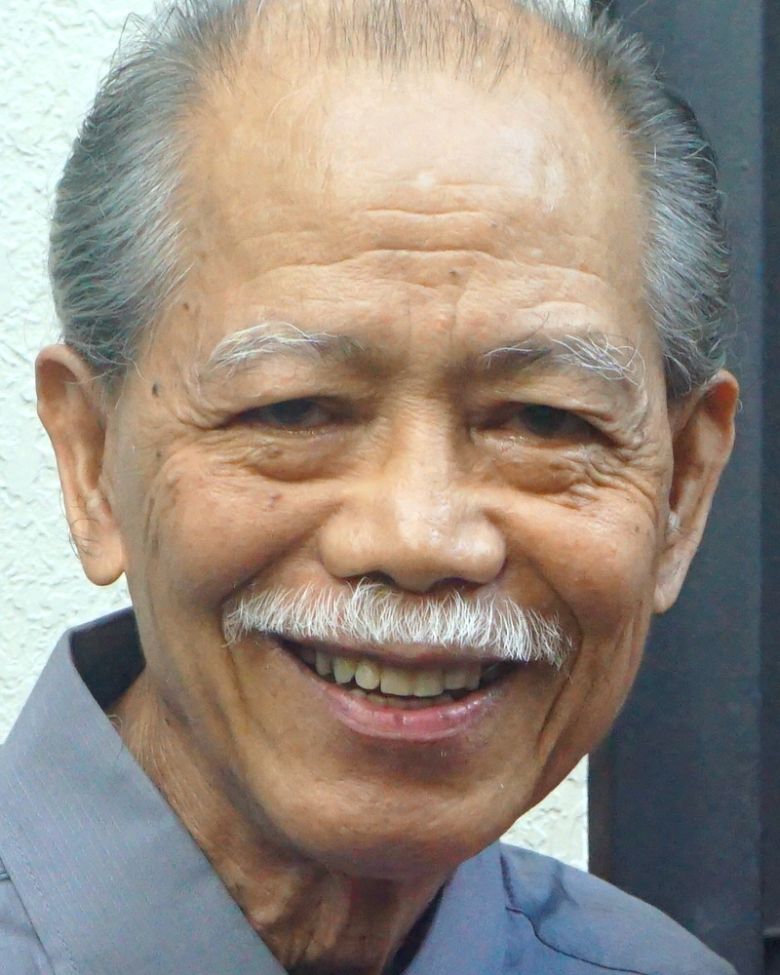
Adult Bible Study Guide
Oct • Nov • Dec 2022
Teacher’s Preview
powerpoint presentation designed by claro ruiz vicente
Notes:
“At malalaman ninyo ang katotohanan, at ang katotohanan ang magpapalaya sa inyo” (Juan 8:32 FSV).

Slide 2
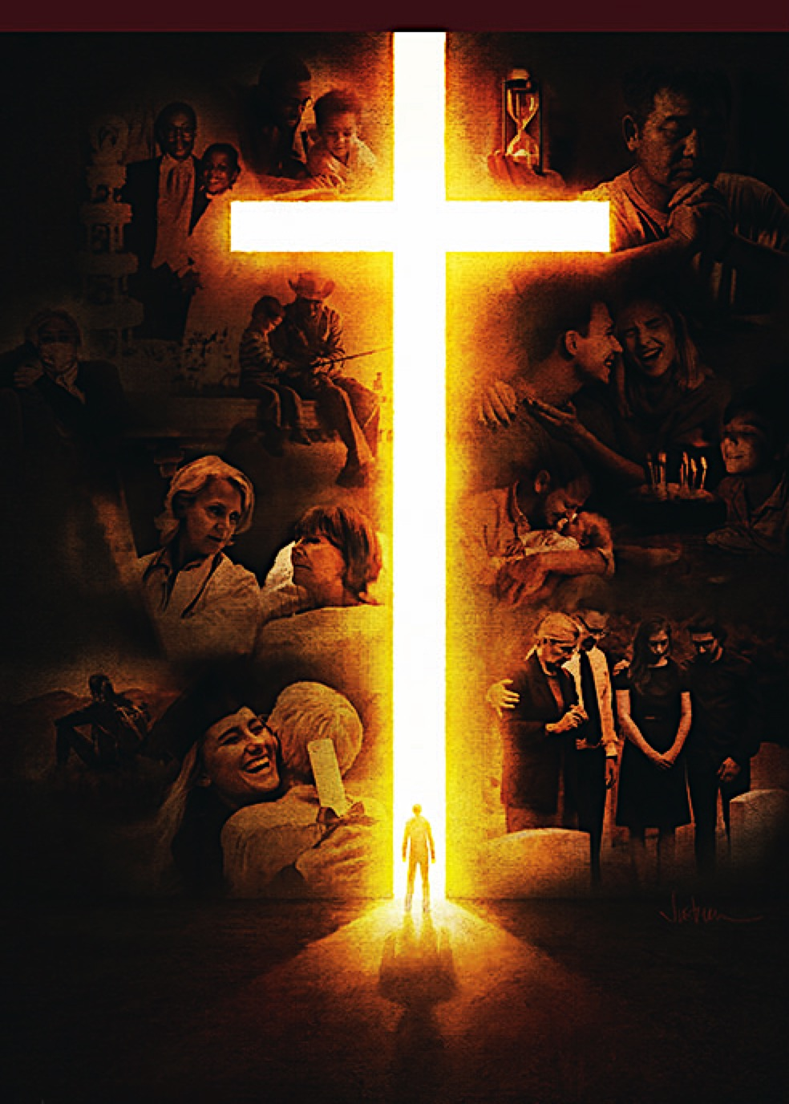
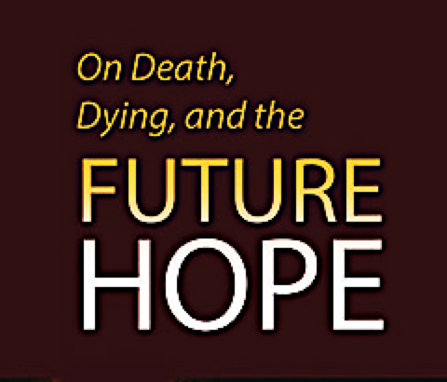
Alberto R. Timm
Principal Contributor
Notes:
Sa Kamatayan, Pag-aagaw-buhay, at ang Kinabukasang Pag-asa.

Slide 3
Summary
On Death and Dying: Our Future Hope
We will explore the painful subject of death
but through the lens of the hope offered us through Jesus.
Notes:
Buod. Sa Kamatayan at Nag-aagaw-buhay: ang Kinabukasang Pag-asa. Ating sasaliksikin ang mahirap na paksa ng kamatayan ngunit sa pamamagitan ng lente ng pag-asang iniaalok sa atin sa pamamagitan ni Jesus.

Slide 4
On Death, Dying, and the Future Hope
Contents
1 Rebellion in a Perfect Universe
2 Death in a Sinful World
3 Understanding Human Nature
4 The Old Testament Hope
5 Resurrections Before the Cross
6 He Died for Us
7 Christ’s Victory Over Death
8 The New Testament Hope
9 Contrary Passages?
10 The Fires of Hell
End-Time Deceptions
12 The Biblical Worldview
13 The Judging Process
14 All Things New
Notes:
Huling Liksyon

Slide 5
On Death, Dying, and the Future Hope
Lesson 14, December 31, 2022
All Things New
Notes:
Lahat ng mga Bagay ay Bago

Slide 6
All Things New
Key Text
Revelation 21:5 NKJV
“Then He who sat on the throne said, ‘Behold, I make all things new.’ And He said to me, ‘Write, for these words are true and faithful.’ ”
Notes:
Susing Talata. “At sinabi ng nakaupo sa trono, “Masdan ninyo, ginagawa kong bago ang lahat ng mga bagay.” Sinabi rin niya, “Isulat mo, sapagkat ang mga salitang ito ay tapat at tunay” (Apocalipsis 21:5).

Slide 7
All Things New
Sabbath Afternoon, December 24
•The promise of “a new heaven and a new earth” (Rev. 21:1) a fantasy?
•Told by those in power to keep the masses in line?
•In the last days, scoffers will ridicule our blessed hope (2 Pet. 3:3–7).
•This week: the glorious promise, the presence of God, the end of death and tears, the triumph of God’s love.
Notes:
Sabbath ng Hapon, Disyembre 24. •Ang pangako ng “isang bagong langit at isang bagong lupa” (Apocalipsis 21:1) ay isang imahinasyon? ¶ •Sinabi ng mga nasa kapangyarihan upang mapanatili ang mga tao na sumasang-ayon? ¶ •Sa mga huling araw, ang mga manlilibak ay kukutyain ang ating pinagpalang pag-asa (2 Pedro 3:3–7). ¶ •Sa linggong ito: ang maluwalhating pangako, ang presensya ng Diyos, ang wakas ng kamatayan at mga luha, ang tagumpay ng pag-ibig ng Diyos.

Slide 8
Sunday, December 25
A New Heaven and a New Earth
•Greek Philosophy: If something is material, it cannot be spiritual; and if something is spiritual, it cannot be material.
•The Bible: Heaven in concrete terms but without the limitations imposed by the presence of sin.
Notes:
•Pilosopiyang Griyego: Kung materyal ang isang bagay, hindi ito magiging espirituwal; at kung espirituwal ang isang bagay, hindi ito magiging materyal. ¶ Ang Biblia: ang langit sa tunay na katawagan subalit walang limitasyong iginigiit ng presensya ng kasalanan.

Slide 9
Sunday, December 25
A New Heaven and a New Earth
•Isaiah 65, 66: how the earth would have been if Israel had remained faithful to their covenant with God.
•Life would have grown more and more toward God’s original plan (before sin).
•New plan. Prophecies of Isaiah have to be reread from the perspective of the church (2 Pet. 3:13, Rev. 21:1–5).
Notes:
• Isaias 65, 66: paano sana ang lupa kung ang Israel ay nanatiling tapat sa kanilang tipan sa Diyos. ¶ •Ang buhay sana ay lumagong higit at higit pa tungo sa orihinal na panukala ng Diyos (bago ang kasalanan). ¶ •Bagong panukala. Ang mga propesiya ni Isaias ay dapat na muling basahin mula sa pananaw ng iglesya (2 Pedro 3:13, Apocalipsis 21:1–5)..

Slide 10
A New Heaven and a New Earth
The Great Controversy 675
“In the Bible the inheritance of the saved is called ‘a country.’ Hebrews 11:14–16. There the heavenly Shepherd leads His flock to fountains of living waters. ... There the wide-spreading plains swell into hills of beauty.... On those peaceful plains, beside those living streams, God’s people, so long pilgrims and wanderers, shall find a home.”
“In the Bible the inheritance of the saved is called ‘a country.’ Hebrews 11:14–16. There the heavenly Shepherd leads His flock to fountains of living waters. ... There the wide-spreading plains swell into hills of beauty....
“In the Bible the inheritance of the saved is called ‘a country.’ Hebrews 11:14–16.
Notes:
The Great Controversy 675. “Sa Biblia ang mana ng mga ligtas ay tinawag na ‘isang bayan.’ Hebreo 11:14–16. Ang makalangit ng Pastol ay inaakay ang Kanyang kawan sa mga bukal ng buhay na tubig. ... Doon ang malawakang kumakalat na kapatagang papalaki sa mga burol na pagkaganda-ganda.... Sa mapapayapang burol na ito, sa tabi ng mga buhay na sapa, ang bayan ng Diyos, na napakatagal na mga manlalakbay at pagala-gala ay makakasumpong ng isang tahanan.”

Slide 11
Monday, December 26
In the Temple of God
The book of Revelation refers to a specific sanctuary/temple within the New Jerusalem, where God’s throne and the sea of glass are located (Rev. 4:2–6, 7:9–15, 15:5–8).
There the great multitude of saints from all nations, tribes, peoples, and tongues will worship God forever (Rev. 7:9–17).
Notes:
Lunes, Disyembre 26. Sa Templo ng Diyos. Ang aklat ng Apocalipsis ay tumutukoy sa isang tiyak na santuwaryo/templo sa loob ng Bagong Jerusalem, kung saan naroon ang trono ng Diyos at kinalalagyan ng dagat na salamin (Apocalipsis 4:2–6, 7:9–15, 15:5–8). ¶ Doon ang malaking karamihan ng mga banal mula sa lahat na mga bansa, tribu, tao, at wika ay sasambahin ang Diyos magpakailanman (Apocalipsis. 7:9–17).

Slide 12
Monday, December 26
In the Temple of God
“They are before the throne of God, and serve Him day and night in His temple”
(Rev. 7:15). “But I saw no temple in it”
(21:22). The heavenly sanctuary/temple has always been the place of worship.
With the entrance of sin, it also became the place from which salvation is of-fered. When the sin problem is over, it once again revert to its original function.
“They are before the throne of God, and serve Him day and night in His temple”
(Rev. 7:15). “But I saw no temple in it”
(21:22).
Notes:
“Sila’y nasa harapan ng trono ng Diyos at naglilingkod sa kanya araw at gabi sa kanyang templo” (Apocalipsis 7:15). “At hindi ako nakakita ng templo roon” (21:22). ¶ Ang makalangit na santuwaryo/templo ang laging ang lugar ng pagsamba. ¶ Sa pagpasok ng kasalanan, ito rin ay naging lugar kung saan ang kaligtasan ay inialok. Kapag ang problema ng kasalanan ay natapos, muli itong babalik sa orihinal nitong tungkulin.

Slide 13
Monday, December 26
In the Temple of God
“For the Lord God Almighty and the Lamb are its temple” (Rev. 21:22b).
The book of Revelation gives special attention to the One who is being wor-shiped and to those who are worshiping Him. This heavenly worship is centered on God and the Lamb (Rev. 5:13, Rev. 7:10). As always, and as it should be, Christ is the focus of the worship.
“For the Lord God Almighty and the Lamb are its temple” (Rev. 21:22b).
The book of Revelation gives special attention to the One who is being wor-shiped and to those who are worshiping Him. This heavenly worship is centered on God and the Lamb (Rev. 5:13, Rev. 7:10).
Notes:
“Ang Panginoong Diyos na Makapangyarihan sa lahat at ang Kordero ang siyang templo roon” (Apocalipsis 21:22b). “At hindi ako nakakita ng templo roon” (21:22). ¶ Nagbibigay ang aklat ng Apocalipsis nang tanging pansin sa Isang sinasamba at yung mga sumasamba sa Kanya. Itong makalangit na pagsamba ay nakasentro sa Diyos at ang Kordero (Apocalipsis 5:13, 7:10). Gaya nang lagi, at gaya nang ito ang dapat, si Cristo ay ang pokus ng pagsamba.

Slide 14
Tuesday, December 27
In the Presence of God
“No one has ever seen God” (John 1:18, 1 John 4:12, NRSV). “We shall see Him as He is” (1 John 3:2) and “see His face”
(Rev. 22:4). Christ said,“ ‘Blessed are the pure in heart, for they shall see God’ ”
(Matt. 5:8). What a privilege it will be for the redeemed to worship God in His temple! But the supreme privilege of all will be to see His face.
“No one has ever seen God” (John 1:18, 1 John 4:12, NRSV). “We shall see Him as He is” (1 John 3:2) and “see His face”
(Rev. 22:4). Christ said,“ ‘Blessed are the pure in heart, for they shall see God’ ”
(Matt. 5:8).
“No one has ever seen God” (John 1:18, 1 John 4:12, NRSV). “We shall see Him as He is” (1 John 3:2) and “see His face”
(Rev. 22:4).
Notes:
Martes, Disyembre 27. Sa Harapan ng Diyos. “Walang sinumang nakakita kailanman sa Diyos.” (Juan 1:18, 1 Juan 4:12). “Siya’y ating makikita bilang siya” (1 Juan 3:2), at “makikita nila ang kanyang mukha” (Apocalipsis 22:8). ¶ Sinabi ni Cristo, “Mapapalad ang mga may malinis na puso, sapagkat makikita nila ang Diyos” (Mateo 5:8). ¶ Ano ngang magiging isang pribilehiyo para sa natubos upang sambahin ang Diyos sa Kanyang templo! Subalit ang sukdulang pribilehiyo ng lahat ay ang makita ang Kanyang mukha.

Slide 15
Tuesday, December 27
In the Presence of God
•Notice the link between purity and seeing God.
•The “ ‘pure in heart’ ” will see God; he who will see God “purifies himself, just as He is pure” (1 John 3:3).
•God must do a work in us now to help prepare us for heaven.
Notes:
•Pansinin ang koneksyon sa pagitan ng kadalisayan at nakikita ang Diyos. ¶ •Ang “ ‘dalisay ang puso’ ” ay makikita ang Diyos; siya na makikita ang Diyos ay “dinadalisay ang sarili gaya nang Siya ay dalisay” (1 Juan 3:3). ¶ •Kailangan ng Diyos na gawin ang isang gawain sa atin ngayon upang tulungang maihanda tayo para sa langit.

Slide 16
Tuesday, December 27
In the Presence of God
We will go through a purifying process here and now that will help prepare us for our eternal home.
And central to the
purification process
is obedience to
His Word.
Notes:
Tayo’y papasok sa isang proseso ng pagdadalisay dito at ngayon na tutulong sa ihanda tayo para sa ating walang-hanggang tahanan. ¶ At sentro sa prosesong pagdadalisay ay pagsunod sa Kanyang Salita.

Slide 17
Wednesday, December 28
No More Death and Tears
•Immortal soul, in an ever-burning hell, contradicts “ ‘no more death, nor sorrow, nor crying’ ” (Rev. 21:4).
•The “second death” would not eradicate sin and sinners from the universe.
•The universe would never be fully restored to its original perfection.
•The Bible paints a different picture!
Notes:
Miyerkules, Disyembre 28. Wala Nang Kamatayan at Luha. •Ang imortal na kaluluwa, sa isang laging nag-aapoy na impiyerno ay kinukontra ang “ ‘Wala nang kamatayan, ni kalungkutan, ni pagtangis’ ” (Apocalipsis 21:4). ¶ •Ang “ikalawang kamatayan” ay hindi mapupuksa ang kasalanan at mga makasalanan mula sa sansinukob. ¶ •Ang sansinukob ay hinding-hindi lubos na maisasauli sa orihinal nitong kasakdalan. ¶ •Naglalarawan ng Biblia ng isang naiibang tanawin!

Slide 18
Wednesday, December 28
No More Death and Tears
•Tears will continue until that glorious day when death, sorrow, and crying will cease to exist (Rev. 21:1–5).
•“ ‘Where, O death, is your victory? Where, O death, is your sting?’ ” (1 Cor. 15:54, 55 NRSV).
•“ ‘Former things will not be remem-bered, nor will they come to mind’ ”
(Isa. 65:17 NIV).
Notes:
•Magpapatuloy ang mga luha hanggang sa maluwalhating araw kapag ang kamatayan, dalamhati, at pagluha ay titigil sa pag-iral (Apocalipsis 21:1–5). ¶ “ ‘Ang kamatayan ay nilamon sa pagtatagumpay. O kamatayan, nasaan ang iyong pagtatagumpay? O kamatayan, nasaan ang iyong tibo?’ ”(1 Corinto 15:54, 55). ¶ “ ‘Ang mga dating bagay ay hindi na maaalala, o darating man sa isipan’ ” (Isaias 65:17).

Slide 19
Thursday, December 29
His Name on Their Foreheads
•The “plan of salvation,” existing before the Creation (Rev. 13:8), was first pre-sented in Eden, after the Fall.
•Further revealed in the types and shadows of the Hebrew sanctuary service (Exodus 25).
•Given its fullest expression in the life, death, and resurrection of Jesus (see Romans 5).
Notes:
Huwebes, Disyembre 29. Ang Kanyang Pangalan sa Kanilang mga Noo. Ang “panukala ng kaligtasan,” ay umiiral bago ang Paglalang (Apocalipsis 13:8), ay unang inihayag sa Eden, pagkatapos ang Pagkakasala. ¶ •Naiunyag pa sa mga tipo at anino ng Hebreong paglilingkod sa santuwaryo (Exodo 25). ¶ •Nabigyan ng lubos na pagpapahayag sa buhay, kamatayan, at muling pagkabuhay ni Jesus (tingnan ang Roma 5).

Slide 20
Thursday, December 29
His Name on Their Foreheads
•At the center of the plan of salvation is the promise of eternal life, based on the merits of Jesus, to all who accept, by faith, the great provision supplied at the cross.
•Before the cross, after the cross—salvation has always been by faith and never by works, however much works are an expression of our salvation.
Notes:
•At ang sentro ng panukala ng kaligtasan ay ang pangako ng buhay na walang-hanggan, base sa merito ni Jesus, sa lahat nang tatanggap, sa pamamagitan ng pananampalataya, ang malaking paglalaan na bigay sa krus. ¶ Bago ang krus, pagkatapos ng krus—ang kaligtasan ay laging sa pamamagitan ng pananampalataya at hinding-hindi sa pamamagitan ng gawa, gayunman ang maraming gawa ay pagpapahayag ng ating kaligtasan.

Slide 21
Thursday, December 29
His Name on Their Foreheads
•We can have the assurance of salvation if we have accepted Jesus, have surren-dered to Him, and have claimed His promises, including those of a new life now in Him, and if we lean totally on His merits and nothing else.
•This is what it means to have His name written on our foreheads.
Notes:
•Maaaring magkaroon tayo ng katiyakan ng kaligtasan kung tinanggap natin si Jesus, sumuko sa Kanya, at inangkin ang Kanyang mga pangako, kabilang ang isang bagong buhay ngayon sa Kanya, at kung lubos tayong aasa sa Kanyang merito at walang iba. ¶ Ito ang ibig sabihin ng ang Kanyang pangalan ay nakasulat sa ating mga noo.

Slide 22
Friday, December 30. Further Thought
The Great Controversy 678.
“The great controversy is ended. ... The entire universe is clean. One pulse of har- mony and gladness beats through the vast creation. From Him who created all, flow life...throughout the realms of illimi-table space. From the minutest atom to the greatest world, all things, animate and inanimate, in their unshadowed beauty and perfect joy, declare that God is love.”
“The great controversy is ended. ... The entire universe is clean. One pulse of har- mony and gladness beats through the vast creation. From Him who created all, flow life...throughout the realms of illimi-table space.
“The great controversy is ended. ... The entire universe is clean. One pulse of har- mony and gladness beats through the vast creation.
Notes:
Biyernes, Disyembre 30. Karagdagang Isipan “Nagwakas na ang malaking tunggalian. ... Ang buong sansinukob ay malinis. Isang pulso ng pagkakatugma at kagalakan ang pumipintig sa napakalawak na sangnilikha. ¶ Mula sa Kanya na lumikha ng lahat ay dumadaloy ang buhay...sa buong larangan ng walang hangganang kalawakan. ¶ Mula sa pinakamaliit na atoma hanggang sa pinakamalaking sanlibutan, lahat ng mga bagay, may buhay at wala, sa walang aninong kagandahan at sakdal na kaligayahan ng mga ito ay naghahayag na ang Diyos ay pag-ibig.”—The Great Controversy 678.

Slide 23
All Things New
Outline for Teaching
1. New Heaven and Earth
Sun. Home, Finally. Rev. 21:1–5.
2. New Places
a. Mon. God’s Temple. Rev. 21:22. b. Tue. God’s Presence. Rev. 7:14, 15.
3. New Experiences
a. Wed. No Death, Tears. Rev. 7:17
b. Thu. His Name Written. Rev. 22:4.
Notes:
Balangkas para sa Pagtuturo.
Bagong Langit at Lupa
Linggo. Sa Bahay, sa Wakas. Apocalipsis 21:1–5.
(2) Mga Bagong Lugar
a. Lunes. Templo ng Diyos. Apocalipsis 21:22.
b. Martes. Harapan ng Diyos. Apocalipsis 7:14, 15.
(3) Mga Bagong Karanasan
a. Miyerkules. Walang Kamatayan, Luha. Apocalipsis 7:17.
b. Huwebes. Nakasulat ang Kanyang Ngalan. Apocalipsis 22:4.

