Slide 1
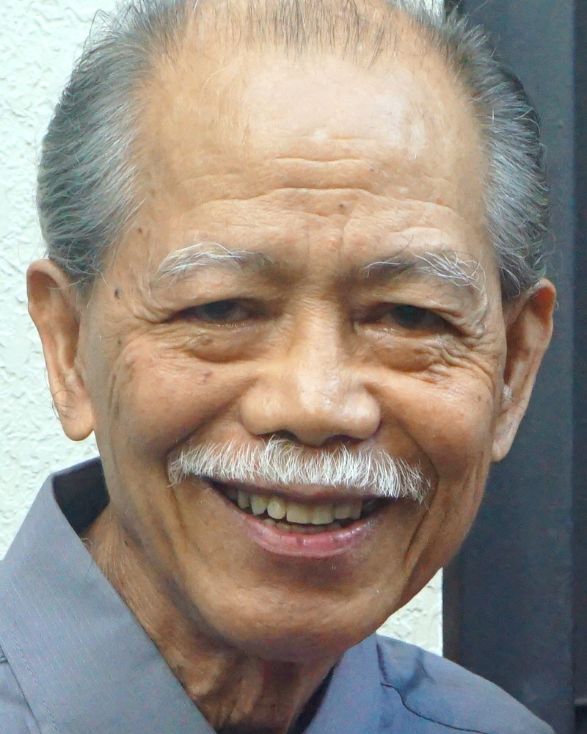
Adult Bible Study Guide
Oct • Nov • Dec 2022
Teacher’s Preview
powerpoint presentation designed by claro ruiz vicente
Notes:
“At malalaman ninyo ang katotohanan, at ang katotohanan ang magpapalaya sa inyo” (Juan 8:32 FSV).

Slide 2
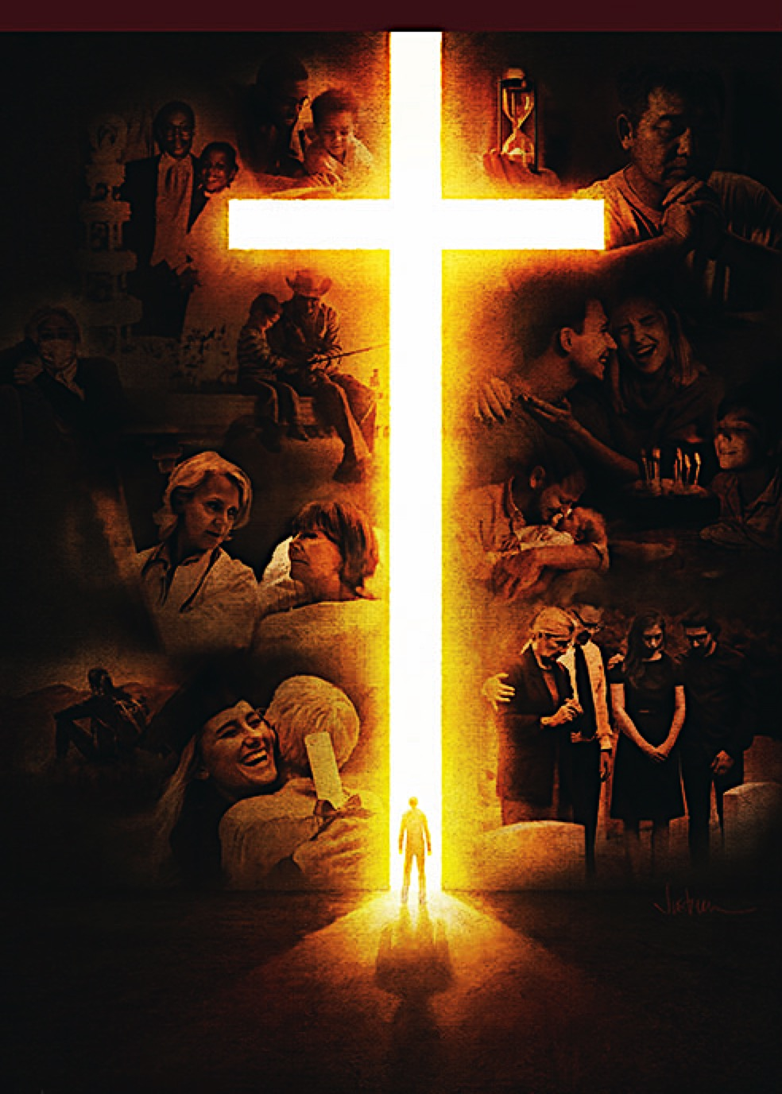
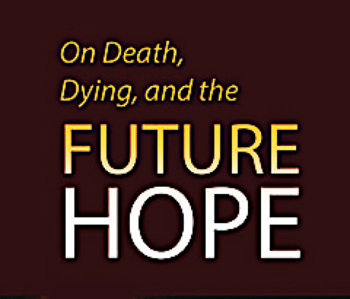
Alberto R. Timm
Principal Contributor
Notes:
Sa Kamatayan, Pag-aagaw-buhay, at ang Kinabukasang Pag-asa.

Slide 3
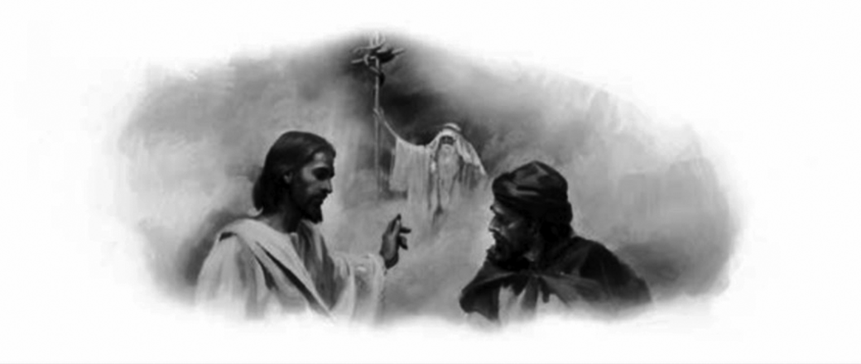
On Death, Dying, and the Future Hope
Lesson 6, November 5, 2022
He Died for Us
Notes:
Namatay Siya para sa Atin

Slide 4
He Died for Us
This Week
We will focus on
Christ’s death and what it means for the promise of eternal life.
Notes:
Sa Linggong Ito. Tayo’y magpupokus sa kamatayan ni Crsito at kung ano ang kahulugan nito para sa pangako ng walang-hanggang buhay.

Slide 5
He Died for Us
Key Text
John 3:14, 15 NKJV
“ ‘And as Moses lifted up the serpent in the wilderness, even so must the Son of Man be lifted up, that whoever believes in Him should not perish but have eternal life.’ ”
Notes:
Susing Talata. “Kung paanong itinaas ni Moises sa ilang ang ahas, kailangan din namang itaas ang Anak ng Tao; upang ang sinumang sumampalataya sa kanya ay magkaroon ng buhay na walang hanggan’ ” (Juan 3:14, 15).

Slide 6
He Died for Us
Sabbath Afternoon, October 29
Because we know that the dead, both the righteous and the wicked, end up in the same place at first, our hope of the resurrection means everything to us. Without this hope, even “those who have fallen asleep in Christ have perished” (1 Cor. 15:18). It is strange thing to say they are buzzing about heaven in the presence of God.
Because we know that the dead, both the righteous and the wicked, end up in the same place at first, our hope of the resurrection means everything to us. Without this hope, even “those who have fallen asleep in Christ have perished” (1 Cor. 15:18).
Because we know that the dead, both the righteous and the wicked, end up in the same place at first, our hope of the resurrection means everything to us.
Notes:
Sabbath ng Hapon, Oktubre 29. Dahil alam natin na ang patay, parehong ang matuwid at ang masama, ay magtatapos sa iisang lugar sa una, ang ating pag-asa ng muling pagkabuhay ay mangangahulugan nang lahat para sa atin. ¶ Kung wala nitong pag-asa, kung gayon “ang mga namatay kay Cristo ay napahamak“ (1 Corinto 15:18). ¶ Ito’y kataka-takang bagay na sabihing sila’y buhay-na-buhay sa langit sa presensya ng Diyos.

Slide 7
He Died for Us
Sabbath Afternoon, October 29
Thus, Christ’s resurrection is central to our faith, because in His resurrection we have the surety of our own. But before Christ was resurrected from the dead, He, of course, had to die. This is why, in Gethsemane, in anticipation of His death, He prayed: “ ‘But for this purpose I came to this hour’ ” (John 12:27). And that purpose was to die.
Thus, Christ’s resurrection is central to our faith, because in His resurrection we have the surety of our own. But before Christ was resurrected from the dead, He, of course, had to die. This is why, in Gethsemane, in anticipation of His death, He prayed:
Thus, Christ’s resurrection is central to our faith, because in His resurrection we have the surety of our own. But before Christ was resurrected from the dead, He, of course, had to die.
Thus, Christ’s resurrection is central to our faith, because in His resurrection we have the surety of our own.
Notes:
Kaya, ang muling pagkabuhay ay sentro sa ating pananampalataya, dahil sa Kanyang muling pagkabuhay ay mayroon tayong kasiguruhan ng sa atin. ¶ Ngunit bago muling nabuhay si Cristo mula sa patay, Siya, ay kailangang mamatay. ¶ Ito ang dahilan kung bakit, sa Getsemani, bilang pag-aabang sa Kanyang kamatayan, Siya’y nanalangin: ¶ “ ‘Ngunit dahil dito ay dumating ako sa oras na ito‘ ” (Juan 12:27). At ang layuning ’yon ay upang mamatay.

Slide 8
Sunday, October 30
“From the Foundation of the World”
“All who dwell on the earth will worship him, whose names have not been written in the Book of Life of the Lamb slain from the foundation of the world” (Rev. 13:8).
What’s crucial here for us is the idea of Christ’s being “slain from the foundation of the world.”
Notes:
“Mula sa Pagkatatag ng Sanlibutan.” “At ang lahat ng naninirahan sa lupa ay sasamba sa kanya, ang lahat na ang pangalan ay hindi nakasulat sa aklat ng buhay ng Kordero na pinaslang buhat nang itatag [likhain] ang sanlibutan” (Apocalipsis 13:8). ¶ Ang napakahalaga rito para sa atin ay ang ideya nang pagiging “napatay mula sa pagkatatag ng sanlibutan” ni Cristo.

Slide 9
Sunday, October 30
“From the Foundation of the World”
This is in a symbolic sense, because Christ wasn’t crucified until thousands of years after the earth’s Creation.
What this text is saying is that the plan of salvation had been put in place before the Creation of the world.
And central to that plan would be the death of Jesus, the Lamb of God, on the cross.
Notes:
Ito’y sa isang simbolikong pagkaunawa, dahil si Cristo ay hindi naipako hanggang libu-libong taon pagkatapos ng Paglalang ng lupa. ¶ “Ang sinasabi nitong talata’y ang panukala ng kaligtasan ay napagpasyahan bago ang Paglalang ng sanlibutan. ¶ At sentro sa panukalang ito’y magiging ang kamatayan ni Jesus, ang Cordero ng Diyos, sa krus.

Slide 10
Sunday, October 30
“From the Foundation of the World”
“The plan for our redemption was not an afterthought, a plan formulated after the fall of Adam....
It was an unfolding of the principles that from eternal ages have been the foundation of God’s throne.” —The Desire of Ages 22.
Notes:
“Ang panukala para sa ating katubusan ay hindi isang kaisipan pagkatapos ng pangyayari, isang panukala na binalangkas pagkatapos ng pagkakasala ni Adan.... ¶ Ito’y isang paglalahad ng mga prinsipyo na mula sa walang-hanggang kapanahunan ay naging ang saligan ng luklukan ng Diyos.”—The Desire of Ages 22.

Slide 11
Sunday, October 30
“From the Foundation of the World”
That plan was revealed first to Adam and Eve in the Garden of Eden (Gen. 3:15, 21), and it was typified by every blood sacri-fice throughout the Old Testament.
While testing Abraham’s faith, God provided a ram to be sacrificed instead of Isaac (22:11–13). This typified even more clearly the substitutionary nature of Christ’s atoning sacrifice on the cross.
Notes:
Ang panukalang ‘yon ay naihayag una kina Adan at Eva sa Halamanan ng Eden (Genesis 3:15, 21), at ito’y kinatawanan ng bawat dugong hain sa buong Lumang Tipan. ¶ Samantalng sinusubukan ang pananampalataya ni Abraham, naglaan ang Diyos ng isang lalaking tupa upang ihahain sa halip na si Isaac (22:11–13). Ito’y kinatawanan na mas malinaw pa ng humahaliling likas ng nagbabayad ng hain ni Cristo sa krus.

Slide 12
Monday, October 31
A Preface to the Cross
Jesus was born to die, and He lived to die. Every step that He took brought Him closer to His great atoning sacrifice on the cross of Calvary. Fully conscious of His mission, He did not allow anyone or anything to distract Him from it. In reality, “His whole life was a preface to His death on the cross.”—Fundamentals of Christian Education 382.
Jesus was born to die, and He lived to die. Every step that He took brought Him closer to His great atoning sacrifice on the cross of Calvary. Fully conscious of His mission, He did not allow anyone or anything to distract Him from it.
Jesus was born to die, and He lived to die. Every step that He took brought Him closer to His great atoning sacrifice on the cross of Calvary.
Notes:
Lunes, Oktubre 31. Isang Paunang Salita Tungkol sa Krus. Ipinanganak si Jesus upang mamatay, at Siya’y nabuhay upang mamatay. Bawat hakbang na kinuha Niya ay nagdala sa Kanya na papalapit sa Kanyang nagbabayad na hain sa krus ng Kalbaryo. ¶ Lubos na may malay ng Kanyang misyon, hindi Niya pinahintulutan ang sinuman o anuman upang umabala sa Kanya mula rito. ¶ Ang totoo, “Ang Kanyang buong buhay ay isang paunang salita sa Kanyang kamatayan sa krus.”—Fundamentals of Christian Education 382.

Slide 13
Monday, October 31
A Preface to the Cross
In the last year of His earthly ministry, Jesus spoke more and more explicitly to His disciples about His forthcoming death. But they seemed unable and unwilling to accept the reality of His statements. Filled with false notions about the role of the Messiah, the last thing that they had expected was for Jesus, especially as the Messiah, to die.
In the last year of His earthly ministry, Jesus spoke more and more explicitly to His disciples about His forthcoming death.
Notes:
Sa huling taon ng Kanyang makalupang ministeryo, nagsalita si Jesus nang higit at higit pang malinaw sa Kanyang mga alagad tungkol sa Kanyang darating na kamatayan. ¶ Subalit parang hindi at aayaw nilang tanggapin ang katotohanan ng Kanyang mga pahayag. Puspos ng maling mga palagay tungkol sa papel ng Mesiyas, ang kahulihang bagay na inasahan nila para kay Jesus, lalo na bilang ang Mesiyas ay upang mamatay.

Slide 14
Monday, October 31
A Preface to the Cross
To Nicodemus: “ ‘And as Moses lifted up the serpent in the wilderness, even so must the Son of Man be lifted up....’ ” (John 3:14, 15).
To His disciples: He had to “ ‘go to Jerusalem, and suffer many things from the elders and chief priests and scribes, and be killed, and be raised the third day’ ” (Matt. 16:21).
Notes:
Kay Nicodemo: “ ‘Kung paanong itinaas ni Moises sa ilang ang ahas, kailangan din namang itaas ang Anak ng Tao; upang ang sinumang sumampalataya sa kanya ay magkaroon ng buhay na walang hanggan’ ” (Juan 3:14, 15). ¶ Sa Kanyang mga Alagad: kailangang pumunta siya “ ‘sa Jerusalem at magtiis ng maraming bagay sa kamay ng matatanda, ng mga punong pari at mga eskriba. Siya’y papatayin at muling bubuhayin sa ikatlong araw’ ” (Mateo 16:21).

Slide 15
Monday, October 31
A Preface to the Cross
Passing privately through Galilee (Mark 9:30–32) and during His final journey to Jerusalem (Luke 18:31–34), Jesus spoke again to His disciples about His death and resurrection.
Because it was not what they wanted to hear, they didn’t listen. How easy it is for us to do the same.
Notes:
Sarilinang dumaan sa Galilea (Marcos 9:30–32) at sa Kanyang pangwakas na paglalakbay sa Jerusalem (Lucas 18:31–34), muling nagsalita si Jesus sa Kanyang mga alagad tungkol sa Kanyang kamatayan at muling pagkabuhay. ¶ Dahil hindi ito ang kanilang nais na marinig, hindi sila nakinig. Paano ngang napakadali rin para sa atin ang gawin din ang gayon.

Slide 16
Tuesday, November 1
“ ‘It Is Finished!’ ”
Finally, the crucial moments for Christ, for humankind, and for the whole universe had arrived. With deep agony, He struggled against the powers of darkness. Slowly He made His way through the Garden of Gethsemane, through His unfair trials, and up the mountain of Calvary. Evil angels were trying to overcome Him.
Finally, the crucial moments for Christ, for humankind, and for the whole universe had arrived. With deep agony, He struggled against the powers of darkness.
Notes:
Martes, Nobyembre 1. “Naganap Na.” Sa wakas, ang mahahalagang sandali para kay Cristo, para sa sangkatauhan, at para sa buong sansinukob ay dumating. May malalim na paghihirap, nakipagpunyagi Siya laban sa mga kapangyarihan ng kadiliman. ¶ Marahang nagtungo Siya sa Harden ng Getsemani, sa Kanyang di makatarungang mga paglilitis, at paakyat sa bundok ng Kalbaryo. Ang mga masasamang anghel ay nagsisikap upang Siya’y madaig.

Slide 17
Tuesday, November 1
“ ‘It Is Finished!’ ”
While Jesus was hanging on the cross, the chief priests, the scribes, and the elders mocked Him, saying “ ‘He saved others; Himself He cannot save. If He is the King of Israel, let Him now come down from the cross, and we will believe Him’ ” (Matt. 27:42).
While Jesus was hanging on the cross, the chief priests, the scribes, and the elders mocked Him, saying
Notes:
Samantalang si Jesus ay nakabayubay sa krus, kinutya Siya ng mga punung pari, eskriba, at matanda, nagsasabing ¶ “ ‘Nagligtas siya ng iba; hindi niya mailigtas ang kanyang sarili. Siya ang Hari ng Israel; bumaba siya ngayon sa krus, at maniniwala tayo sa kanya’ ” (Mateo 27:42).

Slide 18
Tuesday, November 1
“ ‘It Is Finished!’ ”
Could Christ come down from the cross and saved Himself? Yes, He was able but not willing to do so. His unconditional love for all humanity, including those mockers did not allow Him to give up.
Here, in the suffering of Christ, Jesus was defeating the kingdom of Satan, even though it was Satan who had instigated the events that led to the cross.
Notes:
Maaari bang bumaba si Cristo mula sa krus at iligtas ang Kanyang sarili? Oo, kaya Niya ngunit ayaw Niyang gawin ‘yon. Ang Kanyang walang-pasubaling pagmamahal para sa lahat ng sangkatauhan, kabilang yung mga kumutya ay hindi nagpahintulot sa Kanya na sumuko. ¶ Dito, sa pagdurusa ni Cristo, tinatalo ni Jesus ang kaharian ni Satanas, kahit si Satanas ang nagnulsol sa mga pangyayari na umakay sa krus.

Slide 19
Tuesday, November 1
“ ‘It Is Finished!’ ”
Crying from the cross, “ ‘It is finished’ ”
(John 19:30), Christ implied not only that His agony had come to an end, but also especially that He had won the great cosmic-historic controversy against Satan and his evil forces. “All heaven triumphed in the Saviour’s victory. Satan was defeated, and knew that his kingdom was lost.”—The Desire of Ages 758.
Crying from the cross, “ ‘It is finished’ ”
(John 19:30), Christ implied not only that His agony had come to an end, but also especially that He had won the great cosmic-historic controversy against Satan and his evil forces.
Crying from the cross, “ ‘It is finished’ ”
(John 19:30),
Notes:
Humihiyaw mula sa krus, “ ‘Naganap na’ ” (Juan 19:30), ¶ Nagpahiwatig si Cristo na hindi lamang ang Kanyang paghihirap ang nagtapos, kundi lalo na rin na Siya’y napagtagumpayan ang malaking kosmiko-historikong tunggalian laban kay Satanas at ang kanyang masasamang puwersa. ¶ “Ang kalangitan ay nagtagumpay sa pagwawagi ng Tagapagligtas. Natalo si Satanas, at alam na nawala na ang kanyang kaharian.”—The Desire of Ages 758.

Slide 20
Wednesday, November 2
He Died for Us
“ ‘Behold! The Lamb of God who takes away the sin of the world!’ ” (John 1:29).
This statement acknowledged Christ as the antitypical Lamb of God to whom all true sacrifices pointed. But animal sacri-fices could not take away sins by them-selves. They provided only conditional forgiveness dependent on the effective- ness of Christ’s sacrifice on the cross.
“ ‘Behold! The Lamb of God who takes away the sin of the world!’ ” (John 1:29).
This statement acknowledged Christ as the antitypical Lamb of God to whom all true sacrifices pointed. But animal sacri-fices could not take away sins by them-selves.
“ ‘Behold! The Lamb of God who takes away the sin of the world!’ ” (John 1:29).
This statement acknowledged Christ as the antitypical Lamb of God to whom all true sacrifices pointed.
Notes:
Miyerkules, Nobyembre 2. Siya’y Namatay para sa Atin. “ ‘Narito ang Kordero ng Diyos, na nag-aalis ng kasalanan ng sanlibutan!’ ” (Juan 1:29). ¶ Ang pahayag na ito’y kinilala si Cristo bilang ang antitipikong Kordero ng Diyos na sa Kanya’y nakaturo ang lahat ng tunay na hain. ¶ Subalit ang mga hayop na hain ay hindi makapag-aalis ng kasalanan sa pamamagitan nila. ¶ Nagbibigay lamang ang mga ito ng may pasubaling pagpapatawad na nakadepende sa pagiging epektibo ng hain ni Cristo sa krus.

Slide 21
Wednesday, November 2
He Died for Us
“ ‘God so loved the world that he gave his only Son’ ” to die for us (John 3:16). But we should never forget that Christ offered Himself voluntarily on our behalf (Heb. 9:14). Christ died once for all (10:10) and once forever (v. 12), for His sacrifice is all-sufficient and never loses its power.
“ ‘God so loved the world that he gave his only Son’ ” to die for us (John 3:16). But we should never forget that Christ offered Himself voluntarily on our behalf (Heb. 9:14).
“ ‘God so loved the world that he gave his only Son’ ” to die for us (John 3:16).
Notes:
“ ‘Gayon na lamang ang pag-ibig ng Diyos sa sanlibutan na ibinigay niya ang kanyang tanging Anak’ ” upang mamatay para sa atin (Juan 3:16). ¶ Subalit hinding-hindi dapat nating kalilimutan na kusang nag-alay si Cristo ng Sarili para sa ating kapakanan (Hebreo 9:14). ¶ Namatay si Cristo minsan para sa lahat (10:10) at minsan magpawalanghanggan (v. 12), dahil ang Kanyang hain ay sapat-para-sa-lahat at hinding-hindi nawawala ang kapangyarihan nito.

Slide 22
Wednesday, November 2
He Died for Us
And there’s more:
“If but one soul would have
accepted the gospel of His grace,
Christ would, to save that one, have chosen His life of toil and humiliation and His death of
shame.”—The Ministry of Healing 135.
Notes:
At mayroon pa: “Kung iisang kaluluwa lamang ang tatanggapin ang ebanghelyo ng Kanyang biyaya, Si Cristo ay, upang sagipin ang isang ’yon, ay pipiliin ang Kanyang buhay ng pagpapakapagod at pagpapakababa at Kanyang kamatayan ng kahihiyan.”—The Ministry of Healing 135.

Slide 23
Thursday, November 3
The Meaning of the Cross
The Cross of Christ is the very center of salvation history. While Christ was offe-ring Himself as a ransom for the human race, Satan was engulfing Him in suffe-ring and agony. Christ did not die just the natural death that every human being has to face. He died the second death, so that all those who accept Him will never have to experience it for themselves.
The Cross of Christ is the very center of salvation history. While Christ was offe-ring Himself as a ransom for the human race, Satan was engulfing Him in suffe-ring and agony. Christ did not die just the natural death that every human being has to face.
The Cross of Christ is the very center of salvation history. While Christ was offe-ring Himself as a ransom for the human race, Satan was engulfing Him in suffe-ring and agony.
Notes:
Huwebes, Nobyembre 3. Ang Kahulugan ng Krus. Ang Krus ni Cristo ang pinakasentro ng kasaysayan ng kaligtasan. Samantalang si Cristo ay naghahadog ng Kanyang sarili bilang isang pantubos para sa lahi ng tao, si Satanas ay nilalamon Siya sa pagdurusa’t paghihirap. ¶ Si Cristo ay hindi namatay ng isang natural na kamatayan lamang na bawat tao ay haharapin. ¶ Ikinamatay Niya ang ikalawang kamatayan, upang ang lahat ng tataggap sa Kanya ay hinding-hindi kailangang danasin ito para sa kanilang sarili.

Slide 24
The Meaning of the Cross
The Cross Is...
1. the supreme revelation of God’s justice against sin (Rom. 3:21–26).
2. the supreme revelation of God’s love for sinners (Rom. 5:8).
3. the great source of power to break the chains of sin (Rom. 6:22, 23; 1 Cor. 1:17–24).
Notes:
Ang Krus Ay... 1. ang sukdulang kapahayagan ng katarungan ng Diyos laban sa kasalanan (Roma 3:21–26). ¶ ang sukdulang kapahayagan ng pag-ibig ng Diyos para sa mga makasalanan (Roma 5:8). ¶ 3. ang dakilang pinamumulan ng kapangyarihan upang basagin ang mga kadena ng kasalanan (Roma 6:22, 23; 1 Corinto 1:17–24).

Slide 25
The Meaning of the Cross
The Cross Is...
4. our only hope of eternal life (Phil. 3:9–11; John 3:14–16; 1 John 5:11,12).
5. the only antidote against a future rebellion in the universe (Rev. 7:13–17, 22:3).
Notes:
4. ating pag-asa lamang ng buhay na walang hanggan (Filipos 3:9–11; Juan 3:14–6; 1 Juan 5:11, 12). ¶ 5. ang panlunas lamang laban sa isang rebelyon sa sansinukod sa kinabukasan (Apocalipsis 7:13–17, 22:3).

Slide 26
The Meaning of the Cross
The Cross Is...
None of these crucial truths about the Cross can be discovered by the “wisdom of the world.” On the contrary, then, as now, the preaching of the Cross is “foolishness” to worldly wisdom, which often doesn’t even acknowledge the most obvious truth there could be: that a Creator exists (see Rom. 1:18–20).
None of these crucial truths about the Cross can be discovered by the “wisdom of the world.”
Notes:
Wala sa mahahalagang katotohanang ito tungkol sa Krus ang maaaring matuklasan sa pamamagitan ng “katalinuhan ng sanlibutan.” ¶ Sa kasalungat, kung gayon, gaya ng ngayon, ang pangangaral ng Krus ay “kamangmangang” sa makasanlibutang katalinuhan, na kadalasang hindi nga kinikilala ang pinakakitang-kitang katotohanang mayroon: na umiiral ang isang Manlalalang (tingnan ang Roma 1:18–20).

Slide 27
Friday, November 4
Further Thought: Testimonies 1:124.
“I saw that all heaven is interested in our salvation; and shall we be indifferent? Shall we be careless, as though it were a small matter whether we are saved or lost? Shall we slight the sacrifice that has been made for us? Some have done this.
They have trifled with offered mercy, and the frown of God is upon them. God’s Spirit will not always be grieved.
Notes:
Biyernes, Nobyembre 4. Karagdagang Isipan: Testimonies 1:124. “Nakita ko na ang kalangitan ay interesado sa ating kaligtasan; at tayo ba’y magiging hindi interesado? Tayo ba’y maging pabaya, na parang ito’y isang maliit na bagay kung tayo’y maliligtas o mawawaglit? Atin bang mamaliitin ang hain na nagawa para sa atin? May mga gumawa nito. ¶ Kanilang binibiru-biro ang naialok na awa, at ang simangot ng Diyos ay nasa kanila. Ang espiritu ng Diyos ay hindi laging mapamimighatiin.

Slide 28
Friday, November 4
Further Thought: Testimonies 1:124.
It will depart if grieved a little longer.
After all has been done that God could do to save men, if they show by their lives that they slight Jesus’ offered mercy, death will be their portion, and it will be dearly pur-chased. It will be a dreadful death; for they will have to feel the agony that Christ felt upon the cross to purchase
It will depart if grieved a little longer.
After all has been done that God could do to save men, if they show by their lives that they slight Jesus’ offered mercy, death will be their portion, and it will be dearly pur-chased.
Notes:
Ito’y aalis kung pipighatiin pa nang kaunting panahon. ¶ Matapos ang lahat na nagawa na magagawa ng Diyos para iligtas ang tao, kung magpapakita sila sa pamamagitan ng kanilang buhay na kanilang minaliit ang alok ng awa ni Jesus, ang kamatayan ay magiging bahagi nila, at ito’y magiging mahal ang pagkakabili. ¶ Ito’y magiging isang kakilakilabot na kamatayan; dahil kailangan nilang madama ang paghihirap na nadama sa krus upang bilhin

Slide 29
Friday, November 4
Further Thought: Testimonies 1:124.
for them the redemption which they have refused. And they will then realize what they have lost—eternal life and the immortal inheritance.
The great sacrifice that has been made to save souls shows us their worth. When the precious soul is once lost, it is lost forever.”
Notes:
para sa kanila ang katubusan na kanilang tinanggihan. At pagkatapos ay matatanto nila ang nawala sa kanila—walang-hanggang buhay at ang imortal na pamana. ¶ Ang dakilang hain na nagawa upang iligtas ang mga kaluluwa ay nagpapakita sa atin ng kanilang halaga. Kapag ang mamahaling kaluluwa ay minsang mawala, ito’y mawawala magpasawalanghanggan.”

Slide 30
He Died for Us
Outline for Teaching
Before the Cross
a. Sun. Foundation. Rev. 13:8. b. Mon. Preface. John 3:14, 15.
2. At the Cross
a. Tue. “Finished.” John 19:30. b. Wed. Died for Us. 1 John 1:9.
3. Meaning of the Cross
Thu. Five Aspects. 1 John 5:11, 12.
Notes:
Balangkas para sa Pagtuturo.
Bago ang Krus
a. Linggo. Pagtatatag. Apocalipsis 13:8.
b. Lunes. Paunang Salita. Juan 3:14, 15.
(2) Sa Krus
a. Martes. “Naganap Na.” Juan 19:30.
b. Miyerkules. Namatay para sa Atin. 1 Juan 1:9.
(3) Kahulugan ng Krus
Huwebes. Limang mga Pananaw. 1 Juan 5:11, 12.

Slide 31
He Died for Us
Presentation Record
1. PAA ‘77 Dev. 30 Oct 22 via Messenger chat room

