Slide 1
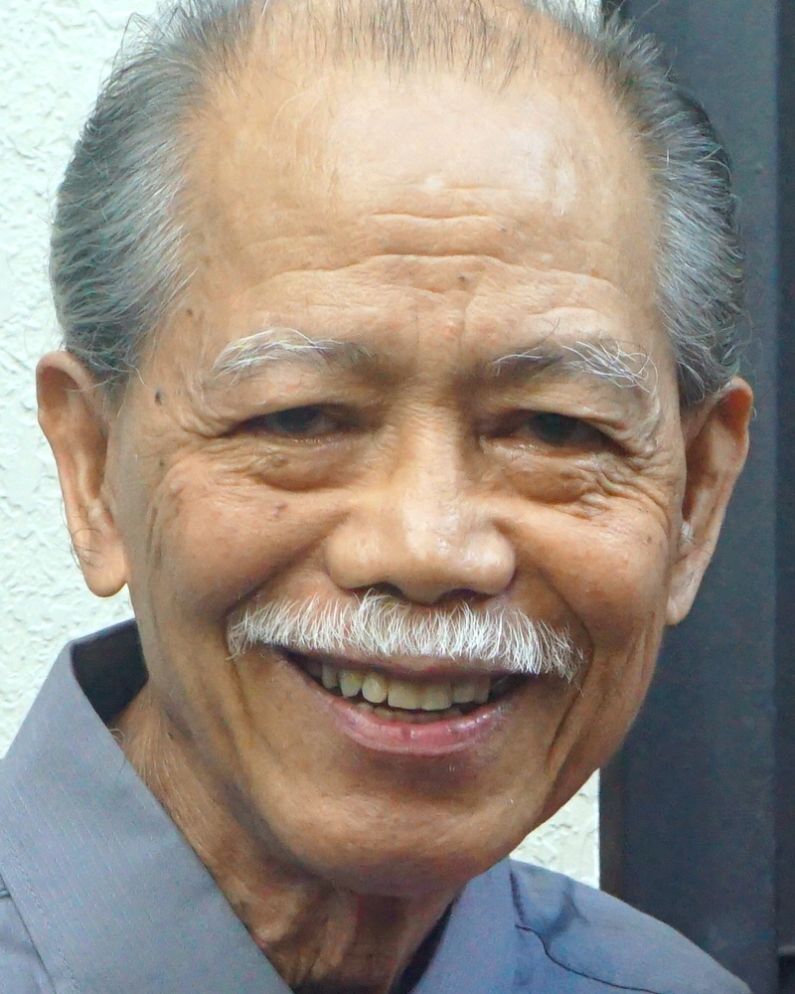
Adult Bible Study Guide
Oct • Nov • Dec 2022
Teacher’s Preview
powerpoint presentation designed by claro ruiz vicente
Notes:
“At malalaman ninyo ang katotohanan, at ang katotohanan ang magpapalaya sa inyo” (Juan 8:32 FSV).

Slide 2
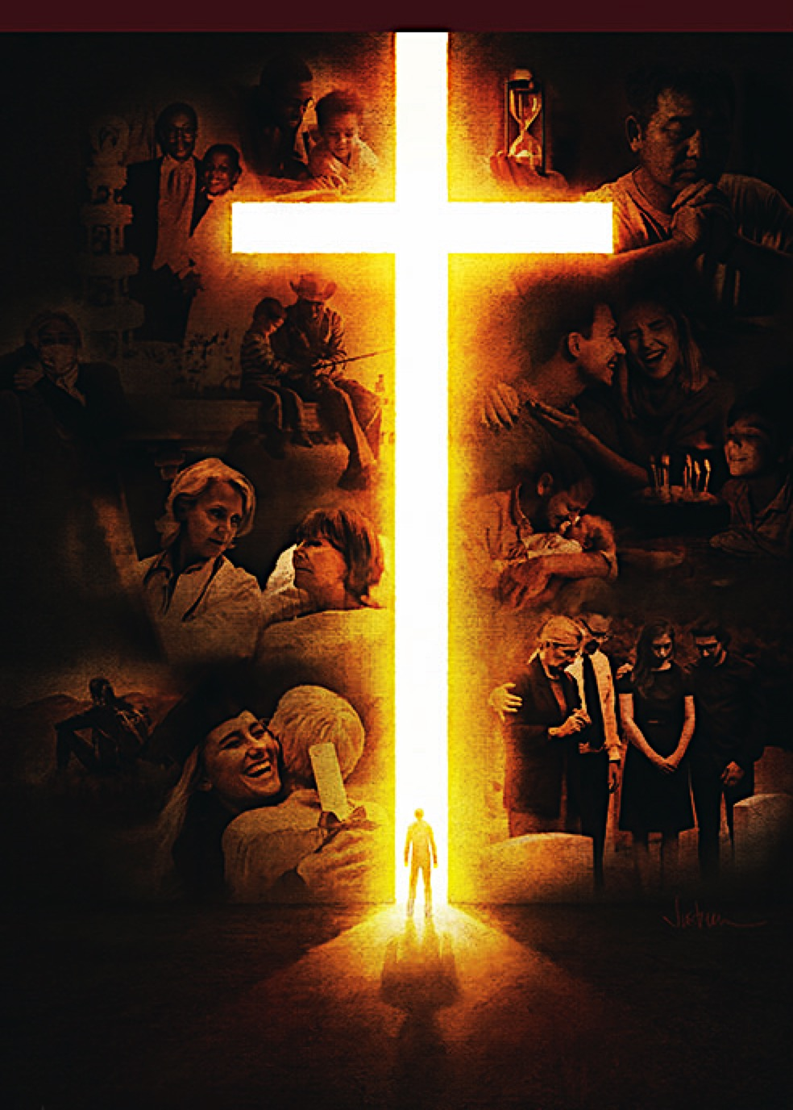
Alberto R. Timm
Principal Contributor
Notes:
Sa Kamatayan, Pag-aagaw-buhay, at ang Kinabukasang Pag-asa.

Slide 3
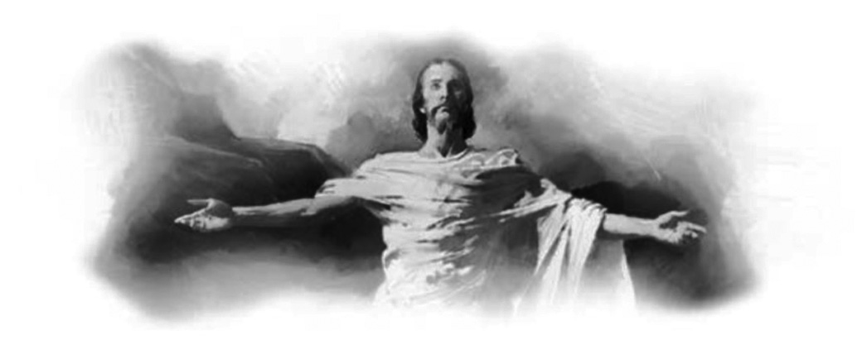
On Death, Dying, and the Future Hope
Lesson 7, November 12, 2022
Christ’s Victory Over Death
Notes:
Ang Tagumpay ni Cristo sa Kamatayan

Slide 4
Christ’s Victory Over Death
Key Text
Revelation 1:17, 18 NCV
“When I saw him, I fell down at his feet like a dead man. He put his right hand on me and said, ‘Do not be afraid. I am the First and the Last. I am the One who lives; I was dead, but look, I am alive forever and ever! And I hold the keys to death and to the place of the dead.’ ”
Notes:
Susing Talata. “Nang siya’y aking makita, ako’y parang patay na bumagsak sa kanyang paanan. Ngunit ipinatong niya sa akin ang kanyang kanang kamay, na sinasabi, ‘Huwag kang matakot; ako ang una at ang huli, at ang nabubuhay. Ako’y namatay, at tingnan mo, ako’y nabubuhay magpakailanpaman, at nasa akin ang mga susi ng kamatayan at ng Hades’ ” (Apocalipsis 1:17, 18).

Slide 5
Christ’s Victory Over Death
Sabbath Afternoon, November 5
Central to the Christian faith is the resurrection of Jesus. Paul made this point very powerfully when he wrote:
“For if the dead do not rise, then Christ is not risen. And if Christ is not risen, your faith is futile; you are still in your sins! Then also those who have fallen asleep in Christ have perished” (1 Cor. 15:16–18).
Notes:
Sabbath ng Hapon, Nobyembre 5. Pinakamahalaga sa pananampalatayang Kristiyano ay ang muling pagkabuhay ni Jesus. Ginawa ni Pablo itong punto nang buong napakamakapangyarihan nang kanyang isinulat: ¶ “Sapagkat kung ang mga patay ay hindi muling binubuhay, si Cristo man ay hindi muling binuhay. Kung si Cristo ay hindi muling binuhay, ang inyong pananampalataya ay walang kabuluhan, kayo’y nananatili pa rin sa inyong mga kasalanan. Kung gayon, ang mga namatay kay Cristo ay napahamak” (1 Corinto 15:16–18).

Slide 6
Christ’s Victory Over Death
Sabbath Afternoon, November 5
Thus, no matter all the emphasis Paul put on Christ’s death, and how important it was—“For I determined not to know anything among you except Jesus Christ and Him crucified” (1 Cor. 2:2)—it really does us no good apart from His resur-rection. That’s how crucial the resur-rection of Jesus is to the entire Christian faith and the plan of salvation.
Thus, no matter all the emphasis Paul put on Christ’s death, and how important it was—“For I determined not to know anything among you except Jesus Christ and Him crucified” (1 Cor. 2:2)—it really does us no good apart from His resur-rection.
Thus, no matter all the emphasis Paul put on Christ’s death, and how important it was—
Notes:
Kaya, ano mang lahat na pagdiriing gagawin ni Pablo sa kamatayan ni Cristo, at kung gaano kahalaga ito—¶ ”Sapagkat aking ipinasiyang walang anumang malaman sa gitna ninyo, maliban na si Jesu-Cristo, at siya na ipinako sa krus” (1 Corinto 2:2)—ito’y walang mabuting magagawa sa atin kung hiwalay sa Kanyang muling pagkabuhay. ¶ Ganoon kahalaga ang muling pagkabuhay ni Jesus sa buong pananampalatayang Kristiyano at sa panukala ng kaligtasan.

Slide 7
Sunday, November 6
A Sealed Tomb
Jesus was lying in a tomb hewed out of a rock, closed with a large and sealed stone, protected by Roman guards (Matt. 27:57–66), and watched by invisible demonic powers.
“If he could, he [Satan] would have held Christ locked in the tomb.” —Manuscript Releases 12:412.
Notes:
Isang Nasarhang Libingan. Si Jesus ay nakahimlay sa isang libingang inukit mula sa isang bato, nasarhan ng isang malaki at pangsarang bato, nababantayan ng mga Romanong guwardiya (Mateo 27:57–66), at minamasdan ng di-nakikitang mga kapangyarihang demonyo. ¶ “Kung magagawa niya, siya [si Satanas] ay pipigilan si Cristo na nasarhan sa libingan.”—Manuscript Releases 12:412.

Slide 8
Sunday, November 6
A Sealed Tomb
During His earthly ministry, Christ had foretold also His resurrection. Using the Eastern inclusive language—in which a fraction of a day stands for a whole day “ ‘as Jonah was three days and three nights in the belly of the great fish, so will the Son of Man be three days and three nights in the heart of the earth’ ” (Matt. 12:40).
During His earthly ministry, Christ had foretold also His resurrection. Using the Eastern inclusive language—in which a fraction of a day stands for a whole day
During His earthly ministry, Christ had foretold also His resurrection.
Notes:
Sa panahon ng makalupang ministeryo ay nakini-kinita rin ni Cristo ang Kanyang muling pagkabuhay. ¶ “Gamit ang Silanganing nagsasamang lengguwahe—kung saan ang isang bahagi ng isang araw ay kumakatawan sa isang buong araw ¶ “ ‘kung paanong si Jonas ay nasa tiyan ng isang dambuhala sa dagat sa loob ng tatlong araw at tatlong gabi, gayundin naman ang Anak ng Tao ay tatlong araw at tatlong gabing mapapasailalim ng lupa’ ” (Mateo 12:40).

Slide 9
Sunday, November 6
A Sealed Tomb
All security measures taken to keep Jesus locked in the tomb only made His victory over death and the hosts of evil even more noticeable.
• stop one who was able to do many miracles, from being resurrected?
• the disciples might steal the body.
• chief priests fear that He just might be resurrected after all.
Notes:
Lahat ng hakbang pangkaligtasang kinuha upang panatilihing naharhan sa libingan ay ginawa lamang na mas kapansinpansin ang Kanyang tagumpay sa kamatayan at ang hukbo ng kasamaan. ¶ pigilan mula sa muling pagkabuhay ang isa na kayang makagawa ng maraming himala? ¶ baka nakawin ng mga alagad ang katawan. ¶ takot ang mga punung-pari na baka nga Siya’y muling mabuhay matapos ang lahat.

Slide 10
Monday, November 7
“ ‘He Is Risen!’ ”
“When Jesus was laid in the grave, Satan triumphed. He dared to hope that the Saviour would not take up His life again.
He...set his guard about the tomb, seek-ing to hold Christ a prisoner. ... His angels fled at the approach of the heavenly mes- senger. When he saw Christ come forth... he knew that his kingdom would have an end, and that he must finally die.”—DA 782.
“When Jesus was laid in the grave, Satan triumphed. He dared to hope that the Saviour would not take up His life again.
He...set his guard about the tomb, seek-ing to hold Christ a prisoner. ... His angels fled at the approach of the heavenly mes- senger.
Notes:
Lunes, Nobyembre 7. “ ‘Nabuhay Siyang Muli.’ ” “Nang si Jesus ay inihiga sa libingan, nagtagumpay si Satanas. ¶ Naglakas-loob siya upang umasa na ang Tagapagligtas ay hindi kukuning muli ang Kanyang buhay. ¶ Kanyang...inilagay ang kanyang mga bantay sa libingan, naghahangad na hawakang preso si Cristo. ... Tumakas ang kanyang mga anghel sa paglapit ng mga makalangit na tagapahayag. Nang makita niyang lumabas si Cristo...alam niyang may katapusan na ang kanyang kaharian, at sa wakas ay kailangan siyang mamatay.”—Desire of Ages 782.

Slide 11
Monday, November 7
“ ‘He Is Risen!’ ”
“ ‘I lay down My life that I may take it again. ... No one takes it from Me, but I lay it down of Myself. I have power to lay it down, and I have power to take it again’ ” (John 10:17, 18).
“ ‘I am the resurrection and the life’ ”
(11:25).
Notes:
“ ‘Ibinibigay ko ang aking buhay, upang ito’y kunin kong muli. Walang nag-aalis nito sa akin, kundi kusa kong ibinibigay. May kapangyarihan akong ibigay ito, at may kapangyarihan akong kunin itong muli’ ”(Juan 10:17, 18). ¶ “ ‘Ako ang muling pagkabuhay at ang buhay’ ” (11:25).

Slide 12
Monday, November 7
“ ‘He Is Risen!’ ”
“Jesus of Nazareth...whom God raised up” (Acts 2:22–24).
“The Spirit of Him who raised Jesus from the dead ” (Rom. 8:11).
“Through Jesus Christ and God the Father who raised Him from the dead” (Gal. 1:1).
Notes:
“Si Jesus na taga-Nazaret...muling binuhay ng Diyos” (Mga Gawa 2:22–24). ¶ “Ang Espiritu niyaong bumuhay na muli kay Jesus” (Roma 8:11). ¶ “Sa pamamagitan ni Jesu-Cristo, at ng Diyos Ama, na muling bumuhay sa kanya mula sa mga patay” (Galacia 1:1).

Slide 13
Monday, November 7
“ ‘He Is Risen!’ ”
The religious leaders “gave a large sum of money to the soldiers” (Matt. 28:12) to keep these men quiet implied that whatever the soldiers told them disturbed them deeply.
And what they told of, of course, was the resurrection of Jesus.
Notes:
Ang mga lider ng relihiyon ay “nagbigay ng sapat na salapi sa mga kawal” (Mateo 28:12) upang patahimikin ang mga taong ito ay nagpahiwatig na anumang sinabi ng mga kawal sa kanila ay malalim na gumambala sa kanila. ¶ At ang sinabi sa kanila, siyempre, ay ang muling pagkabuhay ni Jesus.

Slide 14
Tuesday, November 8
Many Arose With Him
“Then, behold, the veil of the temple was torn in two from top to bottom; and the earth quaked, and the rocks were split, and the graves were opened; and many bodies of the saints who had fallen asleep were raised; and coming out of the graves after His resurrection, they went into the holy city and appeared to many” (Matt. 27:51–53).
Notes:
Martes, Nobyembre 8. Maraming Bumangong Kasama Niya. “At nang sandaling iyon, ang tabing ng templo ay napunit sa dalawa, mula sa itaas hanggang sa ibaba; nayanig ang lupa; at nabiyak ang mga bato. Nabuksan ang mga libingan at maraming katawan ng mga banal na natulog ay bumangon, at paglabas nila sa mga libingan pagkatapos ng kanyang muling pagkabuhay ay pumasok sila sa banal na lunsod at nagpakita sa marami” (Mateo 27:51–53).

Slide 15
Tuesday, November 8
Many Arose With Him
These saints were raised glorified as witnesses of Christ’s own resurrection and as prototypes of those who will be raised at the final resurrection. Thus, many of the Jewish people were given powerful evidence to believe in His resurrection and thus to accept Him as their Savior, which many did, including many priests (see Acts 6:7).
These saints were raised glorified as witnesses of Christ’s own resurrection and as prototypes of those who will be raised at the final resurrection.
Notes:
Itong mga banal ay binangong naluwalhati bilang mga saksi ng sarili ni Cristong muling pagkabuhay at bilang kinatawang-uri ng mga babangunin sa pangwakas na muling pagkabuhay. ¶ Sa gayon, marami sa mga Judio ay nabigyan nang makapangyarihang katibayan upang paniwalaan ang Kanyang muling pagkabuhay at sa gayon ay tanggapin Siya bilang kanilang Tagapagligtas, na marami ang gumawa, kabilang ang maraming mga pari (tingnan ang Mga Gawa 6:7).

Slide 16
Tuesday, November 8
Many Arose With Him
“During His ministry, Jesus had raised the dead to life. He had raised the son of the widow of Nain, and the ruler’s daughter and Lazarus. But these were not clothed with immortality. After they were raised, they were still subject to death. But those who came forth from the grave at Christ’s resurrection were raised to everlasting life.
“During His ministry, Jesus had raised the dead to life. He had raised the son of the widow of Nain, and the ruler’s daughter and Lazarus. But these were not clothed with immortality.
“During His ministry, Jesus had raised the dead to life. He had raised the son of the widow of Nain, and the ruler’s daughter and Lazarus.
Notes:
“Sa panahon ng Kanyang ministeryo, binuhay ni Jesus ang patay. Binuhay Niya ang binata ng balo ng Nain, at ang anak na babae ng pinuno at si Lazaro. ¶ Subalit ang mga ito’y hindi nadamtan ng imortalidad. ¶ Pagkatapos na sila’y binuhay, sila’y nasa ilalim pa rin ng kamatayan. Ngunit yung bumangon mula sa libingan sa muling pagkabuhay ni Cristo ay bumangon tungo sa buhay na walang hanggan.

Slide 17
Tuesday, November 8
Many Arose With Him
They ascended with Him as trophies of His victory over death and the grave.... These went into the city, and appeared unto many, declaring, Christ has risen from the dead, and we be risen with Him. Thus was immortalized the sacred truth of the resurrection.”—The Desire of Ages 786.
They ascended with Him as trophies of His victory over death and the grave.... These went into the city, and appeared unto many, declaring, Christ has risen from the dead, and we be risen with Him.
They ascended with Him as trophies of His victory over death and the grave....
Notes:
Umakyat sila kasama Niya bilang mga tropeo ng Kanyang tagumpay sa kamatayan at ang libingan.... ¶ Naparoon sila sa lunsod, at nagpakita sa marami, nagsasabing, bumangon si Cristo mula sa patay, at tayo’y babanguning kasama Niya. ¶ Sa gayon ay napanatiling-buhay ang banal na katotohanan ng muling pagkabuhay.”—The Desire of Ages 786.

Slide 18
Wednesday, November 9
Witnesses of the Risen Christ
1. Two angels at the empty tomb.
2. Jesus appeared to Mary Magdalene and some other women.
3. He appeared also to Peter.
4. Two disciples on their way to Emmaus.
5. The disciples a the Upper Room.
6. To Thomas.
7. By over 500 brethren at once.
8. Paul considered himself an eyewitness.
Notes:
Mga Saksi sa Muling Pagkabuhay ni Cristo. 1. Dalawang anghel sa bakanteng libingan. 2. Nagpakita si Jesus kay Maria Magdalena at iba pang mga babae. 3. Nagpakita rin Siya kay Pedro. 4. Dalawang alagad nang patungo sila sa Emmaus. 5. Ang mga alagad sa kuwarto sa itaas. 6. Kay Tomas. 7. Ng higit 500 kapatid na minsanan. 8. Itinuring ni Pablo ang sarili na isang saksi.

Slide 19
Wednesday, November 9
Witnesses of the Risen Christ
“ ‘Blessed are those
who have not seen and
yet have believed’ ”
(John 20:29).
Notes:
“ ‘Mapapalad ang mga hindi nakakita subalit sumasampalataya’ ” (Juan 20:29).

Slide 20
Thursday, November 10
“First Fruits of Those Who Have Died”
The offering of “the first fruits” was an ancient Israelite agricultural practice with deep religious significance. It was a sacred recognition of God as the gracious Provi-der, who had entrusted His stewards with the land where the crops grew and were ready to be harvested (see Exod. 23:19).
It told that the harvest was starting and revealing the quality of its products.
The offering of “the first fruits” was an ancient Israelite agricultural practice with deep religious significance.
Notes:
Huwebes, Nobyembre 10. “Unang Bunga ng mga Namatay.” Ang handog ng “unang mga bunga” ay isang matandang kagawiang agrikultural ng mga Israelita na may malalim na kahulugang pangrelihiyon. ¶ Ito’y isang banal na pagkilala sa Diyos bilang Tagapaglaan, na ipinagkatiwala sa Kanyang mga katiwala ang lupa kung saan lumalaki ang mga pananim at pwede nang maaani (tingnan ang Exodo 23:19). ¶ Nagsasabi ito na ang pag-aani ay nagpapasimula at naghahayag sa kalidad ng mga produkto nito.

Slide 21
Thursday, November 10
“First Fruits of Those Who Have Died”
“Just as the ‘first fruits’ or the first taste of the ripening crop show what the rest of the harvest will be like for that crop, so Christ as the ‘first fruits’ shows what our resurrection bodies will be like when, in God’s final ‘harvest,’ he raises us from the dead and brings us into his presence.”—Wayne Grudem Systematic Theology 615.
Notes:
“Gaya ng ang ‘unang mga bunga’ o ang unang paglasap ng nahihinog na pananim ay nagpapakita kung ano ang itsura ng mga susunod na ani para sa tanim na ‘yon, gayundin si Cristo bilang ang ‘unang mga bunga’ ay nagpapakita kung ano ang katulad ng ating muling binuhay na mga katawan kapag, sa pangwakas na ‘pag-aani’ ng Diyos ay babangunin Niya tayo mula sa patay at dadalhin tayo sa kanyang presensya.”—Wayne Grudem Systematic Theology 615.

Slide 22
Thursday, November 10
“First Fruits of Those Who Have Died”
It is worth remembering that Jesus came out of the grave with a glori- fied human body, but He was still carrying the marks of His crucifixion (John 20:20, 27). Does this mean that the risen children of God will likewise bear the physical marks of their own sufferings?
It is worth remembering that Jesus came out of the grave with a glori- fied human body, but He was still carrying the marks of His crucifixion (John 20:20, 27).
Notes:
Karapat-dapat na tandaan na si Jesus ay lumabas mula sa libingan na may naluwalhating katawan ng tao, subalit daladala pa rin Niya ang mga marka ng Kanyang pagkakapako (Juan 20:20, 27). ¶ Ibig bang sabihin nito’y ang nabuhay na mga anak ng Diyos ay gayunding magdadala ng mga pisikal na marka ng kanilang sariling pagdurusa?

Slide 23
Thursday, November 10
“First Fruits of Those Who Have Died”
This does not mean that any other of the glorified redeemed will be raised with the marks of their own sufferings.
In the case of Christ, “the marks of this cruelty He will ever bear. Every print of the nails will tell the story of man’s wonderful redemption and the dear price by which it was purchased.”
—Early Writings 179.
This does not mean that any other of the glorified redeemed will be raised with the marks of their own sufferings.
In the case of Christ, “the marks of this cruelty He will ever bear.
Notes:
Hindi ito nangangahulugang alinman sa ibang naluwalhating tinubos ay babanguning kasama ang mga marka ng kanilang sariling pagdurusa. ¶ Sa kaso ni Cristo, “ang mga marka nitong kalupitan ay lagi Niyang dadalhin. Bawat tatak ng mga pako ay sasabihin ang kuwento nang kamangha-manghang katubusan ng tao at ang mahal na halagang pinangbili rito.”—Early Writings 179. Ang Kanyang mga marka ay siyang gumagarantiya sa atin na lahat nang nasa atin ay mawawala magpakailanman.

Slide 24
Friday, November 11
Further Thought: The Desire of Ages 787.
“At the Saviour’s resurrection a few graves were opened, but at His second coming all the precious dead shall hear His voice, and shall come forth to glo-rious, immortal life. The same power that raised Christ from the dead will raise His church, and glorify it with Him,...above
every name that is named, not only in this world, but also in the world to come.”
“At the Saviour’s resurrection a few graves were opened, but at His second coming all the precious dead shall hear His voice, and shall come forth to glo-rious, immortal life.
Notes:
Biyernes, Nobyembre 11. Karagdagang Isipan. Sa muling pagkabuhay ng Tagapagligtas ilang mga libingan ay nabuksan, subalit sa Kanyang ikalawang pagparito lahat ng mamahaling patay ay maririnig ang Kanyang tinig, at babangon sa maluwalhati at buhay na walang kamatayan. Ang katulad na kapangyarihan na nagbangon kay Cristo mula sa patay ay babangunin ang Kanyang iglesya, at luluwalhatiin ito kasama Niya,...higit sa bawat pangalang napaipangalan, hindi lamang sa mundong ito, kundi sa mundo ring darating.”—The Desire of Ages 787.

Slide 25
Christ’s Victory Over Death
Outline for Teaching
1. A Sealed Tomb
Sun. Locked in? Matt. 27:64.
2. A Risen Savior
a. Mon. Resurrection! Matt. 28:6.
b. Tue. With Him! Matt. 27:52. c. Wed. Witnesses. Matt. 27:53.
3. The First Fruits
Thu. Glorious, immortal. Exo. 23:19.
Notes:
Balangkas para sa Pagtuturo.
Isang Nasarhang Libingan
Linggo. Nasarhan?” Mateo 27:64
(2) Isang Bumangong Tagapagligtas
a. Lunes. Muling Pagkabuhay! Mateo 28:6
b. Martes. Kasama Niya! Mateo 27:52
c. Miyerkules. Mga Saksi. Mateo 27:3
(3) Ang Unang mga Bunga.
Huwebes. Wlang Kamatayan. Exodo 23:19

Slide 26
Christ’s Victory Over Death
Presentation Record
1. PAA ‘77 Dev. 13 Nov 22 via Messenger chat room

