Slide 1
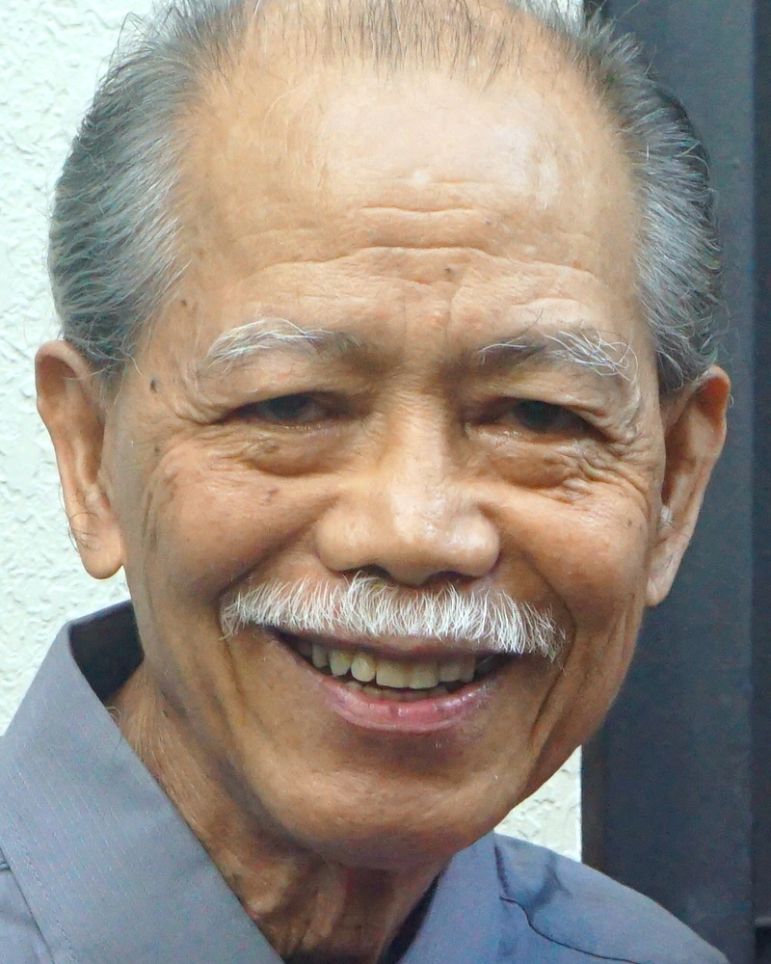
Adult Bible Study Guide
Oct • Nov • Dec 2022
Teacher’s Preview
powerpoint presentation designed by claro ruiz vicente
Notes:
“At malalaman ninyo ang katotohanan, at ang katotohanan ang magpapalaya sa inyo” (Juan 8:32 FSV).

Slide 2
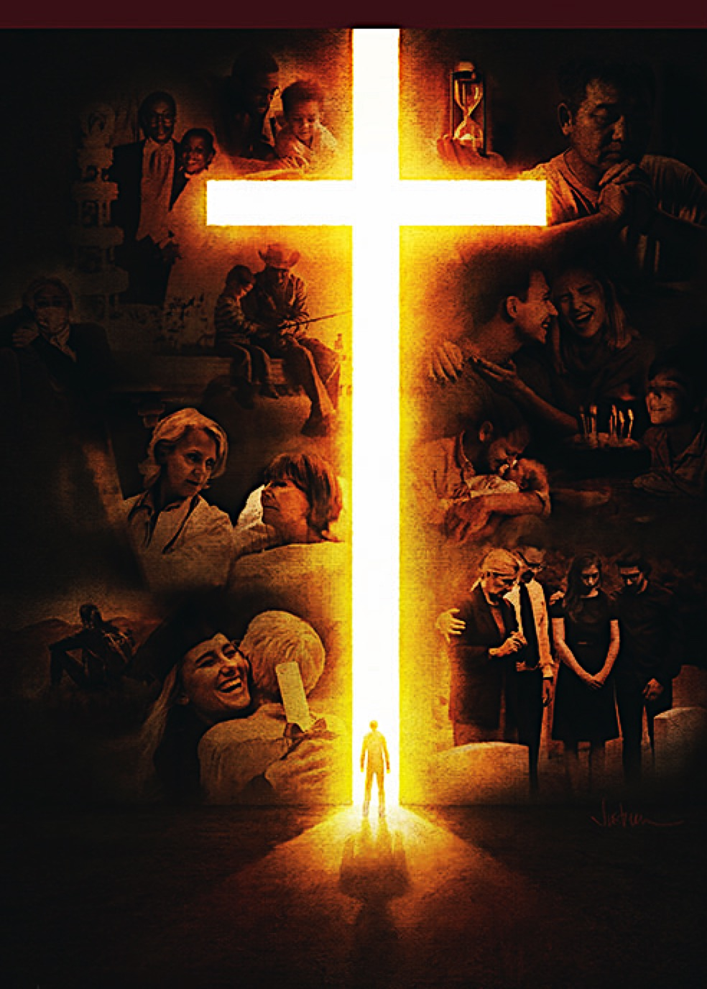
Alberto R. Timm
Principal Contributor
Notes:
Sa Kamatayan, Pag-aagaw-buhay, at ang Kinabukasang Pag-asa.

Slide 3
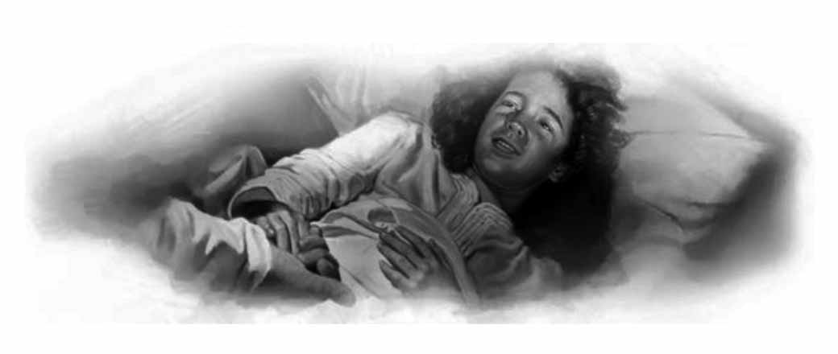
Resurrections Before the Cross
Lesson 5, October 29, 2022
Resurrections Before the Cross
Notes:
Mga Muling Pagkabuhay Bago ang Krus

Slide 4
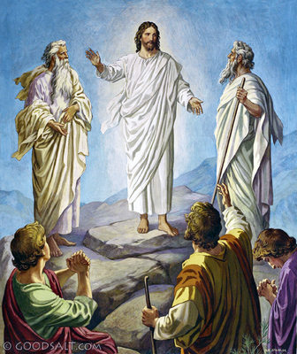
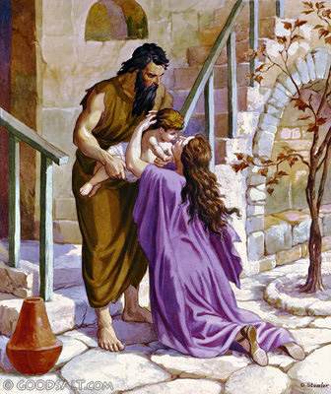
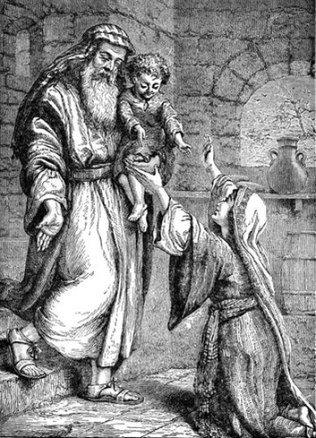
Resurrections Before the Cross
This Week
Resurrections that occurred before Christ’s own death and resurrection.
Notes:
Sa Linggong Ito. Ating pag-iisipang mabuti ang Mga muling pagkabuhay na nangyari bago ang sariling kamatayan at muling pagkabuhay ni Cristo. Tatlo sa Lumang Tipan at

Slide 5
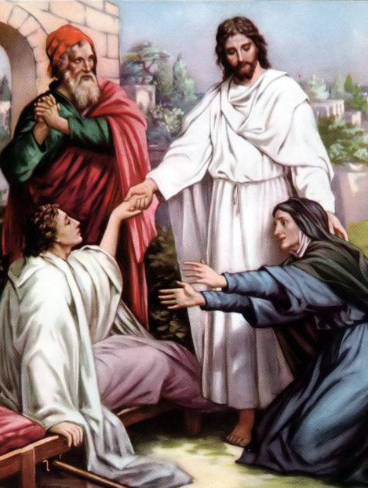
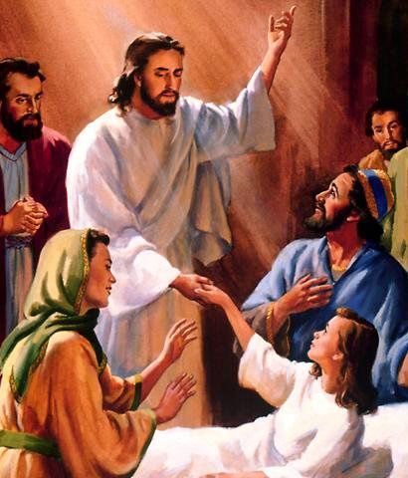
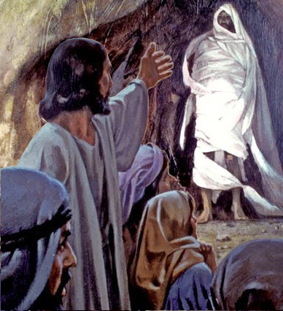
Resurrections Before the Cross
This Week
Resurrections that occurred before Christ’s own death and resurrection.
Notes:
Tatlo sa Bagong Tipan.

Slide 6
Resurrections Before the Cross
Key Text
John 11:25, 26 LEB
“Jesus said to her, ‘I am the resurrection and the life. The one who believes in me, even if he dies, will live, and everyone who lives and believes in me will never die forever. Do you believe this?’ ”
Notes:
Susing Talata. “Sinabi ni Jesus sa kanya, ‘Ako ang muling pagkabuhay at ang buhay. Siya na maniniwala sa akin, kahit kapag siya’y namatay, ay mabubuhay, at lahat na nabubuhay at naniniwala sa akin ay hinding-hindi mamamatay magpawalang-hanggan. Pinaniniwalaan mo ba ito?’ ” (Juan 11:25, 26).

Slide 7
Resurrections Before the Cross
Sabbath Afternoon, October 22
The first resurrection was of Moses (Jude 9, Luke 9:28–36). During Israel’s monarchy, the son of the widow of Zarephath (1 Kings 17:8–24) and the Shunammite’s son (2 Kings 4:18–37) also were resurrected. Christ, resur-rected the son of the widow of Nain (Luke 7:11–17), Jairus’s daughter (Luke 8:40–56),
The first resurrection was of Moses (Jude 9, Luke 9:28–36). During Israel’s monarchy, the son of the widow of Zarephath (1 Kings 17:8–24) and the Shunammite’s son (2 Kings 4:18–37) also were resurrected. Christ, resur-rected the son of the widow of Nain (Luke 7:11–17),
The first resurrection was of Moses (Jude 9, Luke 9:28–36). During Israel’s monarchy, the son of the widow of Zarephath (1 Kings 17:8–24) and the Shunammite’s son (2 Kings 4:18–37) also were resurrected.
The first resurrection was of Moses (Jude 9, Luke 9:28–36).
The first resurrection was of Moses (Jude 9, Luke 9:28–36). During Israel’s monarchy, the son of the widow of Zarephath (1 Kings 17:8–24) and the Shunammite’s son (2 Kings 4:18–37) also were resurrected. Christ, resur-rected the son of the widow of Nain (Luke 7:11–17), Jairus’s daughter (Luke 8:40–56), and then Lazarus (John 11).
Notes:
Sabbath ng Hapon, Oktubre 22. Ang unang pagkabuhay ay kay Moises (Judas 9, Lucas 9:28–36). ¶ Sa panahon ng monarkiya ng Israel, ang anak na lalaki ng balo ng Sarepta (1 Mga Hari 17:8–24) at ang anak na lalaki ng Sunamita (2 Mga Hari 4:18–37) ay muling nabuhay rin. ¶ Muling binuhay rin ni Cristo ang anak na lalaki ng balo ng Nain (Lucas 7:11–17), ¶ ang anak na babae ni Jairo (Lucas 8:40–56), ¶ at pagkatapos ay si Lazaro (Juan 11).

Slide 8
Resurrections Before the Cross
Sabbath Afternoon, October 22
Except for Moses, all these people were raised as mortals who eventually would die again. These cases also confirm the biblical teaching of the unconsciousness of the dead (Job 3:11–13; Ps. 115:17; Ps. 146:4; Eccles. 9:5, 10). In none of these accounts, nor in any other biblical resur- rection narratives, is there any mention of a supposed afterlife experience.
Except for Moses, all these people were raised as mortals who eventually would die again. These cases also confirm the biblical teaching of the unconsciousness of the dead (Job 3:11–13; Ps. 115:17; Ps. 146:4; Eccles. 9:5, 10).
Except for Moses, all these people were raised as mortals who eventually would die again.
Notes:
Maliban kay Moises, lahat ng mga taong ito’y binangon bilang mga taong sa katapusan ay muling mamamatay. ¶ Ang mga kalagayang ito’y nagpapatunay sa katuruan ng Biblia ng kawalang ng malay-tao ng patay (Job 3:11–13; Awit 115:17; Awit 146:4; Eclesiastes 9:5, 10). ¶ Wala sa mga salaysay na ito, ni sa alinmang naratibo ng muling pagkabuhay sa Biblia, ay may anumang pagbanggit ng isang inaakalang karanasan pagkatapos ng buhay.

Slide 9
Sunday, October 23
The Resurrection of Moses
“Christ Himself, with the angels who had buried Moses, came down from heaven to call forth the sleeping saint.... For the first time Christ was about to give life to the dead. As the Prince of life and the shining ones approached the grave, Satan was alarmed for his supremacy....
“Christ Himself, with the angels who had buried Moses, came down from heaven to call forth the sleeping saint.... For the first time Christ was about to give life to the dead. As the Prince of life and the shining ones approached the grave,
“Christ Himself, with the angels who had buried Moses, came down from heaven to call forth the sleeping saint.... For the first time Christ was about to give life to the dead.
“Christ Himself, with the angels who had buried Moses, came down from heaven to call forth the sleeping saint....
Notes:
Linggo, Oktubre 23. Ang Muling Pagkabuhay ni Moises. “Si Cristo mismo, kasama ang mga anghel na naglibing kay Moises, ay bumaba mula sa langit upang tawagin ang natutulog na banal.... ¶ Sa unang pagkakataon si Cristo ay magbibigay ng buhay sa patay. ¶ Samantalang ang Prinsipe ng buhay at ang mga nagliliwanag [mga anghel] ay papalapit sa libingan, si Satanas ay natakot para sa kanyang paghahari....

Slide 10
Sunday, October 23
The Resurrection of Moses
Christ did not stoop to enter into controversy with Satan.... But Christ referred all to His Father, saying, ‘The Lord rebuke thee.’ Jude 9.... The resurrection was forever made certain. Satan was despoiled of his prey; the righteous dead would live again.”—Patriarchs and Prophets 478, 479.
Christ did not stoop to enter into controversy with Satan.... But Christ referred all to His Father, saying, ‘The Lord rebuke thee.’ Jude 9.... The resurrection was forever made certain.
Christ did not stoop to enter into controversy with Satan.... But Christ referred all to His Father, saying, ‘The Lord rebuke thee.’ Jude 9....
Christ did not stoop to enter into controversy with Satan....
Notes:
hindi nagbaba ng sarili si Cristo upang makipagtunggalian kay Satanas.... ¶ Kundi iniharap ni Cristo ang lahat sa kanyang Ama, nagsasabing, ‘Sawayin ka nawa ng Panginoon.’ Judas 9.... ¶ Ang muling pagkabuhay ay natiyak magpakailanman. ¶ Si Satanas ay ay naagawan ng kanyang biktima; ang matuwid na patay ay mabubuhay muli.”—Patriarchs and Prophets 478, 479.

Slide 11
Sunday, October 23
The Resurrection of Moses
A clear evidence of Moses’ resurrec-tion is found at the Transfiguration. There Moses appeared with the pro-phet Elijah, who had been translated with-out seeing death (2 Kings 2:1–11). Moses and Elijah even dialogued with Jesus (see Luke 9:28–36). “And behold, two men talked with Him, who were Moses and Elijah, who appeared in
A clear evidence of Moses’ resurrec-tion is found at the Transfiguration.
There Moses appeared with the pro-phet Elijah, who had been translated with-out seeing death (2 Kings 2:1–11).
Moses and Elijah even dialogued with Jesus (see Luke 9:28–36).
Notes:
Isang malinaw na katunayan ng muling pagkabuhay ni Moises ay masusumpungan sa Pagbabagong-anyo. ¶ Doon ay nagpakita si Moises kasama ang propeta Elias, na ipinarating sa langit na hindi namatay (2 Mga Hari 2:1–11). ¶ Sina Moises at Elias ay nakipag-usap pa nga kay Jesus (tingnan ang Lucas 9:28–36). ¶ “At narito, dalawang lalake ay nakikipagusap sa kanya, ang ang mga ito’y si Moises at si Elias, na nakipagkitang may

Slide 12
Sunday, October 23
The Resurrection of Moses
glory and spoke of His decease which He was about to accomplish at Jerusa-lem” (Luke 9:30, 31). Moses’ appear-ance, proof of Christ’s coming victory over sin and death, is depicted here in unmistakable terms. It was Moses and Elijah, not their “spirits” (after all, Elijah hadn’t died), who had appeared to Jesus there.
glory and spoke of His decease which He was about to accomplish at Jerusa-lem” (Luke 9:30, 31). Moses’ appear-ance, proof of Christ’s coming victory over sin and death, is depicted here in unmistakable terms.
glory and spoke of His decease which He was about to accomplish at Jerusa-lem” (Luke 9:30, 31).
Notes:
kaluwalhatian at nakipag-usap tungkol sa kanyang pagkamatay na malapit niyang ganapin sa Jerusalem” (Lucas 9:30, 31). ¶ Ang pagpapakita ni Moises, katunayan ng darating na tagumpay ni Cristo sa kasalanan at kamatayan, ay nailarawan dito sa hindi mapagkakamalang katawagan. ¶ Si Moises at si Elias, hindi ang kanilang ”mga espiritu” (matapos ang lahat si Elias ay hindi namatay), ang nagpakita kay Jesus doon.

Slide 13
Sunday, October 23
The Resurrection of Moses
Moses was not allowed to enter the earthly Canaan but was taken into the heavenly Canaan.
God “is able to do exceedingly abundantly above all that we ask or think, according to the power that works in us” (Eph. 3:20).
Notes:
Hindi pinahintulutan ni Moises na pumasok sa makalupang Canaan ngunit dinala sa makalangit na Canaan. ¶ Ang Diyos “ay makapangyarihang gumagawa ng lubhang sagana ng higit sa lahat ng ating hinihingi o iniisip, ayon sa kapangyarihang gumagawa sa atin” (Efeso 3:20).

Slide 14
Monday, October 24
Two Old Testament Cases
By faith “women received back their dead by resurrection” (Heb. 11:35 NASB).” A Zarephath widow’s son (1 Kings 17) and a Shunammite’ son (2 Kings 4). These women had different back-grounds but the same saving faith.
The faithful mothers appealed to those prophets of God and had the joy of seeing their children come to life again.
By faith “women received back their dead by resurrection” (Heb. 11:35 NASB).” A Zarephath widow’s son (1 Kings 17) and a Shunammite’ son (2 Kings 4).
By faith “women received back their dead by resurrection” (Heb. 11:35 NASB).
Notes:
Lunes, Oktubre 24. Dalawang Pangyayari sa Lumang Tipan. Sa pamamagitan ng pananampalataya “tinanggap ng mga babae ang kanilang mga patay sa pamaamgitan ng pagkabuhay na muli” (Hebreo 11:35).¶ Anak na lalake ng isang balo sa Sarepta (1 Mga Hari 17) at anak na lalake ng isang Sunamita (2 Mga Hari 4). ¶ May magkaibang karanasan ang mga babaeng ito ngunit magkatulad na nagliligtas na pananampalataya. ¶ Ang matatapat na ina ay umapela sa mga propeta ng Diyos at nagkaroon ng kagalakang makita ang kanilang mga anak na mabuhay muli.

Slide 15
Monday, October 24
Two Old Testament Cases
These are great stories, but for each of these two accounts, how many untold others didn’t end with something so miraculous?
What should this sad fact teach us about just how central to our faith is the promised resurrection at the end of time?
Notes:
Dakilang mga kuwento ang mga ito, ngunit sa bawat isa nitong dalawang salaysay, gaano karaming ang hindi naihayag na hindi nagtapos na may ganitong talagang kahima-himala? ¶ Ano ang dapat ituro sa atin nitong malungkot na katotohanan tungkol sa kung gaano ka-sentro sa ating pananampalataya ang naipangakong muling pagkabuhay sa wakas ng panahon?

Slide 16
Tuesday, October 25
The Son of the Widow of Nain
Jesus and His followers were approach-ing the gates of Nain when a funeral pro- cession was going through those gates.
In the open coffin was the only son of a widow, who was weeping inconsolably.
Full of compassion, Jesus said to her, “ ‘Do not weep.’ ” Then Jesus turned to the dead son in the coffin and ordered him, “ ‘Young man, I say to you, arise.’ ”
Notes:
Martes, Oktubre 25. Ang anak na lalaki ng Balo ng Nain. Si Jesus at ang kanyang mga tagasunod ay papalapit sa tarangkahan ng Nain nang isang prusisyon ng paglilibing ang papalabas sa tarangkahan. ¶ Sa loob ng bukas na kabaong ay ang nag-iisang anak ng isang balo, na umiiyak na basag ang puso. ¶ Lubos ang awa, sinabi ni Jesus sa kanya, “ ‘Huwag kang tumangis.’ ” Pagkatapos ay bumaling si Jesus sa patay na anak na nasa kabaong at nag-utos sa kanya, “ ‘kabataan, sinasabi ko sa ‘yo, bangon.’ ”

Slide 17
Tuesday, October 25
The Son of the Widow of Nain
The son came to life, and Jesus “pre-sented him to his mother” (Luke 7:15).
The presence of Jesus completely changed the whole scenario, and many people who had witnessed the miracle knew not only that something astonish-ing had happened but also that some-one special (they called Him “a great prophet”) was among them.
Notes:
Nabuhay ang anak, at si Jesus ay “ibinigay siya sa kanyang ina” (Lucas 7:15). ¶ Lubos na nabago ang buong tanawin ng presensya ni Jesus, at maraming taong nasaksihan ang himala ay alam hindi lamang na isang bagay na kamangha-mangha ang nangyari kundi na isang bagay rin na natatangi (tinawag nila Siya na “isang dakilang propeta”) ay nasa kalagitnaan nila.

Slide 18
Tuesday, October 25
The Son of the Widow of Nain
Both the Phoenician widow and the Shunammite woman had asked for help—from Elijah and Elisha, respectively.
But the widow of Nain was helped without even asking for it. This means that God cares for us even when we are unable or feel unworthy to ask Him for help. Jesus saw the problem and dealt with it—so typical of Jesus in His ministry.
Both the Phoenician widow and the Shunammite woman had asked for help—from Elijah and Elisha, respectively.
But the widow of Nain was helped without even asking for it. This means that God cares for us even when we are unable or feel unworthy to ask Him for help.
Both the Phoenician widow and the Shunammite woman had asked for help—from Elijah and Elisha, respectively.
But the widow of Nain was helped without even asking for it.
Notes:
Parehong ang balo ng Fenicia at ang Sunamitang babae ay humingi ng tulong—mula kina Elias at Eliseo, ayon sa pagkakabanggit. ¶ Subalit ang balo ng Nain ay natulungan na hindi man lang humingi para rito. ¶ Ito’y nangangahulugang ang Diyos ay kumakalinga sa atin kahit kapag hindi natin kaya o hindi nakadaramang karapat-dapat upang humingi sa Kanya para sa tulong. ¶ Nakita ni Jesus ang problema at hinarap ito—talagang kaugalian ni Jesus sa Kanyang ministeryo.

Slide 19
Wednesday, October 26
Jairus’s Daughter
Jairus’s 12-year-old daughter was lying deathly sick at home. So, he went to Jesus and begged Him to come to his home and lay His healing hands on her. But before they could get there, someone brought the news “ ‘Your daughter is dead. Why trouble the Teacher any further?’ ” (Mark 5:35). Then Jesus said to the grieving father, “ ‘Do not fear, only believe’ ” (v. 36).
Jairus’s 12-year-old daughter was lying deathly sick at home. So, he went to Jesus and begged Him to come to his home and lay His healing hands on her. But before they could get there, someone brought the news “ ‘Your daughter is dead. Why trouble the Teacher any further?’ ” (Mark 5:35).
Jairus’s 12-year-old daughter was lying deathly sick at home. So, he went to Jesus and begged Him to come to his home and lay His healing hands on her.
Notes:
Miyerkules, Oktubre 26. Ang Anak na Babae ni Jairo. Ang 12-taong-gulang na anak na babae ni Jairo ay nakaratay sa nakamamatay na karamdaman sa bahay. Kaya, naparoon siya kay Jesus at pinakiusapang sumama sa kanyang tahanan at ipatong ang kanyang nagpapagaling na kamay sa kanya. ¶ Subalit bago Siya nakarating doon, may nagdala ng balita “ ‘Namatay na ang anak mong babae. Bakit mo pa inaabala ang Guro?’ ” ” (Mark 5:35). ¶ Pagkatapos ay sinabi ni Jesus sa nagdadalamhating ama, “ ‘Huwag kang matakot; manampalataya ka lamang’ ” (tal. 36).

Slide 20
Wednesday, October 26
Jairus’s Daughter
Arriving at the house, Jesus said to those who gathered there, “ ‘Why do you make a commotion and weep? The child is not dead but sleeping’ ”
(Mark 5:39). They ridiculed Him because (1) they knew that she was dead, and (2) they did not grasp the meaning of His words.
Arriving at the house, Jesus said to those who gathered there, “ ‘Why do you make a commotion and weep? The child is not dead but sleeping’ ”
(Mark 5:39).
Notes:
Pagdating sa bahay, sinabi ni Jesus sa mga nagtitipon doon, “ ‘Bakit kayo nagkakagulo at nag-iiyakan? Hindi patay ang bata, kundi natutulog lamang’ ” (Marcos 5:39). ¶ Kanilang kinutya Siya dahil (1) alam nilang patay na siya, at (2) hindi nila maunawaan ang kahulugan ng Kanyang mga salita.

Slide 21
Wednesday, October 26
Jairus’s Daughter
“The metaphor by which ‘sleep’ stands for ‘death’ seems to have been Christ’s favorite way of referring to this experience (see John 11:11–15).
Death is a sleep, but it is a deep sleep from which only the great Life-giver can awaken one, for He alone has the keys to the tomb....”—The SDA Bible Commentary 5:609.
Notes:
“Ang metapora kung saan ginamit ang ‘pagtukog’ tila paboritong paraan ni Jesus ng pagtukoy sa karanasang ito (tingnan ang Juan 11:11–15). ¶ Ang kamatayan ay isang pagtulog, ngunit ito’y isang malalim na pagtulog kung saan ang dakilang tagapag-bigay-ng, buhay lamang ang makagigising, dahil Siya lamang ang may susi sa nitso....”—The SDA Bible Commentary 5:609.

Slide 22
Thursday, October 27
Lazarus
“ ‘Our friend Lazarus has fallen asleep; but I am going there to wake him up’ ”
(John 11:11 NIV). When some thought He was talking about literal sleep (v. 12), Jesus clearly stated what He meant:
“ ‘Lazarus is dead’ ” (v. 14). When Jesus arrived, Lazarus had been dead four days; his corpse already was rotting (v. 39). There’s no question: the person is dead.
“ ‘Our friend Lazarus has fallen asleep; but I am going there to wake him up’ ”
(John 11:11 NIV). When some thought He was talking about literal sleep (v. 12), Jesus clearly stated what He meant:
“ ‘Lazarus is dead’ ” (v. 14).
“ ‘Our friend Lazarus has fallen asleep; but I am going there to wake him up’ ”
(John 11:11 NIV).
Notes:
Huwebes, Oktubre 27. Si Lazaro. “ ‘Si Lazaro na ating kaibigan ay natutulog, ngunit ako'y pupunta roon, upang gisingin siya’ ” (Juan 11:11). ¶ Nang may nag-isip na nagsasalita Siya tungkol sa literal na pagtulog (tal. 12), malinaw na sinabi ni Jesus ang ibig Niyang sabihin: “ ‘Namatay si Lazaro’ ” (tal. 14). ¶ Nang dumating si Jesus, si Lazaro ay patay na nang apat na araw; nabubulok na ang kanyang bangkay (tal. 39). Walang duda: ang tao’y patay.

Slide 23
Thursday, October 27
Lazarus
In this context, when Jesus told Martha, “ ‘Your brother will rise from the dead’ ”
(John 11:23 NASB), she reaffirmed her belief in the final resurrection. But Jesus declared, “ ‘I am the resurrection and the life. The one who believes in me, even if he dies, will live, and everyone who lives and believes in me will never die forever. Do you believe this?’ ” (v. 25 LEB).
In this context, when Jesus told Martha, “ ‘Your brother will rise from the dead’ ”
(John 11:23 NASB), she reaffirmed her belief in the final resurrection.
Notes:
Sa kontekstong ito, nang sabibin ni Jesus kay Marta, “ ‘Ang kapatid mo’y babangon mula sa patay’ ” (Juan 11:23), kanyang muling pinagtibay ang kanyang paniniwala sa pangwakas na muling pagkabuhay. ¶ Ngunit nagpahayag si Jesus, “Ako ang muling pagkabuhay at ang buhay. Siya na naniniwal saakin, kahit siya’y mamatay ay mabubuhay, at lahat na nabubuhay at naniniwala sa akin ay hinding-hindi mamamataya magpawalanghanggan. Naniniwala ka ba rito?’ ” (tal. 25).

Slide 24
Thursday, October 27
Lazarus
Jesus added, “ ‘If you believe, you will see the glory of God’ ” (John 11:40 NASB). Martha believed, and she saw the glory of God in the resurrection of her brother.
Jesus ordered, “ ‘Lazarus, come forth!’ ”
(v. 43). The same power that spoke our world into existence is the same power that at the end of the age will call the dead back to life in the resurrection.
Notes:
Dagdag ni Jesus, “ ‘Kung naniniwala ka, makikitamo ang kaluwalhatian ng Diyos’ ” (Juan 11:40). Naniwala si Marta, at nakita niya ang kaluwlahatian ng Diyos sa muling pagkabuhay ng kanyang kapatid. ¶ Nag-utos si Jesus “ ‘Lazaro, lumabas ka!’ ” (tal. 43). ¶ Ang katulad na kapangyarihan na nagbigkas sa pag-iral ng ating daigdig ay ang katulad na kapangyarihan na sa katapusang ng panahon ay tatawagin ang patay pabalik sa buhay sa muling pagkabuhay.

Slide 25
Friday, October 28, Further Thought
The Desire of Ages 530
“In Christ is life, original, unborrowed, underived. ‘He that hath the Son hath life.’ 1 John 5:12. The divinity of Christ is the believer’s assurance of eternal life. ...
The miracle which Christ was about to perform, in raising Lazarus from the dead, would represent the resurrection of all the righteous dead. By His word...He declared Himself the Author of the resurrection.”
Notes:
The Desire of Ages 530. “Kay Cristo ay buhay, orihinal, di-hiram, di-nakamtan. ‘Ang kinaroroonan ng Anak ay kinaroroonan ng buhay.’ 1 Juan 5:12. Ang pagkadiyos ni Cristo ay ang katiyakan ng mananampalataya ng walang-hanggang buhay. ... ¶ Ang himala na isasagawa ni Cristo, sa pagbangon kay Lazaro mula sa patay, ay kakatawanin ang muling pagkabuhay ng lahat ng matuwid na patay. Sa pamamagitan ng Kanyang salita...inihayag Niya ang sarili na May-akda ng muling pagkabuhay.”

Slide 26
Resurrections Before the Cross
Outline for Teaching
1. The Resurrection of Moses
Sun. First Example. Luke 9:30, 31.
2. Two Old Testament Cases
Mon. •At Zarephath. 1 Kings 17:22.
•At Shunem. 2 Kings 4:35.
3. Three New Testament Cases
a. Tue. At Nain. Luke 7:14, 15.
b. Wed. At Capernaum. Mark 5:41, 42.
c. Thu. At Bethany. John 11:43, 44.
Notes:
Balangkas para sa Pagtuturo.
Ang Muling Pagkabuhay ni Moises.
a. Linggo. Unang Halimbawa. Lucas 9:30, 31.
(2) Dalawang Halimbawa sa Lumang Tipan.
a. Lunes. •Sa Sarepta. 1 Mga Hari 17:22.
•Sa Shunem. 2 Mga Hari 4:35.
(3) Tatlong Halimbawa sa Bagong Tipan.
a. Martes. Sa Hain. Lucas 7:14, 15.
b. Miyerkules. Sa Capernaum. Marcos 5:41, 42.
c. Huwebes. Sa Betania. Juan 11:43, 44

Slide 27
Resurrections Before the Cross
Presentation Record
1. PAA ‘77 Dev. 29 Oct 22 via Messenger chat room

