Slide 1
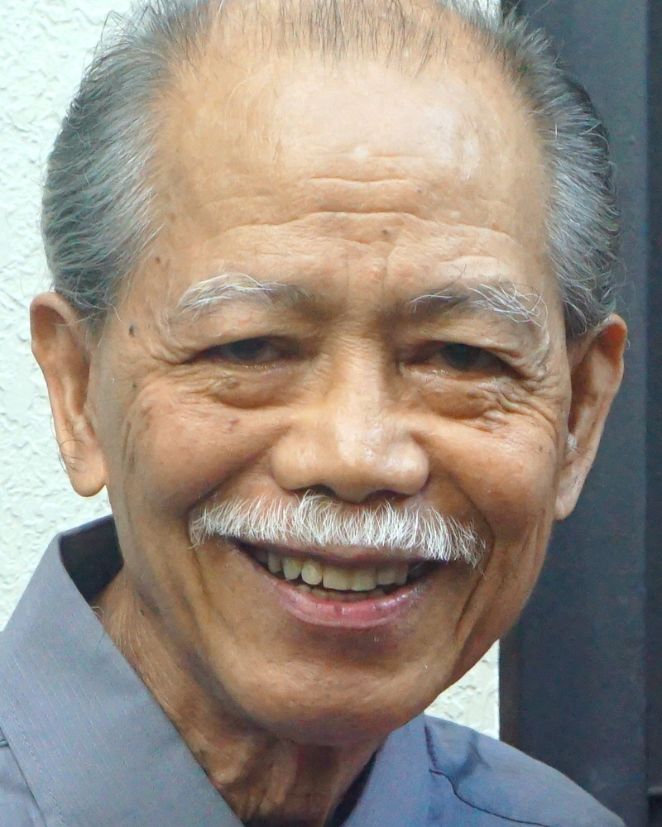
Adult Bible Study Guide
Jul • Aug • Sep 2021
powerpoint presentation designed by claro ruiz vicente
http://clarovicente.weebly.com

Slide 2
Adult Sabbath School Bible Study Guide
An Appeal
DEAR USER
This PowerPoint Show is freely shared to all who may find it beneficial. While intended primarily for personal use, some find it useful for teaching the lesson
in church.
There are those, however, who add illustrations, change background, replace fonts, etc. While their intention may be good, this is not right. Slide #1 says “designed by claro ruiz vicente.” For honest Christians, it is not necessary for another’s creation to be copyrighted in order to be respected.
PLEASE USE AS IS.

Slide 3
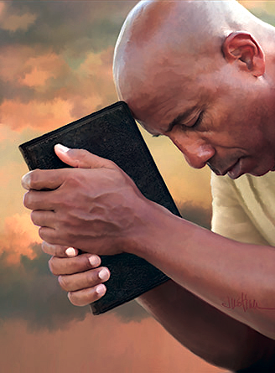
Gerald & Chantal Klingbeil
Principal Contributors
Notes:
Kapahingahan Kay Cristo. Sa isang Adventista, ano ang karaniwang maiisip kapag ang usapan ay tungkol sa kapahingahan, lalo na kung kapahingahan kay Cristo? Ang araw ng Sabbath di ba?

Slide 4
Rest in Christ
Contents
1 Living in a 24-7 Society
2 Restless and Rebellious
3 The Roots of Restlessness
4 The Cost of Rest
5 “ ‘Come to Me . . .’ ”
6 Finding Rest in Family Ties
7 Rest, Relationships, and Healing
8 Free to Rest
9 The Rhythms of Rest
10 Sabbath Rest
11 Longing for More
12 The Restless Prophet
13 The Ultimate Rest
Notes:
Pang-anim na liksyon.

Slide 5
Rest in Christ
Our Goal
“Resting in Christ is the key to the type of life that Jesus promises to His followers: ‘The thief does not come except to steal, and to kill, and to destroy. I have come that they may have life, and that they may have it more abundantly’ ” (John 10:10 NKJV).
As we study the weekly lessons, let us remember to come and rest in Him.
Notes:
Ang Ating Mithiin. “Kapahingahan kay Cristo ay ang susi sa uri ng buhay na ipinapangako ni Jesus sa Kanyang mga tagasunod: ‘Ang magnanakaw ay dumarating lamang upang magnakaw, pumatay, at pumuksa. Ako’y pumarito upang sila’y magkaroon ng buhay, at magkaroon nito nang may kasaganaan’ ” (Juan 10:10). ¶ Samantalang pinag-aaralan natin ang lingguhang liksyon, ating tandaang lumapit at magpahinga sa Kanya.

Slide 6
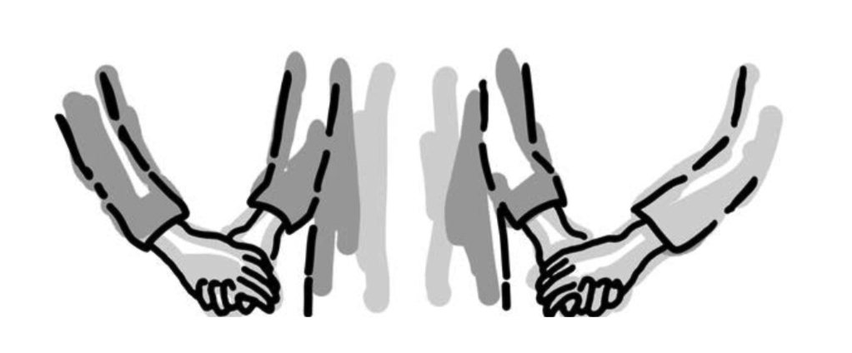
Rest in Christ
Lesson 6, August 7, 2021
Finding Rest in Family Ties
Notes:
Pagkatuklas ng Kapahingahan sa mga Tali ng Pamilya

Slide 7
Finding Rest in Family Ties
Key Text
2 Peter 3:17, 18 NKJV
“You therefore, beloved, since you know this beforehand, beware lest you also fall from your own steadfastness, being led away with the error of the wicked; but grow in the grace and knowledge of our Lord and Savior Jesus Christ. To Him be the glory both now and forever. Amen.”
Notes:
Susing Talata. “Kaya’t kayo, mga minamahal, yamang nalalaman na ninyo noon pa ang mga bagay na ito, mag-ingat kayo, baka mailigaw kayo sa pamamagitan ng kamalian ng masasama at mahulog kayo mula sa inyong sariling katatagan. Subalit lumago kayo sa biyaya at sa pagkakilala sa ating Panginoon at Tagapagligtas na si Jesu-Cristo. Sumakanya nawa ang kaluwalhatian ngayon at hanggang sa araw ng walang-hanggan. Amen” (2 Pedro 3:17, 18).

Slide 8
Finding Rest in Family Ties
Initial Words
We get to choose many things in life —but not our family. No one is perfect, and none of us have perfect families and perfect family relationships.
Family relationships often are complicated and painful, leaving us restless, hurt, and carrying loads of emotional baggage that we, in turn, off-load on others.
Notes:
Panimulang Salita. Makakapili tayo sa maraming bagay ng buhay, ngunit hindi ang ating pamilya. Walang perpekto, at wala sa atin ang may perpektong pamilya at perpektong relasyong pampamilya. Ilan sa atin ang nabiyayaan ng mga magulang, kapatid, at ibang kaanib ng pamilya na nagpapakita ng pag-ibig ng Diyos, subalit marami ang magtitiyaga sa mas mabababa sa huwaran. ¶ Ang relasyong pampamilya ay madalas na magusot at nakasasakit, nagiiwan sa atin na balisa, nasaktan at dala-dala ang mga kargada ng emosyon, bagahe na tayo naman ay nagdidiskarga sa iba.

Slide 9
Finding Rest in Family Ties
Quick Look
1. Choosing a New Direction (Joshua 24:15)
2. Doing Relationships God’s Way (Genesis 39:9)
3. The Lord Was With Joseph (Genesis 39:21-23)
Notes:
1. Pumipili ng isang Bagong Direksyon (Josue 24:15)
2. Nakikipagrelasyon sa Paraan ng Diyos (Genesis 39:9)
3. Kasama Ni Jose ang Panginoon (Genesis 39:21-23)

Slide 10
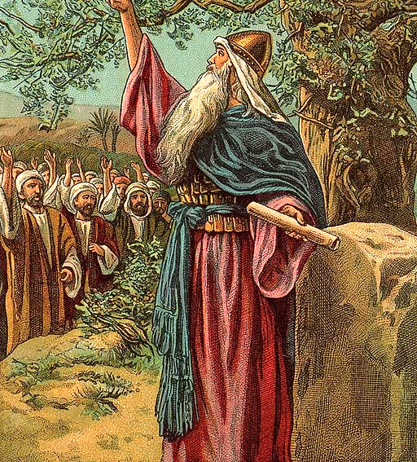
Finding Rest in Family Ties
1. Choosing a New Direction
Joshua 24:15 NKJV
“And if it seems evil to you to serve the Lord, choose for yourselves this day whom you will serve, whether the gods which your fathers served that were on the other side of the River, or the gods of the Amorites, in whose land you dwell.
But as for me and my house, we will serve the Lord.”
Notes:
1. Pumipili ng isang Bagong Direksyon. “Ngayon kung ayaw ninyong maglingkod sa Panginoon, ay piliin ninyo sa araw na ito kung sino ang inyong paglilingkuran; kung ang mga diyos na pinaglingkuran ng inyong mga ninuno sa kabila ng Ilog, o ang mga diyos ng mga Amoreo na ang lupain nila ay inyong tinitirahan; ¶ ngunit sa ganang akin at sa aking sambahayan, kami ay maglilingkod sa Panginoon” (Josue 24:15).

Slide 11
1. Choosing a New Direction
Dysfunction at Home
Joseph knew about dysfunctional families. It had started with his great-grandparents, Abraham and Sarah.
Isaac made a point of favoring Esau.
Jacob was tricked into marrying two sisters who competed with each other through a childbearing race, even enlisting their maids to bear Jacob’s children.
Notes:
Deperensya sa Tahanan. Nalaman ni Jose ang tungkol sa mga pamilyang may deperensya. Nakapagpasimula na ito sa kanyang lolo't lola sa tuhod, sina Abraham at Sara. ¶ Pinaboran ni Isaac si Esau. ¶ Nalinlang si Jacob na pakasalan ang dalawang mag-ate na nagkukumpetensiyahan sa isang karera ng panganganak, nagpapatulong pa nga sa kanilang mga katulong na babae na ipanganak ang anak ni Jacob.

Slide 12
1. Choosing a New Direction
Dysfunction at Home
The rivalry between the mothers obviously spilled over to the children.
Joseph’s older brothers massacred all the males in the town of Shechem. Reuben slept with Bilhah, Rachel’s maid. Judah mistook his widowed daughter-in-law for a prostitute and had twins with her. Jacob added fuel to the fire by his favoritism toward Joseph.
Notes:
Ang kompitensiyahan sa pagitan ng dalawan ina ay malinaw na kumalat sa mga anak. ¶ Ang mga nakatatandang kapatid ni Jose ay pinagpapatay ang lahat ng mga lalaki sa bayan ng Shekem. Si Ruben ay sumiping kay Bilha, ang babaeng katulong ni Raquel. Si Juda ay napagkamalang isang prosti ang kanyang nabalong manugang at nagkaroon ng kambal sa kanya. Nagdagdag si Jacob ng gatong sa apoy sa pamamagitan ng kanyang paboritismo kay Jose.

Slide 13
1. Choosing a New Direction
Committing Self to God
Joseph takes pain, complicated relationships, and anxiety with him as he travels to Egypt, where he is to be sold as a slave. This was not a restful trip as he fought back the tears.
“Then his thoughts turned to his father’s God. In his childhood he had been taught to love and fear Him. Often …he had listened to the story of the
Notes:
Pagtatalaga ng Sarili sa Diyos. Dala-dala ni Jose ang kirot, komplikadong relasyon, at pagkabalisa samantalang naglalakbay siya patungong Ehipto, kung saan ipagbibili siya bilang isang alipin. Hindi ito maginhawang paglalakbay samantalang nilalabanan niya ang mga luha. ¶ “Pagkatapos ang kanyang mga isipan ay bumaling sa Diyos ng kanyang ama. Sa kanyang kabataan ay naturuan siyang mahalin at matakot sa Kanya. Madalas…nakinig siya sa kuwento ng

Slide 14
1. Choosing a New Direction
Committing Self to God
vision that Jacob saw as he fled from his home an exile and a fugitive….
Now all these precious lessons came vividly before him. Joseph believed that the God of his fathers would be his God.
He then and there gave himself fully to the Lord, and he prayed that the Keeper of Israel would be with him in the land of his exile.”—Patriarchs and Prophets 214
Notes:
pangitaing nakita ni Jacob samantalang tumatakas siya mula sa kanyang tahanan na isang itinapon at isang pugante.... ¶ Ngayon ang lahat na mamahaling liksyon ay buong linaw na dumating sa harap niya. Naniwala si Jose na ang Diyos ng kanyang mga ama ay magiging Diyso niya. ¶ Noon at doon kubos na ipinagkaloon niya ang sarili sa Panginoon, at idinalangin na ang Tagapag-ingat ng Israel ay sasamahan siya sa lupain ng kanyang pagkakatapon.”—Patriarchs and Prophets 214

Slide 15
1. Choosing a New Direction
Committing Self to God
Joseph begins to find rest in his relationships by making a personal decision to follow God.
To find rest, we each must make a personal decision to follow God. Even if our ancestors were spiritual giants, this faith and spirituality aren’t trans-mitted genetically. Remember, God has only children, no grandchildren.
Notes:
Nagpapasimula si Jose na makasumpong ng kapayapaan sa kanyang mg aralasyon sa pamamagitan ng paggawa ng isang pagpapasyang sumusnod sa Diyos. ¶ Upang makasumpong ng kapahingahan, bawat isa sa atin ay dapat na gumawa ng isang personal na pagpapasya na sumunod sa Diyos. Kahit ang ating mga ninuno ay mga espirituwal na higante, ang pananampalataya at espirituwalidad ay hindi naisasalin sa pamamagitan ng genes. Alalahanin, may mga anak lamang ang Diyos, walang mga apo.

Slide 16
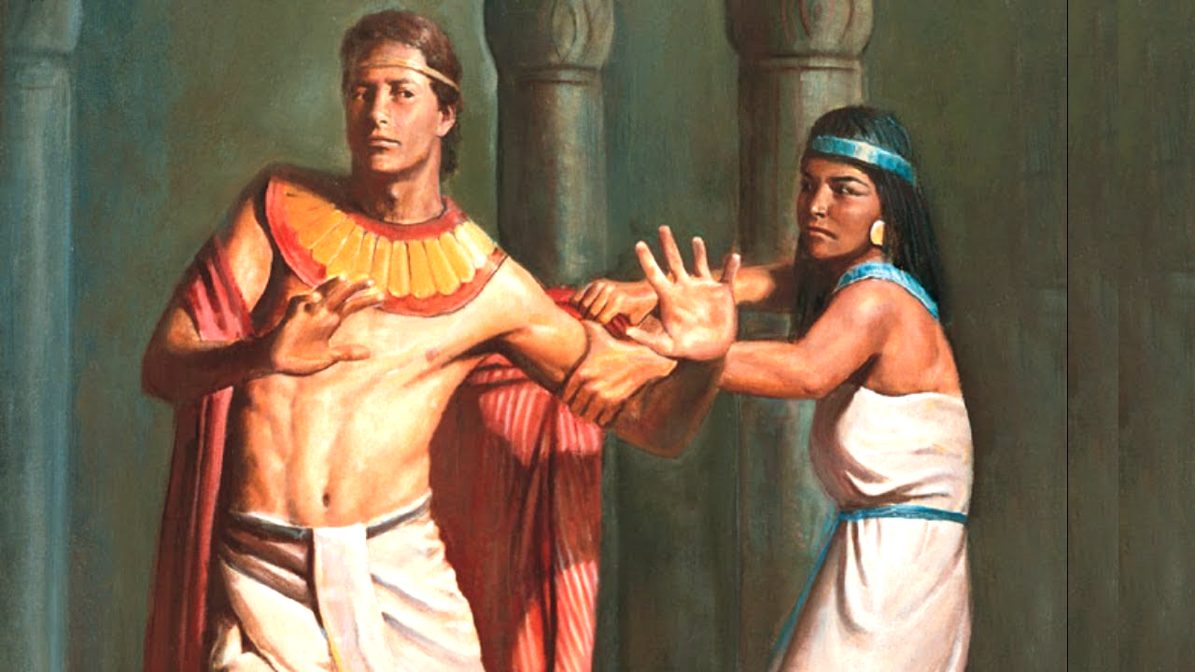
Finding Rest in Family Ties
2. Doing Relationships God’s Way
Genesis 39:9 NKJV
“There is no one greater in this house than I, nor has he kept back anything from me but you, because you are his wife.
How then can I do this great wickedness, and sin against God?”
Notes:
2. Nakikipagrelasyon sa Paraan ng Diyos. “Walang sinumang dakila kaysa akin sa bahay na ito; walang anumang bagay ang ipinagkait sa akin, maliban sa iyo, sapagkat ikaw ay kanyang asawa. ¶ Paano ngang magagawa ko itong malaking kasamaan at kasalanan laban sa Diyos?” (Genesis 39:9).

Slide 17
2. Doing Relationships God’s Way
Finding True Self-Worth
Joseph had grown up believing that he was something special—the oldest son of the most beloved wife (Gen. 29:18). He was definitely his father’s favorite—and the only one with a beautiful coat of many colors (Gen. 37:3, 4).
But who was he now? A slave, some-one who could be bought or sold at will. How quickly his situation changed.
Notes:
Nakakasumpong ng Tunay na Sariling Pagpapahalaga. Lumaki si Jose na naniniwalang siya'y natatangi—panganay na lalaki ng pinakamamahal na misis (Genesis 29:18). Tiyak na siya ang paborito ng kanyang ama, at nag-iisang may napakagandang panlabas na damit ng maraming kulay (Genesis 37:3, 4). Ngunit sino siya ngayon? Isang alipin, isa na mabibili at maipagbibili. Napakatuling nabago ang kanyang sitwasyon.

Slide 18
2. Doing Relationships God’s Way
Finding True Self-Worth
If we are dependent on others to tell us what we are worth, then we will be in for a rough ride and be horribly confused, because not everyone is going to appreciate who we are or what we are like.
We need to find our self-worth in what God thinks of us and not in the roles that we currently have.
Notes:
Kung nakadepende tayo sa iba upang sabihin sa atin kung ano ang ating halaga, kung gayon tayo'y papasok sa isang magulong paglalakbay at magiging labis na lito, dahil hindi lahat ay pahahalagahan kung sino tayo o ano ang katulad natin. ¶ Kailangang masumpungan natin ang ating sariling-kahalagahan sa kung ano ang iniisip ng Diyos tungkol sa atin at hindi sa mga papel na mayroon tayo sa kasalukuyan.

Slide 19
2. Doing Relationships God’s Way
Finding True Self-Worth
God looks at each of us with glasses tinted with grace. He sees a potential, beauty, and talent that we can’t even imagine. Regardless of what others think of us or even what we think about ourselves, God loves us and seeks to redeem us from not only the power of sins now but also from the eternal death that they bring.
Notes:
Nakatingin sa bawat isa sa atin ang Diyos gamit ang mga salamin na nakulayan ng biyaya. Nakikita Niya ang isang pupuwede, kagandahan, at talento na hindi pa nga nating naiisip. Sa kabila ng iniisip ng iba tungkol sa atin o kahit ang ating iniisip tungkol sa sarili natin, iniibig tayo ng Diyos at hinahangad na tubusin tayo mula hindi lamang sa kapangyarihan ng kasalanan ngayon kundi mula sa walang-hanggang kamatayang dala nila.

Slide 20
2. Doing Relationships God’s Way
To Live in God’s Presence
Potiphar’s wife wants to “use” Joseph. Joseph is described as “handsome in form and appearance” (Gen. 39:6).
The Bible seldom mentions people’s physical traits, because God “ ‘does not see as man sees; for man looks at the outward appearance, but the Lord looks at the heart’ ” (1 Sam. 16:7).
Notes:
Na Mamuhay sa Presensya ng Diyos. Gusto ng misis ni Potifar na “gamitin” si Jose. Inilarawan si Jose na “matipuno at makisig na lalaki” (Genesis 39:6). ¶ Bihirang banggitin ng Biblia ang mga katangiang pisikal ng tao, dahil ang Diyos ay “ ‘hindi tumitingin...na gaya ng pagtingin ng tao. Ang tao ay tumitingin sa panlabas na anyo, ngunit ang Panginoon ay tumitingin sa puso’ ” (1 Samuel 16:7).

Slide 21
2. Doing Relationships God’s Way
To Live in God’s Presence
Joseph realized that he could not control the choices of others. He decided, however, to live, love, and treat those around him in a way that would honor God.
Joseph had learned to live in God’s presence. This knowledge helped him resist temptation.
Notes:
Napagtanto ni Jose na hindi niya makukontrol ang mga pagpili ng iba. Nagpasya siay, gayunman, na mamuhay, magmahal, at magtrato sa nakapalibot sa kanya sa paraang magbibigay karangalan sa Diyos. ¶ Natuto si Jose na mamuhay sa presensya ng Diyos. Ang kaalamang ito'y natulungan siyang labanan ang tukso.

Slide 22
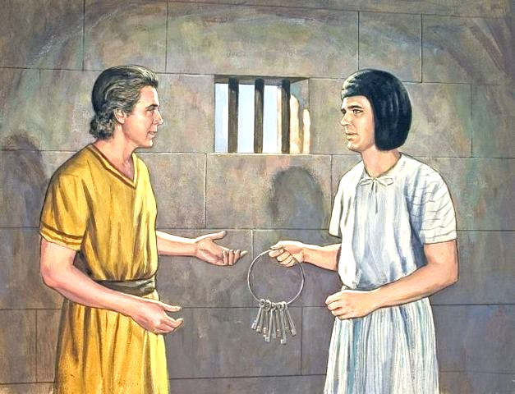
Finding Rest in Family Ties
3. The Lord Was With Joseph
Genesis 9:21-23 niv
“But the Lord was with Joseph and showed him mercy, and He gave him favor in the sight of the keeper of the prison. … The keeper of the prison did not look into anything that was under Joseph’s authority, because
the Lord was with him; and whatever he did, the Lord made it prosper.”
Notes:
3. Kasama Ni Jose ang Panginoon. “Subalit kasama ni Jose ang
Panginoon at nagpakita sa kanya ng tapat na pag-ibig, at pinagkalooban siya ng biyaya sa paningin ng bantay sa bilangguan. … Hindi pinakialaman ng bantay sa bilangguan ang anumang bagay na nasa pamamahala ni Jose sapagkat ¶ ang Panginoon ay kasama niya. Anumang kanyang ginagawa ay pinagpapala ng Panginoon” (Genesis 4:12).

Slide 23
3. The Lord Was With Joseph
Great Controversy, Up Close and Personal
Joseph suffered because of his principled decision. Joseph was thrown into prison. As Potiphar’s property, Joseph could have been killed on the spot. Potiphar obviously didn’t believe his wife but had to guard his reputation by taking action. Despite the horrific circumstances, Scripture says, “The Lord was with Joseph” (Gen. 39:21).
Notes:
Ang Malaking Tunggalian, Malapitan at Personal. Nagdusa si Jose dahil sa kanyang may prinsipyong pagpapasya. Itinapon si Jose sa bilangguan. Bilang pag-aari ni Potipfar, maaaring pinatay agad si Jose, walang tanung-tanong. Malinaw na hindi pinaniwalaan ni Potifar ang kanyang misis ngunit kailangang ingatan niya ang kanyang reputasyon sa pamamagitan ng pagkilos. Sa kabila ng nakatatakot na pangyayari, sinasabi ng Kasulatan, “kasama ni Jose ang Panginoon” (Genesis 39:21).

Slide 24
3. The Lord Was With Joseph
Great Controversy, Up Close and Personal
Life on planet Earth isn’t fair. Good is not always rewarded, and evil is not always immediately punished.
There is some good news, though: Joseph could find rest, even in prison, because God was with him. In prison he could have meditated on the unfairness of his situation, withdrawn, and even given up on God.
Notes:
Ang buhay sa planeta ay hindi patas. Hindi laging ginagantipalaan ang mabuti, at hindi kaagad pinaparusahan ang kasamaan. ¶ May mabuting balita gayunman: makakasumpong si Jose ng kapahingahan, kahit sa bilangguan, dahil kasama niya ang Diyos. Sa piitan ay maaaring pinag-isipan niya ang pagiging di makatarungan ng kanyang katayuan, naging walang kibo, at kahit pa talikuran ang Diyos.

Slide 25
3. The Lord Was With Joseph
Great Controversy, Up Close and Personal
Our relationships are miniature reflections of the great controversy between God and Satan that is raging through the ages. This means, then, that there are no perfect relationships.
Satan has a vested interest in using all our relationships—especially those closest to us—to his advantage in order
Notes:
Ang ating mga relasyon ay maliliit na larawan ng malaking tunggalian sa pagitan ng Diyos at si Satanas na nagngangalit sa buong kapanahunan. Nangangahulugan ito, kung gayon, walang perpektong relasyon. ¶ Si Satanas ay may pansariling kapakanan sa paggamit ng lahat ng ating relasyon—lalo na yung pinakamalapit sa atin—sa kanyang kalamagan upang

Slide 26
3. The Lord Was With Joseph
Great Controversy, Up Close and Personal
to hurt and frustrate God’s will for our lives. We can be thankful that we are not left to fight these battles on our own.
God’s Word sets out principles for our relationships. His promise to give us wisdom (James 1:5) also extends to our relationships. And as He was with Joseph, He promises to be with us when our relationships prove complex.
Notes:
saktan at hadlangan ang kalooban ng Diyos para sa ating mga buhay. Makapagpapasalamat tayo na hindi tayo iniiwang nag-iisa upang lumabang nagsasarili sa mga labanan. ¶ Naglalatag ang Salita ng Diyos ng mga prinsipyo para sa ating mga relasyon. Ang pangako Niyang magbibigay sa ating ng katalinuhan His (Santiago 1:5) ay pinararating din sa ating mga relasyon. At gaya ng Siya ay na kay Jose, nagangako rin Siyang sasaatin kapag ang ating relasyon ay lumabas na magusot.

Slide 27
Final Words
The Spirit of Prophecy 1:132.
“In the context of what happened to Joseph with Potiphar’s wife, Ellen White wrote: ‘God made even the prison the way to his elevation. Virtue will in time bring its own reward.
The shield which covered Joseph’s heart, was the fear of God, which caused him to be faithful and just to his master, and true to God.’ ”
Notes:
Huling Pananalita. The Spirit of Prophecy 1:132. “Sa konteksto ng nangyari kay Jose sa misis ni Potifar, sumulat si Ellen White: ‘Ginawa pa nga ng Diyos ang piitan na daan ng kanyang pagkakaangat. Ang birtud sa panahon ay dadahin ang sarili nitong gantimpala. ¶ Ang pananggalang na tumakip sa puso ni Jose ay ang takot sa Diyos, na naging dahilan upang siya’y maging tapat at makatarungan sa kanyang panginoon, at totoo sa Diyos.’ ”

