Slide 1
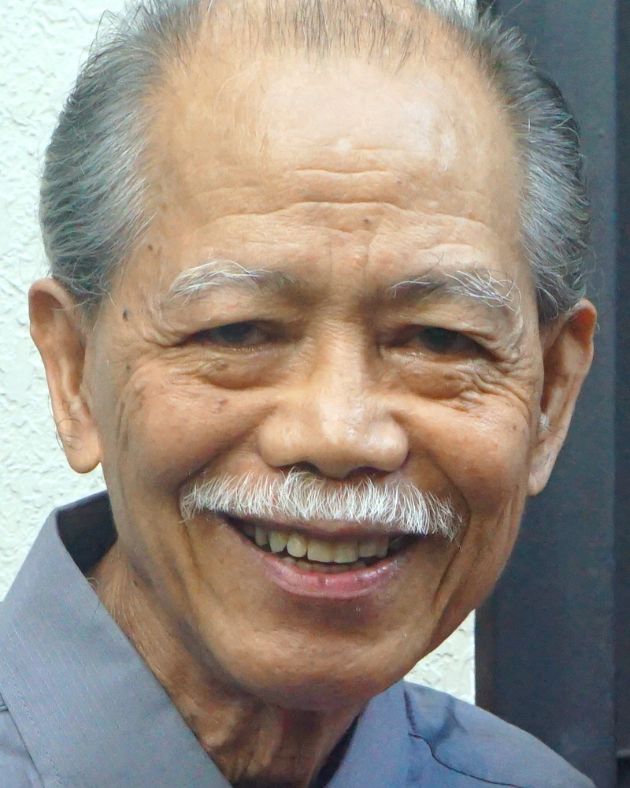
Adult Bible Study Guide
Jul • Aug • Sep 2021
powerpoint presentation designed by claro ruiz vicente
http://clarovicente.weebly.com

Slide 2
Adult Sabbath School Bible Study Guide
An Appeal
DEAR USER
This PowerPoint Show is freely shared to all who may find it beneficial. While intended primarily for personal use, some find it useful for teaching the lesson
in church.
There are those, however, who add illustrations, change background, replace fonts, etc. While their intention may be good, this is not right. Slide #1 says “designed by claro ruiz vicente.” For honest Christians, it is not necessary for another’s creation to be copyrighted in order to be respected.
PLEASE USE AS IS.

Slide 3
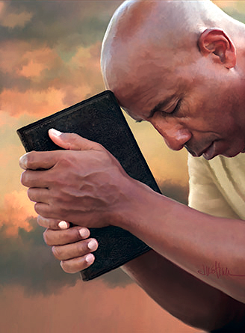
Gerald & Chantal Klingbeil
Principal Contributors
Notes:
Kapahingahan Kay Cristo.

Slide 4
Rest in Christ
Contents
1 Living in a 24-7 Society
2 Restless and Rebellious
3 The Roots of Restlessness
4 The Cost of Rest
5 “ ‘Come to Me . . .’ ”
6 Finding Rest in Family Ties
7 Rest, Relationships, and Healing
8 Free to Rest
9 The Rhythms of Rest
10 Sabbath Rest
11 Longing for More
12 The Restless Prophet
13 The Ultimate Rest
Notes:
Pampitong Liksyon.

Slide 5
Rest in Christ
Our Goal
“Resting in Christ is the key to the type of life that Jesus promises to His followers: ‘The thief does not come except to steal, and to kill, and to destroy. I have come that they may have life, and that they may have it more abundantly’ ” (John 10:10 NKJV).
As we study the weekly lessons, let us remember to come and rest in Him.
Notes:
Ang Ating Mithiin. “Kapahingahan kay Cristo ay ang susi sa uri ng buhay na ipinapangako ni Jesus sa Kanyang mga tagasunod: ‘Ang magnanakaw ay dumarating lamang upang magnakaw, pumatay, at pumuksa. Ako’y pumarito upang sila’y magkaroon ng buhay, at magkaroon nito nang may kasaganaan’ ” (Juan 10:10). ¶ Samantalang pinag-aaralan natin ang lingguhang liksyon, ating tandaang lumapit at magpahinga sa Kanya.

Slide 6
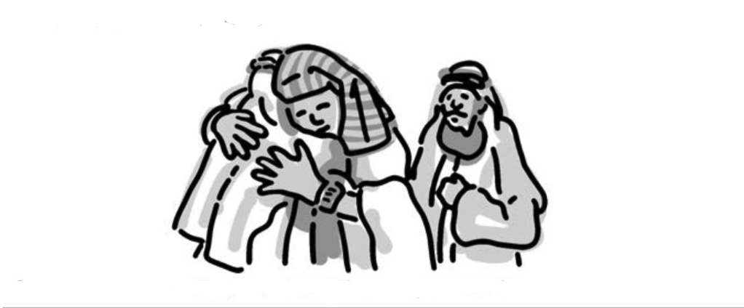
Rest in Christ
Lesson 7, August 14, 2021
Rest, Relationships, and Healing
Notes:
Kapahingahan, mga Relation, at Pagpapagaling

Slide 7
Rest, Relationships, and Healing
Key Text
Genesis 45:5 NKJV
“ ‘But now, do not therefore be grieved or angry with yourselves because you sold me here; for God sent me before you to preserve life.’ ”
Notes:
Susing Talata. “Ngayon huwag kayong mag-dalamhati o magalit sa inyong mga sarili sapagkat ako'y ipinagbili ninyo rito; sapagkat sinugo ako ng Diyos na una sa inyo upang magligtas ng buhay” (Genesis 45:5).

Slide 8
Rest, Relationships, and Healing
Initial Words Patriarchs and Prophets 240
“And Joseph’s…ready forgiveness and noble benevolence toward his unnatural brothers, represent the Saviour’s…forgiveness, not only of His murderers, but of all who have come to Him confessing their sins and seeking pardon.”
We will look at forgiveness and what it can do for restless human hearts.
Notes:
Panimulang Salita. At ang handang pagpapatawad at marangal na kagandahang-loob ni Jose patungo sa kanyang di-natural na mga kuya, ay kumakatawan sa…pagpapatawad ng Tagapagligtas, hindi lamang sa mga pumatay sa Kanya, kundi sa lahat ng lumapit sa Kanya na inaamin ang kanilang mga kasalanan at naghahangad ng kapatawaran.”—Patriarchs and Prophets 240. ¶ Titingnan natin ang kapatawaran at ano ang magagawa nito para sa mga balisang puso ng tao.

Slide 9
Rest, Relationships, and Healing
Quick Look
1. Attitudes For Abuse and Abusers–1 (Genesis 42:7-20)
2. Attitudes For Abuse and Abusers–2 (Matthew 18:21-22)
3. Finding Rest After Forgiveness (Genesis 50:15-21)
Notes:
1. Mga Saloobin sa Abuso at Abusado—1 (Genesis 42:7-20)
2. Mga Saloobin sa Abuso at Abusado—2 (Mateo 18:21-22)
3. Pagkakasumpong ng Kapahingahan Matapos ang Kapatawaran (Genesis 50:15-21)

Slide 10
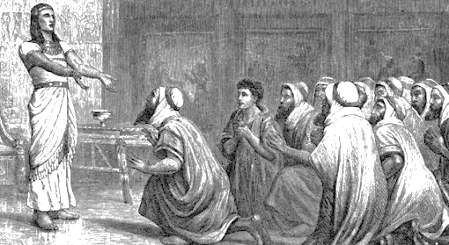
Rest, Relationships, and Healing
1. Attitudes For Abuse and Abusers–1
Genesis 42:7-20 NKJV
“Joseph saw his brothers and recog-nized them, but he acted as a stranger to them and spoke roughly…. ‘You are spies!’ … ‘Your servants are twelve brothers…the youngest is with our father today, and one is no more.’ … ‘Bring
your youngest brother…so your words will be verified, and you shall not die.’ ”
Notes:
1. Mga Saloobin sa Abuso at Abusado—1. “Nakita ni Jose ang kanyang mga kapatid at nakilala sila, subalit siya'y nagkunwaring iba sa kanila, at nagsalita ng marahas …. ‘Kayo'y mga espiya.’ … ‘Kaming iyong mga lingkod ay labindalawang magkakapatid…. Ang bunso ay nasa aming ama ngayon, at ang isa ay wala na.’ … ‘Dalhin ¶ ninyo…ang inyong kapatid na bunso; sa ganito'y mapapatotohanan ang inyong mga salita, at hindi kayo mamamatay’ ” (Genesis 42:7-20).

Slide 11
1. Attitudes For Abuse and Abusers–1
Facing the Past
Eventually, things moved in the right direction for Joseph. He not only got out of prison, but he also was made prime minister of Egypt after interpre- ting Pharaoh’s dreams (Genesis 41).
The storehouses of Egypt were full, and the predicted famine had begun. And then, one day, Joseph’s brothers turned up in Egypt.
Notes:
Humaharap sa Nakaraan. Sa wakas, kumilos ang mga bagay sa tamang direksiyon para kay Jose. Hindi lamang siya lumabas sa bilangguan, kundi ginawa siyang punong ministro ng Ehipto matapos ang pagpapaliwanag ng mga panaginip ng Faraon (Genesis 41). ¶ Puno ang mga kamalig ng Ehipto, at ang hinulaang taggutom ay nagpasimula na. At pagkatapos, isang araw, sumipot ang mga kuya ni Jose sa Ehipto.

Slide 12
1. Attitudes For Abuse and Abusers–1
Facing the Past
Joseph had the power and could have taken his revenge on his brothers without having to justify himself.
But, rather than revenge, Joseph was concerned about the members of his family at home. He was worried about his father. Was he still alive, or had a dysfunctional family become a family without a patriarch?
Notes:
Nakay Jose ang kapangyarihan at makapaghihiganti siya sa kanyang mga kuya na hindi kailangang pawalang-sala ang sarili. ¶ Ngunit, sa halip na paghihiganti, nag-aalala si Jose tungkol sa mga kaanib ng kanyang pamilya sa tahanan. Nababalisa siya tungkol sa kanyang ama. Buhay pa kaya siya, o ang may deperensyang pamilya ba ay naging isa pamilyang walang patriarka?

Slide 13
1. Attitudes For Abuse and Abusers–1
Facing the Past
And what about his brother Benjamin?
As his father’s delight and joy, Benjamin was now in the same position that Joseph had been.
Had the brothers transferred their dangerous jealousy to Benjamin? Joseph was now in a position to look out for these vulnerable people in his family, and he did just that.
Notes:
At ano ang tungkol sa kanyang kapatid na si Benjamin? ¶ Bilang kaluguran at katuwaan ng kanyang ama, si Benjamin ay nasa katulad na katayuan na ngayon kung saan dati si Jose. ¶ Inilipat ba ng mga kuya ang mapanganib nilang selos kay Banjamin? Nasa katayuan na ngayon si Jose na pangalagaan itong mga mahihinang tao sa kanyang pamilya, at ginawa niya ang gayon.

Slide 14
1. Attitudes For Abuse and Abusers–1
Facing the Past
We have all been bought through Jesus’ blood, and legally we are all His. Anyone who is abusive is attacking Jesus’ property. Sexual abuse and emotional or physical violence are never to be a part of family dynamics.
This is not just private family business to be resolved internally. This will require outside help and intervention.
Notes:
Lahat tayo'y binili sa pamamagitan ng dugo ni Jesus, at legal na sa Kanya tayong lahat. Sinumang abusado ay inaatake ang pag-aari ni Jesus. Ang pang-aabuso sa sex at emosyonal o pisikal na karahasan ay hinding-hindi magiging isang bahagi ng mga kilos ng pamilya. ¶ Hindi lamang ito pribadong problema ng pamilya na aayusin sa loob ng pamilya. Mangangailangan ito ng tulong at pakikialam mula sa labas.

Slide 15
1. Attitudes For Abuse and Abusers–1
Setting the Stage
Joseph had forgiven his brothers. He probably would never have thrived in Egypt if he had not forgiven because, most likely, the anger and bitterness would have eaten away at his soul and damaged his relations with the Lord.
Without forgiveness, we remain victims. Forgiveness has more to do with us than with the person who have wronged us.
Notes:
Paghahanda ng Tanghalan. Napatawad na ni Jose ang kanyang mga kuya. Marahil hinding-hindi umunlad si Jose sa Ehipto kung hindi siya nakapagpatawad dahil, malamang, ang galit at kapaitan ay nakain ang kanyang kaluluwa at pininsala ang kanyang relasyon sa Panginoon. ¶ Mananatili tayong biktima kung walang pagpapatawad. Ang pagpapatawad ay higit na may kinalaman sa sarili natin kaysa sa tao o mga taong nagkasala sa atin.

Slide 16
1. Attitudes For Abuse and Abusers–1
Setting the Stage
All communication had been taking place through an interpreter, and so Joseph’s brothers were unaware that he could understand them. Joseph heard his brothers’ confession. Instead of finding rest, they had been plagued by a guilty conscience all those years.
Their deed had led to restlessness and a paralyzing fear of God’s retribution.
Notes:
Lahat ng usapan ay nangyayari sa pamamagitan ng mga tagasalin, kaya ang mga kuya ni Jose ay walang-malay na nauunawaan niya sila. Narinig ni Jose ang pag-amin ng kanyang mga kuya. Sa halip na makasumpong ng kapahingahan, sila’y sinalot sa pamamagitan ng isang may salang konsiyensya sa lahat ng mga taong iyon. ¶ Ang kanilang ginawa ay dinala sila sa pagkabalisa at isang pumaparalisang takot sa ganti ng Diyos.

Slide 17
1. Attitudes For Abuse and Abusers–1
Setting the Stage
Joseph knew that the famine would still last several more years, and so he insisted that they bring Benjamin back with them the next time they came to buy grain (Gen. 42:20). He also kept Simeon hostage (Gen. 42:24).
After seeing that Benjamin was still alive, he organized a feast in which he obviously showed favoritism to
Notes:
Alam ni Jose na ang taggutom ay sa marami pang taon, kaya nagpilit siyang dalhin nila si Benjamin sa susunod na pagbili nila ng butil (Genesis 42:20). Ipinkulong din niya si Simeon bilang prenda (Genesis 42:24). ¶ Matapos makitang buhay pa si Benjamin, nagpapiyesta siya kung saan malinaw siyang nagpakita ng paboritismo kay

Slide 18
1. Attitudes For Abuse and Abusers–1
Setting the Stage
Benjamin (Gen. 43:34) to see if the old patterns of jealousy were still there.
The brothers didn’t show any signs of being jealous, but Joseph knew how cunning they could be. And he surely figured that they must have lied to their own father about his fate (Gen. 37:31–34). So, he devised one more major test. (See Genesis 44.)
Notes:
Banjamin (Genesis 43:34) upang makita kung ang matandang pag-uulit ng pagseselos ay naroroon pa rin. ¶ Hindi nagpakita ng anumang palatandaan ng selos ang mga kuya, subalit alam ni Jose kung gaano katuso sila. At nakini-kinita niyang may katiyakan na nagsinungaling sila sa kanilang ama tungkol sa kanyang kapalaran (Genesis 37:31–34). Kaya, bumalangkas siya ng isa pang malaking pag-subok. (Tingnan ang Genesis 44.)

Slide 19
Rest, Relationships, and Healing
2. Attitudes For Abuse and Abusers–2
Matthew 18:21, 22 NKJV
“Then Peter came to Him and said, ‘Lord, how often shall my brother sin against me, and I forgive him? Up to seven times?’
Jesus said to him, ‘I do not say to you, up to seven times, but up to seventy times seven.’ ”
Notes:
2. Mga Saloobin sa Abuso at Abusado—2. “Pagkatapos ay lumapit si Pedro at sinabi sa kanya, ‘Panginoon, makailang ulit magkakasala ang aking kapatid laban sa akin at siya’y aking patatawarin? Hanggang sa makapito ba?’ ¶ Sinabi ni Jesus sa kanya, ‘Hindi ko sinasabi sa iyo, hanggang sa makapito, kundi, hanggang sa makapitumpung pito’ (Mateo 18:21, 22).

Slide 20
2.Attitudes For Abuse and Abusers–2
Forgive and Forget?
Forgiveness has been defined as the willingness to abandon one’s right to resentment, condemnation, and revenge toward an offender who acts unjustly.
Dr. Marilyn Armour, a family therapist who worked with Holocaust survivors writes: “The whole idea of forgiveness is an intentional act by the victim. It’s not something that just happens.”
Notes:
Magpatawad at Makalimot? Ang pagpapatawad ay naipaliwanag na ang kahandaang talikuran ang karapatan sa paghihinakit, pagtuligsa, at paghiganti sa isang nakapinsala o grupo na kumikilos na walang-katarungan. ¶ Si Dr. Marilyn Armour, isang terapist ng pamilya na gumawa sa mga nakaligtas sa Holocaust ay sumulat: “Ang buong ideya ng kapatawaran ay isang sinasadyang kilos ng biktima. Hindi ito isang bagay na basta nangyayari.”

Slide 21
2.Attitudes For Abuse and Abusers–2
Forgive and Forget?
Forgiveness doesn’t mean that there will be no consequences. Forgiveness doesn’t mean letting an abuser continue abusive patterns. Forgiveness means, instead, that we turn our resentment and our desire for revenge over to God.
If not, the anger, the bitterness, the re-sentment, and the hatred will make what-ever that person did to us even worse.
Notes:
Ang kapatawaran ay hindi nangangahulang wala ng mga kahihinatnan. Ang kapatawaran ay hindi nangangahulang pinababayaan ang isang nang-aabuso na magpatuloy sa abusadong kaayusan. Ang kapatawaran ay nangangahulugan, sa halip, na ibaling natin sa Diyos ang hinanakit at kagustuhan nating gumanti. ¶ Kung hindi, ang galit, ang kapaitan, ang hinanakit, at ang pagkamuhi ay gagawing lalo pang masama ang anumang ginawa ng tao sa atin.

Slide 22
2.Attitudes For Abuse and Abusers–2
Forgive and Forget?
Every sin is a sin against our Lord and Maker; and yet, in Jesus, we can claim forgiveness for all those sins, not because we deserve it but only because of God’s grace toward us.
Once we experience God’s forgive-ness, we can begin to forgive others. We forgive not because others deserve it but because it’s what we got from God.
Notes:
Bawat kasalanan ay isang kasalanan laban sa ating Panginoon at Manlalalang; at gayunman, kay Jesus, maaari tayong umangkin ng kapatawaran para sa lahat ng mga kasalanang iyon, hindi dahil karapat-dapat tayo kundi dahil lamang sa biyaya ng Diyos sa atin. ¶ Kapag nakaranas ng kapatawaran ng Diyos, makapagpapasimula na tayong magpatawad sa iba. Magpapatawad tayo hindi dahil karapat-dapat ang iba kundi dahil ito ang ating natanggap mula sa Diyos.

Slide 23
2.Attitudes For Abuse and Abusers–2
Making It Practical
In order to forgive, I must admit that I have been hurt. This can be hard to do, as we are sometimes more inclined to try to bury our feelings rather than work through them. Acknowledging un-Christian feelings of resentment and even anger before God is fine.
Feel free to tell God that what hap-pened makes you sad or angry or both.
Notes:
Paggawang Praktikal Nito. Upang makapagpatawad, Kailangang tanggapin ko na nasaktan ako. Maaaring mahirap itong gawin, dahil kung minsan higit na nakahilig tayong itago ang ating mga damdamin sa halip na gumawa sa pamamagitan ng mga ito. Mabuti ang pagkilala sa mga di-kristiyanong damdamin ng paghihinanakit at kahit pa galit sa harapan ng Diyos. Madaramang malayang sasabihin sa Diyos na ang nangyari ay nagpalungkot o nagpagalit sa ‘yo o pareho.

Slide 24
2.Attitudes For Abuse and Abusers–2
Making It Practical
Jesus didn’t wait for us to ask for forgiveness first. We do not have to wait for our offender to ask for forgiveness. We can forgive others without having them accept our forgiveness.
Forgiveness, like love, begins with a choice rather than a feeling. We can make the choice to forgive, even if our emo- tions may not agree with this decision.
Notes:
Hindi naghintay si Jesus sa atin na humingi ng kapatawaran muna. Hindi kailangang maghintay tayo para sa nagkasala sa atin na humingi ng patawad. Mapapatawad natin ang iba na wala ang pagtanggap nila sa ating pagpapatawad. ¶ Ang kapatawaran, gaya ng pag-ibig, ay nagpapasimula sa isang pagpili sa halip na isang damdamin. Magagawa natin ang pagpiling magpatawad, kahit kung ang ang ating emosyon ay hindi sang-ayon sa kapasyahang ito.

Slide 25
2.Attitudes For Abuse and Abusers–2
Making It Practical
God knows that in our own strength this choice is impossible, but “with God all things are possible” (Mark 10:27).
Forgiveness isn’t always easy. The pain and the damage done devastating, leaving us hurt, crippled, and broken.
Healing will come, but holding on to bitter-ness and anger and resentment will make healing much harder, if possible at all.
Notes:
Alam ng Diyos na sa ating sariling kalakasan ang pagpiling ito’y imposible, ngunit “sa Diyos ang lahat ng mga bagay ay maaaring mangyari” (Marcos 10:27). ¶ Hindi laging madali ang pagpapatawad. Ang kirot at ang pinsalang nagawa sa atin ay maaaring maging mapangwasak, iniiwan tayong nasaktan, nalumpo, nasiraan ng loob. Darating ang pagpapagaling, ngunit ang pagkapit sa kapaitan at galit at hinanakit ay lalong magpapahirap sa pagpapagaling, kung posible pa nga.

Slide 26
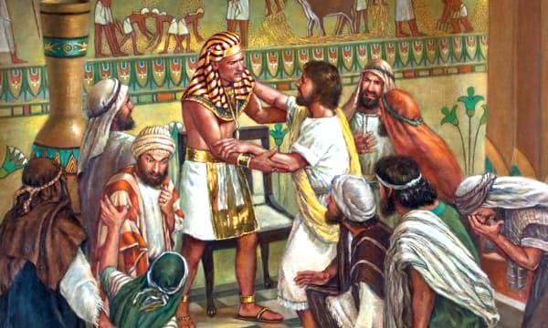
Rest, Relationships, and Healing
3. Finding Rest After Forgiveness
Genesis 50:15-21 nkjv
“When Joseph’s brothers saw that their father was dead…. Joseph said to them, ‘Do not be afraid…. You meant evil against me; but God meant it for good, in order to bring it about as it is this day, to save many people alive.’
… And he comforted them and spoke kindly to them.”
Notes:
3. Pagkakasumpong ng Kapahingahan Matapos ang Kapatawaran. “Nang makita ng mga kapatid ni Jose na ang kanilang ama’y patay na…. Sinabi ni Jose sa kanila, ‘Huwag kayong matakot. Kayo’y nagnasa ng masama laban sa akin, ngunit inilagay ng Diyos para sa kabutihan, upang mangyari ang gaya sa araw na ito, upang mapanatiling buháy ang napakaraming tao.’ ¶ Kanya silang inaliw at nagsalitang may kabaitan sa kanila” (Genesis 50:15-21).

Slide 27
3. Finding Rest After Forgiveness
A Happy Ending
While it may not always be possible or wise to restore relationships, this does not mean that we cannot forgive.
We may want to voice our forgiveness either vocally or through a letter. And then it is time to let go of pain to the utmost degree we can.
Some pain will always remain, but at least we can be on the path to healing.
Notes:
Isang Masayang Katapusan. Samantalang hindi laging posible o matalino ang pagsasauli ng relasyon, hindi ito nangangahulugang hindi tayo makapagpapatawad. ¶ Maaari nating sabihin ang ating pagpapatawad alinmang sa salita o sa sulat. At pagkatapos ay panahon na na pakawalan ang kirot sa sukdulang antas na makakaya natin. May kirot na laging mananatili, ngunit kahit papano ay nasa daan na tayo patungo sa pagpapagaling.

Slide 28
3. Finding Rest After Forgiveness
A Happy Ending
When Jacob died, His brothers were afraid that Joseph would take his revenge. Joseph reassured them of his forgiveness again.
If the wound is deep, we will have to forgive many times. When memories of the wrong come to mind, we will need to go to God immediately in prayer and make the choice to forgive again.
Notes:
Nang namatay si Jacob, natakot sila na kukunin na ni Jose ang paghihiganti niya. Muling tiniyak ni Jose ang kanyang kapatawaran sa kanila. ¶ Kung malalim ang sugat, marahil ay kailangang magpapatawad tayo nang maraming beses. Kapag ang alaala ng mali ay sumagi sa isip, kakailanganin natin na agad pumaroon sa Diyos sa panalangin at gawin ang pagpiling muling magpatawad.

Slide 29
3. Finding Rest After Forgiveness
A Happy Ending
Joseph firmly believed that his life was part of God’s big plan to help save the then-known world from famine—and then to help his family fulfill God’s promise to become a great nation.
Knowing that God had overruled the evil plans of his brothers to bring about good helped Joseph to forgive.
Notes:
Matibay na naniwala si Jose na ang kanyang buhay ay bahagi ng malaking panukala ng Diyos upang iligtas ang noon ay kilalang daigdig mula sa taggutom, at pagkatapos ay tulungan ang kanyang pamilya na tuparin ang pangako ng Diyos na maging isang malaking bansa.¶ Nalalamang pinawalang-saysay ng Diyos ang masasamang panukla ng kanyang mga kuya upang palitawin ang mabuti ang nakatulong kay Jose na magpatawad.

Slide 30
Rest, Relationships, and Healing
Final Words: Christ’s Object Lessons 251
“Nothing can justify an unforgiving spirit. He who is unmerciful toward others shows that he himself is not a
partaker of God’s pardoning grace.
In God’s forgiveness the heart of the erring one is drawn close to the great heart of Infinite Love. The tide of divine compassion flows into the sinner’s soul, and from him to the souls of others.”
Notes:
Huling Pananalita. Christ’s Object Lessons 251. “Walang mapangangatwiran ang isang di-nagpapatawad na espiritu. Siya na walang awa sa iba ay nagpapakita na siya mismo ay hindi isang kasalo sa nagpapatawad na biyaya ng Diyos. ¶ Sa kapatawaran ng Diyos ang puso ng isa na nagkakasala ay naaakit nang malapit sa dakilang puso ng Walang-hanggang Pag-ibig. Ang agos ng maka-Diyos na pagkahabag ay dumadaloy sa kaluluwa ng makasalanan, at mula sa kanya tungo sa mga kaluluwa ng iba.”

