Slide 1
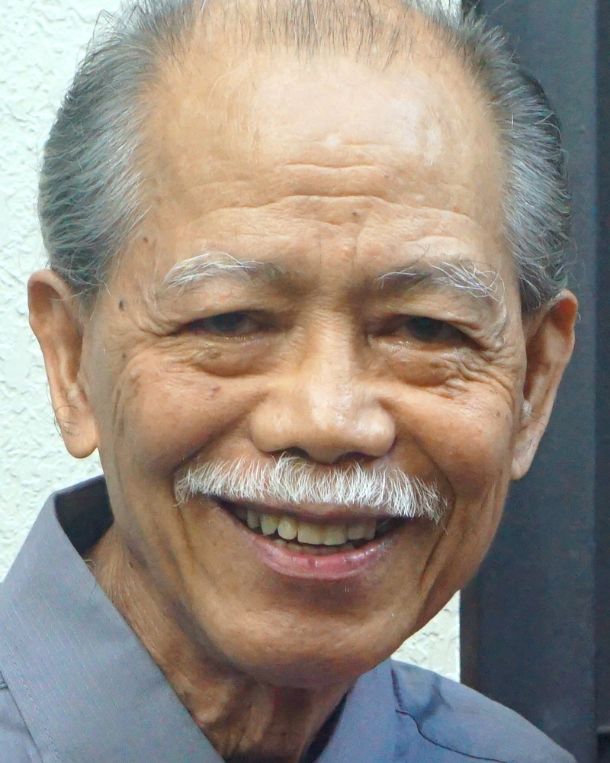
Adult Bible Study Guide
Oct • Nov • Dec 2022
Teacher’s Preview
powerpoint presentation designed by claro ruiz vicente
Notes:
“At malalaman ninyo ang katotohanan, at ang katotohanan ang magpapalaya sa inyo” (Juan 8:32 FSV).

Slide 2
Alberto R. Timm
Principal Contributor
Notes:
Sa Kamatayan, Pag-aagaw-buhay, at ang Kinabukasang Pag-asa.

Slide 3
On Death, Dying, and the Future Hope
Contents
1 Rebellion in a Perfect Universe
2 Death in a Sinful World
3 Understanding Human Nature
4 The Old Testament Hope
5 Resurrections Before the Cross
6 He Died for Us
7 Christ’s Victory Over Death
8 The New Testament Hope
9 Contrary Passages?
10 The Fires of Hell
End-Time Deceptions
12 The Biblical Worldview
13 The Judging Process
14 All Things New
Notes:
Panlabing-isang Liksyon

Slide 4
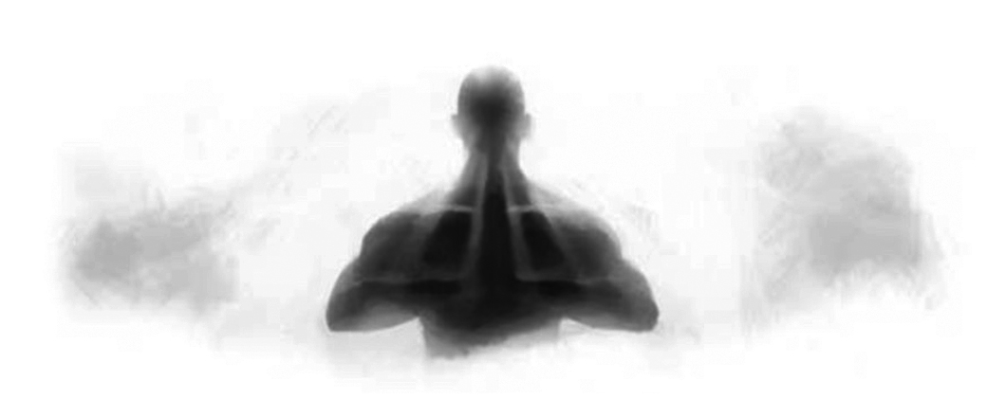
On Death, Dying, and the Future Hope
Lesson 11, December 10, 2022
End-Time Deceptions
Notes:
Ang mga Panlilinlang sa Wakas ng Panahon

Slide 5
End-Time Deceptions
Key Text
2 Corinthians 11:14, 15, NRSV
“And no wonder! Even Satan disguises himself as an angel of light. So it is not strange if his ministers also disguise themselves as ministers of righteousness. Their end will match their deeds.”
Notes:
Susing Talata. “At hindi nakapagtataka! Sapagkat maging si Satanas man ay nagpapanggap na anghel ng liwanag. Kaya’t hindi nakapagtataka na ang kanyang mga ministro naman ay magpanggap na mga ministro ng katuwiran. Ang kanilang wakas ay magiging ayon sa kanilang mga gawa” (2 Corinto 11:14, 15).

Slide 6
End-Time Deceptions
This Week
We will consider some end-time deceptions, including mysticism, near-death experiences, reincarnation, necromancy and ancestor worship, and others.
These are dangerous subjects that we should be aware of but without exposing ourselves to their influences.
Notes:
Sa Linggong Ito. Ating isasaalang-alang ang ilan sa mga panlilinlang sa wakas ng panahon, kabilang ang mistisismo, mga karanasang muntik-ng-mamatay, nekromansya [pakikipag-usap sa “kaluluwa” ng patay], at pagsamba sa ninuno, at iba pa. ¶ Ang mga ito’y mapapanganib na paksa na dapat tayong maging nakababatid subalit hindi inilalagay ang ating sarili sa mga impluwensya nito.

Slide 7
End-Time Deceptions
Sabbath Afternoon, December 3
The old lie “ ‘You surely will not die!’ ”
(Gen. 3:4 NASB) has inspired some of the most-read books and most-watched movies and many popular video games, as well. Undeniably, we are exposed to and tempted by the enchanted ground of Satan, which can appear in myriad forms and even, in some cases, can come hidden under the veneer of science.
The old lie “ ‘You surely will not die!’ ”
(Gen. 3:4 NASB) has inspired some of the most-read books and most-watched movies and many popular video games, as well.
Notes:
Sabbath ng Hapon, Disyembre 3. Ang matandang kasinungalingang “ ‘Tiyak na hindi kayo mamamatay!’ ” (Gen. 3:4) ay nagpasigla sa ilan sa pinakabinabasang aklat at pinakapinanunuod na pelikula at maraming sikat na laro sa bidyo, din naman. Di-maipagkakaila, tayo’y bilad sa at tinutukso ng nakagagayumang lugar ni Satanas, na maaaring magpakita sa napakaraming porma at kahit pa, sa ilang pagkakataon ay maaaring dumating na nakatago sa ilalim ng panakip ng Siyensya.

Slide 8
Sunday, December 4
Mysticism
From a religious perspective, mysticism implies the union of the individual with the Divine or Absolute in some kind of spiritual experience or trance. The ten-dency always is to replace the authority of the Written Word of God with one’s own subjective experiences. The Bible loses much of its doctrinal function, and the Christian remains vulnerable to his
From a religious perspective, mysticism implies the union of the individual with the Divine or Absolute in some kind of spiritual experience or trance. The ten-dency always is to replace the authority of the Written Word of God with one’s own subjective experiences.
From a religious perspective, mysticism implies the union of the individual with the Divine or Absolute in some kind of spiritual experience or trance.
Notes:
Linggo, Disyembre 4. Mistisismo. Mula sa isang relihiyosong pananaw, ang mistisismo ay nagpapahiwatig nang pagsasanib ng tao sa Diyos o Kataas-taasan sa isang uri ng espirutuwal na karanasan o pagkawala sa sarili. ¶ Ang hilig ay laging palitan ang awtoridad ng Nasusulat na Salita ng Diyos ng kanyang mga personal karanasan. ¶ Nawawalan ang Biblia nang marami nitong doktrinal na tungkulin, at ang Kristiyano ay mananatiling mahina sa kanyang

Slide 9
Sunday, December 4
Mysticism
or her own experiences. This does not provide a safeguard against any decep-tion, especially end-time ones.
“Not everyone who says to Me, ‘Lord, Lord,’ shall enter the kingdom of hea-ven, but he who does the will of My Father in heaven. ... Therefore whoever hears these sayings of Mine, and does them, I will liken him to a wise man who
or her own experiences. This does not provide a safeguard against any decep-tion, especially end-time ones.
“Not everyone who says to Me, ‘Lord, Lord,’ shall enter the kingdom of hea-ven, but he who does the will of My Father in heaven. ...
or her own experiences.
Notes:
sariling mga karanasan. ¶ Hindi ito nagbigay ng isang pananggalang laban sa anumang panlilinlang, lalo na yung mga nasa wakas ng panahon. ¶ “Hindi lahat ng nagsasabi sa akin ‘Panginoon, Panginoon,’ ay papasok sa kaharian ng langit, kundi ang gumaganap ng kalooban ng aking Ama na nasa langit. ... Kaya't ang bawat nakikinig sa mga salita kong ito at ginaganap ang mga ito ay matutulad sa isang matalinong tao na

Slide 10
Sunday, December 4
Mysticism
built his house on the rock: and the rain descended, the floods came, and the winds blew and beat on that house; and it did not fall.... But everyone who hears these sayings of Mine, and does not do them, will be like a foolish man who built his house on the sand: and the rain descended,...the winds blew and beat on that house; and it fell” (Matt. 7:21-27).
built his house on the rock: and the rain descended, the floods came, and the winds blew and beat on that house; and it did not fall....
built his house on the rock:
Notes:
nagtayo ng kanyang bahay sa ibabaw ng bato. Bumagsak ang ulan, at dumating ang baha. Humihip ang mga hangin at hinampas ang bahay na iyon, ngunit hindi iyon bumagsak.... Ang bawat nakikinig sa mga salita kong ito at hindi ginaganap ang mga ito ay matutulad sa isang taong hangal na nagtayo ng kanyang bahay sa buhanginan. Bumagsak ang ulan.... Humihip ang mga hangin at hinampas ang bahay na iyon, at iyon ay bumagsak” (Mateo 7:21-27).

Slide 11
Sunday, December 4
Mysticism
Personal feelings end up being the crite-ria for interpreting the Scriptures or for rejecting what the Bible clearly teaches, often about obedience to God, which as Jesus said is essential to building one’s house on the rock. Those who think that it matters not what they believe in doctrine, so long as they believe in Jesus Christ, are on dangerous ground.
Personal feelings end up being the crite-ria for interpreting the Scriptures or for rejecting what the Bible clearly teaches, often about obedience to God, which as Jesus said is essential to building one’s house on the rock.
Notes:
Ang mga personal na pandama ay nagiging pamantayan para sa pagpapaliwanag ng Kasulatan o para sa pagtanggi sa buong linaw na itinuturo ng Biblia, kadalasang tungkol sa pagsunod sa Diyos, na gaya ng sinabi ni Jesus ay kailangan upang maitayo ang sariling bahay sa ibabaw ng bato. ¶ Sa mga nag-iisip na hindi mahalaga ang kanilang pinaniniwalaan sa doktrina, hanggat sila’y naniniwala kay Jesu-Cristo, ay nasa mapanganib na lugar.

Slide 12
Mysticism
Satanic Deception
“The position that it is of no conse-quence what men believe is one of Satan’s most successful deceptions.
He knows that the truth, received in the love of it, sanctifies the soul of the receiver; therefore he is cons-tantly seeking to substitute false theories, fables, another gospel.” —The Great Controversy 520.
Notes:
Satanikong Panlilinlang. “Ang paninindigang walang kalalabasan ang pinaniniwalaan ng tao ay isa sa pinakamatagumpay ng panlilinlang ni Satanas. ¶ Nalalaman niya na ang katotohanan, na tinanggap dahil sa pagmamahal dito, ay nagpapabanal ng kaluluwa ng tumatanggap; kaya siya’y laging nagsisikap upang ipalit ang mga maling teorya, katha-katha, ibang ebanghelyo.”—The Great Controversy 520.

Slide 13
Monday, December 5
Near-Death Experiences
Resurrection accounts: 1 Kings 17:22–24, 2 Kings 4:34–37, Mark 5:41–43, Luke 7:14–17, and John 11:40–44.
All near-death experiences reported in modern literature are of people con-sidered clinically dead, but not really dead, in contrast to Lazarus, who was dead for four days and whose corpse was rotting (John 11:39).
Notes:
Lunes, Disyembre 5. Mga Karanasang Muntik-ng-Mamatay. Mga salaysay ng muling pagkabuhay: 1 Mga Hari 17:22–24, 2 Mga Hari 4:34–37, Marcos 5:41–43, Lucas 7:14–17, and Juan 11:40–44. ¶ Lahat ng mga karanasang muntik-ng-mamatay na iniulat sa modernong literatura ay mula sa mga taong itinuring na patay ayon sa panggagamot medikal, ngunit hindi talaga patay, ihambing kay Lazaro, na apat na araw nang patay at ang bangkay ay nabubulok na (Juan 11:29).

Slide 14
Monday, December 5
Near-Death Experiences
If we accept the biblical teaching of the unconsciousness of the dead (Job 3:11–13, Ps. 115:17, Ps. 146:4, Eccles. 9:10), then we are left with two main possibilities: either it is a natural psychochemical hallucination under extreme conditions, or it can be a supernatural, satanic, deceptive experience (2 Cor. 11:14).
If we accept the biblical teaching of the unconsciousness of the dead (Job 3:11–13, Ps. 115:17, Ps. 146:4, Eccles. 9:10), then we are left with two main possibilities:
Notes:
Kung tatanggapin natin ang katuruan ng Biblia sa pagiging walang-malay ng patay (Job 3:11–13, Awit 115:17, Awit 146:4, Eclesiastes 9:10), kung gayon mayroon lamang tayong dalawang naiiwang pangunahing posibilidad: ¶ alinamang ito’y isang natural na sikolokemikal na pagdedeliryo sa ilalim ng matitinding katayuan, o maaaring ito’y isang sobrenatural, sataniko at mapanlinlang na karanasan (2 Corinto 11:14).

Slide 15
Monday, December 5
Near-Death Experiences
Satanic deception could indeed be the explanation, especially because in some cases, these people claim to have talked to their dead relatives!
But it could be a combination of both factors.
Notes:
Talgang maaaring ang paliwanag ay Satanikong panlilinlang, lalo na dahil sa ilang mga pangyayari, ang mga taong ito’y nagsasabing nakipag-usap sila sa kanilang patay na mga kamag-anak! ¶ Subalit ito’y maaaring isang kombinasyon ng dalawang dahilan.

Slide 16
Tuesday, December 6
Reincarnation
The unbiblical theory of reincarnation or transmigration of the soul has been adopted by some major world religions.
Those who believe in reincarnation hold that such an immortal soul goes through many cycles of death and rebirth here on earth.
Notes:
Martes, Disyembre 6. Reinkarnasyon. Ang di-biblikal na teorya ng reinkarnasyon o paglipat ng kaluluwa ay niyakap ng ilang pangunahing relihiyong pandaigdig. ¶ Yung mga naniniwala sa reinkarnasyon ay nanghahawakang ang gayong imortal na kaluluwa ay pumapasok sa maraming ikot ng kamatayan at pagkapanganak dito sa lupa.

Slide 17
Tuesday, December 6
Reincarnation
It is a spiritual evolution that allows the spirit to attain ever greater levels of knowledge and morality in its journey toward perfection. Hindus believe that the eternal soul goes through a progres-sion of consciousness in six classes of life: aquatics, plants, reptiles, insects, birds, animals, and human beings, including the residents of heaven.
It is a spiritual evolution that allows the spirit to attain ever greater levels of knowledge and morality in its journey toward perfection.
Notes:
Ito’y isang espirituwal na ebolusyon na nagpapahintulot sa espiritu upang marating ang mas malaking antas ng kaalaman at moralidad sa paglalakbay nito tungo sa kasakdalan. ¶ Naniniwala ang mga Hindu na ang walang-hanggang kaluluwa ay pumapasok sa isang pagsulong ng may-malay sa anim na uri ng buhay: sa tubig, halaman, reptilya, insekto, ibon, hayop, at tao, kabilang ang mga naninirahan sa langit.

Slide 18
Tuesday, December 6
Reincarnation
Hebrews 9:25–28 and 1 Peter 3:18 says Jesus died just “once” and all human beings die just “once.”
Many people believe not in what they should believe but in what they want to believe.
If a theory brings them existential peace and comfort, that is enough to settle the discussion for them.
Notes:
Sinasabi ng Hebreo 9:25–28 at 1 Pedro 3:18 na namatay “minsan” si Jesus at lahat ng tao ay mamamatay “minsan” lamang. ¶ Maraming tao ang naniniwala hindi sa dapat nilang paniwalaan kundi sa nais nilang paniwalaan. ¶ Kung ang isang teoya ay nagdadala sa kanila ng ayon sa karanasang kapayapaan at ginhawa, ‘yon ay sapat para tapusin ang usapan para sa kanila.

Slide 19
Tuesday, December 6
Reincarnation
1. Contradicts the mortality of the “soul” and the resurrection of the body (1 Thess. 4:13–18).
2. Negates salvation by grace through faith in the redemptive work of Jesus Christ (Eph. 2:8–10) and replaces it with human works.
3. Contradicts: one’s eternal destiny is decided forever by one’s decisions in
Notes:
1. Kinukontra ang pagiging mortal ng “kaluluwa” at ang muling pagkabuhay ng katawan (1 Tesalonica 4:13–18). ¶ 2. Itinatanggi ang kaligtasan sa pamamagitan ng pananampalataya sa nagtutubos na gawain ni Jesu-Cristo (Efeso 2:8–10) at pinapalitan ito ng gawa ng tao. 3. Kinukontra: ang walang-hanggang kapalaran ay napagpasyahan magpakailanman sa pamamagitan ng sariling mga kapasyahan sa

Slide 20
Tuesday, December 6
Reincarnation
this life (Matt. 22:1–14, 25:31–46).
4. Downplays the meaning and relevance of Christ’s second coming (John 14:1–3).
5. Proposes after-death opportunities for someone still to overcome his or her own life’s pitfalls, which is unbiblical (Heb. 9:27).
Notes:
buhay na ito (Mateo 22:1–14, 25:31–46). 4. Minamaliit ang kahulugan at kabuluhan ng ikalawang pagparito ni Cristo (Juan 14:1–3). ¶ 5. Nagmumungkahi ng pagkatapos-ng-kamatayang mga oportunidad para sa isa upang mapananagumpayan pa ang sarili niyang mga sagabal, na di-biblikal (Hebreo 9:27).

Slide 21
Wednesday, December 7
Necromancy and Ancestor Worship
The word “necromancy” derives from the Greek terms nekros (dead) and manteia (divination).
Practiced since ancient times, necromancy is a form of summoning the alleged active spirits of the dead in order to obtain knowledge, often about future events.
Notes:
Miyerkules, Disyembre 7. Nekromansya at Pagsamba sa mga Ninuno. Ang salitang “nekromansya” ay nagbubuhat sa Griyegong terminong nekros (patay) at manteia (panghuhula). ¶ Isinasagawa mulang nang matandang panahon, ang nekromansya ay isang porma ng pagtawag sa sinasabing aktibong mga espiritu ng patay upang makakuha ang kaalaman, kadalasang tungkol sa kinabukasang mga pangyayari.

Slide 22
Wednesday, December 7
Necromancy and Ancestor Worship
The Bible stated very clearly that all spiritists, mediums, sorcerers, and necromancers, in the ancient Israelite theocracy, were abominations to the Lord and should be put to death by stoning (Deut. 18:9–14).
In accordance with this law, Saul had destroyed all mediums and spiritists from Israel (1 Sam. 28:3, 9).
Notes:
Buong linaw na sinasabi ng Biblia na lahat ng mga espiritu, medyum, manggagaway, at mangkukulam, sa matandang Israelitang teokrasya, ay karumaldumal sa Panginoon at dapat patayin sa pamamagitan ng pagbato (Deuteronomio 18:9–14). ¶ Ayon sa batas na ito, pinatay ni Saul ang lahat ng mga medyum at espiritista na mula sa Israel (1 Samuel 28:3, 9).

Slide 23
Wednesday, December 7
Necromancy and Ancestor Worship
But after being rejected by the Lord, Saul himself went to the Canaanite city of Endor to inquire of a woman medium (1 Sam. 28:6, 7, 15). He asked her to bring up the deceased prophet Samuel, who supposedly came up in a necromancer apparition and spoke with Saul (vs. 13–19). The deceiving spirit, who pretended to be Samuel, told Saul, “ ‘Tomorrow you
But after being rejected by the Lord, Saul himself went to the Canaanite city of Endor to inquire of a woman medium (1 Sam. 28:6, 7, 15). He asked her to bring up the deceased prophet Samuel, who supposedly came up in a necromancer apparition and spoke with Saul (vs. 13–19).
But after being rejected by the Lord, Saul himself went to the Canaanite city of Endor to inquire of a woman medium (1 Sam. 28:6, 7, 15).
Notes:
Subalit pagkatapos na matanggihan ng Panginoon, si Saul mismo ay nagpunta sa Canaanitang lunsod ng Endor upang magtanong sa isang babaeng medyum (1 Sam. 28:6, 7, 15). ¶ Hiniling niya sa kanya na bangunin ang namatay na propetang Samuel, na ipinapalagay na bumangon sa isang nekromansyang pagpapakita at nakipag-usap kay Saul (tal. 13–19). ¶ Ang mandarayang espiritu, na nagpanggap na si Samuel, ay nagsabi kay Saul, “Bukas ikaw

Slide 24
Wednesday, December 7
Necromancy and Ancestor Worship
and your sons will be with me’ ” (1 Sam. 28:19). While predicting Saul’s death, that deceiving spirit, merely by assuming the form of Samuel, reaffirmed the unbiblical theory of the natural immor-tality of the soul. It was a powerful deception, and Saul should have known better than to become involved with what he had previously condemned.
and your sons will be with me’ ” (1 Sam. 28:19). While predicting Saul’s death, that deceiving spirit, merely by assuming the form of Samuel, reaffirmed the unbiblical theory of the natural immor-tality of the soul.
and your sons will be with me’ ” (1 Sam. 28:19).
Notes:
ang iyong mga anak ay makakasama ko’ ” (1 Samuel 28:19). ¶ Samantalang hinuhulaan ang kamatayan ni Saul, yung manlilinlang na espiritu, sa pamamagitan lamang nang pag-aanyo sa porma ni Samuel ay muling pinagtibay ang di-biblikal na teorya ng natural na imortalidad ng kaluluwa. ¶ Ito’y isang makapangyarihan panlilinlang, at dapat si Saul ay may sapat na talino upang hindi masangkot sa dati niyang binatikos.

Slide 25
Thursday, December 8
Personations and Other Appearances
Similar to necromancy are the demonic personations of the dead and other demonic appearances. The personations can be in the form of a deceased family member, friend, or anyone. Both the physical appearance and the voice are very similar to those of the deceased.
All these satanic deceptions will be used to deceive those who are not firmly
Similar to necromancy are the demonic personations of the dead and other demonic appearances. The personations can be in the form of a deceased family member, friend, or anyone.
Similar to necromancy are the demonic personations of the dead and other demonic appearances.
Notes:
Huwebes, Disyembre 8. Mga Panggagaya at Ibang Pagpapakita. Katulad sa nekromansya ay ang demonikong panggagaya ng patay at ibang demonikong pagpapakita. ¶ Ang mga panggagaya ay maaaring nasa porma ng isang pumanaw na kapamilya, kaibigan, o sinuman. ¶ Parehong ang pisikal na pagpapakita at ang boses ay talagang katulad ng sa namatay. ¶ Lahat nitong mga satanikong panlilinlang ay magagamit upang linlangin yung hindi matibay na

Slide 26
Thursday, December 8
Personations and Other Appearances
grounded in God’s Word. “The apostles, as personated by these lying spirits, are made to contradict what they wrote at the dictation of the Holy Spirit when on earth.”—The Great Controversy 557.
And further, “As the crowning act in the great drama of deception, Satan himself will personate Christ.”—Ibid. 624.
grounded in God’s Word.
Notes:
naka-ugat sa Salita ng Diyos. ¶ “ Ang mga apostol, gaya nang pagkakagaya nitong mga nagsisinungaling na espiritu, at ginawa upang salungatin ang kanilang naisulat sa pagkakadikta ng Banal na Espiritu nang nasa lupa.” —The Great Controversy 557. ¶ At karagdagan, “Bilang nagtatanghal na gawa sa malaking drama ng panlilinlang, si Satanas mismo ay gagayahin si Cristo.” —Ibid. 624.

Slide 27
Thursday, December 8
Personations and Other Appearances
“And no wonder! For Satan himself transforms himself into an angel of light” (1 Cor. 11:14).
“For we do not wrestle against flesh and blood, but against principalities, against powers, against the rulers of the darkness of this age, against spiritual hosts of wickedness in the heavenly places” (Eph. 6:12).
Notes:
“At hindi nakapagtataka! Sapagkat maging si Satanas man ay nagpapanggap na anghel ng liwanag” (2 Corinto 11:14). ¶ “Sapagkat ang ating pakikipaglaban ay hindi laban sa laman at dugo, kundi laban sa mga pinuno, laban sa mga may kapangyarihan, laban sa mga kapangyarihang di-nakikita na naghahari sa sanlibutan sa kadilimang ito, laban sa hukbong espirituwal ng kasamaan sa kalangitan” (Efeso 6:12).

Slide 28
Thursday, December 8
Personations and Other Appearances
We can be protected against these deceptions only by being clothed with “the whole armor of God” (Eph. 6:13) described in verses 14–18.
What does it mean to put on the “whole armor of God”? In a day-to-day, practical sense, how do we do this in every area of our lives, not just in dealing with end-time deceptions?
Notes:
Maaari tayong maingatan laban sa mga panlilinlang ng ito sa pamamagitan lamang ng pagiging naramtan ng “buong kasuotang pandigma ng Diyos” (Efeso 6:13) na inilarawan sa mga talatang 14–18. ¶ Ano ang kahulugan ng isuot ang ‘buong kasuotang pandigma ng Diyos”? Sa pang-araw-araw at praktikal na isipan, paano natin gagawin ito sa lahat ng dako ng ating buhay, hindi lamang sa pagharap sa mga panlilinlang sa wakas ng panahon?

Slide 29
Friday, December 9
Further Thought
There exists a foundation which claims that it is creating technology that will allow us to contact the deceased “via texts, phone calls, and video-conferencing.” Calling the dead PMPs (post-material persons), its website claims that when humans die they simply pass on “into another phase of forever” but “retain their
There exists a foundation which claims that it is creating technology that will allow us to contact the deceased “via texts, phone calls, and video-conferencing.”
Notes:
Biyernes, Disyembre 9. Karagdagang Isipan: May umiiral na isang pundasyon na nagsasabing lumilikha ito ng isang teknolohiya na magpapahintulot sa atin upang makausap ang namatay “sa pamamagitan ng teks, tawag sa telepono, at pakikipagtalastasan sa bidyo.” Tumatawag sa mga patay na PMS (post-material persons mga katauhang walang laman) ang website nito’y nagsasabing kapag namatay ang tao sila’y simpleng lumilipat “sa isa pang bahagi ng magpakailanman” ngunit “pinananatili ang kanilang

Slide 30
Friday, December 9
Further Thought
consciousness, identity, and core aspects of their previous physical form.” But, most important, the folks at the foundation claim to be develo-ping, in three phases, technology that will allow communication between material and postmaterial persons.
The first phase will “allow texting and typing with postmaterial family,
consciousness, identity, and core aspects of their previous physical form.” But, most important, the folks at the foundation claim to be develo-ping, in three phases, technology that will allow communication between material and postmaterial persons.
consciousness, identity, and core aspects of their previous physical form.”
Notes:
pagiging may-malay, pagkakakilanlan, at mahalagang kalagayan ng nakaraan nilang pisikal na porma.” ¶ Subalit, pinakamahalaga, ang mga nasa pundasyon ay nagsasabing sila’y umuunlad, sa tatlong bahagi, ng teknolohiya na magpapahintulot sa pag-uusap sa pagitan ng materyal at pagkatapos-ng-materyal na mga tao. ¶ Ang unang bahagi ay “magpapahintulot sa pagti-teks at pagta-tayp sa pamilyang pagkatapos-ng-materyal,

Slide 31
Friday, December 9
Further Thought
friends, and experts in every field of expertise.” Phase two is supposed to “enable talking with your dear ones who are living in another part of forever.” And the third phase, it says, will open the way to “hearing and seeing those who are experiencing the field of all possibilities from a different observation point.”
friends, and experts in every field of expertise.” Phase two is supposed to “enable talking with your dear ones who are living in another part of forever.”
friends, and experts in every field of expertise.”
Notes:
mga kaibigan, at mga eksperto sa lahat ng larangan ng kadalubhasaan.” ¶ Ang ikalawang bahagi ay inaakalang “pakikipag-usap sa iyong mga mahal sa buhay na naninirahan sa ibang bahagi ng magpakailanman.” ¶ At ang ikatlong bahagi, sinasabi nito, ay magbubukas sa daan upang “marinig at makita yung nararanasan ang larangan ng lahat ng posibilidad mula sa iba’t ibang punto de vista.”

Slide 32
Friday, December 9
Further Thought
Especially scary is how they test if the communicating dead are really who they claim to be. For example, a bereaved parent might ask the follow-ing question of a son or a daughter who has changed worlds: ‘Did you have a dog named Snoopy when you were a child? Did we give you a pocketknife for your tenth birthday?’ ”
Especially scary is how they test if the communicating dead are really who they claim to be. For example, a bereaved parent might ask the follow-ing question of a son or a daughter who has changed worlds:
Especially scary is how they test if the communicating dead are really who they claim to be.
Notes:
Talagang nakatatakot ay kung paano nila sinusubukan kung ang nakikipagtalastasang patay ay totoo ang sinasabi nilang sila nga. ¶ Halimbawa, isang nagdadalamhating magulang ay maaaring itanong ang mga sumusunod na tanong sa isang anak na lalaki o babae na nagpalit ng daigig: ‘May aso ka bang nagngangalang Snoopy nang bata ka pa? Nabigyan ka ba namin ng isang lanseta para sa ikasampu mong kaarawan?’ ”

Slide 33
Friday, December 9
Further Thought
How interesting in light of this warning: “Spiritual beings sometimes appear to persons in the form of their deceased friends, and relate incidents connected with their lives and perform acts which they performed while living.”—Patriarchs and Prophets 684.
How interesting in light of this warning:
Notes:
Gaano ngang kawili-wili ito sa lliwanag nitong babala: “Ang mga espirituwal na katauhan any kung minsan nagpapakita sa mga tao sa porma na kanilang mga namatay na kaibigan, at nagsasabi ng mga pangyayaring may kinalaman sa kanilang mga buhay at kumikilos ayon sa dating kilos nang buhay pa.”—Patriarchs and Prophets 684.

Slide 34
End-Time Deceptions
Outline for Teaching
1. Waves of Mysticism
Sun. Self Experiences Matt. 7:21-27
2. Near-death and Reincarnation a. Mon. “Clinical Death.” Eccl. 9:5, 6. b. Tue. Transmigration. Heb. 9:27.
3. Necromancy and Personation
a. Wed. Spirit Mediums. Deut. 18:9-14.
b. Thu. Crowning Act. 1 Cor. 11:14.
Notes:
Balangkas para sa Pagtuturo.
Mga Alon ng Mistisismo
a. Linggo. Sariling Karanasan. Mateo 7:21-27
(2) Muntik-mamatay at Reinkarnasyon.
a. Lunes. Patay ayon sa Medikal. Eccl 9:5, 6
b. Martes. Paglilipat. Hebreo 9:27
(3) Nekromansya at Panggagaya
a. Miyerkules. Espiritung Medyum. Deuteronomio 18:9–14.
b. Huwebes. Nagtatanghal na Gawa. 1 Corinto 11:14.

Slide 35
End-Time Deceptions
Presentation Record
1. Dev. 04 Dec 22 via Messenger chat room

