Slide 1
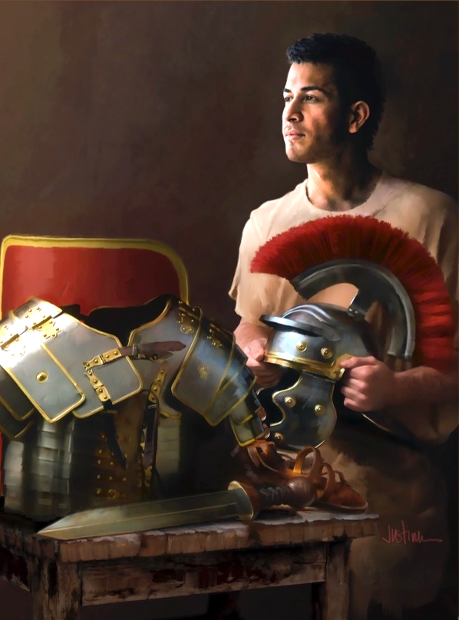
John K. McVay
Principal Contributor
Notes:
Ang liham ni Apostol Pablo sa Mga Taga-Efeso.

Slide 2
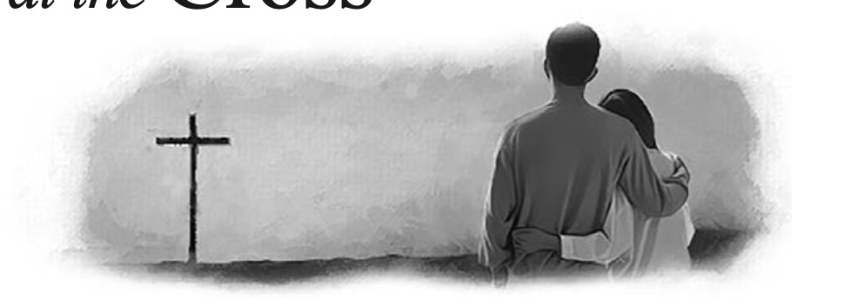
Ephesians
Lesson 10, September 2, 2023
Husbands and Wives: Together at the Cross
Notes:
Mga Asawang Lalaki at Babae: Magkasama sa Krus.

Slide 3
Husbands, Wives: Together at the Cross
Key Text
Ephesians 5:25–27 NKJV
“Husbands, love your wives, just as Christ also loved the church and gave Himself for her, that He might sanctify and cleanse her with the washing of water by the word, that He might present her to Himself a glorious church, not having spot or wrinkle or any such thing, but that she should be holy and without blemish.”
Notes:
Susing Talata. “Mga asawang lalaki, mahalin ninyo ang inyu-inyong mga asawa, gaya ni Cristo na nagmahal sa iglesya, at ibinigay ang kanyang sarili alang-alang sa kanya; upang kanyang pakabanalin siya, na nilinis sa pamamagitan ng paghuhugas ng tubig sa salita, upang kanyang maiharap sa kanyang sarili ang isang maluwalhating iglesya, na walang batik, o kulubot, o anumang gayong bagay, kundi siya ay maging banal at walang dungis” (Efeso 5:25–27).

Slide 4
Husbands, Wives: Together at the Cross
Initial Word
In Ephesians 5:21–33, Paul builds on the idea of the submission of believers to each other (v. 21); he then offers counsel to Christian wives (vs. 22–24) and husbands (vs. 25–32); and he concludes with a distillation of the instruction to both (v. 33).
Notes:
Panimulang Salita. Sa Efeso 5:21–33 nagtatayo si Pablo sa isipan ng pagpapasakop ng mga mananampalataya sa isa’t isa (tal. 21); pagkatapos ay nag-aalok siya ng payo sa mga Kristiyanong misis (tal.22–24) at mga mister (tal. 25–32); at nagtatapos siya sa isang paglilinaw ng tagubilin sa dalawa (tal. 33).

Slide 5
Husbands, Wives: Together at the Cross
Initial Word
From within these structures, believers demonstrate that a new power, the Holy Spirit (Eph. 2:22; 3:16; 5:18–21; 6:17, 18) and a new ethic patterned on Christ (4:13, 15, 20–24, 32; 5:2, 10, 17, 21–33) have been unleashed, which point toward the ultimate fulfillment of God’s plan for His people and the world.
Notes:
Mula sa mga balangkas na ito, ang mga mananampalataya ay nagpapakita na isang bagong kapangyarihan, ang Banal na Espiritu (Efeso 2:22; 3:16; 5:18–21; 6:17, 18) at isang bagong etnikong ginaya kay Cristo (4:13, 15, 20–24, 32; 5:2, 10, 17, 21–33) ay pinakawalan, na nakaturo sa pangwakas na katuparan ng panukala ng Diyos para sa Kanyang bayan at sa sanlibutan.

Slide 6
Husbands, Wives: Together at the Cross
Quick Look
1. The Church, the Bride of Christ
(a) Part 1: What the Divine Bridegroom Does (Eph. 5:25–27).
(b) Part 2: Presentation of the Bride (Eph. 5:25–27).
2. Husband and Wife Relationship
(a) Wife Submit to Your Husband (Eph. 5:22–24).
(b) Husband Love Your Wife (Eph. 5:25-29).
3. “One Flesh” Model of Marriage
Out of Adam’s Rib (Gen. 2:21–24).
Notes:
¶ (1) Ang Iglesya, ang Nobya ni Cristo
¶ (a) Unang Bahagi: Ang Ginagawa ng Makalangit na Nobyo (Efeso 5:25–27).
(b) Ikalawang Bahagi: Ang Pagkakaloob ng Nobya (Efeso 5:25–27).
(2) Ang Relasyon ng Mister at Misis
¶ (a) Misis Pasakop sa Iyong Mister (Efeso 5:22–24).
(b) Mister Mahalin ang Iyong Misis (Efeso 5:25–29).
(3) “Isang Laman” Modelo ng Pag-aasawa
¶ Mula sa Tadyang ni Adan (Genesis 2:21–24).

Slide 7
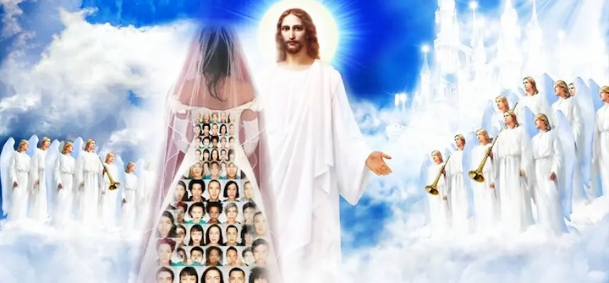
Husbands, Wives: Together at the Cross
1. The Church, the Bride of Christ
a. What the Divine Bridegroom Does
Ephesians 5:25–27 nkjv
“Husbands, love your wives, just as Christ also loved the church and gave Himself for her, that He might sanctify and cleanse her with the washing of water by the word, that He might present her to Himself a glorious church, not having spot or wrinkle or any such thing, but that she
should be holy and without blemish.”
Notes:
1. Ang Iglesya, ang Nobya ni Cristo. Unang kaisipan. Ang Ginagawa ng Makalangit na Nobyo. “Mga asawang lalaki, mahalin ninyo ang inyu-inyong mga asawa, gaya ni Cristo na nagmahal sa iglesya, at ibinigay ang kanyang sarili alang-alang sa kanya; upang kanyang pakabanalin siya, na nilinis sa pamamagitan ng paghuhugas ng tubig sa salita, upang kanyang maiharap sa kanyang sarili ang isang maluwalhating iglesya, na walang batik, o kulubot, o ¶ anumang gayong bagay, kundi siya ay maging banal at walang dungis” (Efeso 5:25–27).

Slide 8
a. What the Divine Bridegroom Does
The Foundling Story of Eze. 16:1–14.
• Originally Jerusalem was a Canaanite city, populated by Amorites and Hittites. It was like an unwanted baby, thrown into a field and left to die from exposure. However, the Lord preserved the child’s life. Later, after she had grown into a young lady, the Lord entered into a marriage covenant with her.
He clothed her with beautiful garments, pro-vided her with food, and made her a queen.”
https://www.family-times.net/commentary/gods-love-for-jerusalem/
• Originally Jerusalem was a Canaanite city, populated by Amorites and Hittites. It was like an unwanted baby, thrown into a field and left to die from exposure. However, the Lord preserved the child’s life. Later, after she had grown into a young lady, the Lord entered into a marriage covenant with her.
• Originally Jerusalem was a Canaanite city, populated by Amorites and Hittites. It was like an unwanted baby, thrown into a field and left to die from exposure. However, the Lord preserved the child’s life.
• Originally Jerusalem was a Canaanite city, populated by Amorites and Hittites. It was like an unwanted baby, thrown into a field and left to die from exposure.
“Originally Jerusalem was a Canaanite city, populated by Amorites and Hittites.
Notes:
Ang Kuwento ng Batang–pulot sa Ezekiel 16:1–14 ¶ “Sa simula ang Jerusalem ay isang Canaanitang lungsod, na pinanirahan ng mga Amoreo at Heteo. ¶ Ito’y gaya ng isang inayawang sanggol na itinapon sa isang bukid at iniwan para mamatay mula sa pagkakabilad. ¶ Gayunman, iningatan ng Diyos ang buhay ng bata. ¶ Pagkalipas, matapos na siya’y lumaki na isang kabataang babae, pumasok ang Panginoon sa isang tipang pag-aasawahan sa kanya. ¶ Kanyang dimantan siya nang magagandang damit, binigyan siya ng pagkain, at ginawa siyang isang reyna.”

Slide 9
a. What the Divine Bridegroom Does
Wedding-Marriage Metaphor
Christ is the divine Bridegroom who:
1. Loves the church as bride (Eph. 5:25).
2. Gives Himself as the bride price (v. 25).
3. Bathes His bride (v. 26 ESV).
4. Speaks the word of promise (v. 26 ESV).
5. Prepares and adorns the bride (v. 27).
6. Presents the bride (to Himself!) (v. 27).
Notes:
Metapora ng Kasalang-Pag-aasawahan. Si Cristo ang Makalangit na Nobyo na: ¶ 1. Minamahal ang iglesya bilang nobya. ¶ 2. Ibinigay ang Kanyang sarili bilang ang kabayaran sa Nobya. ¶ 3. Pinapaliguan ang Kanyang nobya. ¶ 4. Nagsasalita ng salita ng pangako. ¶ 5. Inihahanda at ginagayakan ang nobya. ¶ 6. Ihaharap ang nobya sa Kanyang sarili.

Slide 10
Husbands, Wives: Together at the Cross
1. The Church, the Bride of Christ
b. Presentation of the Bride
Ephesians 5:27 NLT
“He did this to present her to himself as a glorious church without a spot or wrinkle or any other blemish. Instead, she will be holy and without fault.”
Notes:
b. Paghaharap ng Nobya. “Ito ay upang maiharap niya ang iglesiya sa kaniyang sarili na isang marilag na iglesiya, walang batik o kulubot o anumang mga gayong bagay, sa halip, ang iglesiya ay maging banal at walang kapintasan” (Efeso 5:27 SND).

Slide 11
b. Presentation of the Bride
Ancient Weddings as Background
• Ancient weddings often began with a nighttime parade (see Matt. 25:1–13).
• The groom and his entourage would gather at the groom’s home—the couple’s new home—and with grand ceremony begin a procession.
•Lit by torches and accompanied by joyful, lilting music and great rejoicing, the crowd jostles toward the home of the father of the bride.
Notes:
Ang Matandang Kasalan bilang Konteksto • Ang matatandang kasalan ay madalas na nagpapasimula sa isang gabing parada. ¶ • Ang nobyo at kanyang piling kasamahan ay magtitipon sa tahanan ng nobyo—ang bagong tahanan ng dalawa—at kasama ang malaking seremonya ay magpapasimla ang prosesyon. ¶ • Naiilawan ng mga solo at sinasamahan ng masasaya at umiindayog na musika at malaking kasayahan, ang maraming tao ay naggigitgitan tungo sa bahay ng ama ng nobya.

Slide 12
b. Presentation of the Bride
Ancient Weddings as Background
• Gathering up the bride there or meeting the bride’s own procession on the way, the parade would convey the couple to their new home.
•The guests would settle into a weeklong feast, culminating in the wedding ceremony, when the bride would be presented to the groom.
Notes:
• Kinukuha doon ang nobya o sinasalubong ang sariling prosisyon ng nobya sa daan, ang parada ay ihahatid ang dalawa sa kanilang bagong tahanan. ¶ • Ang mga panauhin ay mamamalagi sa isang linggong pista, na lulundo sa seremonya ng kasalan, nang ang nobya ay ihaharap sa nobyo.

Slide 13
b. Presentation of the Bride
Ancient Weddings as Background
Marriage customs and roles to highlight Christ’s relationship to the church—
(1) Betrothal. Christ offered Himself up for the church (as “bride price”) and so became betrothed to her (v. 25).
(2) Preparation for the wedding ceremony. The attentions of the Bridegroom continue in His present efforts to sanctify and cleanse the bride (v. 26).
Notes:
• Ang mga kaugalian at papel ng kasalan ay magbibigay-liwanag sa relasyon ni Cristo sa iglesya— ¶ (1) Kasunduang pagpapakasal. Inihandog ni Cristo ang sarili para sa iglesya (bilang ”bayad sa nobya”) at kaya naging katipan sa iglesya (tal. 25). ¶ Paghahanda para sa seremonya ng kasalan. Ang mga pag-aasikaso ng Nobyo ay nagpapatuloy sa Kanyang kasalukuyang pagsisikap upang pabanalin at linisin ang nobya (tal. 26).

Slide 14
b. Presentation of the Bride
Ancient Weddings as Background
(3) The wedding ceremony itself. Christ’s present attentions are in view of the “presen- tation” of the bride at the wedding (v. 27).
• In ancient times the bride would be given away by the best man, best men, or her father. Never by her groom!
• A moving portrait of Christ’s return as a future wedding ceremony, when the long betrothal between Christ and His church is complete and the wedding celebrated.
Notes:
(3) Ang seremonya ng kasalan mismo. Ang kasalukuyang pag-aasikaso ni Cristo ay patungkol sa “pagbibigay” ng nobya sa kasalan (tal. 27). ¶ • Sa matandang kapanahunan ang nobya ay ibibigay ng lalaking abay o mga abay, o ng kanyang ama. Hinding-hindi ng kanyang nobyo! ¶ • Isang nakapagpapakilos na larawan ng pagbabalik ni Cristo bilang isang hinaharap na seremonya ng kasalan, kapag ang mahabang kasunduangn pagpapakasal sa pagitan ni Cristo at ng Kanyang iglesya ay nakumpleto at ang kasalan ay ipagdiriwang.

Slide 15
Husbands, Wives: Together at the Cross
2. Husband and Wife Relationship
a. Wife Submit to Your Husband
Ephesians 5:22–24 nkjv
“Wives, submit to your own husbands, as to the Lord. For the husband is head of the wife, as also Christ is head of the church; and He is the Savior of the body.
Therefore, just as the church is subject to Christ, so let the wives be to their own husbands in everything.”
Notes:
2. Relasyon ng Mister at Misis. a. Misis Pasakop sa Iyong Mister. “Mga asawang babae, pasakop kayo sa inyu-inyong mga asawa, gaya ng pagpapasakop ninyo sa Panginoon. Sapagkat ang asawang lalaki ang ulo ng asawang babae, gaya ni Cristo na ulo ng iglesya, na siya ang tagapagligtas ng katawan. ¶ Subalit kung paanong ang iglesya ay napapasakop kay Cristo, gayundin ang mga asawang babae sa kanilang mga asawa sa lahat ng mga bagay” (Efeso 5:22–24).

Slide 16
2.. Husband and Wife Relationship
a. Wife Submit to Your Husband
A Hinge Passage (Eph. 5:21).
• Paul begins with a hinge passage connecting Ephesians 5:1–20 and 5:22–33, advocating for church members to submit to each other.
• Believers are to do so “out of reverence for Christ” (v. 21 ESV), the first of several times Paul will identify the relationship with Christ as the most important and defining one for believers.
Notes:
Isang Bisagrang Sipi. ¶ • Magpapasimula si Pablo sa isang bisagrang sipi na nag-uugnay sa Efeso 5:1–20 at 22–33, na nagtataguyod sa mga kaanib ng iglesya upang pasakop sa isa’t isa.. ¶ • Ang mga mananampalataya ay gagawin ito “bilang paggalang kay Cristo” (tal. 21 FSV), ang una sa maraming beses na kikilalanin ni Pablo ang relasyon kay Cristo bilang ang pinakamahalaga at nagtatakda para sa mga mananampalataya.

Slide 17
2.. Husband and Wife Relationship
a. Wife Submit to Your Husband
“As to the Lord”(v. 22).
• Does this mean a wife is to submit to her husband as though he were Christ; or, does this mean that Christ is the truest and highest focus of her submission?
• Slaves are asked to serve “as to the Lord, and not to men” (6:7).
• Wives are asked to submit to their hus-bands “as is fitting in the Lord” (Col. 3:18).
• The latter view is to be preferred.
Notes:
“Gaya ng pagpapasakop sa Panginoon” ¶ • Nangangahulugan ba ito na si misis ay pasasakop sa kanyang mister na parang siya ay si Cristo; o, nangangahulugan ba ito na si Cristo ang pinaka totoo at pinakamataas na pagtutuunan ng kanyang pagpapasakop? ¶ • Ang mga alipin ay hinihingan na maglingkod “sa Panginoon, at hindi sa mga tao” (tal. 6:7). ¶ • Ang mga misis at hinihingan na pasakop sa kanilang mga mister “gaya ng nararapat sa Panginoon” (Colosas 3:18). ¶ Mas pinapaboran ang huling pananaw.

Slide 18
a. Wife Submit to Your Husband
“As to the Lord” (v. 22)
• In both Colossians and Ephesians, only Christ is identified as the Head of the church, which is His body (Eph. 1:22, 5:23, Col. 1:18).
• By analogy, the husband is “the head of the wife,” with the church’s faithfulness to Christ serving as a model for the wife’s loyalty to her husband.
• The passage presumes a loving, caring marriage, and not a dysfunctional one.
Notes:
• Sa parehong Colosas at Efeso, si Cristo lamang ang kinikilala bilang Ulo ng iglesya, na Kanyang katawan (Efeso 1:22, 5:23; Colosas 1:18). ¶ • Sa pamamagitan ng pagkakatulad, si mister ay “ang ulo ng misis,” na ang katapatan ng iglesya kay Cristo ang nagsisilbing modelo para sa katapatan ni misis sa kanyang mister. ¶ • Ang siping ito’y nagpapalagay ng isang maibigin at mapagmalasakit na pag-aasawahan, at hindi ang isang pag-aasawahang sira.

Slide 19
a. Wife Submit to Your Husband
“As to the Lord” (v. 22)
If the husband “is a coarse, rough, boisterous, egotistical, harsh, and overbearing man,
let him never utter the word that the husband is the head of the wife, and
that she must submit to him in everything;
for he is not the Lord, he is not the husband
in the TRUE SIGNIFICANCE of the term.”
—The Adventist Home 117.
Notes:
¶ • Kung ang mister “ay magaspang, magulo, maharot, makasarili, malupit, at dominanteng tao, ¶ ipaalam sa kanyang hinding-hindi niya bibigkasin ang salitang ang mister ay ang ulo ng misis, ¶ at na siya’y dapat pasakop sa kanya sa lahat ng bagay: ¶ dahil hindi siya ang Panginoon, hindi siya ang mister ¶ sa tunay na kahulugan ng salita.”

Slide 20
Husbands, Wives: Together at the Cross
2. Husband and Wife Relationship
b. Husband Love Your Wife
Ephesians 5:25–29 NKJV
“Husbands, love your wives, just as Christ also loved the church…. So husbands ought to love their own wives as their own bodies; he who loves his wife loves himself.
For no one ever hated his own flesh, but nourishes and cherishes it, just as the Lord does the church.”
Notes:
b. Mister Mahalin ang Iyong Misis. “Mga asawang lalaki, mahalin ninyo ang inyu-inyong mga asawa, gaya ni Cristo na nagmahal sa iglesya…. Gayundin naman, nararapat ibigin ng mga asawang lalaki ang kanya-kanyang sariling asawa gaya ng kanilang sariling mga katawan. Ang umiibig sa kanyang sariling asawa ay umiibig sa kanyang sarili. ¶ Sapagkat walang sinumang napoot sa kanyang sariling katawan, kundi inaalagaan at iniingatan ito, gaya naman ni Cristo sa iglesya” (Efeso 5:25–29).

Slide 21
2. Husband and Wife Relationship
b. Husband Love Your Wife
Husbands in the Greco-Roman days
• The legal power of the “father of the family” (Latin, pater familias) was very broad.
• He could punish harshly or even kill his wife, children, and slaves and be within his legal rights (though exercising such power in extreme ways was increasingly constrained by public opinion).
Notes:
Ang mga mister sa panahon ng Greko-Romano. ¶ • Ang legal na kapangyarihan ng “ama ng pamila” (Latin, pater familias) ay napakalawak. ¶ • Maaari siyang magparusa ng buong lupit o kahit patayin ang kanyang misis, mga anak, at mga alipin at manatili sa kanyang legal na mga karapatan (bagaman ang paggamit ng gayong kapangyarihan sa matinding pamamaraan ay lalong napipigilan ng opinyon ng publiko).

Slide 22
2. Husband and Wife Relationship
b. Husband Love Your Wife
As Christ loved the church
• Ephesians 5:25–27, detailed the ultimate example of love, Christ’s love for the church, offering a drastically different model for husbands than the usual one.
• Christian husbands are to respond “in the same way” (v. 28 ESV) as Jesus, who “gave himself up” for His bride, the church, and attends to her every need (vs. 25–27 ESV).
Notes:
Gaya ng pagmamahal ni Cristo sa iglesya. ¶ • Idinidetalye ng Efeso 5:25–27 ang sukdulang halimbawa ng pag-ibig, pag-ibig ni Cristo para sa iglesya, naghahadog ng isang matinding naiibang modelo para sa mga mister kaysa ang isang karaniwan. ¶ • Ang mga Kristiyanong mister ay tutugon “sa katulad na paraan” (tal. 28 FSV) gaya ni Jesus, na “ibinigay ang kanyang sarili” para sa Kanyang nobya, ang iglesya, at inaasikaso ang kanyang lahat na kailangan (tal. 25–27).

Slide 23
2. Husband and Wife Relationship
b. Husband Love Your Wife
As their own body
• Ephesians 5:28–30 adds a new rationale to support the love of Christian husbands for their wives: self-love.
• “No one ever hated his own flesh.”
• The Christian husband is to identify with his wife. He is one with his wife and to harm her is inflicting self-harm.
• Model your behavior toward your wife on the way Christ treats you.
Notes:
Gaya ng kanyang sariling katawan. Ito ang ¶ • Nagdaragdag ang Efeso 5:28–30 ng isang bagong katwiran upang suportahan ang pagmamahal ng mga Kristiyanong mister sa kanilang mga misis: pagmamahal sa sarili. ¶ • “Walang namumuhi sa kanyang sariling laman.” ¶ • Ang Kristiyanong mister ay kikilalanin sa kanyang misis. Siya ay kaisa sa kanyang misis at ang saktan siya ay pagpapahirap sa sarili. ¶ • Tularan ang iyong pag-uugali sa iyong misis sa paraang pinakikitunguhan ka ni Cristo.

Slide 24
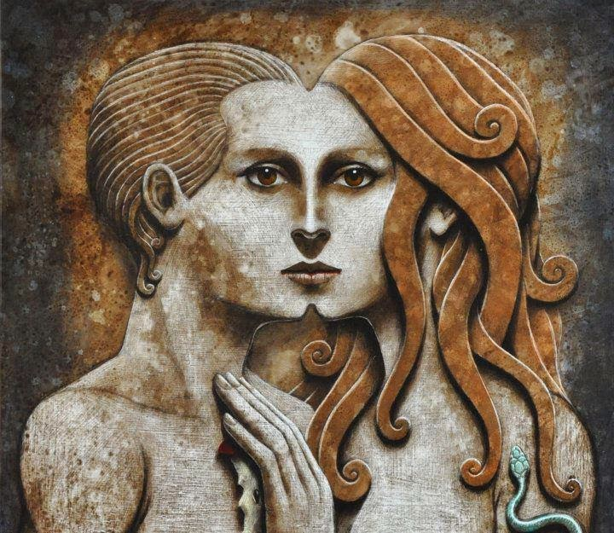
Husbands, Wives: Together at the Cross
3. “One Flesh” Model of Marriage
Genesis 2:21–24 NKJV “And the Lord God caused a deep sleep to fall on Adam…and He took one of his ribs…. Then the rib which the Lord God had taken from man He made into a woman…. And Adam said: ‘This is now bone of my bones and flesh of my flesh; she shall be called Woman, because she was taken out of Man.’ Therefore a man shall leave his father and mother and be joined to his wife, and they shall become one flesh.”
Genesis 2:21–24 NKJV “And the Lord God caused a deep sleep to fall on Adam…and He took one of his ribs…. Then the rib which the Lord God had taken from man He made into a woman…. And Adam said: ‘This is now bone of my bones and flesh of my flesh; she shall be called Woman, because she was taken out of Man.’ Therefore a man shall leave his father and mother and be joined to his wife, and they shall become one flesh.”
Genesis 2:21–24 NKJV “And the Lord God caused a deep sleep to fall on Adam…and He took one of his ribs…. Then the rib which the Lord God had taken from man He made into a woman…. And Adam said: ‘This is now bone of my bones and flesh of my flesh; she shall be called Woman, because she was taken out of Man.’ Therefore a man shall leave his father and mother and be joined to his wife, and they shall become one flesh.”
Notes:
3. Ang “Isang laman” na Modelo ng Pag-aasawa. ¶ “Kaya't pinatulog nang mahimbing ng Panginoong Diyos ang lalaki, at…kinuha niya ang isa sa kanyang mga tadyang…at ang tadyang na kinuha ng Panginoong Diyos sa lalaki ay ginawang isang babae.... At sinabi ng lalaki, ‘Sa wakas, ito'y buto ng aking mga buto at laman ng aking laman. Siya'y tatawaging Babae, sapagkat sa Lalaki siya kinuha.’ ¶ Kaya't iniiwan ng lalaki ang kanyang ama at ang kanyang ina, at pumipisan sa kanyang asawa; at sila'y nagiging isang laman” (Genesis 2:21–24).

Slide 25
3. “One Flesh” Model of Marriage
Out of Adam’s Rib
Genesis 2 narrative on “one flesh”
• “And the LORD God...took one of his ribs…. Then the rib…He made into a woman….” (vs. 21, 22).
• “And Adam said: “This is now bone of my bones and flesh of my flesh; she shall be called Woman, because she was taken out of Man’ ” (v. 23).
• “…and they shall become one flesh” (v. 24).
Notes:
Mula sa Tadyang ni Adan. Ang naratibo ng Genesis 2 sa “isang laman” ¶ • “Kaya’t ang Panginoong Diyos…ay kinuha niya ang…tadyang…ginawang isang babae….” (tal. 21, 22). ¶ • “At sinabi [ni Adan]: ‘ito'y buto ng aking mga buto at laman ng aking laman. Siya'y tatawaging Babae, sapagkat sa Lalaki siya kinuha’ ” (tal. 23). ¶ “…at sila'y nagiging isang laman” (tal. 24).

Slide 26
3. “One Flesh” Model of Marriage
Out of Adam’s Rib
“They shall become one flesh” (Gen. 2:24)
• By divine design, marriage is intended to be a “one flesh” relationship, with sexual unity mirrored in emotional and spiritual unity, and emotional and spiritual unity bringing meaning to the sexual relationship.
• A statement about marriage made before the Fall and applies it to the relationships between Christian husbands and wives.
Notes:
“Sila'y nagiging isang laman” (Gen. 2:24) ¶ • Sa pamamagitan ng banal na desenyo, ang pag-aasawa ay nilayon na maging “isang laman” na relasyon, na may pagkakaisang sekswal na sinasalamin sa emosyonal at espirituwal na pagkakaisa, at ang emosyonal at espirituwal na pagkakaisa ay nagdadala ng kahulugan sa sekswal na relasyon. ¶ • Isang pahayag tungkol sa pag-aasawa na ginawa bago ang Pagkakasala at gagamitin ito sa relasyon sa pagitan ng mga Kristiyanong mister at misis.

Slide 27
Out of Adam’s Rib
“They Shall Become One Flesh”
• In a post-Fall world, rampant exploitation of the sexual relationship between a man and a woman is the idea that the sexual union represents subjugation of the woman.
• Sexual relationship, as reflected in Genesis, is not one of subjugation but of union.
• It does not symbolize or actualize the dominance of the male but the union of husband and wife, so much so that they are “one flesh.”
Notes:
• Sa isang daigdig pagkatapos ng Pagkakasala, laganap ang pagsasamantala ng sekswal na relasyon sa pagitan ng isang lalaki at isang babae ay ang kaisipan na ang sekswal na pagsasanib ay kumakatawan sa pagsupil sa babae. ¶ • Ang relasyong sekswal, gaya ng pagwawari sa Genesis, ay hindi isang pagsupil kundi nang pagsasanib. ¶ • Hindi ito sumisimbolo o nagsasakatuparan ng pangingibabaw ng lalaki kundi ng pagsasanib ng mister at misis, gayun na lamang na sila’y “isang laman.”

Slide 28
3. “One Flesh” Model of Marriage
Out of Adam’s Rib
A “profound mystery” (v. 32 ESV).
• Christian marriage understood in the light of Christ’s relationship with His church and Christ’s relationship with His church understood in the light of Christian marriage.
• Christian marriage is elevated by comparing it to the relationship between Christ and the church.
• Believers gain new clarity about their shared relationship to Christ.
Notes:
Isang “malalim ng hiwga” (tal. 32). ¶ • Ang Kristiyanong pag-aasawa ay mauunawaan sa liwanag ng relasyon ni Cristo sa Kanyang iglesya at ang relasyon ni Cristo sa Kanyang iglesya ay mauunawaan sa liwanag ng Kristiyanong pag-aasawa. ¶ • Ang Kristiyanong pag-aasawa ay naitataas sa pamamagitan ng paghahalintulad nito sa relasyon sa pagitan ni Cristo at ang iglesya. ¶ • Ang mga mananampalataya ay nakakamit ang isang bagong linaw tungkol sa kanilang pinagsasaluhang relasyon kay Cristo.

Slide 29
Husbands, Wives: Together at the Cross
Last Word
“Do not try to compel each other to yield to your wishes.
You cannot do this and retain each other’s love.
Be kind, patient, and forbearing, considerate, and courteous.”
—The Adventist Home 118.
Notes:
Huling Salita. “Huwag tangkaing pilitin ang bawat isa na magbigay-daan sa iyong mga nais. ¶ Hindi mo magagawa ito at manatili sa pagmamahal ng bawat isa. ¶ Maging mabait, matiisin, at mapagpasensya, maalalahanin, at magalang.” THE END

