Slide 1
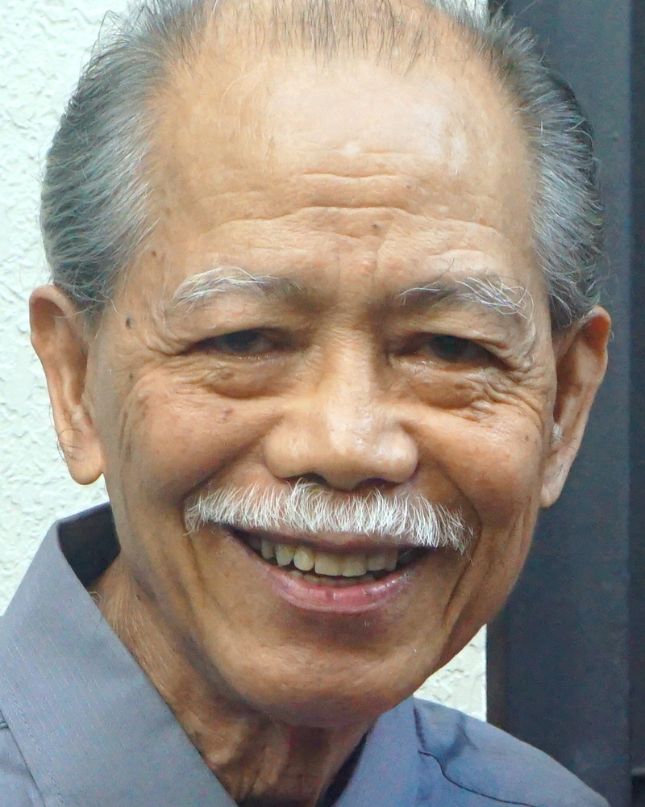
Adult Bible Study Guide
Apr • May • Jun 2022
powerpoint presentation designed by claro ruiz vicente
http://clarovicente.weebly.com
Notes:
“At malalaman ninyo ang katotohanan, at ang katotohanan ang magpapalaya sa inyo” (Juan 8:32 FSV).

Slide 2
Adult Sabbath School Bible Study Guide
An Appeal
DEAR USER
This PowerPoint Show is freely shared to all who may find it beneficial. While intended primarily for personal use, some find it useful for teaching the lesson
in church.
There are those, however, who add illustrations, change background, replace fonts, etc. While their intention may be good, this is not right. Slide #1 says “designed by claro ruiz vicente.” For honest Christians, it is not necessary for another’s creation to be copyrighted in order to be respected.
PLEASE USE AS IS.

Slide 3
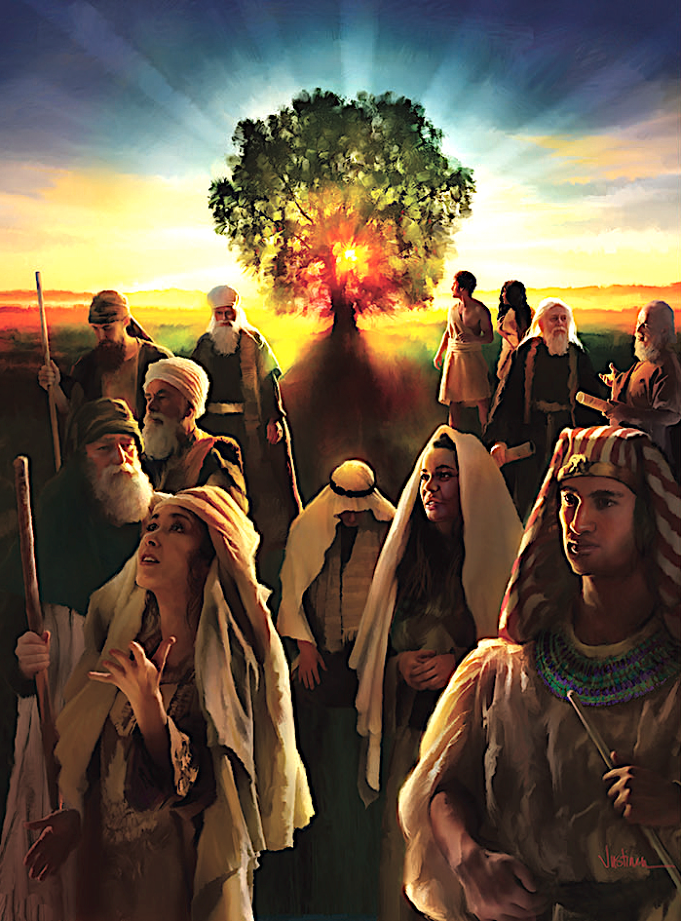
Jacques B. Doukhan
Principal Contributor
Notes:
Genesis

Slide 4
Genesis
The Book of the Beginning
Genesis is about Jesus:
Jesus our Creator,
Jesus our Sustainer,
Jesus our Redeemer.
“In Him was life, and the life was the light of men” (John 1:4).
Notes:
Ang Aklat ng Pasimula. Ang Genesis ay tungkol kay Jesus: // si Jesus and ating Manlalalang, // si Jesus ang ating Tagasustena, si Jesus ating Manunubos. ¶ “ Nasa sa kanya ang buhay at ang buhay ay siyang ilaw ng mga tao” (Juan 1:4).

Slide 5
Genesis
Our Goal
During this quarter, not only will we read and study the book of Genesis— but we also will enjoy its beautiful stories and learn to walk better with the Lord of Creation, the God of Abraham, Isaac, and Jacob.
Notes:
Ang Ating Mithiin. Sa tatlong buwan na ito, hindi lamang natin babasahin at pag-aaralan ang aklat ng Genesis—kundi atin ding tatamasahin ang magagandang kuwento at matutunan na mas mabuting lumakad kasama ang Panginoon ng Paglalang, ang Diyos ni Abraham, Isaac, at Jacob.

Slide 6
Genesis
Contents
1 The Creation
2 The Fall
3 Cain and His Legacy
4 The Flood
5 All Nations and Babel
6 The Roots of Abraham
7 The Covenant With Abraham
8 The Promise
9 Jacob the Supplanter
10 Jacob-Israel
11 Joseph, Master of Dreams
12 Joseph, Prince of Egypt
13 Israel in Egypt
Notes:
Pang-anim na Liksyon

Slide 7
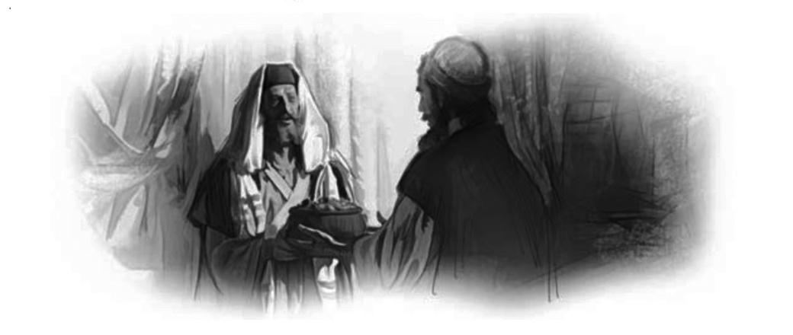
Genesis
Lesson 6, May 7, 2022
The Roots of Abraham
Notes:
Ang Kanununuan ni Abraham

Slide 8
The Roots of Abraham
Key Text
Hebrews 11:8 NKJV
“By faith Abraham obeyed when he was called to go out to the place which he would receive as an inheritance. And he went out, not knowing where he was going.”
Notes:
Susing Talata. “Sa pananampalataya si Abraham, nang tawagin, ay sumunod upang pumunta sa isang lugar na kanyang tatanggapin bilang pamana; at siya’y pumunta na hindi nalalaman ang kanyang pupuntahan” (Mga Hebreo 11:8).

Slide 9
Roots of Abraham
Initial Words
Abraham exemplifies faith (Gen. 15:6) and is remembered in the Hebrew Scriptures as the man of faith (Neh. 9:7, 8).
In the New Testament, Abraham is one of the most mentioned figures from the Old Testament, and this week we will start to see why.
Notes:
Panimulang Salita. Nagpapakita si Abraham ng pananampalataya (Genesis 15:6) at siya’y naaalaala sa Hebreong Kasulatan bilang ang tao ng pananampalataya (Nehemias 9:7, 8). ¶ Sa Bagong Tipan, si Abraham ay isa sa pinakanababanggit na tao mula sa Lumang Tipan, at sa linggong ito’y pasisimulan nating makita ang dahilan.

Slide 10
The Roots of Abraham
Quick Look
1. Abraham Regarding Pharaoh (Genesis 12:18, 19)
2. Abraham Regarding Lot (Genesis 13:8, 9)
3. Abraham Regarding Melchizedek (Genesis 4:18–20)
Notes:
1. Si Abraham Tungkol kay Faraon (Genesis 12:18, 19).
2. Si Abraham Tungkol kay Lot (Genesis 13:8, 9).
3. Si Abraham Tungkol kay Melquizedek (Genesis 4:18–20).

Slide 11
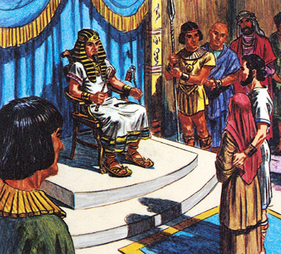
The Roots of Abraham
1. Abraham Regarding Pharaoh
Genesis 12:18, 19 NKJV
“And Pharaoh called Abram and said, ‘What is this you have done to me? Why did you not tell me that she was your wife? Why did you say, “She is my sister”? I might have taken her as my wife.
Now therefore, here is your wife; take her and go your way.’ ”
Notes:
1. Si Abraham Tungkol kay Faraon. “Tinawag ng Faraon si Abram, at sinabi, ‘Ano itong ginawa mo sa akin? Bakit hindi mo sinabi sa akin na siya’y iyong asawa? Bakit mo sinabing, “Siya’y aking kapatid?” na anupa’t siya’y aking kinuha upang maging asawa. ¶ Kaya’t ngayon, narito ang iyong asawa. Siya’y kunin mo at umalis ka’ ” (Genesis 12:18, 19).

Slide 12
1. Abraham Regarding Pharaoh
a. Abraham’s Departure
Abram leaves all that is familiar to him, his family, his country, even a part of him-self. The intensity of this going is reflec-ted in the repetition of the keyword “go,” which occurs seven times in this context. Abram has to leave “Ur of the Chaldeans,” which also is Babylonia (Isa. 13:19).
The call to “go out of Babylon” has a long history among the prophets (Isa. 48:20).
Notes:
Pag-alis ni Abraham. Iniwan ni Abram ang lahat na malapit sa kanya, ang kanyang pamilya, ang kanyang bayan, kahit pa ang isang bahagi ng kanyang sarili. Ang tindi nitong pag-aalis ay makikita sa pag-uulit ng susing salitang “humayo,” na pitong beses mangyayari sa kontekstong ito. Kinailangang lisanin ni Abram ang “Ur ng Caldeo,” na Babilonia rin (Isaias 13:19). ¶ Ang panawagan upang “lumabas sa Babilonia” ay may mahabang kasaysayan sa mga propeta (Isaias 48:20).

Slide 13
1. Abraham Regarding Pharaoh
a. Abraham’s Departure
God’s call to go involves even more. The Hebrew phrase lekh lekha, “go,” trans-lated literally, means “go for your-self.”
Abram’s departure from Babylon con-cerns more than his environment, or even his family. The phrase suggests an emphasis on himself. Abram has to leave himself, to get rid of the part of himself that contains his Babylonian past.
Notes:
Higit pa ang sangkot sa pagtawag ng Diyos na humayo. Ang pariralang lekh lekha, “humayo,” na literal na isinasalin ay nangangahulugang “humayo para sa iyo.” ¶ Ang paglisan ni Abram mula sa Babilonia ay higit pang may kinalaman sa kanyang kapaligiran, o kahit pa sa kanyang pamilya. Nagmumungkahi ang parirala ng isang pagdiriin sa sarili. Kailangang lisanin ni Abram ang kanyang sarili, upang alisin ang bahagi ng kanyang sarili na naglalaman ng kanyang Babiloniang karanasan.

Slide 14
1. Abraham Regarding Pharaoh
a. Abraham’s Departure
God’s promise is not just about a physical homeland but about the salvation of the world. This idea is reaffirmed in God’s promise of the blessing for all nations (Gen. 12:2, 3). The verb barakh, “bless,” appears five times in this passage.
This universal blessing will come through the “seed” of Abram that will ultimately be fulfilled in Jesus Christ (Acts 3:25).
Notes:
Hindi lamang tungkol sa isang pisikal na inang-bayan ang pangako ng Diyos kundi tungkol sa kaligtasan ng sanlibutan. Ang isipang ito’y muling pinagtitibay sa pangakong pagpapala ng Diyos para sa lahat ng mga bansa (Genesis 12:2, 3). Ang pandiwang barakh, “pagpalain,” ay lumilitaw nang limang beses sa siping ito. ¶ Itong pangkalahatang pagpapala ay darating sa pamamagitan ng “binhi” ni Abram na matutupad sa wakas kay JesuCristo (Mga Gawa 3:25).

Slide 15
Abraham Regarding Pharaoh
b. The Temptation of Egypt
The temptation of Egypt was often a problem for the ancient Israelites (Num. 14:3). Egypt became a symbol of humans trusting in humans rather than in God (Isa. 36:6).
In Egypt, where water could be seen on a daily basis, faith was not necessary. Compared to the land of famine, Egypt sounded like a good place to be, despite what God told Abram.
Notes:
b. Ang Tukso ng Ehipto. Ang tukso ng Ehipto ay isang madalas na problema para sa matandang Israelta (Bilang 14:3). Naging isang simbolo ang Ehipto ng pagtitiwala ng tao sa tao sa halip na sa Diyos (Isaias 36:6). ¶ Sa Ehipto, kung saan ang tubig ay makikita araw-araw, ang pananampalataya ay hindi kinakailangan. Ang Ehipto, kung ihahambing sa lupa ng taggutom, ay parang isang mabuting lugar upang matahanan, sa kabila nang sinabi ng Diyos kay Abram.

Slide 16
Abraham Regarding Pharaoh
b. The Temptation of Egypt
Before, Abram was portrayed as a man of faith who left Ur in response to God’s call; now, Abram leaves the Promised Land by himself, of his own volition.
Before, Abram relied on God; now he behaves like a manipulative and unethical politician who counts only on himself.
Notes:
Dati, si Abram ay nailarawan bilang isang tao ng pananampalataya na nilisan ang Ur bilang tugon sa tawag ng Diyos; ngayon, nilisan ni Abram ang Lupang Pangako mismo, sa sarili niyang pagkukusa. ¶ Dati, umasa si Abram sa Diyos; ngayon kumikilos siya gaya ng isang mapagmanipula’t walang moralidad na politiko na umaasa lamang sa sarili.

Slide 17
Abraham Regarding Pharaoh
b. The Temptation of Egypt
“During his stay in Egypt, Abraham gave evidence that he was not free from human weakness and imperfection.
In concealing the fact that Sarah was his wife, he betrayed a distrust of the divine care, a lack of that lofty faith and courage so often and nobly exemplified in his life.” —Patriarchs and Prophets 130.
Notes:
“Sa panahon nang kanyang pananatili sa Ehipto, si Abraham ay nagpakita na hindi siya ligtas mula sa kahinaan at pagiging di-ganap ng tao. ¶ Sa pagtatago ng katotohanang asawa niya si Sara, pinagtaksilan niya ang isang pagtitiwala ng makalangit na pangangalaga, isang kakulangan nung matayog na pananampalataya at tapang na madalas at marangal na naihalimbawa sa kanyang buhay.”—Patriarchs and Prophets 130.

Slide 18
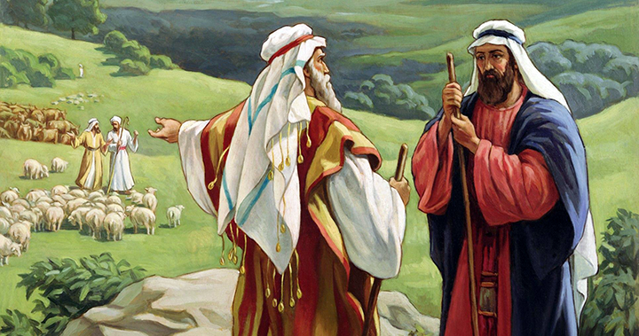
The Roots of Abraham
2. Abraham Regarding Lot
Genesis 13:8, 9 NKJV
“So Abram said to Lot, ‘Please let there be no strife between you and me...for we are brethren. Is not the whole land before you? Please separate from me. If you take the left, then I will go to the right; or,
if you go to the right, then I will go to the left.’ ”
Notes:
2. Si Abraham Tungkol kay Lot. “Sinabi ni Abram kay Lot, ‘Huwag na tayong magkaroon ng pagtatalo, maging ang ating mga pastol, sapagkat tayo’y magkapatid. Di ba nasa harapan mo ang buong lupain? Humiwalay ka sa akin. Kapag kinuha mo ang nasa kaliwa, ako ay pupunta sa kanan; o ¶ kapag kinuha mo ang nasa kanan, ako ay pupunta sa kaliwa’ ” (Genesis 13:8, 9).

Slide 19
2. Abraham Regarding Lot
a. An Act of Generosity
Abram’s reconnection with God shows in the way that he handles the problem with Lot, his nephew, concerning the use of the land.
It is Abram himself who proposes a peaceful agreement and allows Lot to choose first (Gen. 13:9, 10), an act of generosity and kindness indicative of the kind of man Abram was.
Notes:
a. Isang Gawa ng Pagkamapagbigay. Ang muling pagkakaugnay ni Abram sa Diyos ay nagpapakita sa paraan ng kanyang pamamahala sa problema kay Lot, ang kanyang pamangkin, tungkol sa paggamit ng lupain. ¶ Si Abram mismo ay nagmungkahi nang isang mapayapang kasunduan at nagpahintulot kay Lot upang maunang pumili (Genesis 13:9, 10), isang kilos ng pagkamapagbigay at kabutihan na nagpapakita ng uri ng tao si Abram.

Slide 20
2. Abraham Regarding Lot
a. An Act of Generosity
Abram’s move was an act of faith.
Unlike Lot, Abram looked at the land only at God’s injunction (Gen. 13:14).
“ ‘Lift your eyes now and look...for all the land which you see I give to you....’ ”
God invites Abram to “ ‘walk’ ” on this land as an act of appropriation (v. 17). It is a gift of grace, which must be appro-priated by faith that leads to obedience.
Notes:
Ang kilos ni Abram ay isang gawa ng pananampalataya. ¶ Hindi gaya ni Lot, pinatungkulan lamang ni Abram ang lupain sa pag-uutos ng Diyos (Genesis 13:14). “ ‘Itaas mo ngayon ang iyong paningin, at tumanaw...sapagkat ang buong lupaing natatanaw mo ay ibibigay ko sa iyo....’ ” ¶ Nag-anyaya ang Diyos kay Abram na “ ‘lumakad’” sa lupaing ito bilang isang gawa ng pag-angkin (tal. 17). Ito’y isang regalo ng biyaya, na kailangang maangkin sa pamamagitan ng pananampalataya na aakay sa pagsunod.

Slide 21
2. Abraham Regarding Lot
b. The Babel Coalition
Although this story refers to a specific historical conflict, the timing, just after God’s gift of the Promised Land to Abram, gives this event a particular spiritual significance.
spiritual significance.
Ironically, the camp of Abram, the truly interested party, because he is the only true owner of the land, is the only force that remains outside of the conflict, at least at first.
Notes:
b. Koalisyon ng Babel. Bagaman ang kuwentong ito’y tumutukoy sa isang tiyak na labanang istorikal, ang pagsasaoras, pagkatapos lamang ng regalo ng Diyos ng Lupang Pangako kay Abram ay nagbibigay sa pangyayaring ito ng isang partikular na espirtuwal na kahulugan. ¶ Buong kabalintunaan, ang kampo ni Abram, ang tunay na may interes, dahil siya lamang ang tunay na may-ari ng lupain, ay ang nag-iisang puwersang nananatili sa labas ng labanan, kahiman sa pasimula.

Slide 22
2. Abraham Regarding Lot
b. The Babel Coalition
The reason for Abram’s neutrality is that for Abram, the Promised Land was not acquired through the force of arms or through the wisdom of political strate-gies. Abram’s kingdom was God’s gift.
The only reason Abram will inter- vene is the fate of his nephew Lot, who was taken prisoner in the course of the battles (Gen. 14:12, 13).
Notes:
Ang dahilan para sa pagiging niyutral ni Abram ay, para kay Abram, ang Lupang Pangako ay hindi nakukuha sa pamamagitan ng lakas ng armas o sa pamamagitan ang katalinuhan ng estratehiyang politikal. Ang kaharian ni Abraham ay regalo ng Diyos. ¶ Ang nag-iisang dahilan na makikialam si Abram ay ang kapalaran ng kanyang pamangking si Lot, na nabihag sa panahon ng mga labanan (Genesis 14:12, 13).

Slide 23
2. Abraham Regarding Lot
b. The Babel Coalition
But Abram does not confront the whole coalition. In a quick commando operation, he attacks only the camp where Lot was held prisoner.
Thus, this faithful man of God also showed great courage and fortitude. No doubt his influence in the region grew, and people learned something more of the God whom he served.
Notes:
Ngunit hindi hinarap ni Abram ang buong koalisyon. Sa isang matuling operasyong commando, sinalakay lamang niya ang kampo kung saan si Lot ay napigilan bilang preso. ¶ Kaya, itong matapat na lalaki ng Diyos ay nagpakita rin nang malaking tapang at katatagan. Walang pagdududang lumaki ang kanyang impluwensya sa rehiyon, at ang tao ay higit pang may natutunan sa Diyos na kanyang pinaglingkuran.

Slide 24
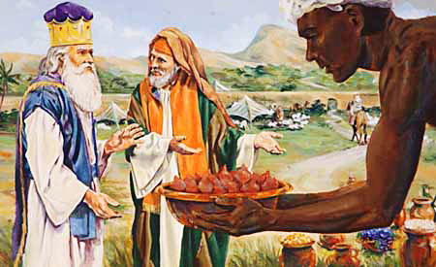
The Roots of Abraham
3. Abraham Regarding Melchizedek
Genesis 4:18–20 NKJV
“Then Melchizedek king of Salem brought out bread and wine; he was the priest of God Most High. And he blessed him and said: ‘Blessed be Abram of God Most High...and blessed be God Most High, who has delivered your enemies into your hand.’
And he gave him a tithe of all.”
Notes:
3. Si Abraham Tungkol kay Melquizedek. “At si Melquizedek, hari ng Salem na pari ng Kataas-taasang Diyos,[a] ay naglabas ng tinapay at alak. Siya'y kanyang binasbasan na sinabi, ‘Pagpalain si Abram ng Kataas-taasang Diyos...at purihin ang Kataas-taasang Diyos, na nagbigay ng iyong mga kaaway sa iyong kamay.’¶ At binigyan siya ni Abram ng ikasampung bahagi ng lahat. (Genesis 4:18–20).

Slide 25
3. Abraham Regarding Melchizedek
The Tithe of Melchizedek
After Abram has been thanked by the Canaanite kings, he now thanks this priest, by his paying his tithe to him.
The association of Melchizedek with “God Most High” clearly indicates that Abram saw him as priest of the God Abram served. He is not to be identified with Christ. He was God’s representa- tive to the people of that time.
Notes:
Ang Ikapu ni Melquisedek. Matapos mapasalamatan si Abraham ng mga hari ng Canaan, ngayo’y nagpasalamat siya sa paring ito, sa pamamagitan ng pag-iikapu niya sa kanya. ¶ Ang pagkakaugnay ni Melquizedek sa “Kataas-taasang Diyos” ay buong linaw na nagpapakita na nakita ni Abram siya bilang pari ng Diyos na pinaglingkuran ni Abram. Siya ay kinatawan ng Diyos sa mga tao nang panahong iyon.

Slide 26
3. Abraham Regarding Melchizedek
The Tithe of Melchizedek
Abram “gave him a tithe of all” as a response to God the Creator, the “Possessor of heaven and earth.” This title alludes to the introduction of the Creation story where the phrase “hea-vens and earth” means totality or “all.”
The tithe is understood not as a gift to God, but as a gift from God, because God gives us everything to begin with.
Notes:
“Binigyan siya ni Abram ng ikasampung bahagi ng lahat” bilang tugon sa Diyos na Manlalalang, ang “May-ari ng langit at lupa.” Ang titulong ito’y nagpapahiwatig sa pagpapakilala ng kuwento ng Paglalang kung saan ang kasabihang “langit at lupa” ay nangangahulugang kabuuan o “lahat.” ¶ Ang ikapu ay nauunawaan hindi bilang isa regalo sa Diyos, kundi bilang isang regalo mula sa Diyos, dahil sa pasimula’y nagbibigay ang Diyos sa atin nang lahat.

Slide 27
The Roots of Abraham
Last Word
“When the Lord chose Abraham it was not simply to be the special friend of God, but to be a medium of the precious and peculiar privileges the Lord desired to bestow upon the nations.
He was to be a light amid the moral darkness of his surroundings.”—EGW Reflecting Christ 205.
Notes:
Huling Pananalita. “Nang pinili ng Diyos si Abraham ito’y hindi lamang upang maging ang natatanging kaibigan ng Diyos, kundi upang maging isang paraan ng mamahalin at natatanging mga prebilehiyo na ninanais ng Panginoon na ipagkaloob sa mga bansa. ¶ Siya’y magiging isang ilaw sa gitna ng moral na kadiliman ng kanyang kapaligiran.”—EGW Reflecting Christ 205.

Slide 28
The Roots of Abraham
Presentation Record
1. Ala SDA Ch SSL 06 May 22 via ZOOM

