Slide 1
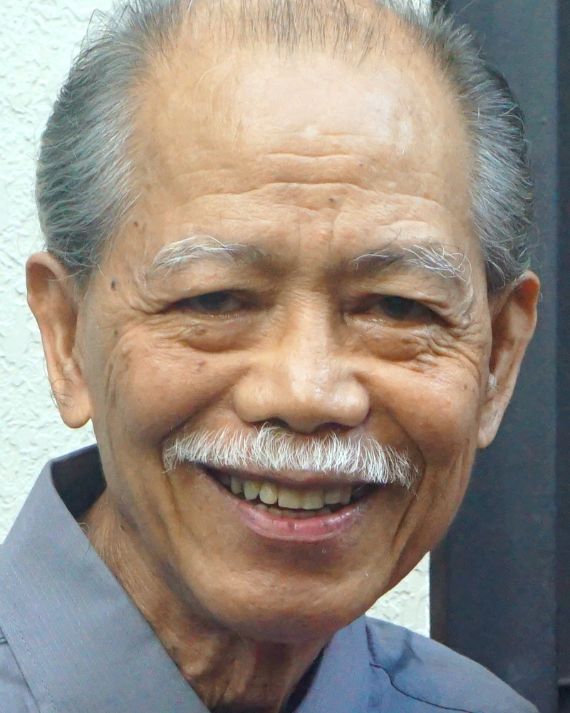
Adult Bible Study Guide
Jan • Feb • Mar 2023
The
CROWN
of
Righteousness
Good&Faithful
@ClaRoVicente8804
Notes:
Ang Korona ng Katwiran.

Slide 2
G. Edward Reid
Principal Contributor
Notes:
Namamahala para sa Panginoon Hanggang sa Siya ay Dumating

Slide 3
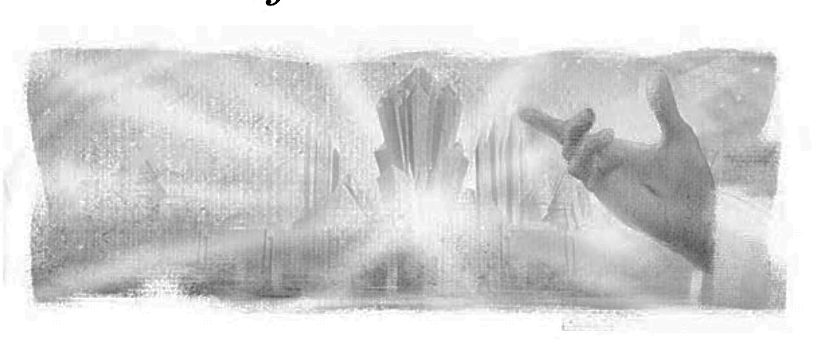
Managing for the Master
Lesson 12, March 25, 2023
Rewards of Faithfulness
Notes:
Mga Gantimpala ng Katapatan,

Slide 4
Rewards of Faithfulness
Key Text
Matthew 25:21 NKJV
“ ‘His lord said to him, “Well done, good and faithful servant; you were faithful over a few things, I will make you ruler over many things. Enter into the joy of your lord.” ’ ”
Notes:
Susing Talata. “ ‘Sinabi sa kanya ng panginoon niya, “Magaling! Mabuti at tapat na alipin. Naging tapat ka sa kaunting bagay, pamamahalain kita sa maraming bagay. Pumasok ka sa kagalakan ng iyong panginoon” ’ ” (Mateo 25:21).

Slide 5
Rewards of Faithfulness
Initial Words
• In various places, the Bible talks about our rewards, what we are promised through Christ after the Second Coming and this terrible detour with sin is once and for all over and done.
• What are we promised, and what assurance do we have of getting what we have been promised?
Notes:
Panimulang Salita. • Sa iba’t ibang mga lugar, nagsasalita ang Biblia tungkol sa ating mga gantimpala, ang naipangako sa atin sa pamamagitan ni Cristo pagkatapos ng Ikalawang Pagparito at itong nakakikilabot na paglihis dahil sa kasalanan ay sa wakas ay lubos na matutuldukan.. ¶ • Ano ang naipangako sa atin, at anong katiyakan ang mayroon tayo na makukuha ang naipangako sa atin?

Slide 6
Rewards of Faithfulness
Quick Look
1. Reward for Faithfulness
The Reward is Clarified (Heb. 11:6).
2. The Heavenly Rewards
a. Everlasting Life (Rom. 6:23).
b. The New Jerusalem (Revelation 12)
c. Ruler Over Many Things (Matt. 25:21).
3. Eyes on the Prize
Faithful in Suffering (Rom. 8:16–18).
Notes:
(1) Gantimpala para sa Katapatan
Nililinaw ang Gantimpala (Hebreo 11:6).
(2) Mga Makalangit na Gantimpala
a. Walang-hanggang Buhay (Roma 6:3).
b. Ang Bagong Jerusalem (Apocalipsis 12).
c. Tagapamahala sa Maraming mga Bagay (Mateo 25:21).
(3) Nakatingin sa Premyo
Matapat sa Panahon ng Pagdurusa (Roma 8:16–18).

Slide 7
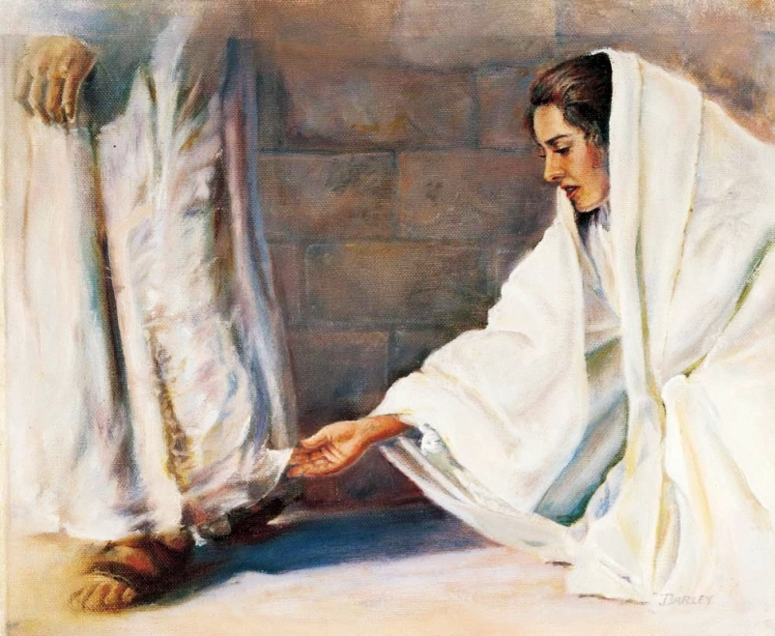
Rewards of Faithfulness
1. Reward for Faithfulness
Hebrews 11:6 NKJV
“But without faith it is impossible to please Him, for he who comes to God must believe that He is, and that He is a rewarder of those who diligently seek Him.”
Notes:
1. Gantimpala para sa Katapatan. “At kung walang pananampalataya ay hindi maaaring kalugdan ng Diyos,[a] sapagkat ang sinumang lumalapit sa kanya ay dapat sumampalatayang may Diyos at siya ang tagapagbigay-gantimpala sa mga masigasig na humahanap sa kanya” (Hebreo 11:6).

Slide 8
1. Reward for Faithfulness
The Reward is Clarified
“Human language is inadequate to describe the reward of the righteous. It will be known only to those who behold it.
No finite mind can comprehend the glory of the Paradise of God.” —The Great Controversy 674.
Notes:
Nililinaw ang Gantimpala. • “Ang pananalita ng tao ay hindi sapat upang ilarawan ang gantimpala ng matutuwid. Maipaaalam lamang ito sa mga nakatingin dito. ¶ Walang may hangganang pag-iisip ang maaaring maunawaan ang kaluwalhatian ang Paraiso ng Diyos.”—The Great Controversy 674.

Slide 9
1. Reward for Faithfulness
The Reward is Clarified
“ ‘Blessed are you when they revile and persecute you, and say all kinds of evil against you falsely for My sake.
Rejoice and be exceedingly glad, for great is your reward in heaven, for so they persecuted the prophets who were before you’ ” (Matt. 5:11, 12).
Notes:
“ ‘Mapapalad kayo kapag kayo ay nilalait, inuusig, at pinagsasabihan ng sari-saring kasamaan na pawang kasinungalingan dahil sa akin. ¶ Magalak kayo at magsaya, sapagkat malaki ang gantimpala ninyo sa langit, sapagkat gayundin nila inusig ang mga propeta na nauna sa inyo’ “ (Mateo 5:11, 12).

Slide 10
1. Reward for Faithfulness
The Reward is Clarified
• Being rewarded for faithfulness, how-ever, is not the same as salvation by works. Who among us, or among any of the characters in the Bible, had works good enough to give them any merit before God? None, of course.
• That’s the whole point of the cross. If we could have saved ourselves by works, Jesus never would have gone to the cross.
Instead, it must be by grace.
• Being rewarded for faithfulness, how-ever, is not the same as salvation by works. Who among us, or among any of the characters in the Bible, had works good enough to give them any merit before God?
• Being rewarded for faithfulness, how-ever, is not the same as salvation by works.
Notes:
• Gayunman, ang pagiging nagantimpalaan dahil sa katapatan ay hindi katulad ng kaligtasan sa pamamagitan ng mga gawa. ¶ Sino sa atin, o sa alin mang mga tauhan sa Biblia, ang may mga gawa na sapat na mabuti upang mabigyan sila ng merito sa harapan ng Diyos? ¶ Wala, siyempre. ¶ • “Yan ang buong punto ng krus. Kung maililigtas natin ang sarili sa pamamagitan ng mga gawa, hinding-hindi kailangang pumaroon sa krus si Jesus. ¶ Sa halip, ito’y kailangang maging sa pamamagitan ng biyaya.

Slide 11
1. Reward for Faithfulness
The Reward is Clarified
Rewards, instead, are the mere outworking of what God has done for us and in us.
Notes:
Ang mga gantimpala, sa halip, ay ang pagsasakatuparan lamang ng kung ano ang nagawa ng Diyos para sa atin at sa atin.

Slide 12
Rewards of Faithfulness
2. The Heavenly Rewards
a. Everlasting Life
Notes:
2. Mga Makalangit na Gantimpala. a. Walang-hanggang Buhay. “Sapagkat ang kabayaran ng kasalanan ay kamatayan; ngunit ang kaloob ng Diyos na walang bayad ay buhay na walang hanggan kay Cristo Jesus na Panginoon natin” (Roma 6:23).

Slide 13
2. The Heavenly Rewards
a. Everlasting Life
• As human beings (and whether we like it or not), an eternity awaits us. And according to the Bible, this eternity will come in one of two manifestation: either eternal life or eternal death.
• God has the unique ability to do what-ever He says He can do—to fulfill all His promises. Our part is simply to believe Him, rest upon the merits of Jesus, and by faith obey His Word.
Notes:
• Bilang mga tao (sa gusto mo’t hindi), naghihintay sa atin ang isang walang hanggan. At ayon sa Biblia, itong walang-hanggan ay darating sa isa sa dalawang pagpapakita: alinmang walang-hanggang buhay o walang-hanggang kamatayan. ¶ • Ang Diyos ay may pambihirang kakayahang gawin ang anumang sinasabi Niyang magagawa Niya—upang tuparin ang lahat ng Kanyang mga pangako. Ang ating bahagi ay simpleng paniwalaan Siya, sumasalalay sa mga merito ni Jesus, at sa pamamagitan ng pananampalataya ay sundin ang Kanyang Salita.

Slide 14
a. Everlasting Life
John 14:1–3
A Counsel and Two Promises
¹ “Let not your heart be troubled; you believe in God, believe also in Me. ² In My Father’s house are many mansions; if it were not so, I would have told you. I go to prepare a place for you. ³ And if I go and prepare a place for you, I will come again and receive you to Myself; that where I am, there you may be also.”
A Counsel and Two Promises
¹ “Let not your heart be troubled; you believe in God, believe also in Me. ² In My Father’s house are many mansions; if it were not so, I would have told you. I go to prepare a place for you.
A Counsel and Two Promises
¹ “Let not your heart be troubled; you believe in God, believe also in Me.
Notes:
Juan 14:1–3. Isang Payo at Dalawang mga Pangako. ¹ “Huwag mabagabag ang inyong puso. Sumampalataya kayo sa Diyos, sumampalataya rin naman kayo sa akin. ¶ ² Sa bahay ng aking Ama ay maraming tahanan. Kung hindi gayon, sasabihin ko ba sa inyo na ako'y paparoon upang ihanda ko ang lugar para sa inyo? ¶ ³ At kung ako'y pumunta roon at maihanda ko ang isang lugar para sa inyo, ako'y babalik at kayo'y tatanggapin ko sa aking sarili, upang kung saan ako naroroon, kayo rin ay naroroon.

Slide 15
a. Everlasting Life
His Second Coming Guaranteed
Christ’s death on the cross at His
first coming
is our
greatest assurance
of His
second coming,
for without the Second Coming,
what good was His first one?
Notes:
Ginagarantiyahan ang Kanyang Ikalawang Pagparito. Ang kamatayan ni Cristo sa krus sa Kanyang unang pagparito ay ang ating pinakadakilang katiyakan ng Kanyang ikalawang pagparito, dahil kung wala ang Ikalawang Pagparito, anong buti ang meron sa Kanyang Nauna?

Slide 16
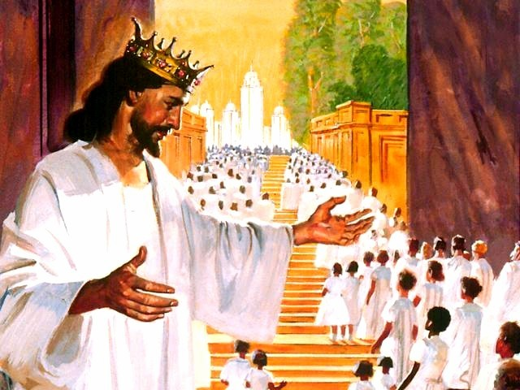
2. The Heavenly Rewards
b. The New Jerusalem
Revelation 21:1, 2 NKJV
“Now I saw a new heaven and a new earth, for the first heaven and the first earth had passed away. Also there was no more sea. Then I, John, saw the holy city,
New Jerusalem, coming down out of heaven from God, prepared as a bride adorned for her husband.”
Notes:
b. Ang Bagong Jerusalem. “At nakita ko ang isang bagong langit at ang isang bagong lupa; sapagkat ang unang langit at ang unang lupa ay lumipas na, at ang dagat ay wala na. At nakita ko ang banal na lunsod, ¶ ang bagong Jerusalem, na bumababa mula sa langit buhat sa Diyos, na nakahanda na gaya ng isang babaing ikakasal na nagagayakan para sa kanyang asawa” (Apocalipsis 21:1, 2).

Slide 17
2. The Heavenly Rewards
b. The New Jerusalem
• The biblical description of the New Jerusalem is what Abraham saw by faith. “For he looked for a city which hath foundations, whose builder and maker is God” (Heb. 11:10). The New Jerusalem is God’s masterpiece.
• The New Jerusalem will be the home of God’s faithful children in heaven during the millennium and, afterward, on the new earth for eternity.
Notes:
• Ang biblikal na paglalarawan ng Bagong Jerusalem ay ang nakita ni Abraham sa pamamagitan ng pananampalataya. “Sapagkat siya'y umaasa sa lunsod na may mga kinasasaligan, na ang nagplano at nagtayo ay ang Diyos.“ (Hebreo 11:10). Ang Bagong Jerusalem ay ang obra-maestra ng Diyos.. ¶ • Ang Bagong Jerusalem ang magiging ang tahanan ng mga matatapat na anak ng Diyos sa langit sa panahon ng milenyo at, pagkatapos, sa bagong lupa sa walang hanggan.

Slide 18
2. The Heavenly Rewards
b. The New Jerusalem
• Just as Jesus dwelt with us in this fallen world when He came in the flesh, He will dwell with us in the new one.
• “ ‘And God will wipe away every tear from their eyes; there shall be no more death, nor sorrow, nor crying’ ” (Rev. 21:4).
• God’s throne will be there, and “they shall see His face” (22:4)
Notes:
• Gaya nang si Jesus ay nanirahan kasama natin dito sa nagkasalang sanlibutan nang pumarito Siya sa laman, Siya ay maninirahan kasama natin sa bagong lupa. ¶ • “ ‘At papahirin niya ang bawat luha sa kanilang mga mata, at hindi na magkakaroon ng kamatayan; hindi na rin magkakaroon pa ng pagdadalamhati, o ng pagtangis man, o ng kirot man’” (Apocalipsis 21:4). ¶ • Ang trono ng Diyos ay naroroon, at “makikita nila ang kanyang mukha” (22:4

Slide 19
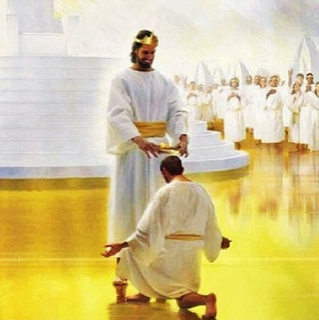
2. The Heavenly Rewards
c. Ruler Over Many Things
Matthew 25:21 NKJV
“His lord said to him, ‘Well done, good and faithful servant; you were faithful over a few things, I will make you ruler over many things. Enter into the joy of your lord.’ ”
Notes:
c. Tagapamahala sa Maraming mga Bagay. “Sinabi sa kanya ng panginoon niya, ‘Magaling! Mabuti at tapat na alipin. Naging tapat ka sa kaunting bagay, pamamahalain kita sa maraming bagay. Pumasok ka sa kagalakan ng iyong panginoon’ ”’ (Mateo 25:21).

Slide 20
2. The Heavenly Rewards
c. Ruler Over Many Things
• Matthew 25 talks about conditions in the church just before Jesus comes again.
These conditions are illustrated by three stories, one of which is the parable of the talents, which talks about how God’s people have used the gifts that He has given to them.
Notes:
• Nagsasalita ang Mateo 25 tungkol sa mga katayuan sa iglesya bago lamang ang muling pagparito si Jesus. ¶ Ang mga katayuang ito’y inilalarawan sa pamamagtian ng tatlong mga kuwento, isa ay ang talinghaga ng mga talento, na nagsasalita tungkol sa kung paano ang bayan ng Diyos ay ginamit ang mga kaloob na naibigay Niya sa kanila.

Slide 21
2. The Heavenly Rewards
c. Ruler Over Many Things
• “I was shown that the parable of the talents has not been fully understood.
This important lesson was given to the disciples for the benefit of Christians living in the last days. And these talents do not represent merely the ability to preach and instruct from the word of God. The parable applies to the temporal means which God has entrusted to His people.” —Testimonies for the Church 1:197.
• “I was shown that the parable of the talents has not been fully understood.
This important lesson was given to the disciples for the benefit of Christians living in the last days. And these talents do not represent merely the ability to preach and instruct from the word of God.
• “I was shown that the parable of the talents has not been fully understood.
This important lesson was given to the disciples for the benefit of Christians living in the last days.
Notes:
• “Naipakita sa akin na ang talinghaga ng mga talento ay hindi lubusang naunawaan. ¶ Itong mahalagang aral ay naibigay sa mga alagad para sa pakinabang ng mga Kristiyanong nabubuhay sa mga huling araw. ¶ At ang mga talentong ito’y hindi lamang kumakatawan sa kakayahang mangaral at magturo mula sa salita ng Diyos. ¶ Ang talinghaga ay tumutukoy sa pansamantalang kayamanan na ipinagkatiwala ng Diyos sa Kanyang bayan.”—Testimonies for the Church 1:197.

Slide 22
2. The Heavenly Rewards
c. Ruler Over Many Things
• It is quite natural for us to think that another person has more talents than we have and is therefore more responsi-ble to God. In this story, however, it is the person with only one talent—the least money—who proved unfaithful and lost the kingdom. Rather than to think of the responsibilities of others, let us focus on what God has entrusted to us and how we can use it to His glory.
• It is quite natural for us to think that another person has more talents than we have and is therefore more responsi-ble to God. In this story, however, it is the person with only one talent—the least money—who proved unfaithful and lost the kingdom.
• It is quite natural for us to think that another person has more talents than we have and is therefore more responsible to God.
Notes:
• Sadyang natural para sa atin na isipin na ang ibang tao na may higit na talento kaysa sa atin at kaya higit na mananagot sa Diyos. ¶ Sa kuwentong ito, gayunman, itong taong may isa lang na talento—ang pinakakaunting pera—ang napatunayang hindi tapat at nawala niya ang kaharian. ¶ Sa halip na isipin ang mga pananagutan ng iba, tayo’y magtuon sa ipinagkatiwala ng Diyos sa atin at kung paano natin magagamit ito sa Kanyang kaluwalhatian.

Slide 23
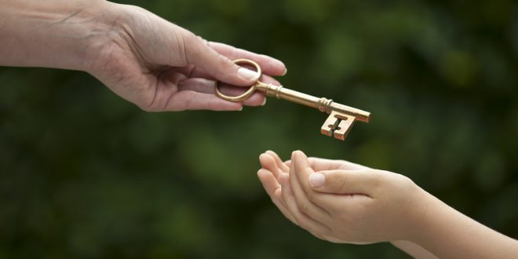
Rewards of Faithfulness
3. Eyes on the Prize
Romans 8:16–18 NKJV
“The Spirit Himself bears witness with our spirit that we are children of God, and if children, then heirs—heirs of God and joint heirs with Christ, if indeed we suffer with Him, that we may also be glorified together. For I consider that the sufferings of this present time are
not worthy to be compared with the glory which shall be revealed in us.”
Notes:
Pangatlong paghahati. 3. Nakatingin sa Premyo. “Ang Espiritu mismo ang nagpapatotoo kasama ng ating espiritu na tayo'y mga anak ng Diyos. At kung mga anak, ay mga tagapagmana rin, mga tagapagmana ng Diyos, at mga kasamang tagapagmana ni Cristo; kung tunay ngang nagtitiis tayong kasama niya, upang tayo'y luwalhatiin namang kasama niya. Itinuturing ko na ang pagtitiis sa panahong kasalukuyan ay ¶ hindi karapat-dapat maihambing sa kaluwalhatiang mahahayag sa atin” (Roma 8:16–18).

Slide 24
3. Eyes on the Prize
Faithful In Suffering
• The value Paul placed on the reward of the faithful is what kept him excited about suffering for Christ. He wrote from prison:
“Brethren, I do not count myself to have apprehended; but one thing I do, forget-ting those things which are behind and reaching forward to those things which are ahead, I press toward the goal for the prize of the upward call of God in Christ Jesus” (Phil. 3:13, 14).
• The value Paul placed on the reward of the faithful is what kept him excited about suffering for Christ. He wrote from prison:
“Brethren, I do not count myself to have apprehended; but one thing I do, forget-ting those things which are behind and reaching forward to those things which are ahead,
• The value Paul placed on the reward of the faithful is what kept him excited about suffering for Christ. He wrote from prison:
“Brethren, I do not count myself to have apprehended; but one thing I do,
Notes:
Matapat Samantalang Nagdurusa. ¶• Ang halagang inilagay ni Pablo sa gantimpala ng matapat ay ang nagpanatili sa kanya na maging masigla tungkol sa pagdurusa para kay Cristo. Isinulat niya mula sa bilangguan: ¶ “Mga kapatid, hindi ko pa inaaring naabot ko na, ngunit isang bagay ang ginagawa ko, ¶ nililimot ko ang mga bagay na nasa likuran, at tinutungo ang mga bagay na hinaharap, ¶ nagpapatuloy ako tungo sa mithiin para sa gantimpala ng dakilang pagtawag ng Diyos kay Cristo Jesus” (Filipos 3:13, 14).

Slide 25
3. Eyes on the Prize
Biblical Prosperity
• From the biblical perspective, prosperity is having what you need when you need it. It is not the accumulation of possessions. Prosperity also is claiming the promise of God in Philippians 4:19:
“My God shall supply all your need according to his riches in glory by Christ Jesus.” Finally, prosperity is to be thankful for what you have in the Lord and trust in Him in all things.
• From the biblical perspective, prosperity is having what you need when you need it. It is not the accumulation of possessions. Prosperity also is claiming the promise of God in Philippians 4:19:
“My God shall supply all your need according to his riches in glory by Christ Jesus.”
• From the biblical perspective, prosperity is having what you need when you need it. It is not the accumulation of possessions.
Notes:
Biblikal na Kasaganaan. • Mula sa biblikal na pananaw, ang kasaganaan ay pagkakaroon ng kailangan mo kapag kailangan mo ito. Hindi ito ang pagtitipon ng mga pag-aari. ¶ • Ang kasaganaan ay ang pag-angkin din ng pangako ng Diyos sa Filipos 4:19: ¶ “At pupunuan ng aking Diyos ang bawat kailangan ninyo ayon sa kanyang mga kayamanan sa kaluwalhatian kay Cristo Jesus.” ¶ Sa wakas, ang kasaganaan ay ang maging mapagpasalamat sa kung ano ang mayroon ka sa Panginoon at pagtitiwala sa Kanya sa lahat ng bagay.

Slide 26
3. Eyes on the Prize
Biblical Prosperity
• God does not promise His children that they will ALL be rich in this world’s goods.
• What He does offer is better than any worldly wealth. He says,
“I will supply your needs, and wherever you go I will be with you.”
• Then in the end, He will give His faithful ones true wealth and responsibility and eternal life. What an awesome reward!
Notes:
• Hindi nangangako ang Diyos sa Kanyang mga anak na lahat sila’y magiging mayaman sa ari-arian nitong sanlibutan. ¶ • Ang iniaalok Niya ay mas mabuti kaysa anumang makamundong yaman. Sinasabi niya, ¶ “Aking ibibigay ang iyong mga pangangailangan, at saan ka man pumaroon ako’y kasama mo.” ¶ Pagkatapos sa wakas, bibigyan Niya ang Kanyang matatapat ng tunay na yaman at responsibilidad at buhay na walang hanggan. Ano ngang kamangha-manghang gantimpala!.

Slide 27
Rewards of Faithfulness
Last Word
• “I have fought a good fight, I have finished my course, I have kept the faith: Henceforth there is laid up for me a crown of righteousness, which the Lord, the righteous judge, shall give me at that day…” (2 Tim. 4:6–8).
• May we all, through God’s grace, be able to say the same thing, and with the same assurance, as well.
Notes:
Huling Salita. • “Nakipaglaban ako ng mabuting pakikipaglaban, natapos ko na ang aking takbuhin, iningatan ko ang pananampalataya. Kaya't mula ngayon ay nakalaan na sa akin ang putong ng katuwiran, na ibibigay sa akin ng Panginoon na tapat na hukom sa araw na iyon...” (2 Timoteo 4:6–8). ¶ • Nawa’y lahat tayo’y, sa pamamagitan ng biyaya ng Diyos, ay makapagsasabi rin ng gayon, at may katulad na katiyakan, din naman.

